Slide 1
University of York Update
December 2021

Slide 2
Environment Modelling
Countertops
Hob/Cooker
Sink
Bathroom
Bedroom (s)
Master bedroom

Slide 3
Environment Modelling
17
18
19
21
22
Create a graph using nodes for key locations within the environment, with edges connecting neighbouring nodes
13
16
20
24
14
12
23
15
11
10
25
8
9
6
5
4
26
29
7
27
30
3
28
2
1

Slide 4
Environment Modelling
17
18
19
21
22
Each edge is weighted:
Green low risk
Orange medium risk
Red high risk
Each risk category has three sub-categories (low, medium, high)
”low-low”
”medium-low”
“high-medium”
Etc
Each connection also has a distance value
13
16
20
24
14
12
23
15
11
10
25
8
9
6
5
4
26
29
7
27
30
3
28
2
1

Slide 5
Path Finding – Dijkstra
Shortest distance path in a graph
3
3
1
1.8
1
1.8
1
5
1
5
2
1.2
2
1.2
0.8
0.8
0.6
4
0.6
4
2
1.5
2
1.5
Shortest Distance Path:
1
3
5

Slide 6

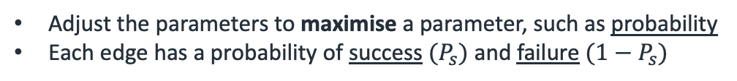

Path Finding – Dijkstra
Adjust the parameters to maximise a parameter, such as probability
Each edge has a probability of success ${(P}_{s})$ and failure $(1−P_{s})$
0.4
3
0.7
0.4
3
0.7
0.5
0.2
0.5
0.2
1
5
1
0.2
0.4
0.4
0.2
0.4
0.5
0.6
0.3
0.7
0.6
0.3
0.7
0.9
0.9
0.8
0.8
0.7
4
0.7
4
2
0.3
2
0.3
Highest Probability Path:
1
2
4
5
$$0.7 × 0.7 × 0.9=0.441$$
Shortest Distance Path:
1
3
5
$$0.5 × 0.2=0.1$$

Slide 7
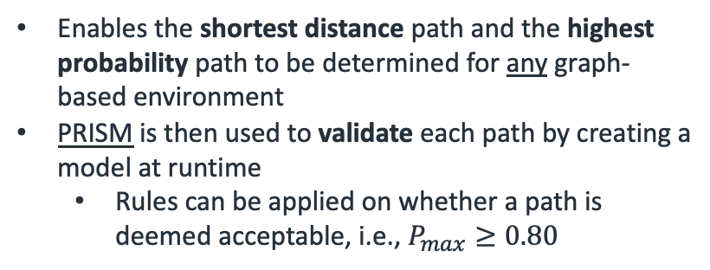
Path Finding – Dijkstra
Enables the shortest distance path and the highest probability path to be determined for any graph-based environment
PRISM is then used to validate each path by creating a model at runtime
Rules can be applied on whether a path is deemed acceptable, i.e., $P_{max}≥0.80$
3
1
1.8
1
5
2
1.2
0.8
0.6
4
2
1.5
0.4
3
0.7
0.5
0.2
1
0.2
0.4
0.5
0.7
0.6
0.3
0.8
0.9
0.7
4
2
0.3

Slide 8
Path Finding Example (Agent)
17
18
19
21
22
Start Node
13
20
Final Node
16
14
24
12
23
Highest Probability Path (Robot)
15
11
10
25
Minimum Distance Path (Robot)
8
9
Mutual Path (Robot)
6
5
4
26
29
7
Minimum distance path is 2.9 m with 58% chance of success
Maximum probability path is 4.0 m with 92% chance of success
27
30
3
28
2
1

Slide 9
Path Finding Example (Human)
17
18
19
21
22
Start Node
13
Final Node
16
20
24
14
Minimum Distance Path (Human)
12
23
15
11
10
25
Human starts at node 15 and paths to node 6 using the minimum distance path
This path causes a spatial conflict with the path of the agent
8
9
6
5
4
26
29
7
27
30
3
28
2
1

Slide 10
Path Finding Example (Co-Op)
17
18
19
21
22
Start Node
13
Final Node
16
20
24
14
Highest Probability Path (Robot)
12
23
15
11
10
Minimum Distance Path (Robot)
25
8
Mutual Path (Robot)
9
6
5
Conflict Node
4
26
29
7
Artificially update the probability heat map for the agent based on the path of the human
Probability decreased from 92% to 23% chance of success
27
30
3
28
2
1

Slide 11
Path Finding Example (Co-Op)
17
18
19
21
22
Start Node
13
Final Node
16
20
24
14
12
23
Highest Probability Path (Robot)
15
11
10
Minimum Distance Path (Robot)
25
8
9
Mutual Path (Robot)
6
5
4
26
29
The agent now re-plans it’s path around the environment, increasing the probability of reaching the final node
Maximum probability path is 4.8 m with 81% chance of success
7
27
30
3
28
2
1

Slide 12
What does this mean?
Require knowledge of the human’s position and intentions
Whilst but could be a fair assumption if we were guiding the human to locations during a cooperative task…
Requires accurate predictions of the human’s behaviour, i.e., how they will navigate through the environment.
Assume the human takes the least distance path (Factor some creativity?)
Working on spatial deconfliction -- not temporal & spatial deconfliction
Future work for time-based simulations with kinematic movement analysis?
Purely predictive behaviour?
Adaptation at runtime?

Slide 13
Mission Management
Previously discussed how a mission can be comprised of multiple tasks, each with sub-tasks.
Food Preparation
Phase 1: Locating
Phase 2: Making
Locate Sauce
Guidance
Locate Pasta
Monitoring
Locate Utensil
Assistance

Slide 14
Mission Management
Food Preparation
Perform Check (Tasks)
Phase 1: Locating
Phase 2: Making
Check Cupboard 1
Check Cupboard 2
Locate Sauce
Guidance
Locate Pasta
Monitoring
Request Human
Retrieval
Locate Utensil
Assistance

Slide 15
Mission Management
Two room environment (kitchen and sitting area)
20 nodes connected to neighbour with distance and probability values
1
11
14
17
19
2
6
9
15
3
7
12
20
16
18
4
10
5
8
13

Slide 16
Defining a Mission
Consider the food preparation mission introduced before, with the following abstracted workflow:
Phase 1:
// Check Cupboard 1 → Check Cupboard 2 → Check Fridge → Check Table Clear → Hold/Wait…
Phase 2:
// Begin instructions for making → Loop Phase…
In Phase 1, there are four tasks, which are not order dependant. This means that the tasks can be completed in any order, and only when all have been completed, can progression be made to the “Hold/Wait” task.

Slide 17
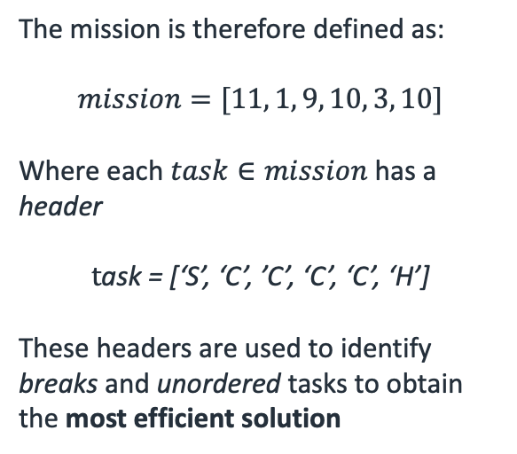
Defining a Mission
Based on Phase 1:
Start node 11
unordered waypoints: [1, 9, 10, 3]
Final Hold/Wait occurring at node 10.
The mission is therefore defined as:
$$mission=[11, 1, 9, 10, 3, 10]$$
Where each $task∈mission$ has a header
$$t\text{ask}\text{ = [‘}\text{S}\text{’, ‘}\text{C}\text{’, ’}\text{C}\text{’, ‘}\text{C}\text{’, ‘}\text{C}\text{’, ‘}\text{H}\text{’]}$$
These headers are used to identify breaks and unordered tasks to obtain the most efficient solution
1
11
14
17
19
2
6
9
15
3
7
12
20
16
18
4
10
5
8
13

Slide 18
Defining a Mission
The nodes representing tasks in the set mission are used to create a fully connected subset graph
11
10
1
11
1
14
17
19
2
6
9
15
3
3
7
12
20
9
16
18
4
The edges of the subset map are unknow and determined by obtaining the solution between each node on the main map using Dijkstra
5
8
13

Slide 19



Subset Graph Solution
The edges connecting each node in the subset map are determined by solving Dijkstra’s algorithm for distance and probability on the main map
11
$$1$$
2
10
1
4
3
1
11
14
17
19
2
6
9
3
15
3
7
12
9
20
16
18
$${1=\{D}_{10→11, }P_{10→11}\}=11→9→7→10$$
4
$${2=\{D}_{1→11, }P_{1→11}\}=11→9→6→1$$
13
$${3=\{D}_{9→11, }P_{9→11}\}=11→9$$
5
8
$${4=\{D}_{3→11, }P_{3→11}\}=11→9→6→3$$

Slide 20
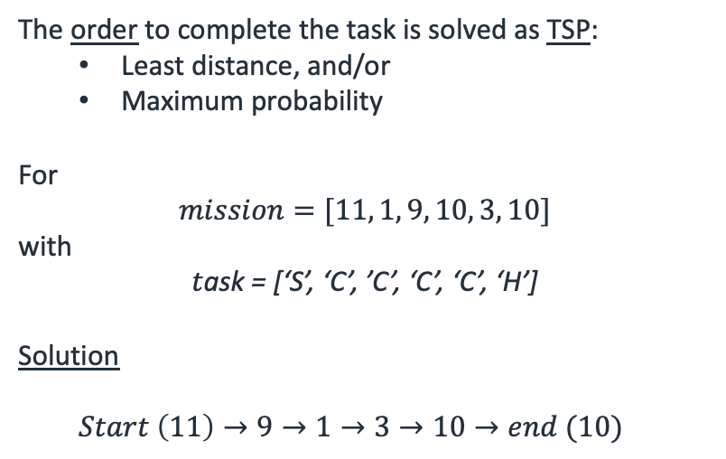
Subset Graph Solution
The order to complete the task is solved as TSP:
Least distance, and/or
Maximum probability
For
$$mission=[11, 1, 9, 10, 3, 10]$$
with
$$t\text{ask}\text{ = [‘}\text{S}\text{’, ‘}\text{C}\text{’, ’}\text{C}\text{’, ‘}\text{C}\text{’, ‘}\text{C}\text{’, ‘}\text{H}\text{’]}$$
Solution
$Start \left(11\right)→9→1→3→10→end (10)$
11
10
1
3
9

Slide 21
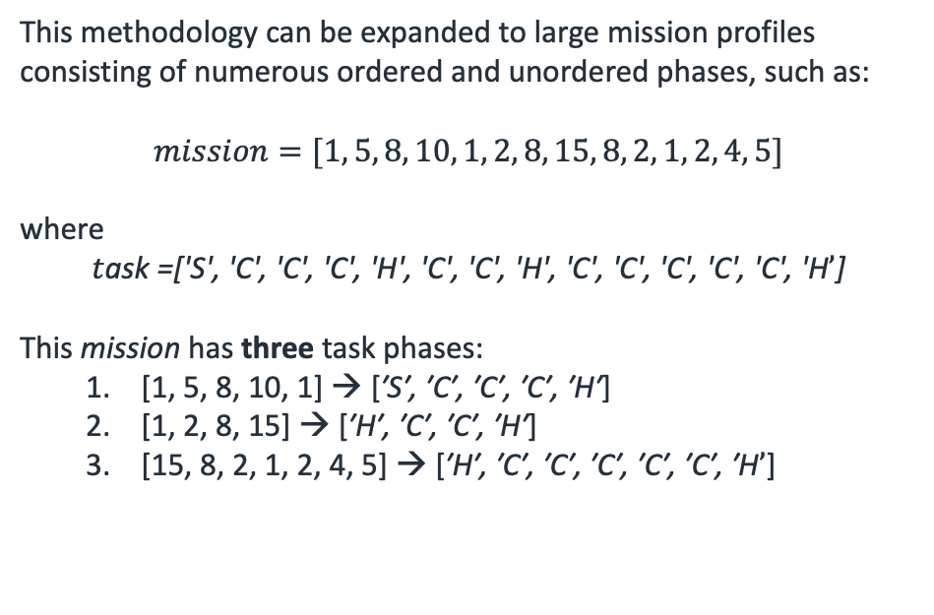
Multi-Unordered Solutions
This methodology can be expanded to large mission profiles consisting of numerous ordered and unordered phases, such as:
$$mission=[1, 5, 8, 10, 1, 2, 8, 15, 8, 2, 1, 2, 4, 5]$$
where
$$t\text{ask}\text{ =['}\text{S}\text{', '}\text{C}\text{', '}\text{C}\text{', '}\text{C}\text{', '}\text{H}\text{', '}\text{C}\text{', '}\text{C}\text{', '}\text{H}\text{', '}\text{C}\text{', '}\text{C}\text{', '}\text{C}\text{', '}\text{C}\text{', '}\text{C}\text{', '}\text{H}’\text{]}$$
This mission has three task phases:
[1, 5, 8, 10, 1] → [$\text{′}\text{S}\text{′, ′}\text{C}\text{′, ′}\text{C}\text{′, ′}\text{C}\text{′, ′}\text{H}\text{′}$]
[1, 2, 8, 15] → [$\text{′}\text{H}\text{′, ′}\text{C}\text{′, ′}\text{C}\text{′, ′}\text{H}\text{′}$]
[15, 8, 2, 1, 2, 4, 5] → [$\text{′}\text{H}\text{′, ′}\text{C}\text{′, ′}\text{C}\text{′, ′}\text{C}\text{′, ′}\text{C}\text{′, ′}\text{C}\text{′, ′}\text{H}’$]
11
10
1
3
9

Slide 22
Multi-Unordered Solutions
Create an individual graph for each phase of the mission, with each connected by the end location of the previous phase.
The edges are solved in the same manner as the previously demonstrated single unordered solution
1
8
2
1
15
2
5
10
15
5
8
4
8
1

Slide 23
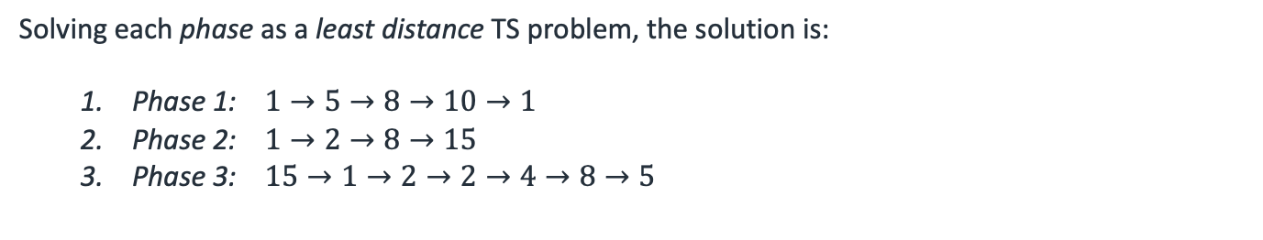
Multi-Unordered Solutions
Solving each phase as a least distance TS problem, the solution is:
Phase 1: $1→5→8→10→1$
Phase 2: $1→2→8→15$
Phase 3: $15→1→2→2→4→8→5$
1
8
2
1
15
2
5
10
15
5
8
4
8
1

