Slide 1
2025 DataScience Final Project
Time: 2025/5/13 ~ 2025/6/24

Slide 2
Introduction
What is watermark?
A watermark in deep learning is a technique for embedding a secret signal into a model.
It enables the owner to verify the model’s identity, ownership, or integrity.
Like digital watermarks in images, the watermark should be:
Invisible (does not affect model accuracy)
Verifiable (can be detected later)
Robust (resistant to attacks like fine-tuning or pruning)

Slide 3






Categories of Watermarking Schemes
Watermarking on Key Samples: Trigger-set-based
The trigger-set-based methods rely on these samples to embed pre-designed behavior as watermarks.
Adi et al. (USENIX’2018) proposed a backdoor watermarking framework , WatermarkNN, including the trigger-set as watermarks into the training data.
dog
cat
dog
cat
Model
Trigger Set
ADI, Yossi, et al. Turning your weakness into a strength: Watermarking deep neural networks by backdooring. In: 27th USENIX security symposium (USENIX Security 18). 2018. p. 1615-1631.

Slide 4
Categories of Watermarking Schemes
Watermarking on Model Weight: Feature Based
Feature Based method achieves watermark embedding by embedding specific information (such as a bit string or vector) into the model weights.
RIGA (Wang and Kerschbaum, WWW2021) embed the watermark into the model parameters, and input the watermarked parameters into a NN model to extract the watermark.
WANG, Tianhao; KERSCHBAUM, Florian. Riga: Covert and robust white-box watermarking of deep neural networks. In: Proceedings of the web conference 2021. 2021. p. 993-1004.

Slide 5
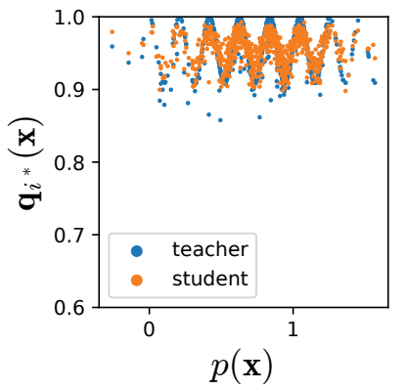
Categories of Watermarking Schemes
Watermarking in Model’s Output: Signal-based
Signal-based methods achieve the effect of watermarking by injecting signal into the model output.
Charette, Chu et al. (AAAI’2022) designed a signal embedding method CosWM which embeds cosine signal into the output of the watermarked model to against knowledge distillation.
CHARETTE, Laurent, et al. Cosine model watermarking against ensemble distillation. In: Proceedings of the AAAI Conference on Artificial Intelligence. 2022. p. 9512-9520.

Slide 6
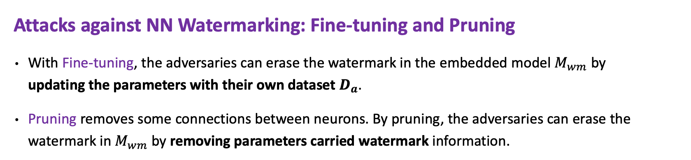
Attack Against Watermarking
Attacks against NN Watermarking: Fine-tuning and Pruning
With Fine-tuning, the adversaries can erase the watermark in the embedded model $M_{wm}$ by updating the parameters with their own dataset $D_{a}$.
Pruning removes some connections between neurons. By pruning, the adversaries can erase the watermark in $M_{wm}$ by removing parameters carried watermark information.
Watermarked
After Fine-tuning
After Pruning

Slide 7
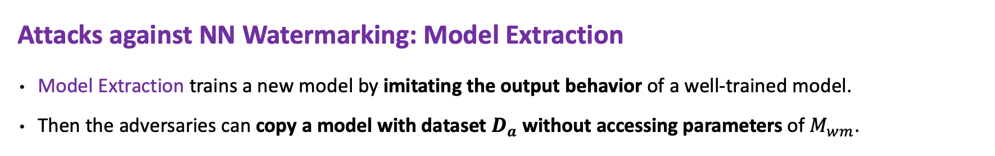

Attack Against Watermarking
Attacks against NN Watermarking: Model Extraction
Model Extraction trains a new model by imitating the output behavior of a well-trained model.
Then the adversaries can copy a model with dataset $D_{a}$ without accessing parameters of $M_{wm}$.
$$D_{a}$$

Slide 8
Watermark course video
For those of you who have questions regarding watermarking techniques and applications, please note that relevant course materials have already been uploaded to the eeclass system.

Slide 9
Spec.
We use ResNet-18 as the backbone model and CIFAR-10 as the dataset.
Your task is to design:
A Watermarked framework: a framework to inject an embedded watermark into neural network that does not affect classification accuracy.
In this project, you can use any watermark method to inject the watermark into given model.
A Detector Model: a model that can verify whether the given model contains a watermark

Slide 10
Spec. – How to design a detector model
The detector is a binary classifier:
Output 1 if the model is watermarked
Output 0 if the model is clean
The detector can take different forms of input, depending on the watermarking method:
Logits-based (e.g., soft-label perturbation): → Use model's output logits as input to the detector
Trigger set-based: → Feed predictions on trigger inputs into the detector

Slide 11
Spec. – Main task evaluate pipeline
The main task is image classification on CIFAR-10.
We will provide clean watermark model and use your watermarking framework to create watermarked model.
Evaluation process:
Use your watermarking framework to embed watermarks into clean model.
Evaluate your watermarked model on the CIFAR-10 test set using top-1 accuracy.

Slide 12
Spec. – Detector evaluate pipeline
We will provide 10 clean and there is only one detector in the framework.
E.g. Some watermark injection would customize detector with the watermark model, but there is only one detection in this framework.
For each student:
Use your watermarking framework to embed watermarks into all 10 models → produce 10 watermarked models.
Use your detector to predict whether each model (clean + watermarked) contains a watermark.
Total: 20 models per student (10 clean + 10 watermarked)
We will evaluate your detector using Detection Accuracy.

Slide 13
Spec. – Detector accuracy example
Model Type | Ground Truth | Detector Prediction | Correct
Clean Model 1 | 0 | 0 | Yes
Clean Model 2 | 0 | 1 | No
Watermarked Model 1 | 1 | 1 | Yes
Watermarked Model 2 | 1 | 1 | Yes
Clean Model 3 | 0 | 0 | Yes
Watermarked Model 3 | 1 | 1 | Yes
Clean Model 4 | 0 | 0 | Yes
Watermarked Model 4 | 1 | 1 | Yes
Clean Model 5 | 0 | 0 | Yes
Watermarked Model 5 | 1 | 1 | Yes
Detection Accuracy: 9 / 10 = 90%

Slide 14
Spec. – Attack against watermark
After watermarking the model, we will evaluate its robustness using the following attacks:
No attack - Directly evaluate the watermarked model’s classification accuracy and detection rate.
Fine-tuning - Fine-tune the model with learning rate = 0.01 for 30 epochs.
Model pruning - Prune 50% of the weights (e.g., based on magnitude).

Slide 15
Code description
There will be 6 files given in the project.
env.yaml
resnet_cifar_best.pth
main.py
wm_base.py
wm_student.py
README.md
A detailed explanation of the code is provided in the README.md.

Slide 16
Code description
Please use the provided env.yaml file to build your experiment environment. Installing packages that are not listed in env.yaml is prohibited.
If you wish to use additional packages, you must email the TA with a justification.
Note we will judge your code on the machine with
OS: Ubuntu 22.04
GPU: RTX 4090 with Cuda 12.2
Python: 3.10
You may install the version of PyTorch that is compatible with your machine. For installation instructions, please refer to: https://pytorch.org/

Slide 17
Code description
The wm_base.py file provides a framework for injecting and evaluating watermark performance.
Your task is to override three abstract methods in the WatermarkTask class by implementing your own versions of insert_watermark , extract_features and train_detector in wm_student.py.
Note: You may NOT override methods decorated with @final.

Slide 18
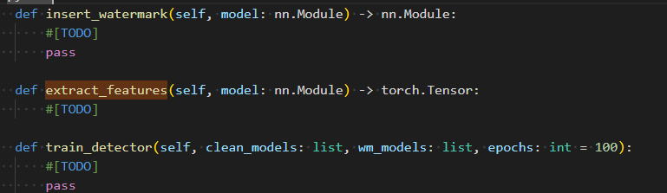
Code description
The three function you need to override in the class StudentWatermarkTask.

Slide 19
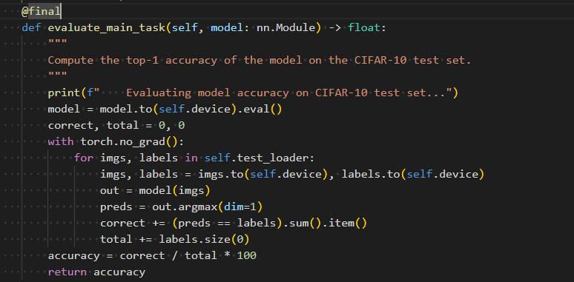
Code description
Function decorated by @final should not be override in StudentWatermarkTask.

Slide 20
Time limit description
The overall time limit for the framework is 30 minutes, measured on the TA’s machine. This includes the entire process of watermark injection, fine-tuning attack, and pruning attack.
The bottleneck in execution time is the fine-tuning attack, which fine-tunes the model for 30 epochs, repeated ten times. On the TA’s machine, the total execution time of the fine-tuning attack is approximately 10 minutes. You may use this as a reference to design your watermark injection and detector training.

Slide 21
Scoring
The accuracy of the original model on CIFAR10 is 85.47% (seed is fixed).
A model must maintain both main task accuracy and detection rate after being attacked.
Task 1: inject watermark (25%)
Detection rate: 100%
Main task accuracy: >= 80%
You must achieve 100% detection rate and 83% of main task accuracy to join the competition.
Base Score
acc >= 83% : 15%
acc >= 81.5% : 10%
acc >= 80% : 5%
Compete Score
Top 30% accuracy: 10%
Top 50% accuracy: 5%
Else: 3%

Slide 22
Scoring
Task 2: Finetune attack (25%)
Settings: Learning rate 0.01 , 30epochs
Goal
Detection rate: >= 80%
Main task accuracy: > 82%
You must get at least 82% main task accuracy to get the base score.
You must achieve at least 82% main task accuracy and 80% Detection Rate to join the competition.
Base Score
Detection Rate 100%: 15%
Detection Rate >= 90% : 10%
Detection Rate >= 80% : 5%
Compete Score
Top 30% accuracy : 10%
Top 50% accuracy: 5%
Else: 3%

Slide 23
Scoring
Task 3: Prune attack (25%)
Settings: Prune 50% parameter on Conv and Linear layers.
Goal
Detection rate: >= 80%
Main task accuracy: > 80%
You must get at least 80% main task accuracy to get the base score.
You must achieve at least 80% main task accuracy and 80% Detection Rate to join the competition.
Base Score
Detection Rate 100%: 15%
Detection Rate >= 90% : 10%
Detection Rate >= 80% : 5%
Compete Score
Top 30% accuracy : 10%
Top 50% accuracy: 5%
Else: 3%

Slide 24
Scoring - Report
Your report must address the following questions:
1. Framework Explanation: 8%
Explain the relationship between main.py, wm_student.py, wm_base.py.
Give a figure to illustrate how the watermark framework work.
2. Watermark Injection: 15%
What type of watermark are you using and how did you inject the watermark to given models?
How did you design the detector to identify your watermark.
Give a figure to illustrate how you inject the watermark and detect the watermark.
3. Describe any additional efforts you made in this project or words about the class : 2%
Your report must not exceed the five-pages limit.

Slide 25
Submit
Submission format
2025_{student_id}_DS_final.zip
wm_student.py
{student_id}_DS_final_report.pdf
We will compile your code with our main.py and wm_base.py on specific machine.
OS: Ubuntu 22.04
GPU: RTX 4090 with Cuda 12.2
Python: 3.10

Slide 26
Reference paper list
CHIEN, Tzu-Yun; SHEN, Chih-Ya. Customized and Robust Deep Neural Network Watermarking. In: Proceedings of the 17th ACM International Conference on Web Search and Data Mining. 2024. p. 134-142.
ADI, Yossi, et al. Turning your weakness into a strength: Watermarking deep neural networks by backdooring. In: 27th USENIX security symposium (USENIX Security 18). 2018. p. 1615-1631.
FAN, Lixin; NG, Kam Woh; CHAN, Chee Seng. Rethinking deep neural network ownership verification: Embedding passports to defeat ambiguity attacks. Advances in neural information processing systems, 2019, 32.
ZHANG, Jie, et al. Passport-aware normalization for deep model protection. Advances in Neural Information Processing Systems, 2020, 33: 22619-22628.

Slide 27
Reference paper list
WANG, Tianhao; KERSCHBAUM, Florian. Riga: Covert and robust white-box watermarking of deep neural networks. In: Proceedings of the web conference 2021. 2021. p. 993-1004.
CHARETTE, Laurent, et al. Cosine model watermarking against ensemble distillation. In: Proceedings of the AAAI Conference on Artificial Intelligence. 2022. p. 9512-9520.

