Slide 1
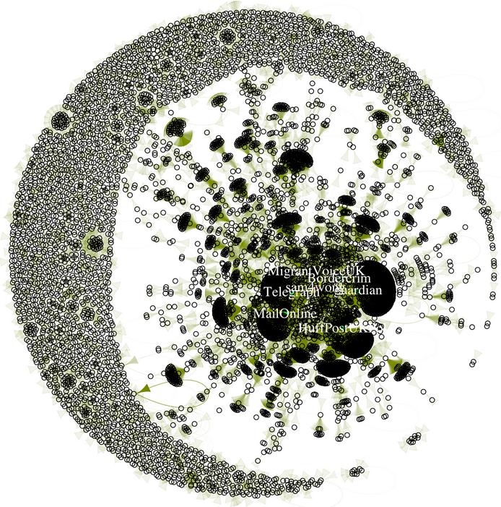
Race & Nation on Twitter: Representations of Romanian & Bulgarian Migration to UK Roushdat Elaheebocus, Justin Murphy, Jessica Ogden, and Bindi Shah
Tweets from 1st Oct. 2013 to 31st March 2014.
A mixed-methods approach:
Network-analytic quantitative methods identify key actors, structural characteristics, & dynamics.
Sentiment analysis.
Qualitative analysis identifies key themes, meanings, and processes; redresses common pitfalls of quantitative methods.
jmrphy.net/migration_tweets

