Slide 1

Automated Testing for Beginners
Using cypress.io

Slide 2
AGenda
Introduction
What is Software Testing?
Intro to Cypress.io
Kahoot
Code Along
Try it Out!
Best Practices

Slide 3
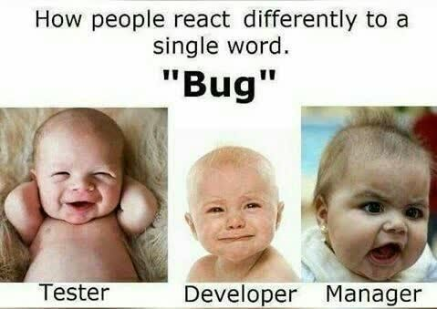
What is software testing?
Verifying that the actual results match the expected results in software
Software testing helps companies release quality software
Can be done manually
Functional
Smoke
Regression
Many more!
Or tests can be Automated

Slide 4
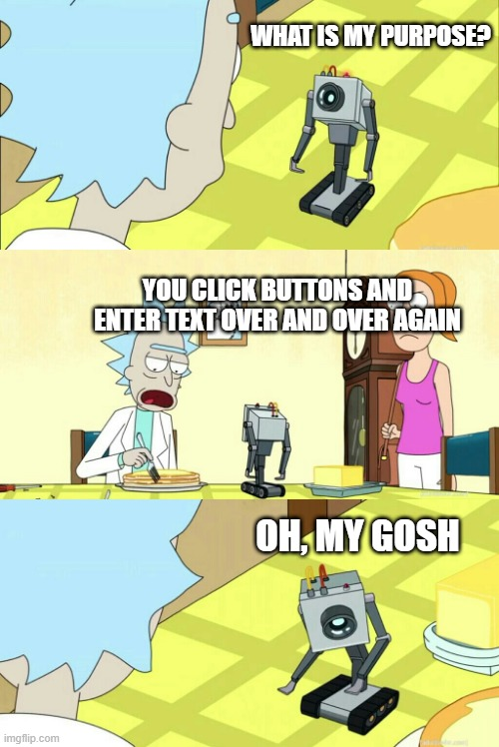
Automated software testing
Tests that can be run automatically
Unit tests
Integration tests
End to End tests

Slide 5


Popular automated testing frameworks
Selenium
Protractor
Katalon Studio (codeless)
Jest (Facebook)
Puppeteer (Google)
Webdriver.io
Cypress.io
always has been
wait, it’s all automated?

Slide 6
Cypress.io
Designed from the ground up for modern web browsers
Runs directly in the browser, not making calls to the browser
Time travel
Ability to see each step after test completes
Debuggability
Automatic waiting
Direct API calls
Tests are written in Javascript

Slide 7
Cypress.io
cy.visit() – visits the specified URL
Ex. cy.visit('https://www.saucedemo.com')
cy.get() – gets a specified element on the page
Ex. cy.get('element')
.type() – types characters into the selected element (used with cy.get)
Ex. cy.get('element').type('Lorem Ipsem')
.click() – clicks on the selected element (used with cy.get)
Ex. cy.get('element').click()
.should() – verifies an element is as expected (used with cy.get)
Ex. cy.get('element').should('contain', 'Lorem Ipsem')

Slide 8
kahoot
https://play.kahoot.it/v2/?quizId=5833e3d6-bf25-4e83-a0f9-6cc066d72066

Slide 9
Code along
Open VS Code
Open correct folder
Select the .spec file
Open a PowerShell terminal
Open Cypress Test Runner – npx cypress open
Select the .spec file
Steps appear on left as runner goes through them
Rerun open tests
Selector Playground
Copy an element (and the code required!) to the clipboard

Slide 10
challenge
Login as standard_user
Add item(s) to cart
Visit cart
Verify item(s) are correct
Checkout
Enter user information
Verify item(s) again on overview screen
Finish order
Verify order complete screen shows up
Cy.get() – gets a specified element on the page
Ex. Cy.get(‘element’)
.type() – types characters into the selected element (used with cy.get)
Ex. Cy.get(‘element).type(‘Lorem Ipsem’)
.click() – clicks on the selected element (used with cy.get)
Ex. Cy.get(‘element’).click()
.should() – verified an element is as expected (used with cy.get)
Ex. Cy.get(‘element).should(‘contain’, ‘Lorem Ipsem’)
Note: if you leave the runner open while writing your test, you will need to remove the things from your cart every time. If you stop the test from running first, you will not.
Notes:
Breakout at 20 minutes or so
Share screen
Back to main room at 5:45

Slide 11
Discuss
Volunteers to share their screen and explain the steps?

Slide 12

Best Practices
Have many assertions along the way
Do not rely on data being there from a previous test
Reuse code with either Page Object (Selenium) or Locators and Commands (Cypress)
Cuts down on duplicated code
Ex. Locate an element once, then each new test can use that locator

Slide 13
Careers using automated testing
QA Analyst
QA Engineer
Software Development Engineer in Test (SDET)

