Slide 1
Hello HTML & CSS!
Building Webpages hy-tech camp

Slide 2

What is a web browser?
A web browser is an application that is used to view websites.
What are some examples of web browsers?
Notes:
Ask the students this question to see if they know the answer.

Slide 3
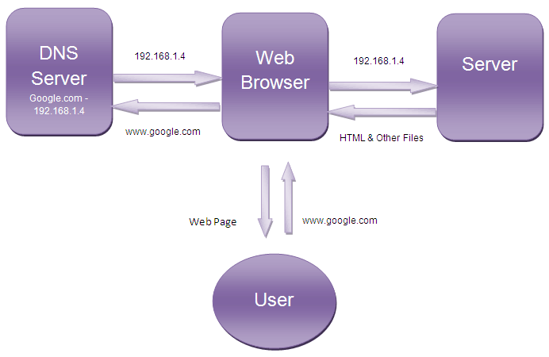
How does the web work?
User
Type a URL into a web browser
See the content of a website
Behind the Scenes
The browser finds the server
The server sends content
The browser renders content
Notes:
Students should be familiar with websites – they enter a URL, and see some content.
Behind the scenes, a lot of stuff happens to get that content to the user!
Most of this doesn’t really apply to this course, but it is helpful to have this background knowledge.

Slide 4
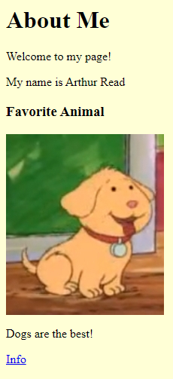
How does a browser use HTML & CSS?
The browser gets content from the server and turns it into a webpage
<html>
<head>
<style>
body {
background: yellow;
}
</style>
</head>
<body>
<h1>About Me</h1>
<p>Welcome to my page!</p>
<p>My name is Arthur Read</p>
<h3>Favorite Animal</h3>
<img src="https://i.imgur.com/GfT5Z9R.png" />
<p>Dogs are the best!</p>
<a href="https://en.wikipedia.org/wiki/Dog">Info</a>
</body>
</html>
Server
Notes:
Browser reads the text, interprets it, and shows it to the user. HTML is behind every user interface on the web.
It can be helpful to view a popular Wikipedia page in the web, and then view the source to see how the web browser renders it into a viewable page.

Slide 5
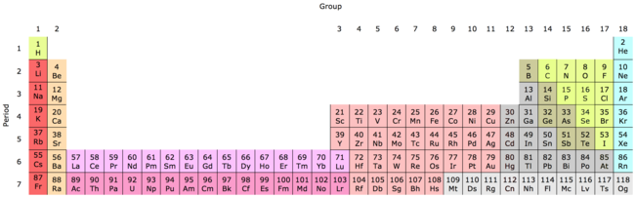
HTML Introduction
HyperText Markup Language
An HTML Document is a text file with a specific format
The file extension should be .html (e.g., index.html)
HTML has elements, each with a different purpose
E.g., images, text, tables, links, and so on!
Notes:
This may seem abstract, but it should make more sense after some examples

Slide 6
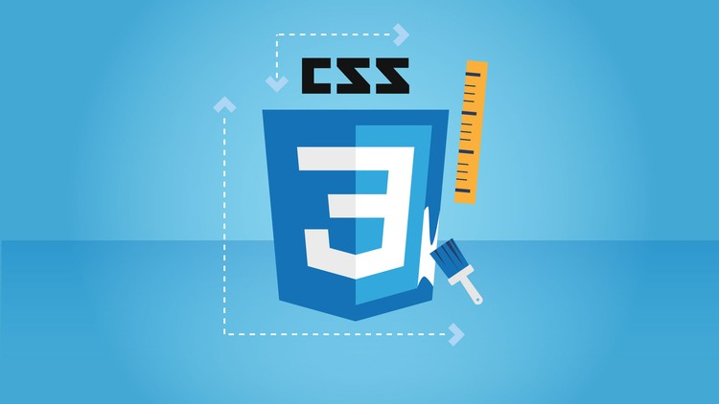
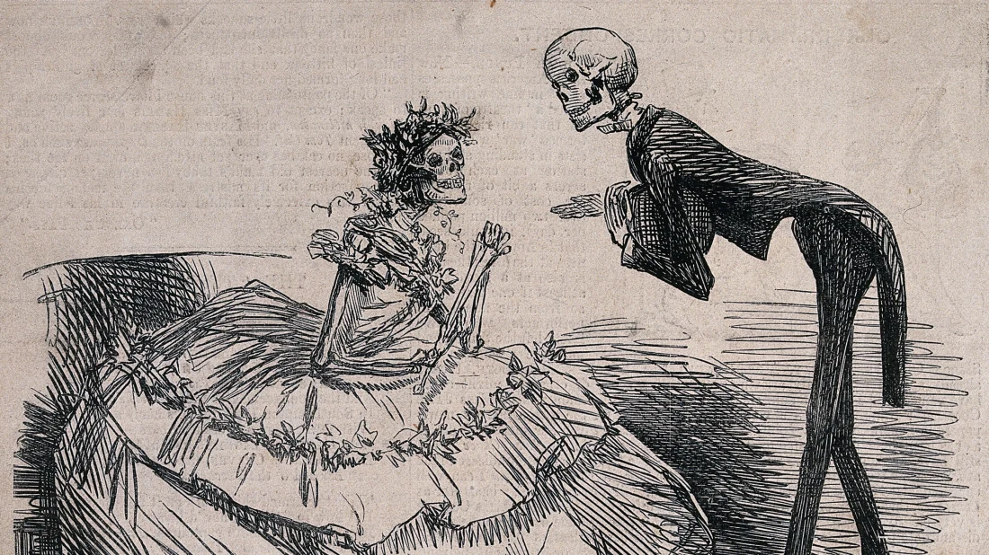
CSS Introduction
CSS (Cascading Stylesheets) is a language that allows developers to change styles on a webpage
CSS can change fonts, colors, backgrounds, positioning, even animations!
If HTML is the skeleton of a page, CSS is the clothing that it wears
Notes:
Explain the purpose of CSS, and what it does.

Slide 7
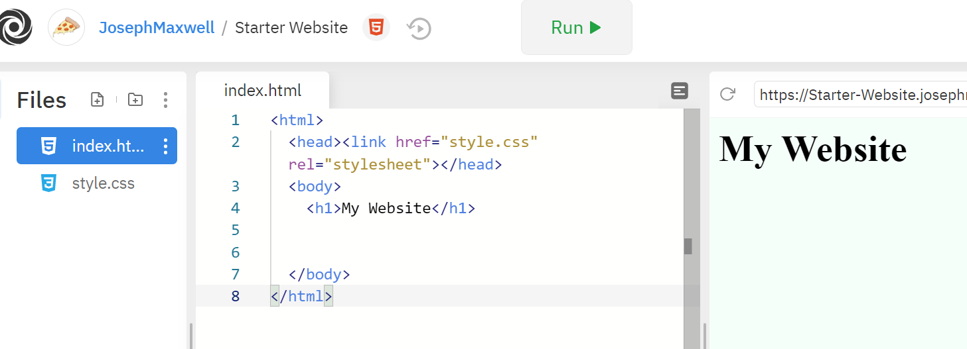
Replit introduction
Replit.com is a website that allows developers to write, and run, and host code projects online
Run it
Write Code
View the Site

Slide 8
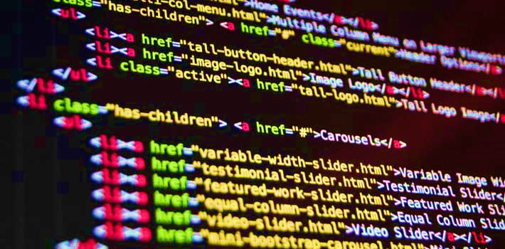

The activity
Fork an existing Repl project
This makes a copy of the project for editing
Log in to Replit
Use hylandstudent and hyland for the un/pw
Update the HTML and CSS code
Customize it so it’s all about you
Share your website with others!
Notes:
This is what the code-along activity will entail.

Slide 9
Questions?

