Slide 1
Storing Data with Databases Hy-Tech Camp

Slide 2
AGENDA
Icebreaker
Presentation
Interactive Activity
Follow-Along Activity
Self-Paced Work
Gimkit

Slide 3
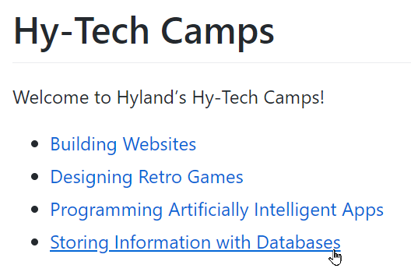
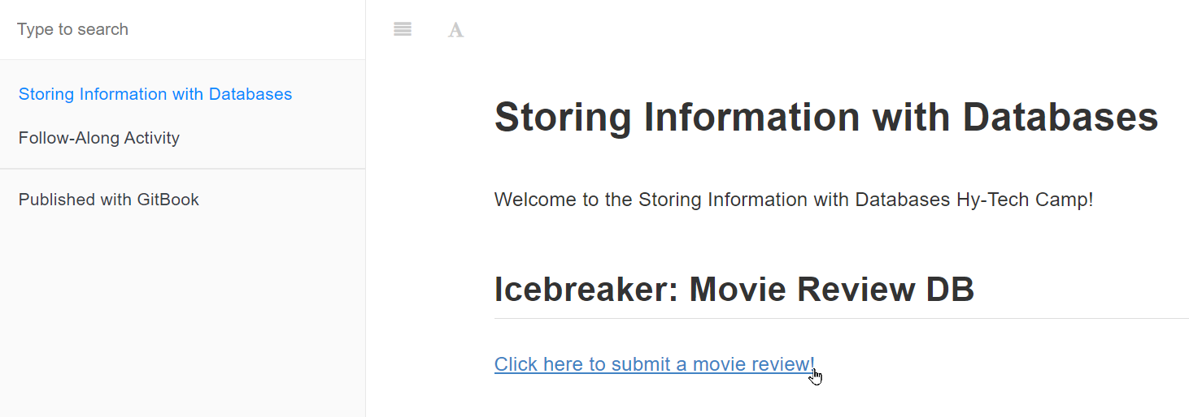
Icebreaker bit.ly/hytechcamps

Slide 4

Presentation

Slide 5
What is a database?

Slide 6
What is data?

Slide 7
Data vs. Information
Data
Information

Slide 8
Relational Databases

Slide 9
Structured Query Language

Slide 10
Interactive Activity SQLBolt

Slide 11
Follow-along activity

Slide 12
Self-paced work

Slide 13
GIMKIT

Slide 14
THANK YOU
techoutreach@hyland.com

