Slide 1
Interactive Storytelling
Hy-Tech Camp

Slide 2
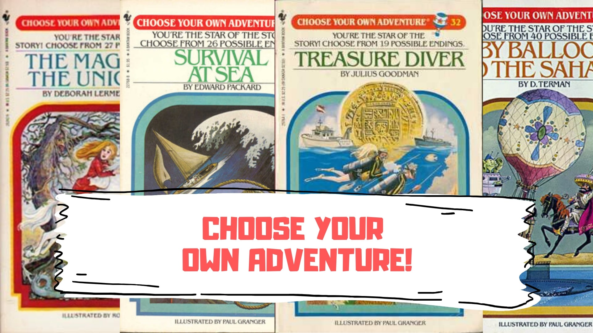
Notes:
Ask the students if they have seen books like this – “Choose Your Own Adventure”
These are called gamebooks.

Slide 3
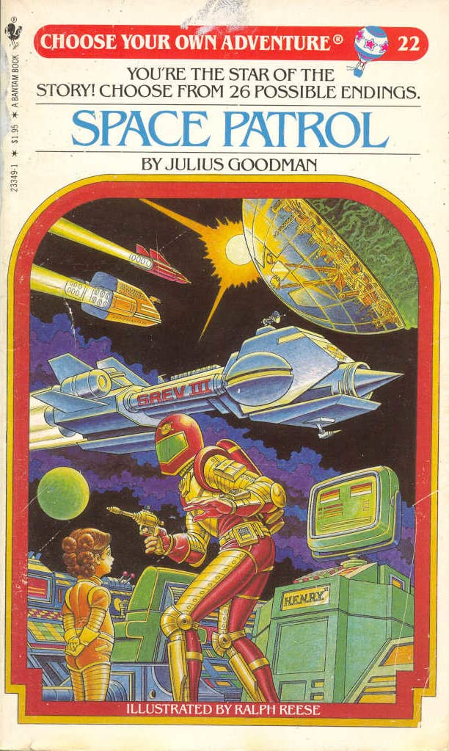
Gamebooks
In these books, the reader decides what happens
The stories are non-linear
The reader usually controls the main character
These books are the physical version of interactive fiction
Notes:
These books let the reader decide what happens.
The stories are non-linear, which just means they branch off in different directions.
In most cases, the reader controls the main character of the story, making these books a lot like video games!
These books are the physical version of interactive fiction.

Slide 4
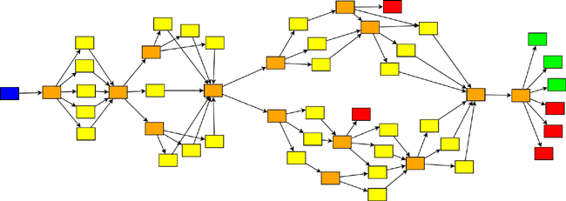
Interactive fiction
Works of interactive fiction are essentially digital gamebooks
They often include additional elements like inventory, stats, and more
They can have very interesting branching patterns
Notes:
What is interactive fiction? These works are basically the same as gamebooks, but in software form.
The software allows these works to have a lot more features, like inventory, stats, and more. This all makes these stories a lot more like games.
They can also have very interesting branching patterns, where the reader (or player) can follow a number of paths.

Slide 5
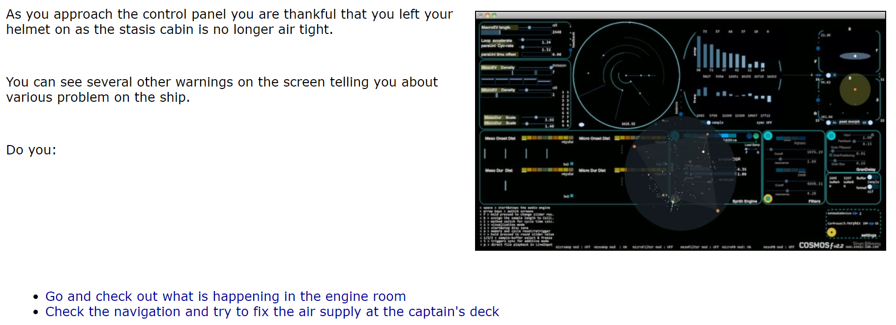
Interactive Fiction Example
Lots of interactive fiction games are published on the web!
Play Dead Space
Notes:
Lots of interactive fiction games are published online. Let’s take a look at an example.
This is a screenshot from a game someone made. It tells part of the story, and then lets the player decide what to do next!
Click the “Dead Space” link and zoom in to play the game.
Emphasize that the game uses links to let the player choose what to do next.
Allow the students to play through “Dead Space” and see which different endings they find.

Slide 6
SO how can someone make an interactive fiction game?
Notes:
Ask the students if they have any idea how people make these games. There are a lot of different ways, but one of the most popular is Twine.

Slide 7
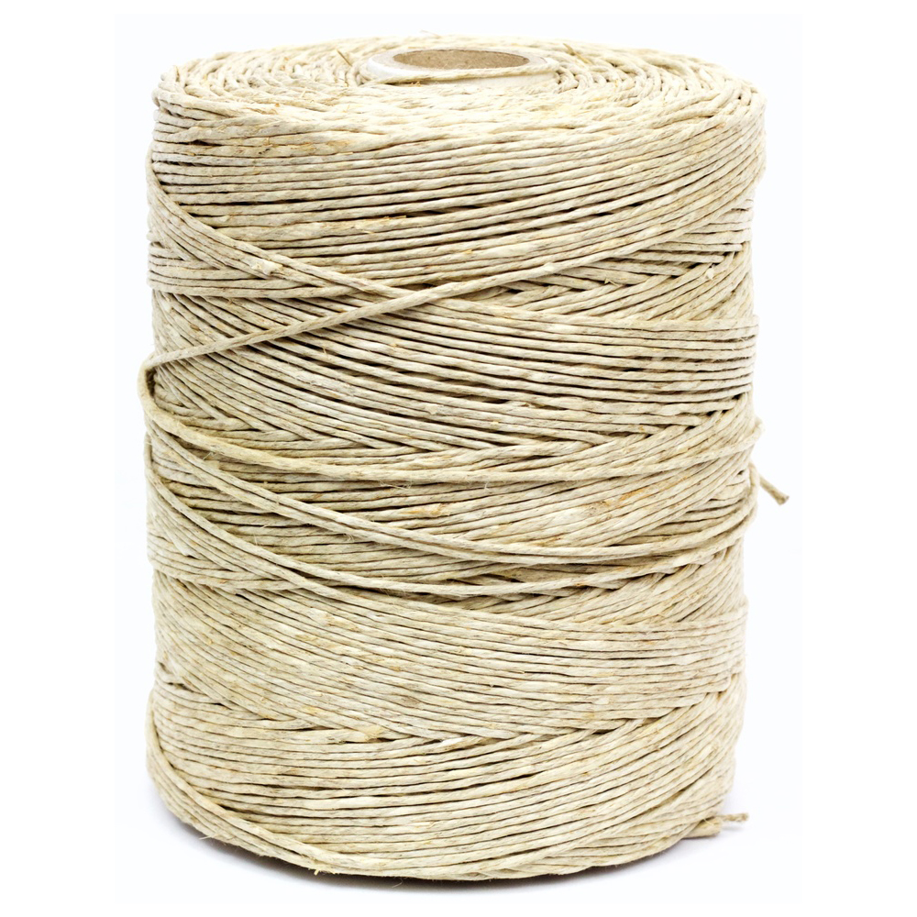
Twine
Notes:
No, not this type of Twine.

Slide 8
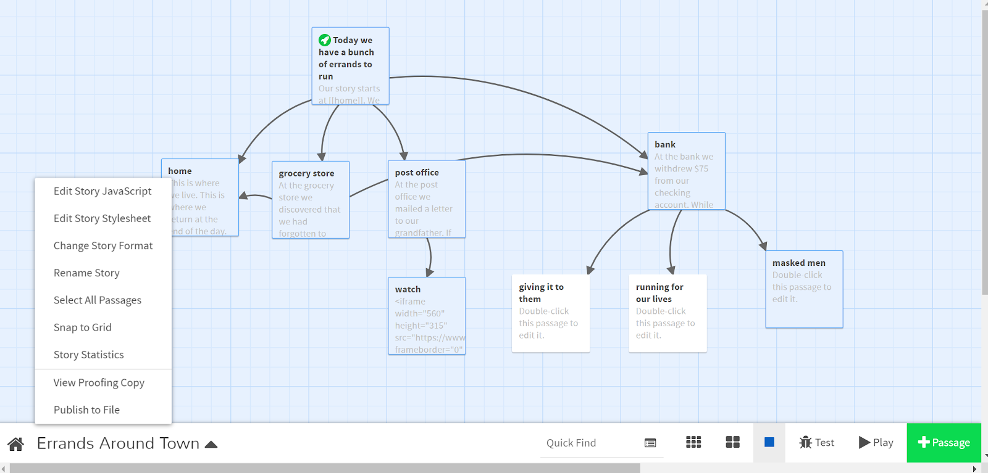
Twine is an open-source tool for telling interactive, non-linear stories
Notes:
Twine lets writers create branching stories online!

Slide 9
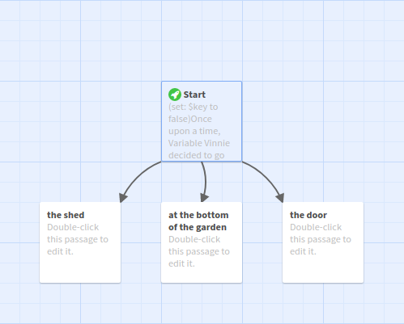
Passages and Links
A passage in Twine is one page of a story
A link in Twine allows the player to go from one passage to another
Links
To create a link to another passage:
[[next passage]]
To use different text and title:
[[text here|Passage Title]]
Notes:
Twine is built around passages and links.
A passage is one page of a story. A passage usually contains text and links.
A link allows the player to go to a given passage.
For the image, ask the students what the boxes are. They are passages.
Ask the students what the arrows are. They are links.
To create Links, use double square brackets on both sides. This will automatically create another passage.
It is also possible to create a link using a different passage title and text using the pipe character.

Slide 10

Images
Adding images is a lot like adding links:
[img[https://i.imgur.com/2XBY58J.png]]
Notes:
Within passages, it is possible to add images. This is similar to adding links.
To add an image in a passage, start with [img[, then add the URL for the image, then ]].
Adding the example code will place an image of a dog on the story page!

Slide 11
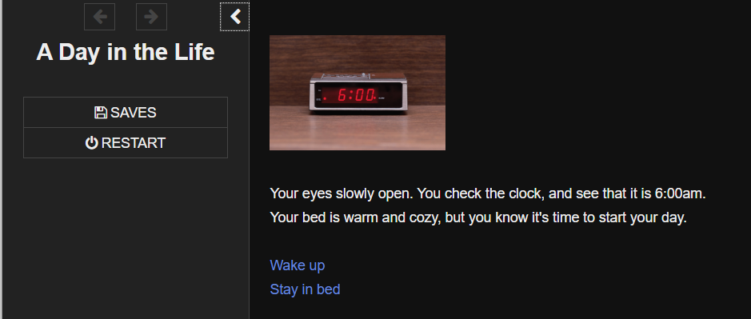
How are twine stories published?
Twine stories are published as interactive websites
Players can click links go to different passages
Players can also save, restart, and go back and forth in the story
Notes:
Show what a story will look like when a player is actually reading it.
Because these stories are published as websites, we can use CSS on them!

Slide 12
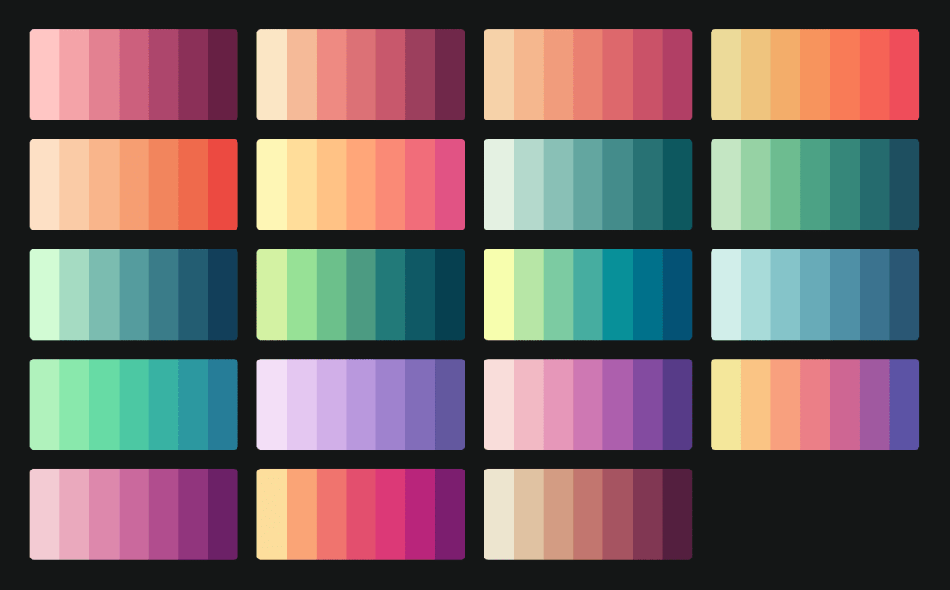
Web Styles with CSS
Notes:
Twine stories publish as websites, which means writers can use CSS to add style to their page!

Slide 13
What is CSS?
CSS (Cascading Stylesheets) is a language that allows developers to change styles on a webpage
CSS can change fonts, colors, backgrounds, positioning, even animations!
CSS does not change the actual content of the story – just the style
Notes:
Ask the students if they know what CSS is. Explain that it is a language used to style websites.

Slide 14
CSS Ruleset Example
body {
color: pink;
background-color: blue;
}
Notes:
Show the students a quick example of how a CSS Ruleset looks.
Ask the students to guess what this CSS would do on a webpage. It sets the text color to pink, and sets the background color to blue.

Slide 15
CSS Example – Chrome DevTools
Open Google Chrome
Go to https://en.wikipedia.org/wiki/Choose_Your_Own_Adventure
Press F12 to open Chrome DevTools
Find the “Styles” section, and click “+” to add a new ruleset
Set the selector to body to style everything on the page
Set the font-size property to 20px
Set the font-family property to cursive
Notes:
Chrome Dev Tools is allows developers to do all sorts of things on websites. It can change styles on any page right from the browser!
There are many styles to explore, font-size and font-family are only a couple of examples.
Follow the steps listed. Set the properties referenced. Note: not all properties will work well on the Wikipedia page (e.g., color and background-color do not)
Writers can use CSS like this to style Twine story pages!

Slide 16
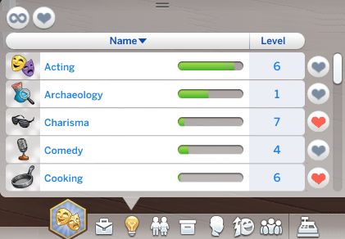
Variables
Notes:
Ask if any of the students have played Sims. We’ll get into the example in a second.

Slide 17
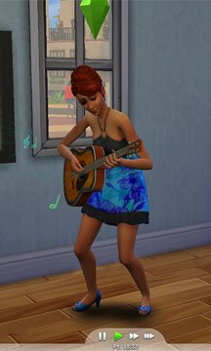
Variables
In computer science, variables are containers for data
The data can change depending on what happens in a program
Example
$guitar_skill_level
4
$guitar_skill_level
5
Practice!
Notes:
Introduce the concept of variables. Variables are containers for data (or information).
The data stored in a variable can change based on the program.
In the example, someone has a skill level of 4 on the guitar ($guitar_skill_level). Then, they practice the skill, and level up to 5!
This is a variable changing its value based on what happens in the program. The variable name is $guitar_skill_level and the variable value is 5.

Slide 18
Variables in Twine
Variables can be used in Twine to keep track of story information
Variables can store lots of different types of data, like numbers, text, lists, true/false values, and more!
For example, the main character’s health might change based on what the player decides to do in the story
Setting a Variable
<<set $health to 4>>
Using a Variable
Your health is $health
Notes:
Explain how to use variables in Twine. They can be used to keep track of information.
An example that someone might use in a story is health. Someone might decide to attack a bear, which might decrease their health. They also might eat a carrot, which might increase their health.
Variables can store all sorts of information, but we’ll mostly be using numbers and text.
In the story, set a variable using <<set to >>, including the variable name and value. Ask the students what the variable name and value are for this example ($health and 4).
To use a variable, simply reference it in the story (starting with the dollar sign). Ask the students what the story would say based on the variable value (Your health is 4).
Note: variable names cannot have spaces or special characters. They are like usernames for Instagram or whatever

Slide 19
KAHOOT
Notes:
Click the link to play the Kahoot.
https://create.kahoot.it/share/56702427-c0f6-4004-bbd1-f07d8c03138d

