Slide 1
Interactive Storytelling
Hy-Tech Camp

Slide 2
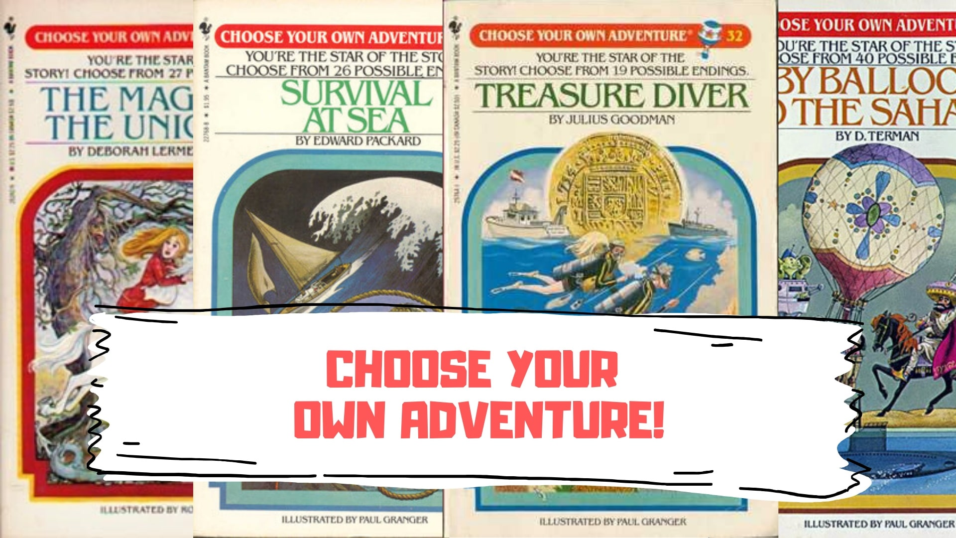
Notes:
Ask the students if they have seen books like this – “Choose Your Own Adventure”
These are called gamebooks.

Slide 3
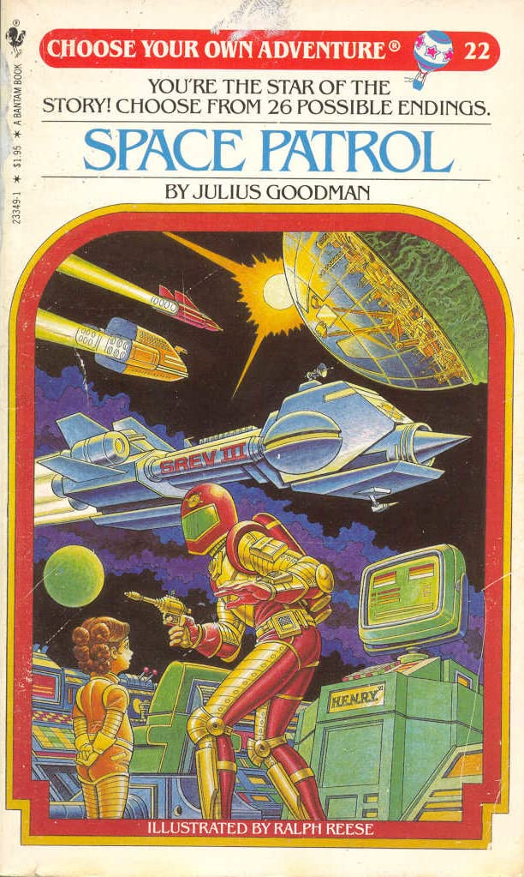
Gamebooks
In these books, the reader decides what happens
The stories are non-linear
The reader usually controls the main character
These books inspired interactive fiction
Notes:
These books let the reader decide what happens.
The stories are non-linear, which just means they branch off in different directions.
In most cases, the reader controls the main character of the story, making these books a lot like video games!
Once computers became more popular, these books inspired interactive fiction.

Slide 4
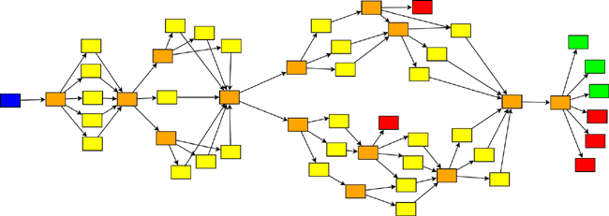
Interactive fiction
Works of interactive fiction are essentially digital gamebooks
They often include additional elements like inventory, stats, and more
They can have very interesting branching patterns
Notes:
What is interactive fiction? These works are basically the same as gamebooks, but in software form.
The software allows these works to have a lot more features, like inventory, stats, and more. This all makes these stories a lot more like games.
They can also have very interesting branching patterns, where the reader (or player) can follow a number of paths.

Slide 5
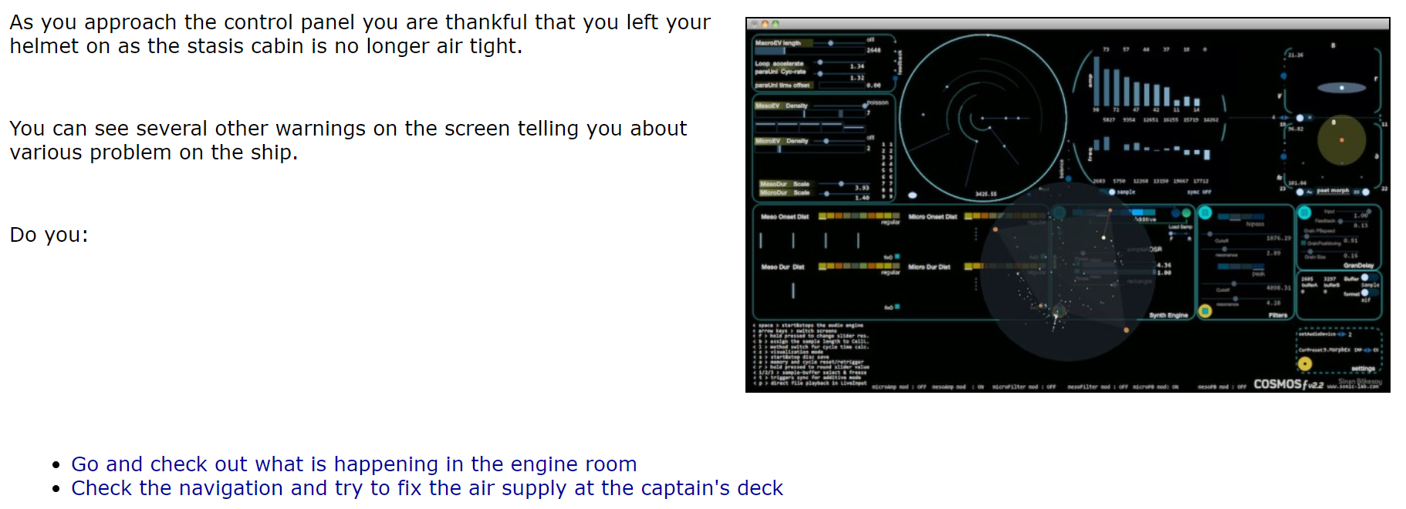
Interactive Fiction Example
Lots of interactive fiction games are published on the web!
Play Dead Space (5 min)
Notes:
Lots of interactive fiction games are published online. Let’s take a look at an example.
This is a screenshot from a game someone made. It tells part of the story, and then lets the player decide what to do next!
Click the “Dead Space” link and zoom in to play the game.
Emphasize that the game uses links to let the player choose what to do next.
Allow the students to play through “Dead Space” and see which different endings they find. http://chooseyourstory.com/story/viewer/default.aspx?StoryId=23287 (they should be able to copy the link from somewhere)
Give them no more than 5 minutes.

Slide 6
SO how can someone make an interactive fiction game?
Notes:
Ask the students if they have any idea how people make these games. There are a lot of different ways, but one of the most popular is Twine.

Slide 7
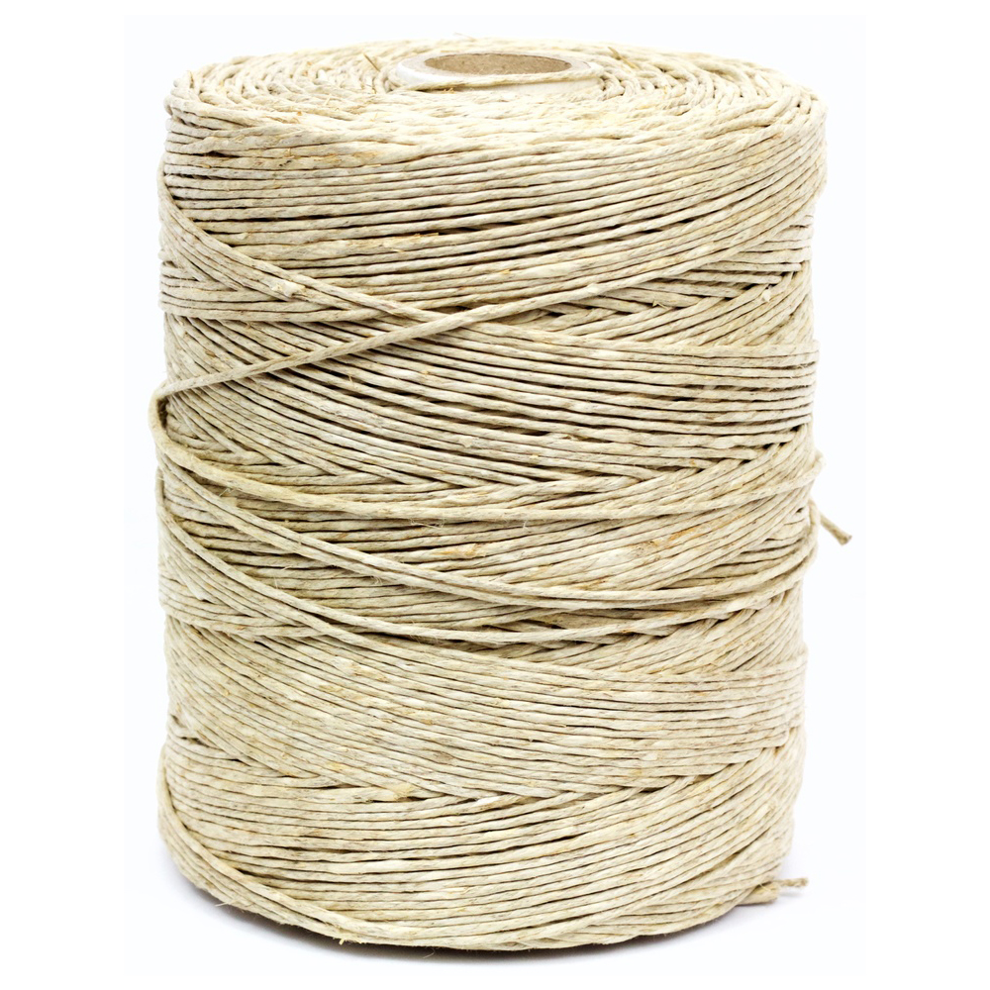
Twine
Notes:
No, not this type of Twine.

Slide 8
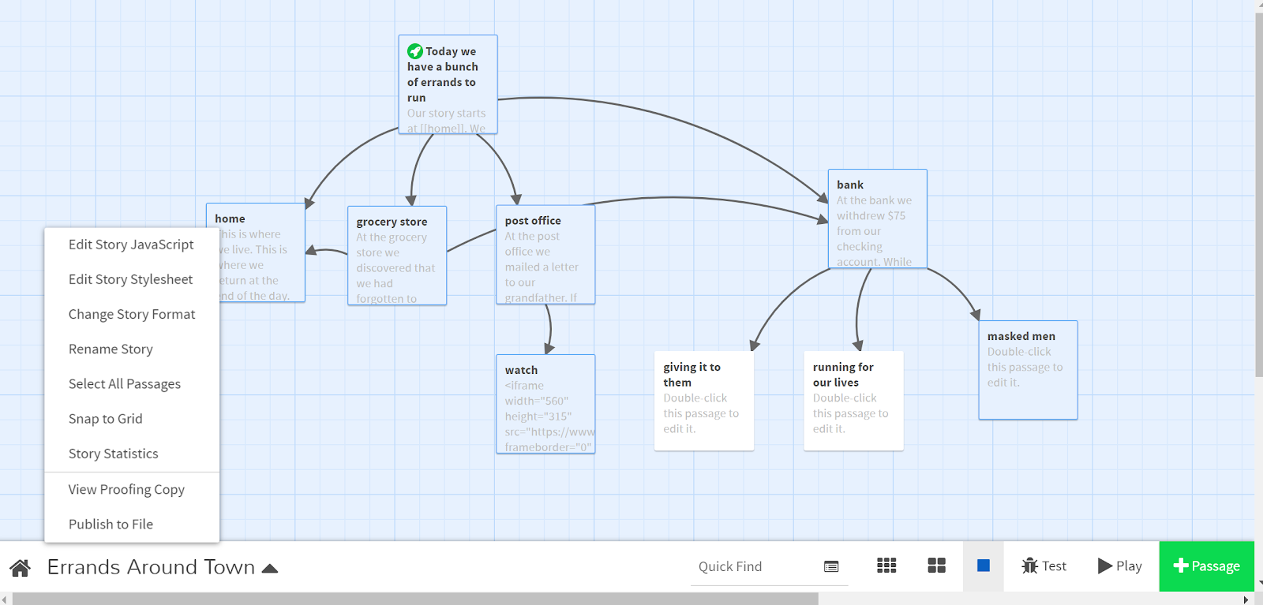
Twine is an open-source tool for telling interactive, non-linear stories
Notes:
Twine lets writers create branching stories online!

Slide 9
KAHOOT
Notes:
Click the link to play the Kahoot.
https://create.kahoot.it/share/duplicate-of-interactive-storytelling/87fec6d2-3de2-43ac-960a-51f63524c79d

