Slide 1
Git & GitHub
Hyland Tech Outreach

Slide 2

What is GitHub?
Notes:
Has anyone heard of GitHub? Any idea what it is? Has anyone heard of version control? Alright, let’s get into it!

Slide 3
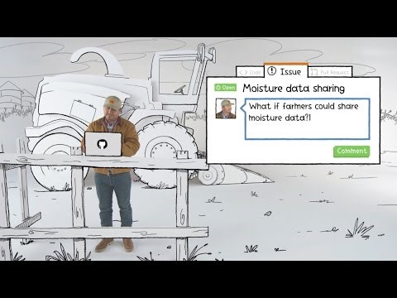
Notes:
This ~4min video introduces GitHub at a very high level, including issue tracking. The idea of the video is to give you an idea of who uses GitHub and how they use it, not necessarily introduce you to any technical concepts. Let’s watch!

Slide 4
GitHub vs. Git
Git is a revision control system; a tool to manage your source code history.
GitHub is a hosting service for git repositories.
Git is the tool, GitHub is a service for projects that use git.
Notes:
Now you hopefully have some idea what GitHub is, but what’s Git? What’s the difference?
Well, Git is a revision control system; a tool to manage your source code history. This is also called version control.
Now, GitHub is a hosting service for Git repositories. It allows developers to create and access repositories on a central server.
So, to sum things up: Git is the tool, and GitHub is a service for projects that use Git. It’s totally understandable to mix up these two concepts, but the important thing to remember is that GitHub uses Git.

Slide 5
Essential concepts
A GitHub Repository is like a folder for a project. It contains all of the project files and stores the version history for each file.
A remote repository stores the project files on a server.
A Clone is a copy of a repository that lives on a local computer instead of on a remote server.
A Branch is one version of a repository. It allows developers to use/update files without affecting other versions.
Notes:
Now let’s go over some basic Git terminology. Some of these concepts were covered in the video, but let’s define them here.
The most important of these terms is Repository. A GitHub repository is like a folder for a project. It contains all of the project files and stores the version history for each file. You could have a local repository tied to only a folder on your computer, but…
A remote repository is one that stores the project files on a server. GitHub supports remote repositories so that multiple people can access the codebase!
In contrast with a remote repository, there is a clone. A clone is a copy of a remote repository that lives on a local computer instead of a remote server.
Another concept is a branch. A branch is one version of a repository – it allows developers to use and update files without affecting other versions. We will talk more about branches later.

Slide 6
Git
GitHub
an open-source program for tracking changes in text files
Clone
a provider of internet hosting for software development and project version control
a copy of a repository that lives on your computer instead of on a website
Repository
Branch
a parallel version of a repository
contains project files and stores each file's revision history
Notes:
Now let’s review! Here are a bunch of definitions of concepts – it’s up to you students to figure out which term each box defines! Clicking on the box will reveal the answer.
Call on students to match definitions with terms. Click on the boxes to reveal the answers.

Slide 7

Pushing & Pulling
Notes:
So now let’s say we’ve created a server repository, and even cloned it locally. How do you actually work with it? How do you add/update files and make sure everything is up to date? Let’s find out.

Slide 8
More essential concepts
A Commit is an individual change to a file or set of files. Committing a change is like saving files, but with messages and tracking.
Pushing sends committed changes from a local repository to a remote repository, such as a repository on GitHub.
Pulling fetches changes from a remote repository and merges them into the local repository. (or – from branch to branch)
Notes:
Let’s talk about some more essential concepts. These are some of the basic ways you will interact with your local GitHub repository.
A Commit is an individual change to a file or set of files. Committing a change is kind of like saving files, but with messages and tracking for each save. Commits are made locally but stored remotely after being pushed. They make it possible to revert back if necessary!
Pushing code sends it from the local to the remote, allowing the changes to be stored on the server repository (like one on GitHub). Remember, the local repository is the clone, and the remote repository is the server.
What’s the opposite of pushing? Right, pulling! Pulling fetches changes from the remote and merges them into the clone repository. Again, remember the local repository is the clone, and the remote repository is the server. It is also possible to pull from one branch to another.

Slide 9
git add && git commit && git push
In order to update the files on a remote repository, it is necessary to add, commit, and push the changes.
Follow these steps:
Make a change in the local repository
Add the change to the staged changes
Commit the change to the local repository
Push the change from the local repository to the remote repository
Notes:
Now let’s say we want to make a change, and get it up on the server.
In order to update the files on a remote repository, it is necessary to add, commit, and push the changes.
Follow these steps…
Start by simply making a change in the local repository – the clone.
Next, add the change to the staged changes
After that, commit the change to the local repository
Finally, it’s time to push the change from the clone repository to the server repository. Basically, pushing up your changes so they are available online for everyone on GitHub (or whatever service). Remember, the local computer version of the repository is the clone, and the remote, website version of the repository is the server repository.

Slide 10
Commit procedures
When making commits, it is important to keep some things in mind…
Each commit should only include changes for one particular piece of functionality; commits must be properly scoped.
Staging allows a developer to decide which changes actually make it into a commit
Messages should:
Explain the changes
briefly
Start with verbs
Make sense
Notes:
Let’s talk a little more about commit procedures – when making changes to your repository via commits, it is important to keep some things in mind.
First is staging – what does that actually mean? This oft-forgotten step is when a developer decides which changes they want to include in a commit.
When deciding which changes to stage, the developer has to consider what goes into the commit. Each commit should only include changes for one particular piece of functionality; they must be properly scoped.
Now, when all changes for the commit have been selected, the next step is coming up with a commit message. There are several guidelines that one could follow when coming up with messages, but some basic ones are that the messages should explain the changes (but not be too wordy), start with verbs, and ultimately make sense. It’s very easy to simply type out “fix something” for every single commit, but that’s not super helpful! There are a lot of more specific guidelines, and some software teams will have certain styles or standards they use. For our purposes, just make sure the messages are decipherable!

Slide 11
git pull
In order to update a local repository with the latest changes from a remote repository it is necessary to pull the changes.
Follow these steps:
Clean up the local repository as needed
Pull from the remote repository
Fix any merge conflicts that might arise
Notes:
Now let’s say there is a new change on the remote repository. How do you get that change from the remote repository to your local repository?
In order to update a local repository with the latest changes from a remote repository, it is necessary to pull the changes.
Follow these steps…
First, get the local repository in a nice state. Get rid of any unwanted changes or anything like that.
Next, perform the pull to get the latest from the remote repository.
After that, it may be necessary to resolve merge conflicts; we’ll talk about that later. It’s usually a good idea to pull before pushing – this can prevent merge issues.

Slide 12
Push
Commit
an individual change to a file (or set of files)
sending changes from a local repository to a remote repository
Pull
fetching and merging changes from another branch
Notes:
Now let’s review! Here are some definitions of concepts – it’s up to you students to figure out which term each box defines! Clicking on the box will reveal the answer.
Call on students to match definitions with terms. Click on the boxes to reveal the answers.

Slide 13
Collaboration
How can the whole team work on the same codebase simultaneously?
Notes:
Alright, so hopefully by now you understand the difference between a local clone repository and a remote server repository, and how to push and pull between them. But what about when multiple people are in the remote repository? How can the whole team work on the same codebase simultaneously???? With branches!

Slide 14
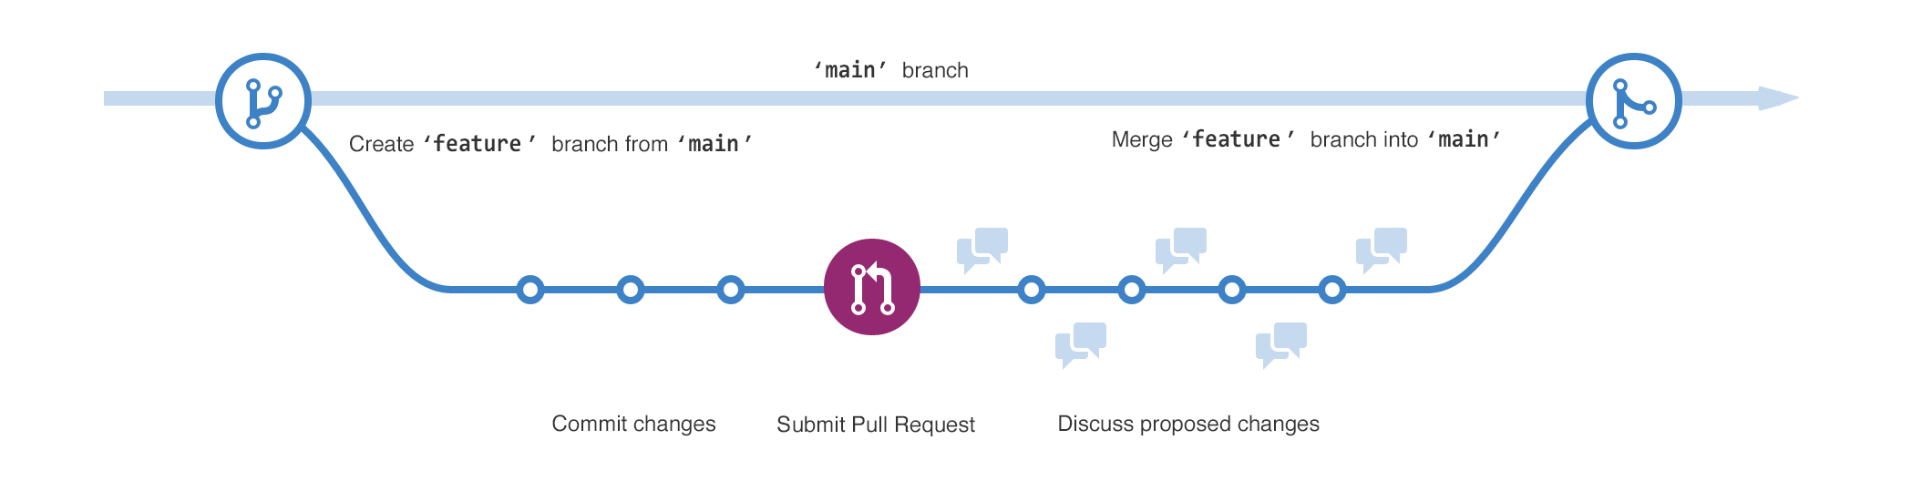
More on Branches
A branch is a parallel version of a repository
Branches allow developers to isolate development work, then merge it together
Two common types of branches are develop and feature
`develop`
`develop`
`develop`
Notes:
Branches are a super powerful tool that make it possible to collaborate with other people in the same GitHub repository. Does anyone remember the definition of a branch?
A branch is a parallel version of a repository
Branches allow developers to isolate development work, and then merge it together
Two common types of branches are develop and feature.
Let’s take a look at this diagram. Here, the develop branch holds the current working team codebase. It is usually the one where the team actively merges their work and creates a “release” for the product. For each new issue, a team member will create a feature branch. They will make some changes, submit a pull request, and discuss any issues with the team through a code review. Once the code is good to go, the feature branch merges into the develop branch. So, what is merging exactly? And what’s a pull request?

Slide 15

Merging takes the changes from one branch and applies them to another.
Notes:
Well, merging takes the changes from one branch and applies them to another. Basically, it’s a way to combine two branches. Merging is often used to pull down the latest changes from the develop branch into a feature branch. It’s also used to add new changes from a feature branch to the develop branch, to get those changes into the codebase. And when does that happen? In a pull request!

Slide 16



Pull Requests & Code Reviews
Pull requests are proposed changes to a repository.
They are usually used to merge a feature branch into the develop branch
`feature`
`develop`
A code review is a discussion of the proposed code changes, designed to ensure quality and high standards
Notes:
Merges into the develop branch are initiated with pull requests.
Pull requests are proposed changes to a repository. This is basically someone saying, “I would like to add my changes to the codebase.”
They are usually used to merge a feature branch into the develop branch.
So when you have a bunch of code that’s ready to go in a feature branch, and you want to get it into the develop branch, you use a pull request. And what actually happens on that pull request?
Well, the whole team can take a look at your changes and perform a code review. A code review is a discussion of the proposed code changes, design to ensure quality and high standards. They are also an opportunity to test if the code actually works how it should. If there’s anything wrong, the developer of the feature branch can create another commit, push to their feature branch, and try again. Once the code looks good to the whole team, they can approve it, and merge it into the codebase!

Slide 17
Typical basic Git Workflow
Developer wants to work on a new feature in the repository
Developer creates a new feature branch in the repository
Developer pushes changes to the feature branch
Team makes changes in the develop branch
Developer merges the develop branch into the feature branch
Developer submits a pull request to the develop branch
Team merges the feature branch into the develop branch
Notes:
Let’s walk through the basic git workflow step by step.
To start things off, let’s say a developer wants to work on a new feature in the repository.
The developer creates the feature branch from their local clone.
Now that they have their own feature branch as a sandbox, they can make changes, and push them up to the server version of the feature branch! Note that this does not affect the develop branch.
Now, say the team is making some changes too. They merge in someone else’s feature branch, so now the develop branch has some new code!
The developer wants to stay up-to-date, so they pull down the latest version of the develop branch, and merge it into the feature branch. This is super important and really helps to avoid merge conflicts.
Now, when the developer feels satisfied with the code in their feature branch, they submit a pull request to merge the feature branch into the develop branch.
The team then reviews the pull request, and when it’s good to go, merges it into the codebase! Note that some of these steps may repeat for one given feature branch; it may be necessary to make additional code changes after the pull request, or merge the latest from develop multiple times.

Slide 18
Typical basic Git Workflow
`develop`
`develop`
`develop`
Notes:
Let’s take a look at this graphic again, and see how it applies to the workflow steps! Note that it does not contain a depiction of new changes from the develop branch merging into the feature branch, but that is also super important.

Slide 19
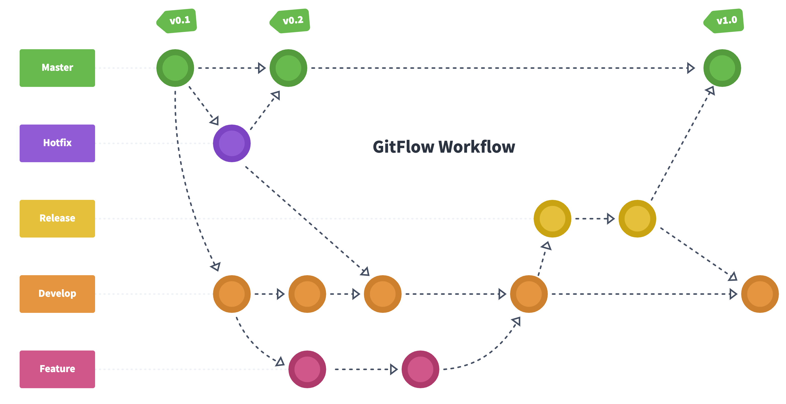
Real world: GitFlow Workflow
Main
Notes:
One quick caveat here – in the real world, using a common paradigm like Gitflow, there are actually a few additional types of branches:
The Main branch is where the actual live production code lives. The develop branch is periodically merged into the main branch through release branches.
Release branches are basically verified snapshots of the develop branch that are ready to be merged into the main branch.
A hotfix branch is one for critical changes that need to be made quick – they go directly to main, and do not stop to pass the develop branch.

Slide 20
Why use Git at all?
If you break something, it’s possible to revive an old version of your code
Git makes it easier for team members to work at the same time
Git is a valuable skill if you want a career as a software developer
GitHub is a great place to showcase code you have written
Contributing to open-source projects can be extremely rewarding
Notes:
So, that was a ton of info! It sounds like GitHub is really difficult to use. It would probably be easier to just use one local version of the codebase, and send code back and forth through email or something. Or maybe use a tool like Replit or VS Live Share to live-edit code collaboratively. So, why is GitHub worth the headache?? Here are just a few reasons.
This will probably never happen because everyone here is a super genius, but.. If you do break something, it’s pretty easy to revive an old version of your code. You don’t have to dig through versions upon versions of files – you can just look through the history and find a point when everything was working!
If you want to work with your team at the same time, but on different features that may touch the same files, git makes this more than possible! Each individual team member can have their own, completely isolated version of the code in a feature branch, and do whatever they want without affecting anyone else. Then, when it’s time, they can merge their changes and other team changes together!
If you have any interest in becoming a professional software developer, or working on real projects, version control will be super important. Git is an incredibly valuable skill to learn – and something that’s not often taught in colleges!
Speaking of a career in software development, GitHub is a fantastic place to showcase work you have completed. Lots of software companies look to GitHub profiles assess a candidate’s proficiency in programming – it’s a great place to show off anything you’ve done. This can be entire projects you made yourself, collaborative team projects, or contributions to other people’s projects!
Speaking of other people’s projects – we won’t get too deep into this, but contributing to open-source projects can be extremely rewarding. Other people made these projects, but anyone in the world can write code for them. Joining the open-source community is a great way to learn new skills by exploring other codebases, and it’s another great resume-builder. All in all, Git is definitely worth learning, and GitHub is definitely worth using!

Slide 21
Questions?
Notes:
Does anybody have any questions!

