Slide 1
Introduction to GitHub
Hy-Tech Club

Slide 2

What is GitHub?
Notes:
Ask the students if they have heard of GitHub or have any idea what version control is

Slide 3
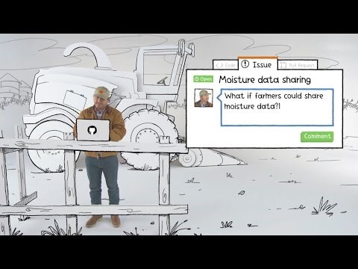
Notes:
This ~4min video introduces GitHub at a very high level, including issue tracking. The idea of the video is to give students an idea of who uses GitHub and how they use it, not introduce them to any technical concepts.

Slide 4
GitHub vs. Git
Git is a revision control system; a tool to manage your source code history.
GitHub is a hosting service for git repositories.
Git is the tool, GitHub is a service for projects that use git.
Notes:
Explain the difference between Git and GitHub. Students may confuse the two, which is understandable. The important thing to remember is that GitHub uses Git.

Slide 5
Essential concepts
A GitHub Repository is like a folder for a project. It contains all of the project files and stores the version history for each file.
A remote repository stores the project files on a server.
A Fork is a repository that was copied from another repository. It allows developers to use/update files from the copied repository without affecting the original repository.
A Clone is a copy of a repository that lives on a local computer instead of on a remote server.
Notes:
Go over some basic Git terminology. The most important part of Git is the Repository. Depending on the context, some courses might use Forks as a way for instructors to deliver code and other materials to students. A Clone is the local copy of a repository that exists elsewhere.

Slide 6
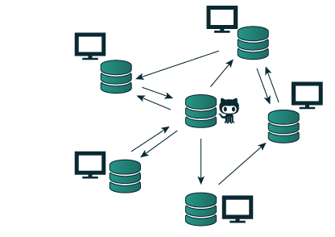
How can github be used in a classroom setting?
Students may create an entirely new GitHub Repository.
Students may create a Fork of an existing repository.
Instructors will use the original repository to deliver lesson materials.
Students will create a local Clone of their repository.
Students will store their work in the server repository.
Students may collaborate using GitHub.
Notes:
Tailor this discussion to the specific needs of the course. Different courses may use GitHub in different ways.

Slide 7
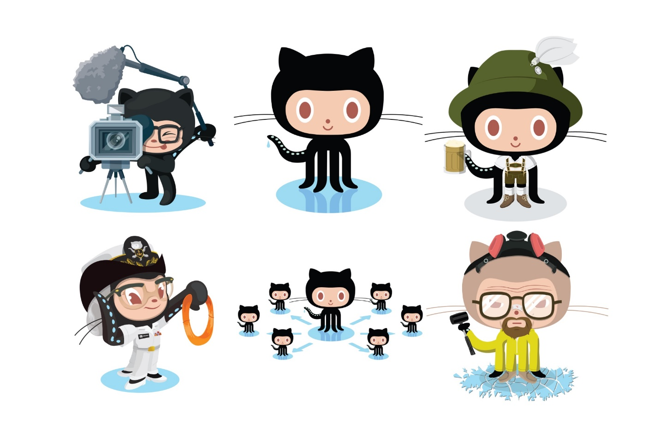
Practice
Fork or Create a repository, then Clone it!
Notes:
Give the students 5-10 minutes to get into GitHub. They should either fork the existing course repository or create a new one, then clone it to their computer. The instructions should be available online for them to follow.

Slide 8
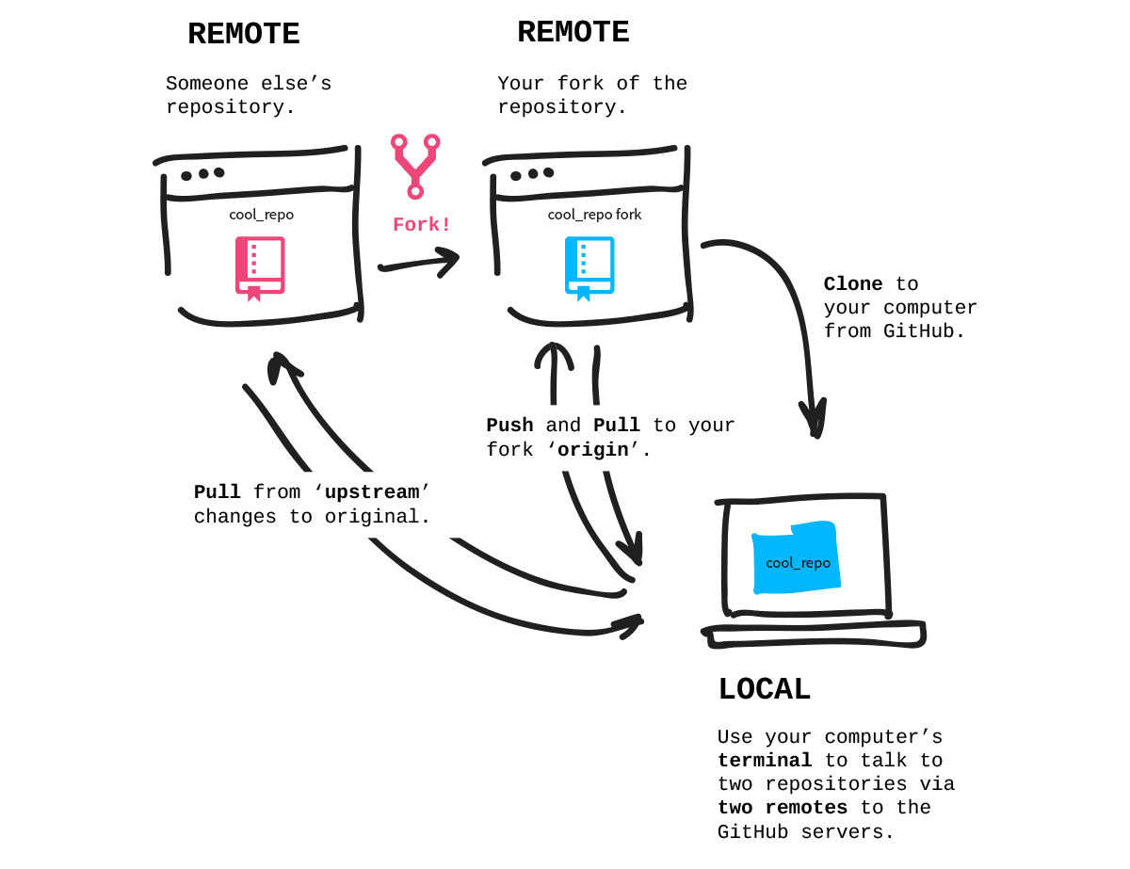
Pushing & pulling
Notes:
So now that a repository exists, how do you actually work with it? How do you add/update files and make sure everything is up to date? Let’s find out.

Slide 9
More essential concepts
A Commit is an individual change to a file or set of files. Committing a change is like saving files, but with messages and tracking.
Pushing sends committed changes from a local repository to a remote repository, such as a repository on GitHub.
Pulling fetches changes from a remote repository and merges them into the local repository.
Notes:
A Commit is like a file save. It keeps track of every change to the file with a message. Commits are made locally but stored remotely after being pushed. They make it possible to revert back if necessary!
Pushing code sends it from the local to the remote, allowing the changes to be stored on the server repository. Remember, the local repository is the clone, and the remote repository is the server.
Pulling fetches changes from the remote and merges them into the clone repository. Again, remember the local repository is the clone, and the remote repository is the server.

Slide 10
git add && git commit && git push
In order to update the files in a repository, it is necessary to add, commit, and push the changes.
Follow these steps:
Make a change in the local repository
Add the change to the staged changes
Commit the change to the local repository
Push the change from the local repository to the remote repository
Notes:
Go over the necessary steps to make a change in the server repository from the clone repository.
Emphasize that local = clone and remote = server.
This applies for regularly-created repositories as well as forked repositories.

Slide 11
git pull
In order to update a local repository with the latest changes from a remote repository, or to merge in changes into a fork from the original repository (called the upstream), it is necessary to pull the changes.
It is possible to:
Pull from the remote repository
Pull from the original repository (upstream)
When pulling changes from the upstream repository, it is necessary to commit and push those changes up to the fork.
Notes:
Go over the purpose and procedure for pulling. Students will either be pulling the latest changes from their own server repository, or from an upstream repository if they have a fork. Be sure to emphasize that changes pulled from upstream must be committed and pushed back up to the fork.

Slide 12
Practice
Push and Pull some changes!
Notes:
Give the students 5-10 minutes to pull some changes down and push changes up. They should either pull from upstream or from their server repository after making some changes online. The instructions should be available online for them to follow.

