Slide 1
GitHub Collaboration
Hy-Tech Club

Slide 2
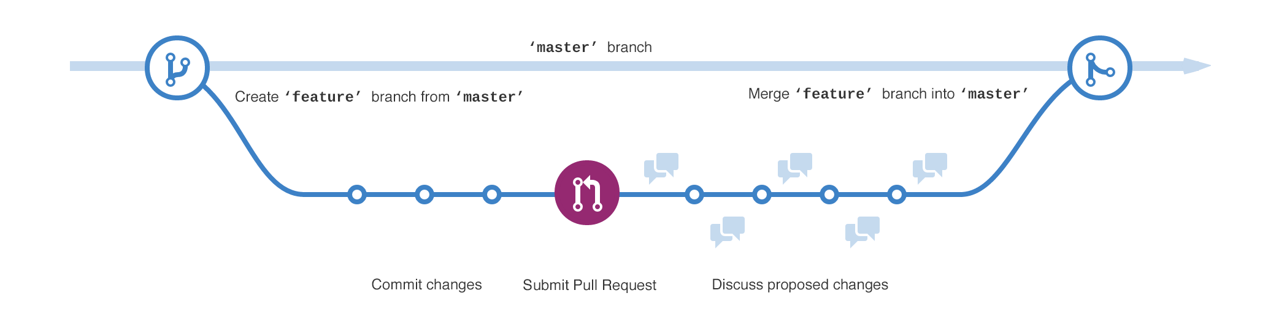
Branches
A branch is a parallel version of a repository
Branches allow developers to isolate development work, then merge it together
Two common types of branches are master and feature
Notes:
Introduce the idea of branching in Git.
The master branch holds all of the “real” code. It is usually the main branch, the one source of truth in a repository.
A feature branch is usually used for development work on features that are in progress. Once the work is complete, the feature branch merges into the master branch.

Slide 3

Merging takes the changes from one branch and applies them to another.
Notes:
Briefly explain merging. It basically means adding changes from one branch to another.
Merging is often used to add new changes from a feature branch to the master branch, or pulling down the latest changes from the master branch into a feature branch.
So how does a merge take place? With a pull request!

Slide 4
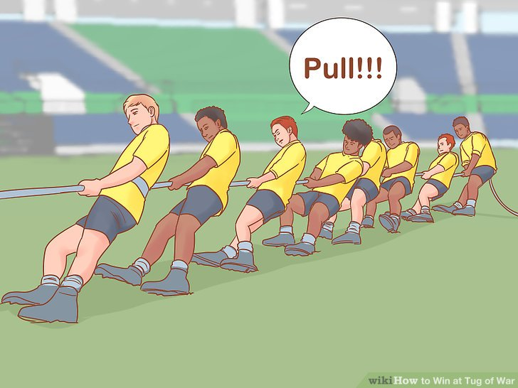

Pull Requests
Pull requests are proposed changes to a repository
They are usually used to merge a feature branch into the master branch
Notes:
Merges are initiated with pull requests. This is basically someone saying, “I would like to add my changes to the repository.” Pull requests can include a number of commits, comments, and discussion. A pull request is complete when the owner of the repository merges it.

Slide 5
Typical Git Workflow
Developer wants to work on a new feature in the repository
Developer creates a new feature branch in the repository
Developer pushes changes to the feature branch
Team makes changes in the master branch
Developer merges the master branch into the feature branch
Developer submits a pull request to the master branch
Team merges the feature branch into the master branch
Notes:
Go over the full workflow of a typical developer.
The developer creates the feature branch and makes some changes in it. Note that this does not affect the master branch.
The blue part: the team makes separate changes in the repository. The developer merges these into the feature branch to make sure all the code is up-to-date.
This is important to avoid merge conflicts
Finally, the developer submits a pull request and the changes are merged into the code.

Slide 6
Typical Git Workflow
Notes:
View a graphic representation of the git workflow.
This graphic does not contain a depiction of changes from master merging into the feature branch, but that is also important.

Slide 7
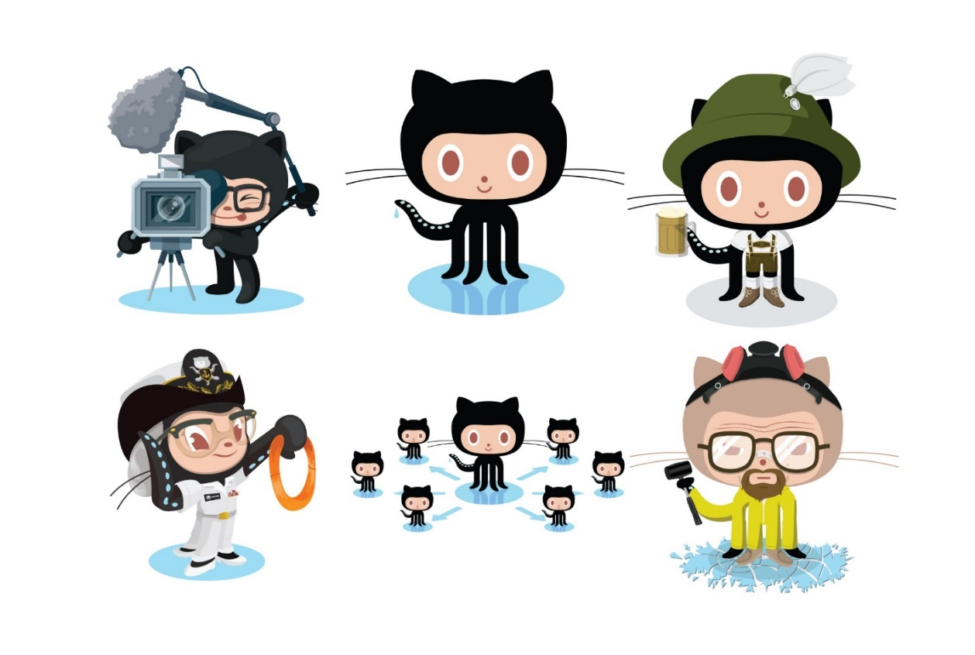
Practice
Play through this interactive tutorial to learn Git branching:
https://learngitbranching.js.org/

