Slide 1
Presentations
Hyland Tech Outreach
Notes:
Hello, and welcome to this presentation about presentations – part 2!

Slide 2
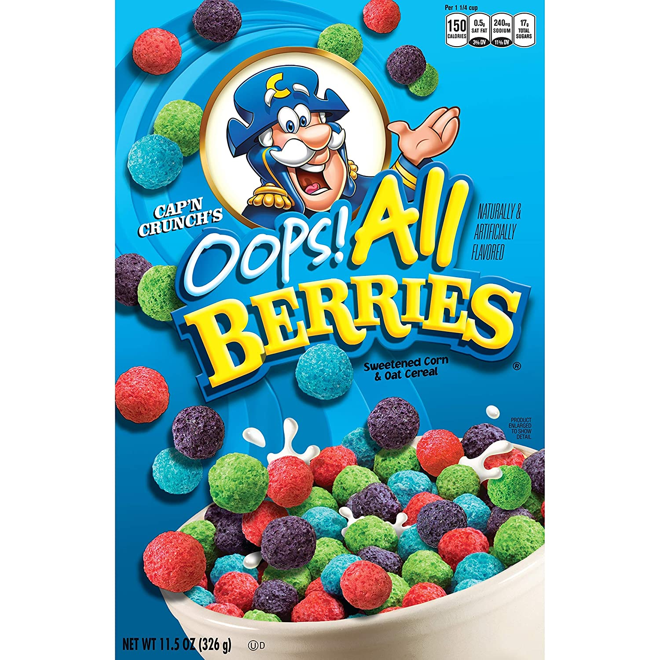
Oops – We Did Bad
The material was real, but it was presented poorly
Let’s try this again
BAD PRACTICES
Notes:
So, you may have noticed… that first presentation wasn’t so great. It was filled with some of things you are not supposed to do.
Some of the material was actually good, but it wasn’t presented very well.
This time, we’re going to try to make as good of a presentation about presentations as we can!

Slide 3
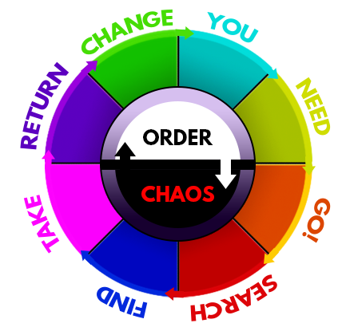
Use Good Structure
Introduce yourself, provide background information
Agenda
Tips for Good Presentations
Best Practices for Demos
Have a good arc + flow between parts
Notes:
One of the most important things is to create a good structure for your presentation. What does that mean?
Well, you always want to start with introductions. Let people know who you are, and give them context for what you’re doing. You may also want to provide an agenda slide to let everybody know what you’re covering.
For example, this presentation is going to give you some tips for good presentations, and some best practices for demos.
You’re also going to want to have a good arc and flow in your presentation. Has anyone heard of Dan Harmon? Creator of Community and Rick & Morty? He made this thing called the story circle
Giving a presentation is a lot like telling a story. You need a beginning, middle, and end, and you need to flow well between each part! Speaking of the next part… another thing you’ll need to do in storytelling or presentation-giving is keep the attention of your audience!

Slide 4

Prepare Compelling Materials
You don’t want your slides to look like this. And you don’t want to just stand there reading directly off of your slides. Unless you’re going for a very specific aesthetic or trying to prove a point like I’m doing right now. But you probably don’t want to do that, so you should just avoid this in general.
Dont spel thigs rong – bee profensional
Notes:
To do that, you’ll want to have some compelling materials.
You want to grab your audience with colors, pictures, animations, whatever! Make your materials stand out.
In addition to this, you want to prepare and fully understand your materials. You don’t want to be reading off the slides, and you don’t want the slides to be a big jumble of full sentence text!
You also want to have a high attention to detail – make sure to avoid typos so your presentation looks professional!

Slide 5


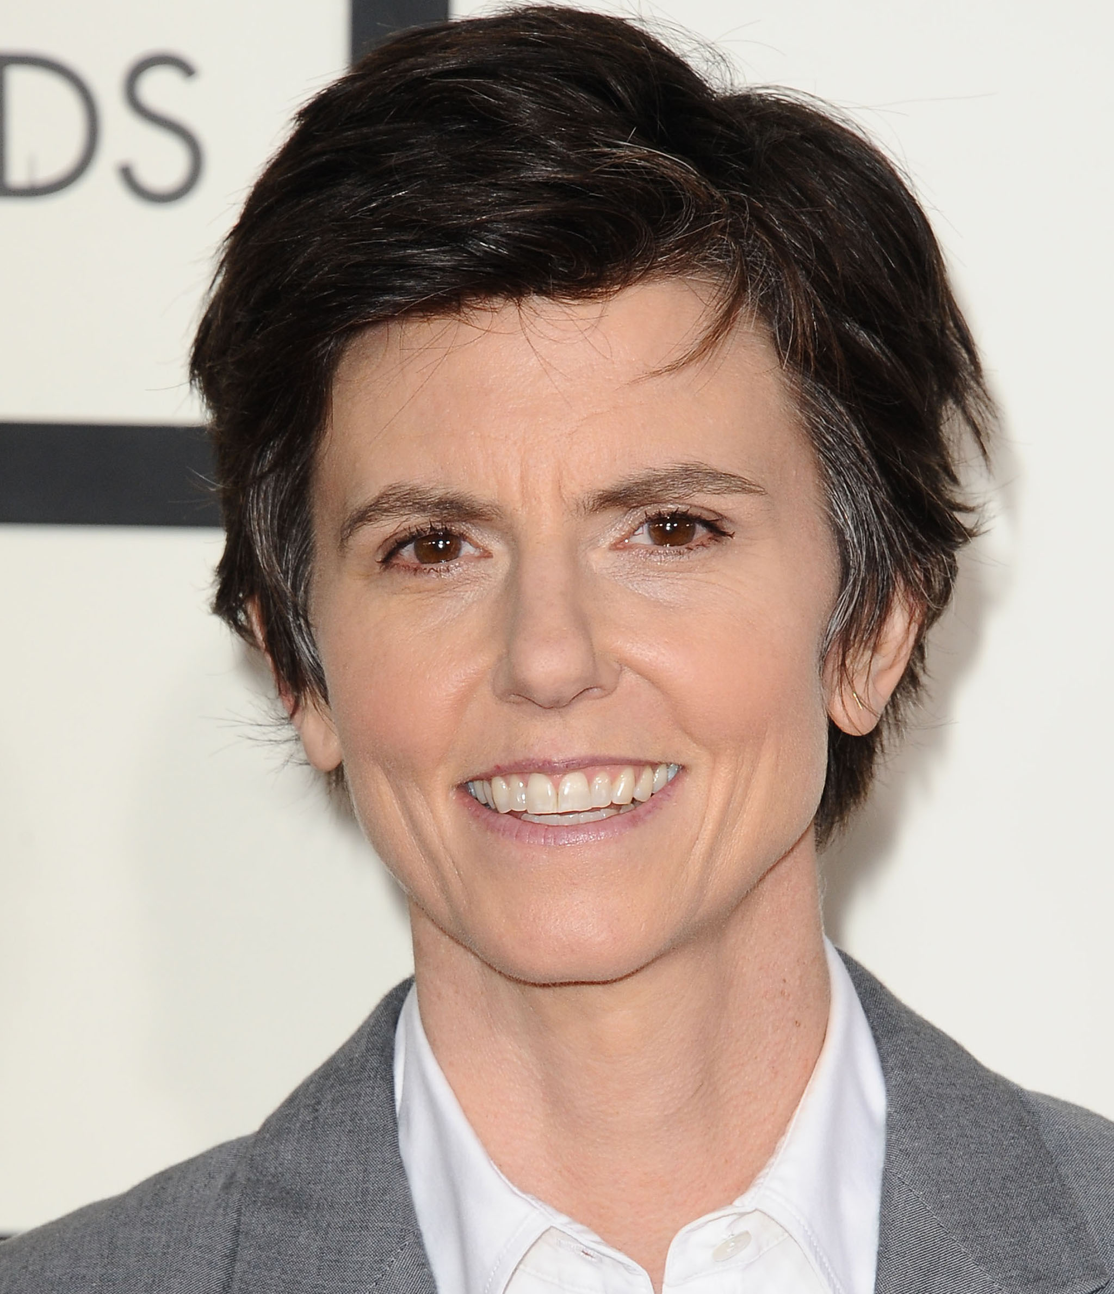


Own The Stage
Interact with your audience
Develop your voice,
Be comfortable
Notes:
Alright, so you’ve got a good presentation prepared… now you have to actually present it. Anybody have a favorite stand-up comedian? What’s one thing all good stand-ups have in common? They all own the stage!
Here are some good stand-up comedians and my friend Joe (top left). Joe used to be the number one result when you searched for “comedian headshot” on google images. Now he’s like number 5 or something. But the important thing is that all great comics can command their audience.
Here’s an example of a joke told by the late great Mitch Hedburg. [play clip]
Everybody has a different voice. You don’t have to be loud or energetic. You just have to develop your own voice, and feel comfortable up there. Now, what’s one of the first things I did on this slide? I asked a question!
You always want to keep the audience in mind. For whom are you presenting? Know who they are and interact with them! Speaking of interacting… what do you think I’m going to cover next? Something totally different!

Slide 6
Follow Best Practices for Demos
Keep the process interactive – ask for input and allow space for questions
Use proper example data, not gibberish – this helps show how someone would actually use your software
Always explain what you’re doing as you’re doing it – keep your audience with you!
Make sure your code is ready to go and free of bugs – even if you have to fake it!
Notes:
Now let’s talk a little bit about demos. These can be the toughest parts of the presentation, because so much can go wrong! Here are some tips to make a good demo. The first one should be familiar –
You’re going to want to keep the whole process interactive. Ask the audience what should be entered, and allow space for them to ask questions if they have them.
Next, you’re going to want to explain what you’re doing – don’t just do things without talking! You want to both show AND tell. This will help keep your audience with you along the way.
Another big one – use proper example data. You don’t want to just enter in 23r90u893p4hfph – you want to show how someone would really use your product.
Lastly, and this is maybe the most important – make sure your code is ready to go! Don’t show off buggy code, as much as you can. At the very least, you should know the limitations of your current product. And if you have to… you can always fake something working, like mock up a database without creating a real one. This will help you show off your product’s functionality even if it’s not actually fully functional yet. Now, for the last piece of advice, the closing thought…

Slide 7
Be Clear & Concise
Just do it. The end
Notes:
The last piece of advice – don’t overcomplicate things. Keep it simple.
Just do it. That’s it!

Slide 8
THANK YOU!
WHAT QUESTIONS DO YOU HAVE?
Notes:
Now, does anyone have any questions?

