Slide 1
Software Development Teams & Processes
Hyland Tech Outreach
Notes:
Hello, and welcome to this presentation about Software Development Teams and Processes!

Slide 2
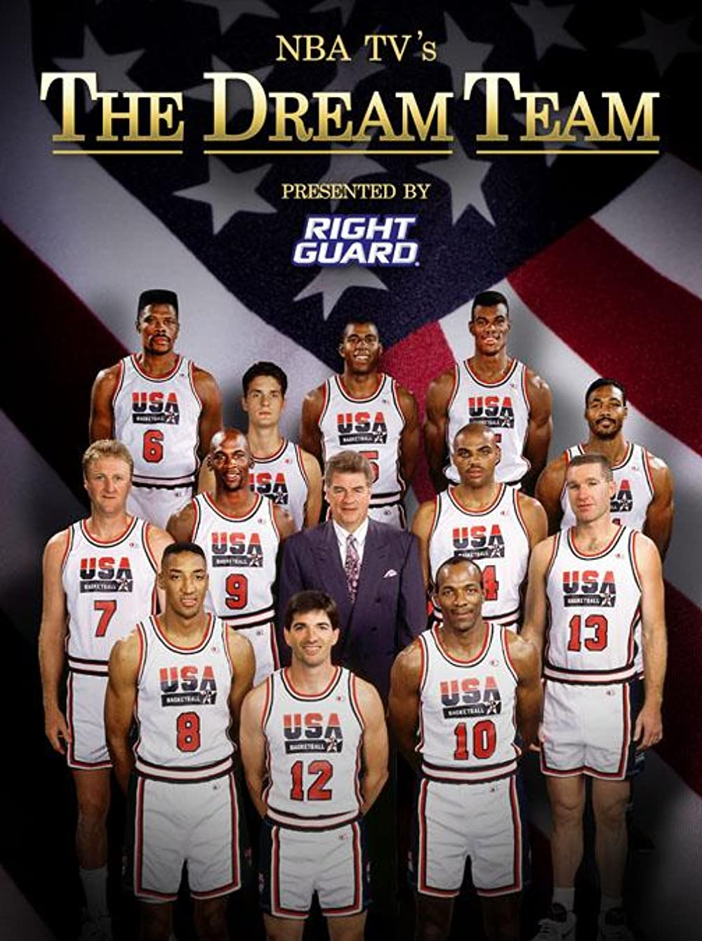
Software Development Teams
Software Development Teams work together to build a software project.
Every team is different, and there are dozens of philosophies, methodologies, and paradigms, but for the purposes of this lesson…
Autonomous: Teams are self-governing and self-directing
Cross-functional: Members have different functional expertise
Notes:
To start things off, what is a software development team?
Put simply, software development teams work together to build a software project.
Now, every team is different… but at many software companies like Hyland, teams share some characteristics.
Teams are autonomous – which means they are self-governing and self-directing. Basically, they decide how best to work together and complete tasks.
Teams are also cross-functional – this means that team members have different specialties and have specific roles. So, what are some of those roles?

Slide 3

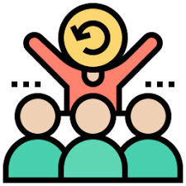





Software Development Roles
UI/UX Designer
Scrum Master
Quality Assurance
Stakeholder
Want the product; provide feedback
Design the product; look & feel & flow
Organize the team; help them function
Test the product; make sure it works
Software Architect
Product Owner
Software Developer
Plan the technical aspects of the product
Guide the product; decide on features
Make the product; write and review code
Notes:
As mentioned before, there are many ways to organize a software development team. That said, most teams will have at least some of these roles.
The most basic role isn’t actually someone on the team – it’s the stakeholder. This is typically a customer or end-user – someone who wants the product. Stakeholders provide feedback throughout the process to ensure that the team is actually building what they want. But how do they make their dream product into a reality?
The product owner is someone who guides the product itself. They listen to the stakeholder and figure out what’s most important in the product – they then help define and prioritize work for the team at the product level. Basically, they turn the dream of the stakeholder into a list of specific features.
The software architect takes that list of features and figures out how to implement them in the grand scheme of things. They are responsible for choosing the technologies, paradigms, and overall view of the product. Basically, they plan out the big picture of how to develop the nuts and bolts of the product.
The ui/ux designer is responsible for the actual user-facing design of the product. Does anyone know what UI or UX stand for? UI stands for User Interface, and UX stands for User Experience. They design how things will look and feel and flow – they always have the end users in mind and try to create the best possible experience for them.
After a whole lot of planning from all of those people, the software developer is responsible for actually making the product. They write the code, and review code from their fellow software developers.
Unfortunately, software developers are not always perfect; they need some quality assurance. These people are responsible for testing the product; they have to make sure it works and does exactly what it is supposed to do. Some testers do manual testing, where they act as if they are end-users; other testers write code that runs automated tests.
There is one more important role here: the scrum master. This person is responsible for organizing the team and doing anything they can to make sure the team functions as efficiently as possible. But does anyone know what scrum means? We’ll talk about that on the next slide 🙂

Slide 4
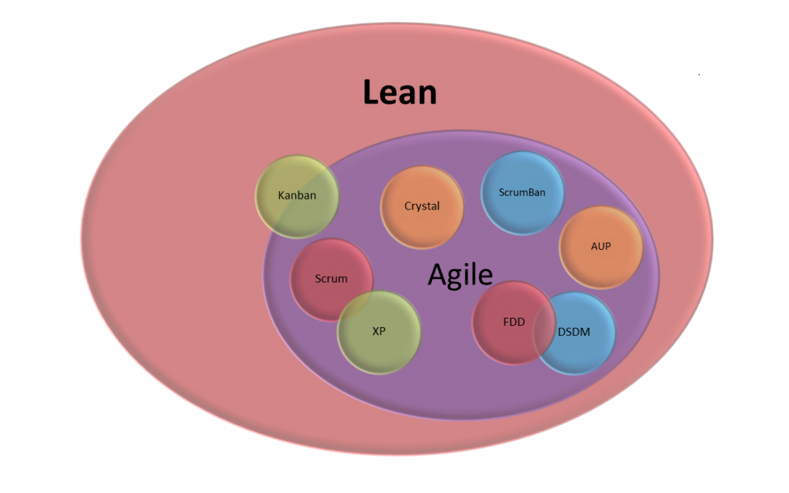
Development Methodologies
How does a team develop software?
so many overlapping paradigms, philosophies, and methodologies…
Agile, Scrum, Lean, DevOps, Waterfall, Kanban, more
Notes:
So, we have the team assembled, but how do they actually develop software?
Well, there are a ton of different ways to do it…
Lots of overlapping paradigms, philosophies, and methodologies… basically, lots of ways to plan out the projects and actually complete the work.
There are things like Agile, Scrum, Lean, DevOps, Waterfall, Kanban, and more… we won’t talk about all of these and what they mean, but they all relate to the process around which software is developed.

Slide 5



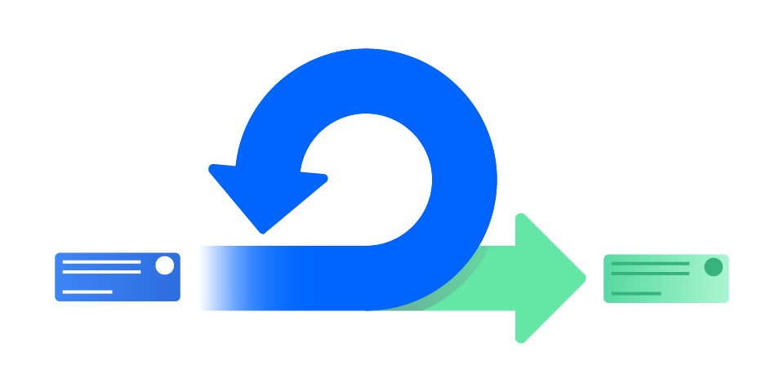

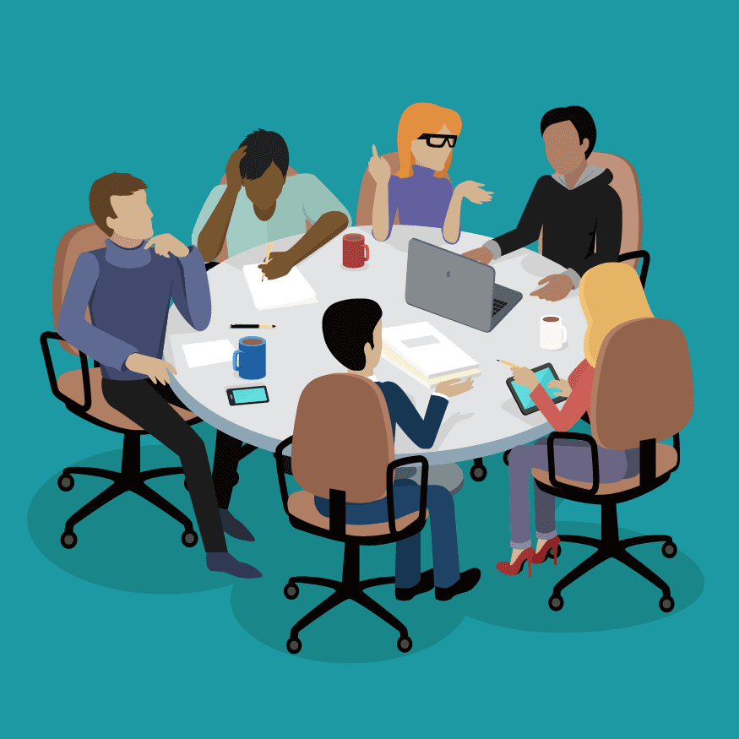
Agile/Scrum*
*ish
Stand-Up
Daily - discuss yesterday’s work, today’s work, any roadblocks
Sprint Review
End of Sprint - demo the completed work
Short, time-boxed period when a team completes a set amount of work
~2wks
Sprint Restrospective
After Sprint - talk about what went well, what went poorly, how to improve
Sprint Planning
Start of Sprint - decide what to do during the sprint period
Notes:
Let’s take a look at the basics of Scrum (ish), which is under the broader Agile philosophy.
In scrum, there are these things called sprints – they are short, time-boxed periods when a team completes a set amount of work. They are often two weeks long. You can basically think of these as two week chunks when people have some work they’re trying to accomplish.
These sprints kick off with a sprint planning meeting. This is where the team decides what to do in the next time block. They have a prioritized list of tasks, and figure out what they can accomplish in two weeks as a team.
Every day during the sprint, there is something called a stand-up; it’s a quick meeting where everyone on the team talks about what they did yesterday, what they are doing today, and any roadblocks they have. This helps everybody on the team stay on the same page with the pace and progress of the sprint.
At the end of the sprint, the team holds a sprint review. This is where they demonstrate the work they completed during the sprint. Stakeholders might be present for these demos; the team gets to show off all the great work they did!
After the sprint, teams will often hold a retrospective. The purpose of these is to figure out how to improve for the next sprint. They talk about what went well, what went poorly, and anything they want to start doing for next time. All of these scrum rituals can be very valuable to help the team achieve the best possible outcome for their project!

Slide 6
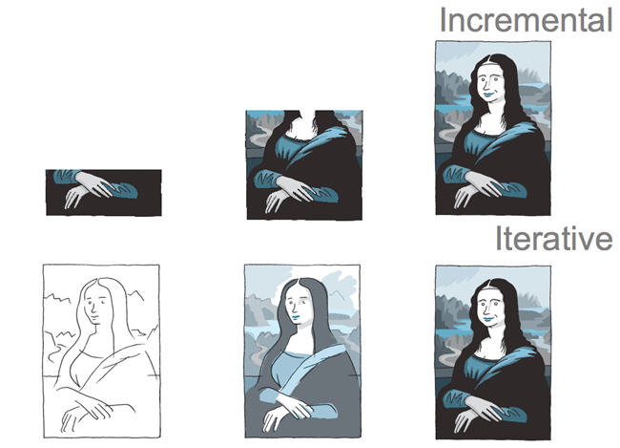
Incremental and Iterative
Incremental: Fully flesh out one small part of a product at a time
Iterative: Build an entire product, and then work on fleshing it all out
Both: Iterate incrementally
Notes:
Within the agile frameworks, there are two important styles of development to consider: incremental and iterative.
In incremental development, the team fully creates a small part of a product. This may not be a fully working product, but it is fully fleshed out and complete. From there, they move onto another small piece, and fully flesh that one out.
In iterative development, the idea is to build an entire product, but only the bare bones of it. From there, they work on filling in the gaps and fleshing out the whole project.
It looks kind of like this picture of the Mona Lisa. You can also think of someone writing a screenplay – you could write out the whole first scene, and fill in every line of dialog, get feedback, and then move onto the second scene… or you could outline the whole story and act structure, and then go back and fill in the details. Which do you think is better? Iterative or incremental?
In truth, agile sort of uses both of these ideas together. The product is broken down to as many small increments as possible, and then each iteration works on creating and improving those increments.

Slide 7
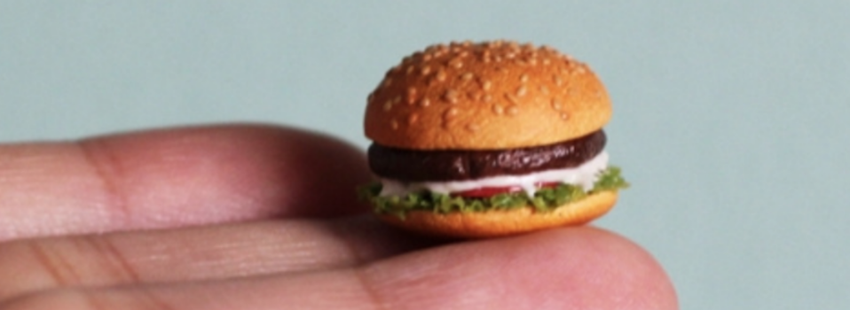
Iteration & Feedback
Get the right feedback at the right time
Break down the needs of the project into small, manageable increments
Each iteration should be focused on improving the product in specific, testable ways
Spend 10 minutes drawing up a mockup
Show it to a stakeholder
They hate it
Spend 10 hours working on a prototype app
Show it to a stakeholder
They hate it
A
B
better→
FAIL FASTER
Notes:
Let’s talk a bit more about iteration, and the role of feedback.
The first step for iteration is to break down the needs of the project into small, manageable increments.
Then, each iteration should focus on improving the product in a specific, testable way. Keeping the iterations small makes it much easier to complete each individual part. But how should the team incorporate feedback?
It’s super important to get the right feedback at the right time. Imagine two scenarios:
In case A, you spend 10 minutes drawing up a mock-up of your application.
In case B, you spend 10 hours writing some actual code and building a prototype of your application.
In either case, you show what you’ve built to a stakeholder…
And, it turns out, they hate it. Now, which of these scenarios is better?
The better one is case A, because you didn’t waste 10 hours on something that isn’t ultimately useful!
The big lesson here is that it’s important to fail quickly. This way, you can adjust and make things better before getting too deep into something that’s going nowhere.

Slide 8
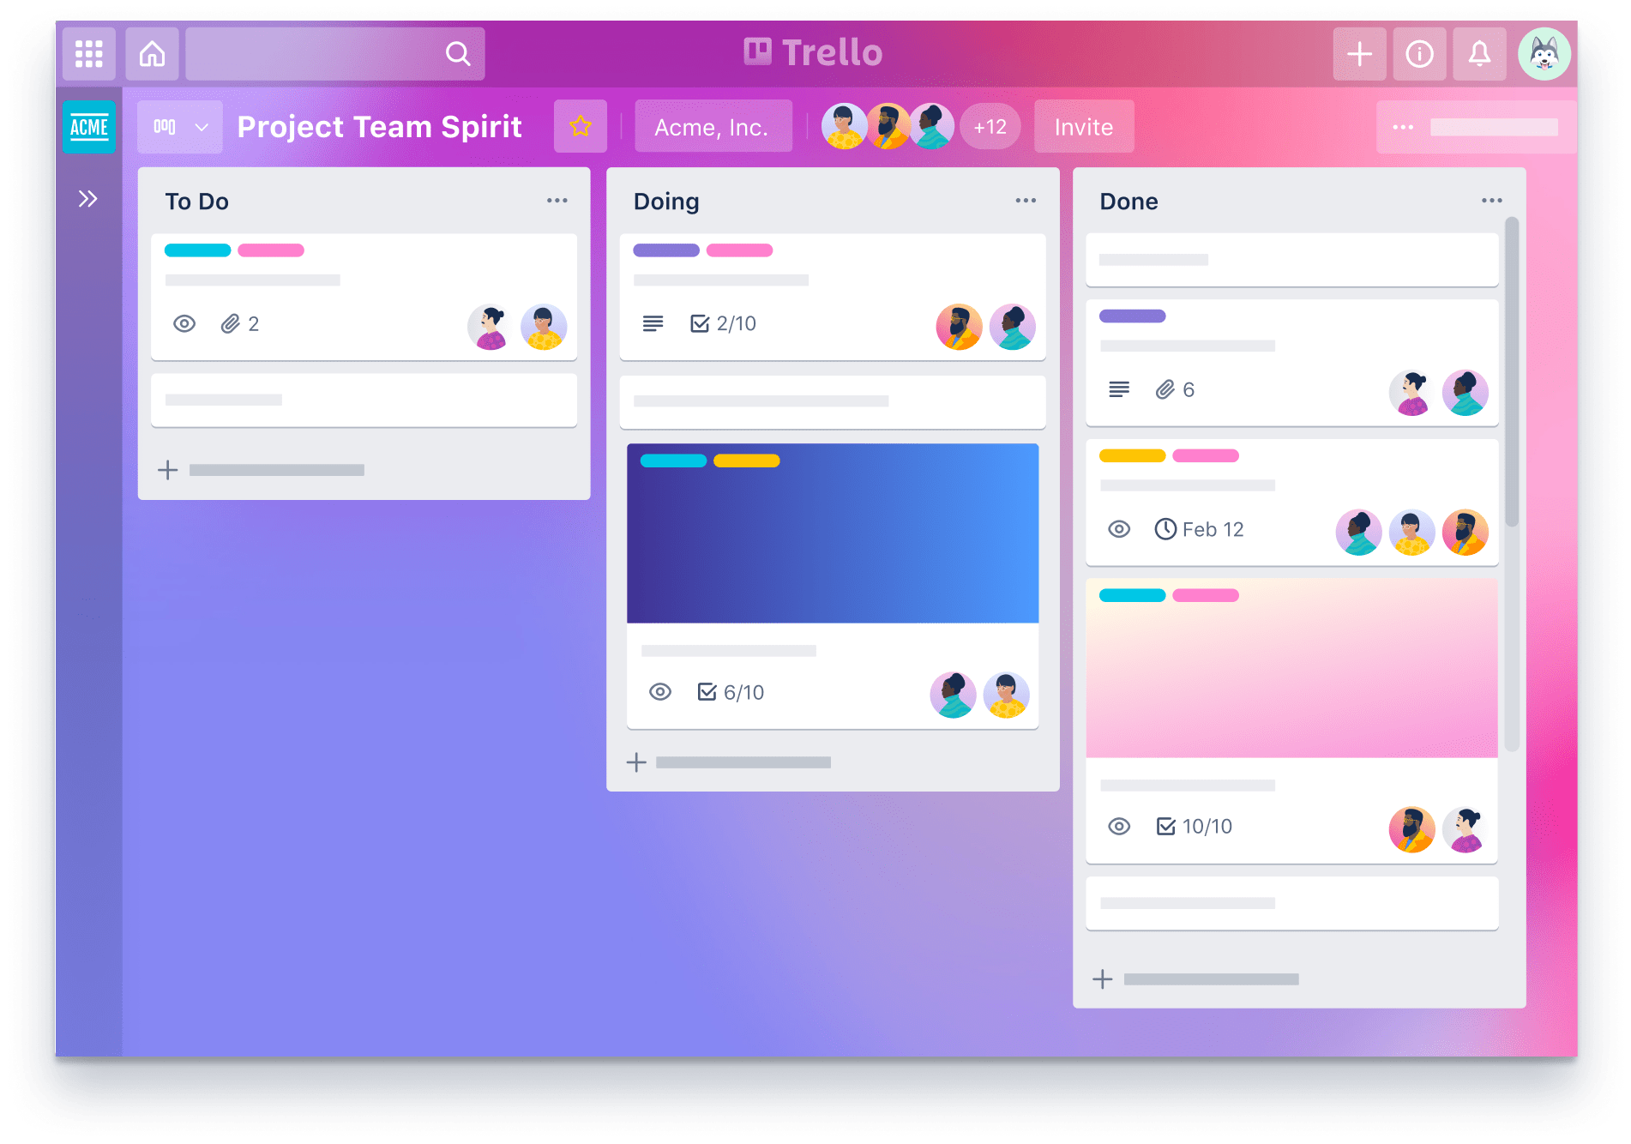
Tracking Work
Issues | Stories | Tickets | Cards
Units of work (2-4 hours)
Features or bug fixes
Status: To Do, Doing, Review, Done
Kanban(看板)
Agile method
Cards pulled from one status to the next
Continuous improvement
Trello has Kanban boards
Notes:
Now, after you’ve done a lot of planning and maybe some mock-ups, you’ll want to start working.
There are things called issues, or stories, or tickets, or cards – they are all synonymous.
Basically, these are just ways to represent units of work – optimally about 2 or 4 hours worth of work
These could be new features, or bug fixes
Each of these cards has a status; something like To Do, Doing, Review, or Done
These different lanes and statuses are part of a process called Kanban
This is a method that falls under the agile philosophy
It’s very simple; cards get pulled from one status into the next, and allow the team to track every piece of work at a glance
The goal of Kanban is to allow for continuous improvement of the process. It’s easy to see if there are bottlenecks or other issues.
There is an online tool called Trello that uses Kanban boards to track cards through custom statuses. Trello is a simple free tool, and it’s great for simple project management.

Slide 9
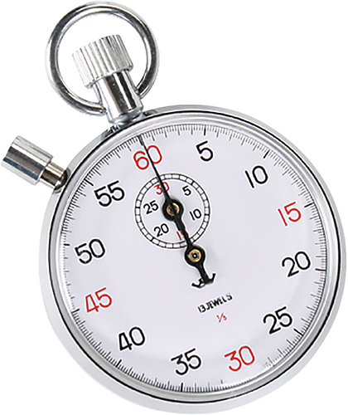
Agility Activity – Part One
1
2
3
….
49
50
1
2
3
….
49
50
Get out a pen and paper
When the stopwatch starts, write out the numbers 1-50 in a vertical column – then add another column
Record your time!
Notes:
So we’ve talked a bit about some Agile methods (like Scrum and Kanban), but let’s do a quick activity to get to the heart of what it means to be agile.
Use an online stopwatch for the activity (e.g., https://www.online-stopwatch.com/). Students should follow the instructions on the screen.

Slide 10
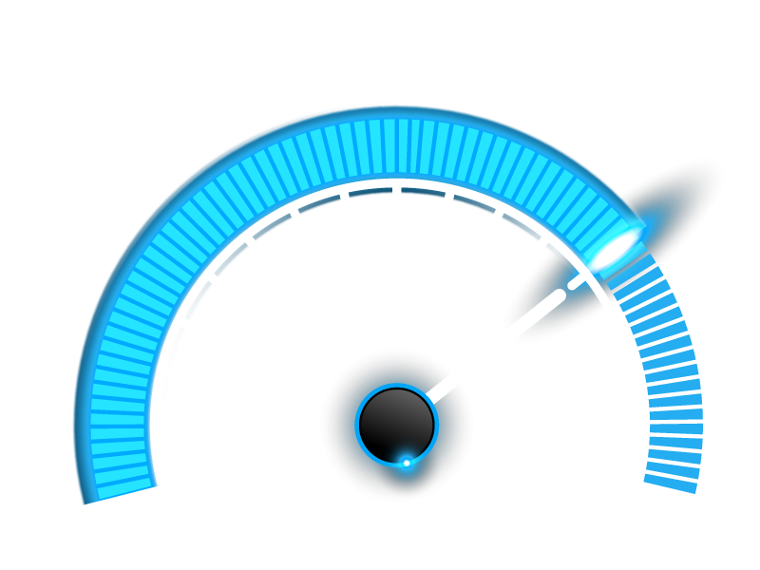
Agility Activity – Part Two
1
2
3
….
49
50
1
2
3
….
49
50
Now when the stopwatch starts again, write out each number twice horizontally in one column
Compare your speed!
Notes:
Alright, now for part two.
Use an online stopwatch for the activity (e.g., https://www.online-stopwatch.com/). Students should follow the instructions on the screen.

Slide 11

Agility Activity – Discussion
Which one was faster?
What if halfway through, you found out you only had to count to 25?
Agile lets you focus on completing useful units of work in a timely way
Notes:
So, how many of you were faster the first time? How many were faster the second time? Interesting!
Here’s an idea – what if halfway through, you found out you only had to count to 25 for each column? Which of these methods would allow you to adapt to that?
This gets to what agile is all about – the focus is completing useful units of work in a timely way. It’s more of a mindset than a method, but it can be quite helpful.

Slide 12
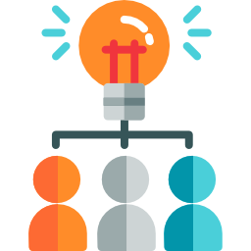

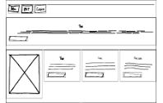
Project Planning
1. Decide on a Project
2. Create Requirements
The project should solve a problem
It should be feasible
It should be something fun
These are the fundamental features of the product
They should be as detailed as possible
Create wireframes for each screen
Create a flow to describe what happens behind the scenes as well
3. Sketch out Screens
Notes:
Alright, so you have your team, you have your process; how do you actually get into your project?
The first step is to decide on a project! It might seem easy, but there are some things to consider.
The project should solve some sort of problem that exists; or create a positive experience for its users
It should be something you can actually complete
And, you’ll do better and learn more if you have fun, so make it something where you can explore a passion of yours if possible!
Once you have a great project idea, you’ll want to outline the requirements for it
Requirements are the fundamental features of the product. What should the user be able to do?
The requirements should be as detailed as possible – this will help a lot when actually building the application
After the requirements, it’s time to start tackling some of the UX, and sketch out the screens
A good place to start is to create wireframes for each screen. These are simple outline diagrams that do not have specifics – they are just used for reference
It’s also important to create a flow and explain (in detail) what happens behind the scenes. All of this planning may not seem fun, but it is crucial to the success of the project. To drive home that point, let’s dive into the second step here a little more…

Slide 13

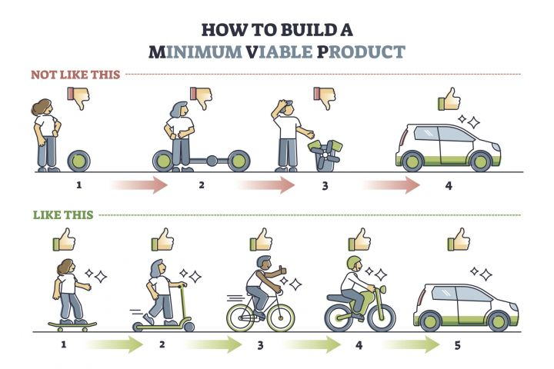
Product M.V.P.
2. Create Requirements
A version of a product with just enough features to be usable
Figure out the highest priority features, and work on those
Create something demo-able, even if it’s not releasable
Minimum Viable Product
Notes:
When creating requirements for a project, it’s important to focus on an MVP.
Does anyone know who this is? It’s Kevin Durant, famous recipient of the NBA’s MVP award. But does anyone know what MVP stands for in the software development world?
It stands for Minimum Viable Product.
Basically, it’s a version of the product with just enough features to be useable. No frills, no nice-to-haves, but fully functional and solving the problem it is meant to solve.
To come up with an MVP, the team should play the role of product owner and figure out the highest priority features. The ones that make or break the product.
An important thing is that you want what you create to be demo-able. A stakeholder should be able to see it and appreciate what it does. This does not mean it has to be perfect; as long as it is workable.
Here’s a little diagram showing this example – imagine building a car. You can start with the whole giant perfect product in mind, and start by building just a wheel – but you can’t actually use that wheel. Another idea would be to start smaller, with something like a skateboard – it’s much easier to develop, and solves the same problem as the car (gets you from A to B). If you choose the MVP route, you can get much more feedback faster (which is super important), and you can actually demo a full product. Defining a clear MVP will help focus your work, and lead you to great success.

Slide 14
THANK YOU!
WHAT QUESTIONS DO YOU HAVE?
Notes:
Alright, that’s it for the presentation. Thank you!

