Slide 1
Boolean Operators
Hy-Tech Club: C# 101

Slide 2
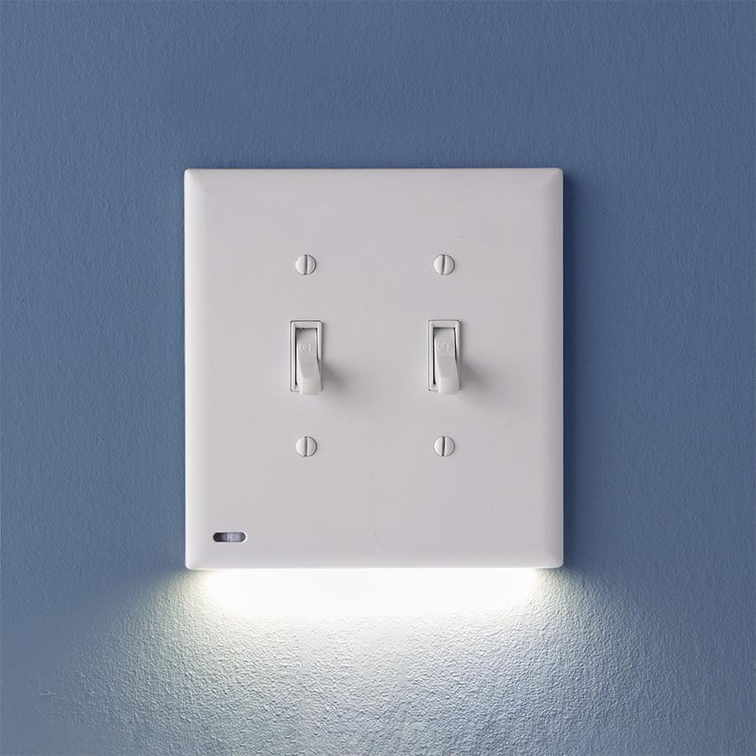
Review: What is a boolean?
A boolean is a form of data that can be true or false.
Notes:
Ask this question to a student and see if they can answer.
Boolean values can be either true or false.
This is like a light switch; they can be on or off.

Slide 3
Combining Booleans
What things are red OR blue?
What things are red AND blue?
What things are red and NOT blue?
Notes:
Ask the students for examples from each of the categories.
red OR blue: either one makes this true
Fire trucks, the sky
red AND blue: has to contain both colors
3D Glasses
US Flag
red and NOT blue: cannot contain blue
Apples

Slide 4
Boolean Operators
red || blue
This will be true if red OR blue are true
red && blue
This will be true if red AND blue are true
!blue
This will be true if blue is NOT true
Notes:
Show the syntax for the different operator types.

Slide 5
Mini-Quiz: True or false?
true && false
False
Notes:
Ask this question to a student, then reveal the answer.

Slide 6
Mini-Quiz: True or false?
false || !false
True
Notes:
Ask this question to a student, then reveal the answer.

Slide 7
Mini-Quiz: True or false?
!(false && true)
True
Notes:
Ask this question to a student, then reveal the answer.

Slide 8
Mini-Quiz: True or false?
!true || false
False
Notes:
Ask this question to a student, then reveal the answer.

Slide 9
Mini-Quiz: True or false?
2 > 3 || 3 < 3
False
Notes:
Ask this question to a student, then reveal the answer.

Slide 10
Mini-Quiz: True or false?
"Hi" != "Hello"
True
Notes:
Ask this question to a student, then reveal the answer.

Slide 11

English Examples of boolean logic
If it is rainy and I have $10, I will go to the movies
If it is snowy or it is below freezing, school will be cancelled
If it is not sunny, I will stay inside
Notes:
These are everyday examples of boolean logic.
Ask the students if they have any other examples like this using and, or, or not.
Ask the students to help translate these statements into code on the whiteboard. The answers are on the next slide.

Slide 12
Code
if (weather == "rainy" && money >= 10) {
Console.WriteLine("I'm going to the movies");
}
if (weather == "snowy" || temp < 32) {
Console.WriteLine("Snow day!");
}
if (weather != "sunny") {
Console.WriteLine("Inside");
}
Notes:
These are code translations of the English sentences.

