Slide 1
Variables & Data Types
Hy-Tech Club: C# 101

Slide 2
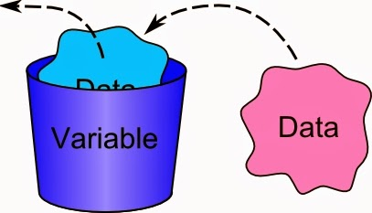
What is a variable?
A variable is a named location in the computer’s memory.
Notes:
This is the textbook definition of a variable. But what does that really mean?

Slide 3


Analogy: a person’s age
How old are you?
I am 32 years old!
spongeBobAge: 32
It’s my birthday! I’m 33 now!
spongeBobAge: 33
Computer
User
Notes:
This example helps illustrate how variables are used.
Sandy asks SpongeBob how old he is
Allow the students to guess how old SpongeBob is
SpongeBob says he is 28 years old
Sandy then remembers his age as 28; she is storing this in her memory with the name spongeBobAge
SpongeBob has a birthday and turns 29
Sandy updates the spongeBobAge variable in her memory so that it is accurate
In this example, Sandy is like the computer, and SpongeBob is like the user. The spongeBobAge variable could have any value – but Sandy knows

Slide 4
Variables in C#: Declaration and assignment
int spongeBobAge = 32;
int (data type)
spongeBobAge (variable name)
= (assignment operator)
32 (value assigned to variable)
; (end of the statement)
Notes:
This code declares a variable and assigns a value to it. This is basically the program saying “I need to remember this name has this value.”
The first part of a variable declaration is the data type. We will talk about data types later.
After the data type comes the variable name. This is what the program will need to refer to the value (which could change)
The equals sign is used for variable assignment. It means, this name has this value
The value is the actual data for the variable. This is subject to change, like when SpongeBob has a birthday.
The semi-colon goes at the end of every command

Slide 5
Mini-Quiz: What would the user see?
string name = "Patrick";
Console.WriteLine(name);
Patrick
Notes:
Ask this question to a student. They may think the user would see “name”, but since name is not in quotes, and it is a variable, the user will see the value of the variable!

Slide 6
Mini-Quiz: What would the user see?
double squidwardWage = 5.15;
squidwardWage = squidwardWage + 2.10;
Console.WriteLine(squidwardWage);
7.25
Notes:
Ask this question to a student. This one is a little tougher. The value is first set to 5.15, and then it increases by 2.10, so ultimately it becomes 7.25.
Squidward makes minimum wage.

Slide 7
Different types of data
What type of data was SpongeBob’s age?
A whole number (integer)
What type of data was Patrick’s name?
Text
What type of data was Squidward’s wage?
A decimal number
Notes:
Students may have noticed that the variables had different types. Ask the students what those types were.
SpongeBob’s age was an integer (a whole number)
Patrick’s name was text
Squidward’s wage was a decimal number

Slide 8
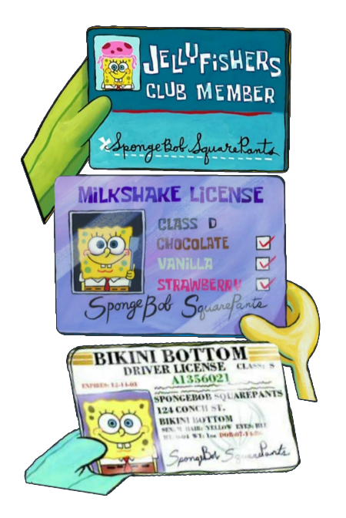
Data Types
In C#, variables have data types that tell the program what they contain. Different types of variables are stored differently, and have different abilities.
There are many data types in C#, including:
int (whole numbers)
string (text values)
double (decimal numbers)
bool (true or false values)
Notes:
Explain that data types let the program interact with variables differently based on the information they contain. Data types tell the program how much space to allocate in memory.
Ask the students to think of examples of each of the data types on a driver’s license.
int: weight
string: name
double: height
bool: organ donor

Slide 9
Data types examples
int weight = 1;
double height = .6;
string name = "SpongeBob";
bool organDonor = true;

Slide 10
Mini-Quiz: What’s the data type?
"Ice Cream"
string

Slide 11
Mini-Quiz: What’s the data type?
1.0
double

Slide 12
Mini-Quiz: What’s the data type?
17
int

