Slide 1
Conditional Statements
Hy-Tech Club: C# 101

Slide 2
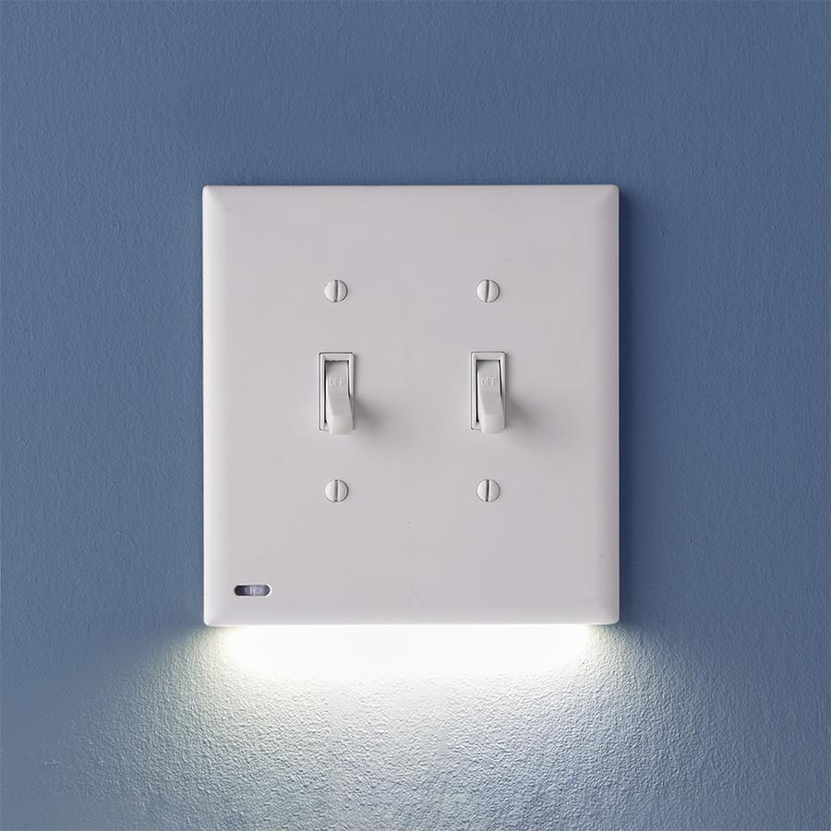
Review: What is a boolean?
A boolean is a form of data that can be true or false.
Notes:
Ask this question to a student and see if they can answer.
Boolean values can be either true or false.
This is like a light switch; they can be on or off.

Slide 3
if Statements
if statements let programs behave differently based on boolean values.
For example, think of a program for a light switch. If it is up, the light is on. If it is down, the light is off.
Notes:
Explain the purpose of if statements. Use the light switch as an example.
Note that it can be helpful to read an if statement just like a sentence in English. They are fairly literal.

Slide 4
if Statement Code
if (switchOn) {
Console.WriteLine("Light!");
}
if keyword
Parentheses
switchOn – Boolean expression
Curly brackets – body
Console.WriteLine – statement
TIP: Read if statements like English sentences!
Notes:
Show the syntax for an if statement. Explain each part of the syntax.
Every if statement has to start with the word “if”
After the “if” comes parentheses surrounding the condition
The condition is a boolean expression between the parentheses
Open and closing curly brackets wrap the body of the if statement
Console.WriteLine is the statement that will run if the condition is true

Slide 5
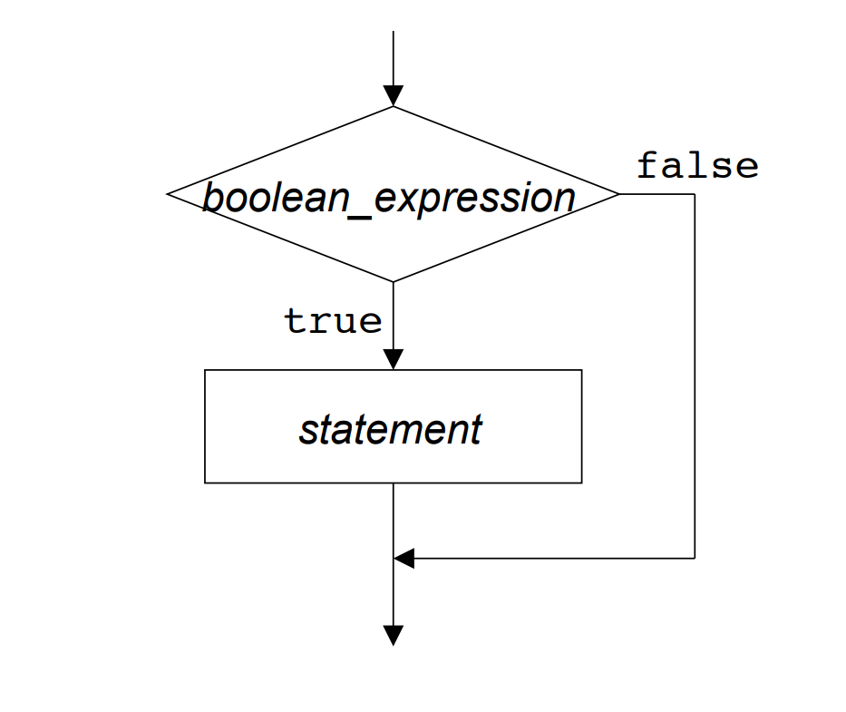
if Statement flowchart
Notes:
This image helps visualize the if statement process.
The execution of the code will reach the if statement, and it will check the value of the boolean_expression. If it is true, it will execute the statement from the body of the if statement. If it is false, it will skip the execution of the statement and move on.

Slide 6
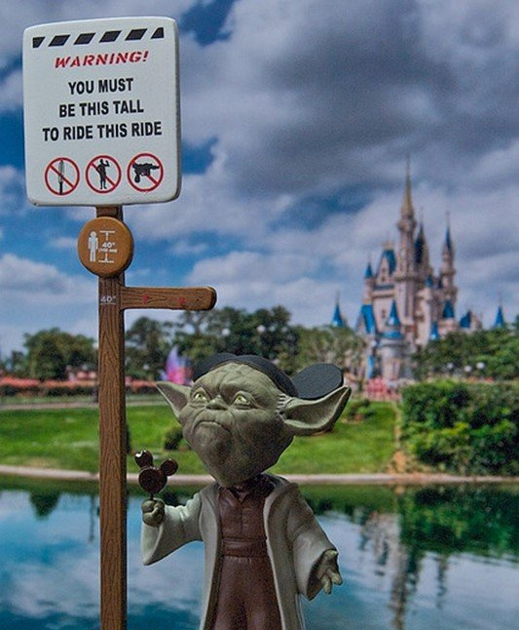
Boolean Operators
Equality
Example: name == "Yoda"
Greater Than/Less Than
Example: age > 900
Example: height < 40
Notes:
Rather than simply using static true/false values, it is possible to compare different values using boolean operators.

Slide 7
Mini-Quiz: What would the user see?
string weather = "Sunny";
if (weather == "Rainy") {
Console.WriteLine("Umbrella!");
}
Nothing
Notes:
Ask this question to a student. If the code runs, nothing will happen because the weather is not rainy. This means the code inside the body of the if statement will not execute.

Slide 8
else Clause
if (switchOn) {
Console.WriteLine("Light!");
} else {
Console.WriteLine("Dark!");
}
Code in the body of the else clause will only execute if the condition is false!
Notes:
Sometimes, developers want code to run when the condition in an if statement is false. This can be accomplished using an else clause.
The else comes immediately after the closing curly bracket of the if statement. Then, there are curly brackets and statements within them.
NOTE: There is no additional boolean expression for the else clause.

Slide 9
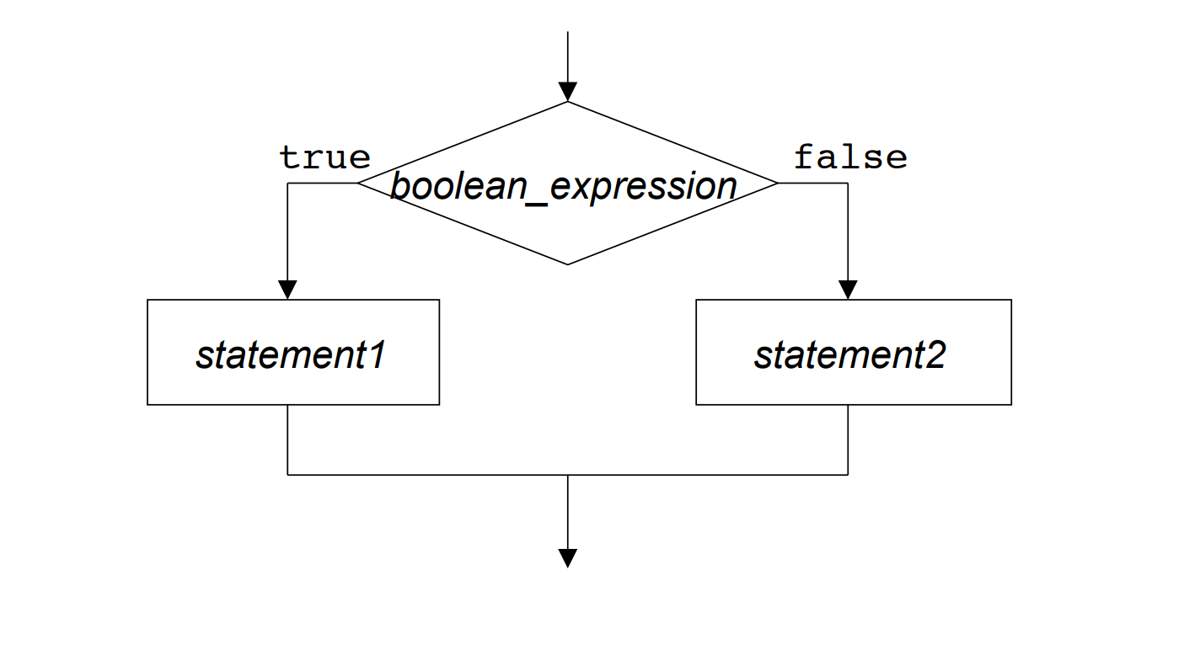
else clause flowchart
Notes:
This image helps visualize the else clause process.
The execution of the code will reach the if statement, and it will check the value of the boolean_expression. If it is true, it will execute statement1 from the body of the if statement. If it is false, it will execute statement2 from the body of the else clause. Then, either way, it will move on.

Slide 10
Mini-Quiz: What would the user see?
int money = 2;
if (money > 1000000) {
Console.WriteLine("You are rich");
} else {
Console.WriteLine("You are not rich");
}
You are not rich
Notes:
Ask this question to a student. If the code runs, it will check if 2 is greater than one million. That is false, so the code from the else body will execute.

Slide 11
else if Clause
if (grade < 6) {
Console.WriteLine("Elementary School");
} else if (grade < 9) {
Console.WriteLine("Middle School");
} else {
Console.WriteLine("High School");
}
Notes:
The else if structure allows a program to branch in more than two directions. This example will determine the level of school based on the grade.
It may be helpful to walk through a couple examples on the whiteboard to see which path they would take.
Ask the students to step through the code for these questions:
What would happen if grade was 6?
What would happen if grade was 2?
What would happen if grade was 9?
What would happen if grade was 8?
What would happen if grade was 12?

