Slide 1
While Loops
Hy-Tech Club: C# 101

Slide 2
while Loops
while loops repeat blocks of code while a given condition is true
They are a lot like if statements
The difference is that they run the code multiple times
while (condition)
{
// body
}
Notes:
Introduce while loops. They repeat the code within the curly brackets as long as condition is true.

Slide 3
Mini-Quiz: What data type is a condition?
Boolean
Notes:
Ask this question to a student.

Slide 4
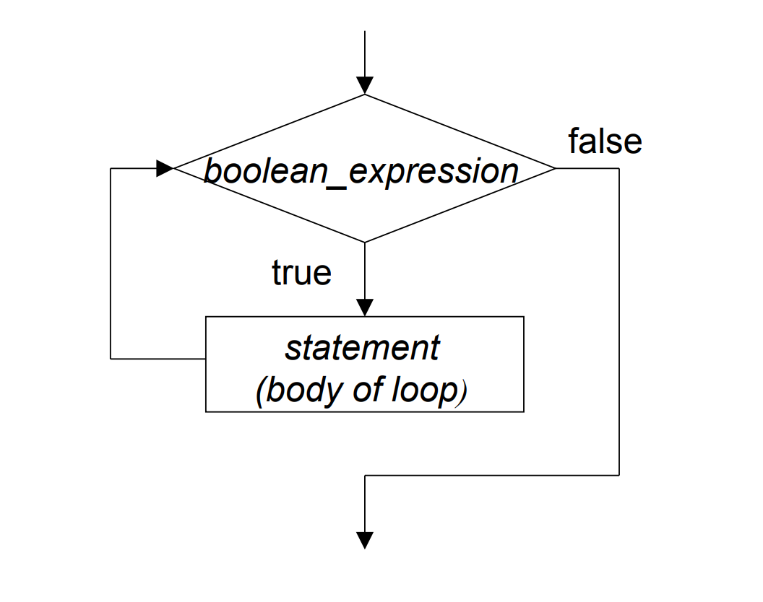
while Loop flowchart
Notes:
Show the flowchart. Explain how the while loop repeats (or not) based on the boolean_expression. The only way to exit the while loop is for the boolean_expression to become false.

Slide 5
Whiteboard Example
int count = 0;
while (count < 5)
{
Console.WriteLine("*");
count = count + 1;
}
5
3
count is:
4
0
1
2
Notes:
Write out this example on the whiteboard, keeping track of the count variable and the output. Allow the students to help step through each line of the code.
Show how each time through the loop, the computer checks the condition. If the condition is true, it enters the body of the loop. If the condition is false, it exits the loop.

Slide 6
Mini-Quiz: What would the user see?
while (4 > 3) {
Console.WriteLine("*");
}
Stars Forever
Notes:
Ask this question to a student. If the code runs, there will be an infinite loop!

Slide 7
The % operator – modulo / Remainder
The remainder operator % computes the remainder after dividing the left number by the right number. Remainder Example
Mini-Quiz
6 % 4
10 % 2
3 % 3
7 % 2
Even Numbers
if (x % 2 == 0)
{
// x is even!
}
→ 2
→ 0
→ 0
→ 1

Slide 8
Repl!
Notes:
Open the REPL to see an example of a while loop in action

