Slide 1
Methods
Hy-Tech Club: C# 101

Slide 2
Think about the lyrics to a song…
Notes:
Ask the students to think about a song they like. Think about how the lyrics to a song might be organized…

Slide 3
Think about the lyrics to a song… All Star
Somebody once told me the world is gonna roll me I ain't the sharpest tool in the shed She was looking kind of dumb with her finger and her thumb In the shape of an "L" on her forehead
Well the years start coming and they don't stop coming Fed to the rules and I hit the ground running Didn't make sense not to live for fun Your brain gets smart but your head gets dumb So much to do, so much to see So what's wrong with taking the back streets? You'll never know if you don't go You'll never shine if you don't glow
Hey now, you're an all-star, get your game on, go play Hey now, you're a rock star, get the show on, get paid And all that glitters is gold Only shooting stars break the mold
It's a cool place and they say it gets colder You're bundled up now, wait till you get older But the meteor men beg to differ Judging by the hole in the satellite picture The ice we skate is getting pretty thin The water's getting warm so you might as well swim My world's on fire, how about yours? That's the way I like it and I never get bored
Hey now, you're an all-star, get your game on, go play Hey now, you're a rock star, get the show on, get paid All that glitters is gold Only shooting stars break the mold
Hey now, you're an all-star, get your game on, go play Hey now, you're a rock star, get the show, on get paid And all that glitters is gold Only shooting stars
Somebody once asked could I spare some change for gas? I need to get myself away from this place I said yep what a concept I could use a little fuel myself And we could all use a little change
Well, the years start coming and they don't stop coming Fed to the rules and I hit the ground running Didn't make sense not to live for fun Your brain gets smart but your head gets dumb So much to do, so much to see So what's wrong with taking the back streets? You'll never know if you don't go (go!) You'll never shine if you don't glow
Hey now, you're an all-star, get your game on, go play Hey now, you're a rock star, get the show on, get paid And all that glitters is gold Only shooting stars break the mold
And all that glitters is gold Only shooting stars break the mold
Notes:
An example of a song is All Star by Smash Mouth. There are a lot of lyrics… how could we make this fit better?
Find the repeating parts! This is often how songwriters organize the lyrics when they write songs.
Rather than writing all the words to the chorus every time, they will just say “chorus” instead.

Slide 4
Think about the lyrics to a song… All Star
Somebody once told me the world is gonna roll me I ain't the sharpest tool in the shed She was looking kind of dumb with her finger and her thumb In the shape of an "L" on her forehead
Well the years start coming and they don't stop coming Fed to the rules and I hit the ground running Didn't make sense not to live for fun Your brain gets smart but your head gets dumb So much to do, so much to see So what's wrong with taking the back streets? You'll never know if you don't go You'll never shine if you don't glow
[CHORUS]
It's a cool place and they say it gets colder You're bundled up now, wait till you get older But the meteor men beg to differ Judging by the hole in the satellite picture The ice we skate is getting pretty thin The water's getting warm so you might as well swim My world's on fire, how about yours? That's the way I like it and I never get bored
[CHORUS]
[CHORUS]
Somebody once asked could I spare some change for gas? I need to get myself away from this place I said yep what a concept I could use a little fuel myself And we could all use a little change
Well, the years start coming and they don't stop coming Fed to the rules and I hit the ground running Didn't make sense not to live for fun Your brain gets smart but your head gets dumb So much to do, so much to see So what's wrong with taking the back streets? You'll never know if you don't go (go!) You'll never shine if you don't glow
[CHORUS]
And all that glitters is gold Only shooting stars break the mold
Notes:
Now rather than repeating all the words, [CHORUS] indicates that the same words will be repeated (defined elsewhere).
What else is repeated here? The “Well the years start coming…” section is the same in two places…

Slide 5
Think about the lyrics to a song… All Star
Somebody once told me the world is gonna roll me I ain't the sharpest tool in the shed She was looking kind of dumb with her finger and her thumb In the shape of an "L" on her forehead
[PRE-CHORUS]
[CHORUS]
It's a cool place and they say it gets colder You're bundled up now, wait till you get older But the meteor men beg to differ Judging by the hole in the satellite picture The ice we skate is getting pretty thin The water's getting warm so you might as well swim My world's on fire, how about yours? That's the way I like it and I never get bored
[CHORUS]
[CHORUS]
Somebody once asked could I spare some change for gas? I need to get myself away from this place I said yep what a concept I could use a little fuel myself And we could all use a little change
[PRE-CHORUS]
[CHORUS]
And all that glitters is gold Only shooting stars break the mold
PRE-CHORUS
Well the years start coming and they don't stop coming Fed to the rules and I hit the ground running Didn't make sense not to live for fun Your brain gets smart but your head gets dumb So much to do, so much to see So what's wrong with taking the back streets? You'll never know if you don't go You'll never shine if you don't glow
CHORUS
Hey now, you're an all-star, get your game on, go play Hey now, you're a rock star, get the show on, get paid And all that glitters is gold Only shooting stars break the mold
Notes:
Now the pre-chorus is defined, the chorus is defined, and they all fit into the song. This helps keep the lyrics organized, and limits the need to repeat text.
So, how do these song lyrics relate to C#?

Slide 6
Methods
Developers use methods to avoid repeating code
Just like how songwriters might use [CHORUS] as a placeholder!
Methods are blocks of code that contain multiple statements
Methods are defined and called
Notes:
Explain what methods are from a conceptual level.
Students may be familiar with functions from other programming languages – for this course, students can think of methods and functions as the same thing!

Slide 7
Code – Defining & Calling a Method
class Program {
public static void PrintHi() {
Console.WriteLine("Hi");
}
public static void Main() {
PrintHi();
}
}
Method Name
PrintHi
Method Definition
Keywords – public static
Return Type – void
Name – PrintHi
Parentheses – ()
Curly Brackets – {}
Body – Console.WriteLine
Method Call
PrintHi();
Notes:
Big picture – the Method Name is “PrintHi”. It is used when the function is defined, and when it is called.
The method definition is the first part of the program:
public static void PrintHi() { Console.WriteLine(“Hi”); }
Break down each part of the method definition – they are all necessary to define a method
Don’t need to talk too much about “public static void”
The method call happens within the “Main” method – it is simply the method name followed by parentheses

Slide 8
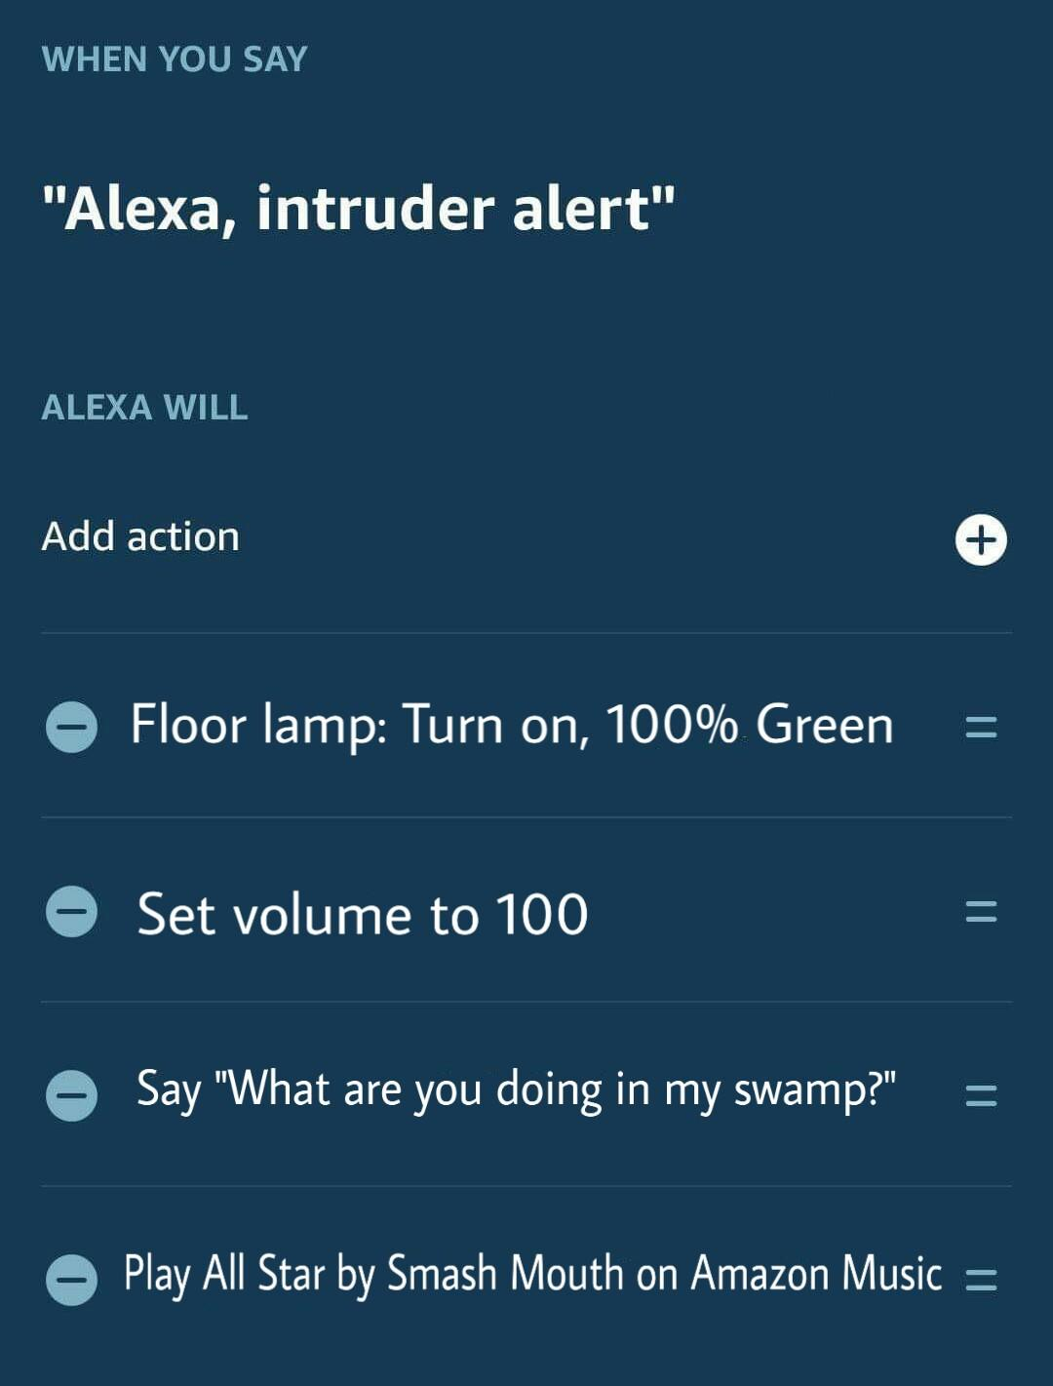
ALEXA CUSTOM COMMANDS
Defining a method is like building a custom command for Alexa…
WHEN YOU SAY <method_name>
ALEXA WILL <method_body>
__________________________________
Calling a method is like invoking a custom command for Alexa…
User says “<method_name>”
→ Execute <method_body>
Notes:
Let’s talk a little more about the difference between defining and calling methods.
In this example, an Alexa owner has created a custom command. Presumably, this would be used in the case of a home invasion. When the person says “Alexa, intruder alert,” the green lamp will turn on, the volume will be set to 100, Alexa will say the phrase, and All Star will play.
This is actually a lot like defining a method in C#!
The command phrase is like the method name, and the action list is like the method body.
Calling a method will run all of the actions defined in the custom command.

Slide 9
Mini-Quiz: Define a Method to Draw a Smiley
public static void DrawSmiley() {
Console.WriteLine("^u^");
}
Notes:
Ask students to come up to the whiteboard to define a method to draw a smiley. The definition should consist of the following parts:
“public static”
Return type - “void”
Function name
Parentheses
Curly brackets
Body (Console.WriteLine)
After the students have completed the method definition, reveal the answer.

Slide 10
Mini-Quiz: call the method
DrawSmiley();
Notes:
Ask a student to come up to the whiteboard and call the previously defined method.
After the students have completed the method call, reveal the answer.

