Slide 1
Method Returns
Hy-Tech Club: C# 101

Slide 2
Return Statements
Notes:
A method that does a calculation and then writes the result to the console
A method that does the same calculation and then writes the result to a file
This illustrates the need for return statements

Slide 3
The DrawBunny function
public static void DrawBunny()
{
Console.WriteLine(" () () ");
Console.WriteLine(" (. .) ");
Console.WriteLine(" (u u) ");
}
Notes:
Here is an example of a method that draws a bunny. We like this method.
But what if we wanted to have another method that would draw the bunny’s eyes differently?

Slide 4
The DrawBunnyStarEyes function
public static void DrawBunnyStarEyes()
{
Console.WriteLine(" () () ");
Console.WriteLine(" (* *) ");
Console.WriteLine(" (u u) ");
}
Notes:
We could define a new method that could draw the bunny with star eyes instead of dot eyes.
But what if we also wanted a method to draw the bunny with dollar signs for eyes?

Slide 5
The DrawBunnyDollarEyes function
public static void DrawBunnyDollarEyes()
{
Console.WriteLine(" () () ");
Console.WriteLine(" ($ $) ");
Console.WriteLine(" (u u) ");
}
Notes:
We could define another new method to draw the bunny with dollar sign eyes.

Slide 6
Find the difference between these three…
public static void DrawBunny() {
Console.WriteLine(" () () ");
Console.WriteLine(" (. .) ");
Console.WriteLine(" (u u) ");
}
public static void DrawBunnyDollarEyes() {
Console.WriteLine(" () () ");
Console.WriteLine(" ($ $) ");
Console.WriteLine(" (u u) ");
}
public static void DrawBunnyStarEyes() {
Console.WriteLine(" () () ");
Console.WriteLine(" (* *) ");
Console.WriteLine(" (u u) ");
}
Differences
Method Names
Eye characters
Notes:
Now all of these methods are very similar! Looks like a lot of repeated code.
Ask the students what the differences are. Reveal that they are the method names, and the eye characters.
Is there a way we could avoid repeating all of these function definitions? Parameters!

Slide 7
Method Parameters
Method parameters allow developers to pass information to methods
This way, methods execute differently based on parameter values
Parameters act as variables inside of the method body
Example: Console.WriteLine("Message");
Notes:
Explain the usage of method parameters.
In the example, ask the students what the parameter is for the Console.WriteLine method call. It is “Message”. This parameter allows the Console.WriteLine method to display different messages to the console!
Note that when values are passed during a method call, those are called arguments.

Slide 8
Defining a method with parameters
public static void DrawBunny(string eye) {
Console.WriteLine(" () ()");
Console.WriteLine(" (" + eye + " " + eye + ") ");
Console.WriteLine(" (u u) ");
}
string eye – this declares the parameter in the method
eye – this is where the parameter is used in the method
Notes:
In the method definition, within the parentheses, the parameter variable is declared just like another variable. The trick is that this variable is not set in the method definition; it will be set when the method is called!
In this method definition, the parameter is declared and then used. Point out exactly where that happens in the code example.

Slide 9
Mini-Quiz: What is the type of the parameter?
public static void Math(int num)
{
Console.WriteLine(num + 2);
}
int
Notes:
Ask this question to a student. The parameter is num.

Slide 10
Mini-Quiz: What is the name of the parameter?
public static void Math(int num)
{
Console.WriteLine(num + 2);
}
num
Notes:
Ask this question to a student. The parameter is num.

Slide 11
C# Method Structure:
public: means anyone can use this (more on that in Adv. C#)
static – needed to be called from a static method (Adv C# too)
double: tells us that when we call this method it will give us a double value back. Known as return type
GetAreaOfRectangle is the method name and clearly describes what it does

Slide 12
C# Method Structure:
(double length, double width) are the arguments for this method.
You can have any number of arguments for a method separated by commas
Each argument has the datatype first then the name, when calling a method you must provide each argument in parentheses

Slide 13
C# Method in use
// the method definition
public double GetAreaOfRectangle(double length, double width)
{ return length * width;
}
// example of calling the method. rectangleArea will equal 6.0 after the method returns
double rectangleArea = GetAreaOfRectangle(2.0, 3.0);

Slide 14
Think about the lyrics to a song…
Notes:
Ask the students to think about a song they like. Think about how the lyrics to a song might be organized…

Slide 15
Think about the lyrics to a song… All Star
Somebody once told me the world is gonna roll me I ain't the sharpest tool in the shed She was looking kind of dumb with her finger and her thumb In the shape of an "L" on her forehead
Well the years start coming and they don't stop coming Fed to the rules and I hit the ground running Didn't make sense not to live for fun Your brain gets smart but your head gets dumb So much to do, so much to see So what's wrong with taking the back streets? You'll never know if you don't go You'll never shine if you don't glow
Hey now, you're an all-star, get your game on, go play Hey now, you're a rock star, get the show on, get paid And all that glitters is gold Only shooting stars break the mold
It's a cool place and they say it gets colder You're bundled up now, wait till you get older But the meteor men beg to differ Judging by the hole in the satellite picture The ice we skate is getting pretty thin The water's getting warm so you might as well swim My world's on fire, how about yours? That's the way I like it and I never get bored
Hey now, you're an all-star, get your game on, go play Hey now, you're a rock star, get the show on, get paid All that glitters is gold Only shooting stars break the mold
Hey now, you're an all-star, get your game on, go play Hey now, you're a rock star, get the show, on get paid And all that glitters is gold Only shooting stars
Somebody once asked could I spare some change for gas? I need to get myself away from this place I said yep what a concept I could use a little fuel myself And we could all use a little change
Well, the years start coming and they don't stop coming Fed to the rules and I hit the ground running Didn't make sense not to live for fun Your brain gets smart but your head gets dumb So much to do, so much to see So what's wrong with taking the back streets? You'll never know if you don't go (go!) You'll never shine if you don't glow
Hey now, you're an all-star, get your game on, go play Hey now, you're a rock star, get the show on, get paid And all that glitters is gold Only shooting stars break the mold
And all that glitters is gold Only shooting stars break the mold
Notes:
An example of a song is All Star by Smash Mouth. There are a lot of lyrics… how could we make this fit better?
Find the repeating parts! This is often how songwriters organize the lyrics when they write songs.
Rather than writing all the words to the chorus every time, they will just say “chorus” instead.

Slide 16
Think about the lyrics to a song… All Star
Somebody once told me the world is gonna roll me I ain't the sharpest tool in the shed She was looking kind of dumb with her finger and her thumb In the shape of an "L" on her forehead
Well the years start coming and they don't stop coming Fed to the rules and I hit the ground running Didn't make sense not to live for fun Your brain gets smart but your head gets dumb So much to do, so much to see So what's wrong with taking the back streets? You'll never know if you don't go You'll never shine if you don't glow
[CHORUS]
It's a cool place and they say it gets colder You're bundled up now, wait till you get older But the meteor men beg to differ Judging by the hole in the satellite picture The ice we skate is getting pretty thin The water's getting warm so you might as well swim My world's on fire, how about yours? That's the way I like it and I never get bored
[CHORUS]
[CHORUS]
Somebody once asked could I spare some change for gas? I need to get myself away from this place I said yep what a concept I could use a little fuel myself And we could all use a little change
Well, the years start coming and they don't stop coming Fed to the rules and I hit the ground running Didn't make sense not to live for fun Your brain gets smart but your head gets dumb So much to do, so much to see So what's wrong with taking the back streets? You'll never know if you don't go (go!) You'll never shine if you don't glow
[CHORUS]
And all that glitters is gold Only shooting stars break the mold
Notes:
Now rather than repeating all the words, [CHORUS] indicates that the same words will be repeated (defined elsewhere).
What else is repeated here? The “Well the years start coming…” section is the same in two places…

Slide 17
Think about the lyrics to a song… All Star
Somebody once told me the world is gonna roll me I ain't the sharpest tool in the shed She was looking kind of dumb with her finger and her thumb In the shape of an "L" on her forehead
[PRE-CHORUS]
[CHORUS]
It's a cool place and they say it gets colder You're bundled up now, wait till you get older But the meteor men beg to differ Judging by the hole in the satellite picture The ice we skate is getting pretty thin The water's getting warm so you might as well swim My world's on fire, how about yours? That's the way I like it and I never get bored
[CHORUS]
[CHORUS]
Somebody once asked could I spare some change for gas? I need to get myself away from this place I said yep what a concept I could use a little fuel myself And we could all use a little change
[PRE-CHORUS]
[CHORUS]
And all that glitters is gold Only shooting stars break the mold
PRE-CHORUS
Well the years start coming and they don't stop coming Fed to the rules and I hit the ground running Didn't make sense not to live for fun Your brain gets smart but your head gets dumb So much to do, so much to see So what's wrong with taking the back streets? You'll never know if you don't go You'll never shine if you don't glow
CHORUS
Hey now, you're an all-star, get your game on, go play Hey now, you're a rock star, get the show on, get paid And all that glitters is gold Only shooting stars break the mold
Notes:
Now the pre-chorus is defined, the chorus is defined, and they all fit into the song. This helps keep the lyrics organized, and limits the need to repeat text.
So, how do these song lyrics relate to C#?

Slide 18
Methods
Developers use methods to avoid repeating code
Just like how songwriters might use [CHORUS] as a placeholder!
Methods are blocks of code that contain multiple statements
Methods are defined and called
Notes:
Explain what methods are from a conceptual level.
Students may be familiar with functions from other programming languages – for this course, students can think of methods and functions as the same thing!

Slide 19
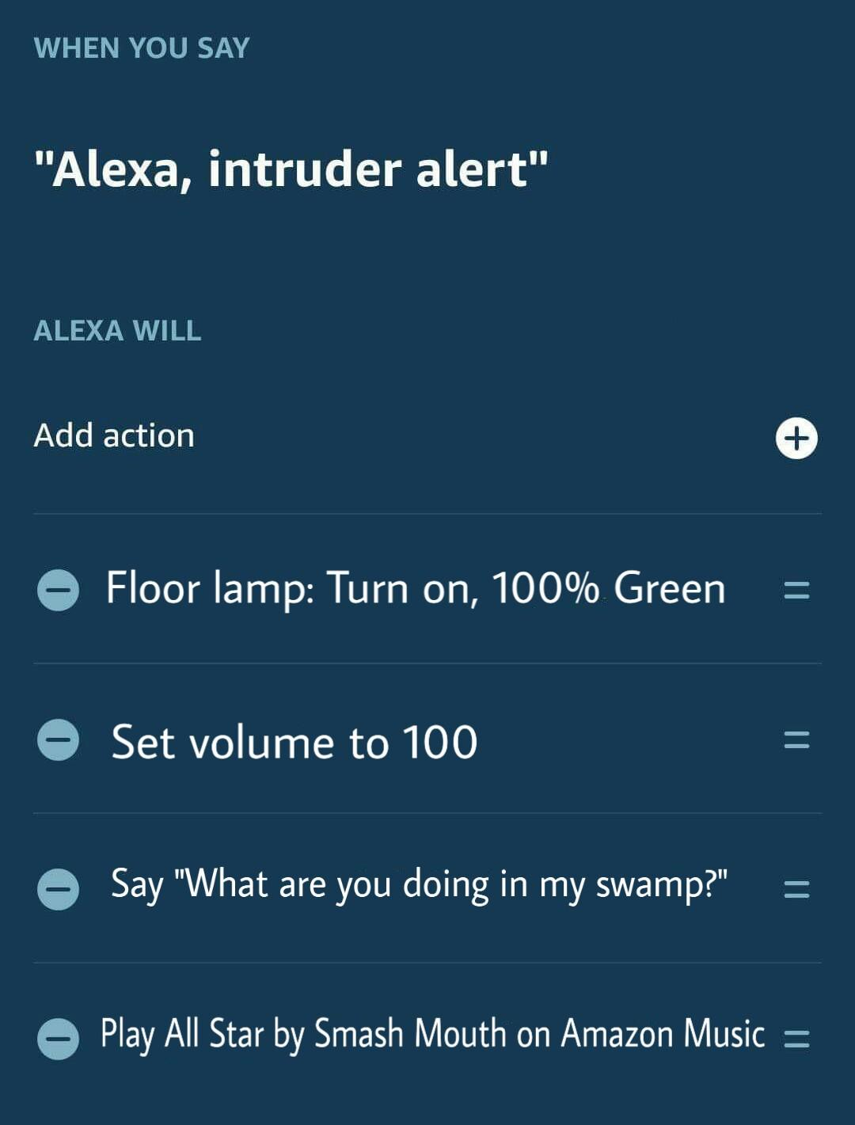
ALEXA CUSTOM COMMANDS
Defining a method is like building a custom command for Alexa.
WHEN YOU SAY <method_name> ALEXA WILL <method_body>
Calling a method is like invoking a custom command for Alexa.
User says “<method_name>”
Notes:
Let’s talk a little more about the difference between defining and calling methods.
In this example, an Alexa owner has created a custom command. Presumably, this would be used in the case of a home invasion. When the person says “Alexa, intruder alert,” the green lamp will turn on, the volume will be set to 100, Alexa will say the phrase, and All Star will play.
This is actually a lot like defining a method in C#!
The command phrase is like the method name, and the action list is like the method body.

Slide 20
if statements let programs behave differently based on boolean values.
For example, think of a program for a light switch. If it is up, the light is on. If it is down, the light is off.
Notes:
Explain the purpose of if statements. Use the light switch as an example.
Note that it can be helpful to read an if statement just like a sentence in English. They are fairly literal.

Slide 21
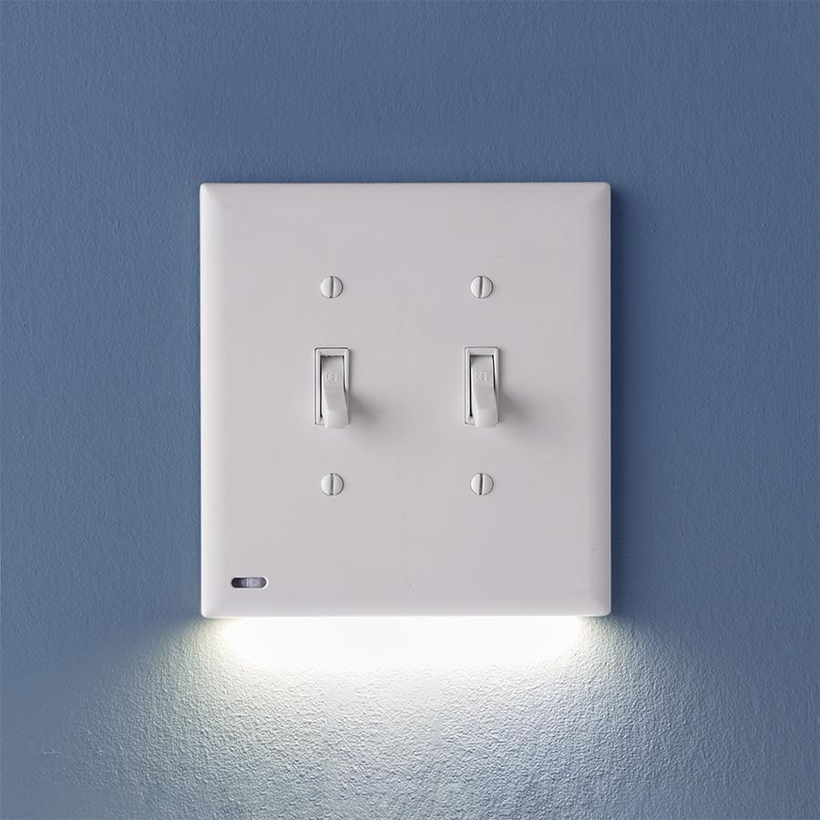
Review: What is a boolean?
A boolean is a form of data that can be true or false.
Notes:
Ask this question to a student and see if they can answer.
Boolean values can be either true or false.
This is like a light switch; they can be on or off.

Slide 22
if Statement Code
if (switchOn) {
Console.WriteLine("Light!");
}
if keyword
Parentheses
switchOn – Boolean expression
Curly brackets – body
Console.WriteLine – statement
TIP: Read if statements like English sentences!
Notes:
Show the syntax for an if statement. Explain each part of the syntax.
Every if statement has to start with the word “if”
After the “if” comes parentheses surrounding the condition
The condition is a boolean expression between the parentheses
Open and closing curly brackets wrap the body of the if statement
Console.WriteLine is the statement that will run if the condition is true

Slide 23
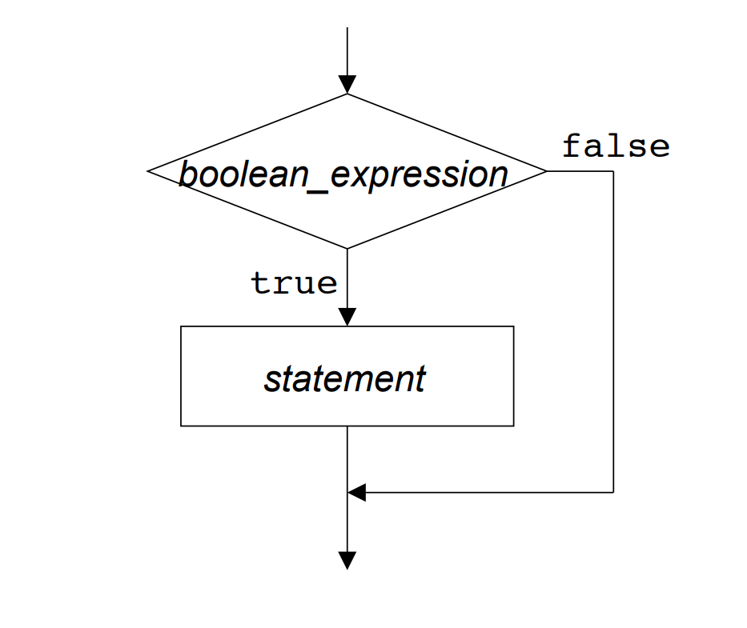
if Statement flowchart
Notes:
This image helps visualize the if statement process.
The execution of the code will reach the if statement, and it will check the value of the boolean_expression. If it is true, it will execute the statement from the body of the if statement. If it is false, it will skip the execution of the statement and move on.

Slide 24
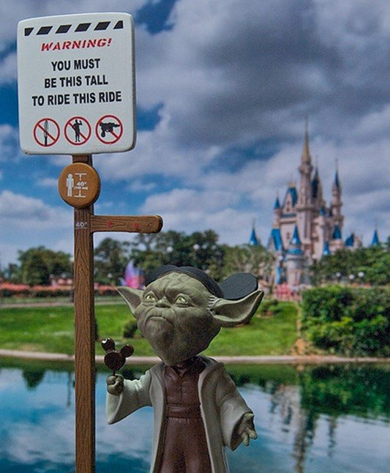
Boolean Operators
Equality
Example: name == "Yoda"
Greater Than/Less Than
Example: age > 900
Example: height < 40
Notes:
Rather than simply using static true/false values, it is possible to compare different values using boolean operators.

Slide 25
else Clause
if (switchOn) {
Console.WriteLine("Light!");
} else {
Console.WriteLine("Dark!");
}
Code in the body of the else clause will only execute if the condition is false!
Notes:
Sometimes, developers want code to run when the condition in an if statement is false. This can be accomplished using an else clause.
The else comes immediately after the closing curly bracket of the if statement. Then, there are curly brackets and statements within them.
NOTE: There is no additional boolean expression for the else clause.

Slide 26
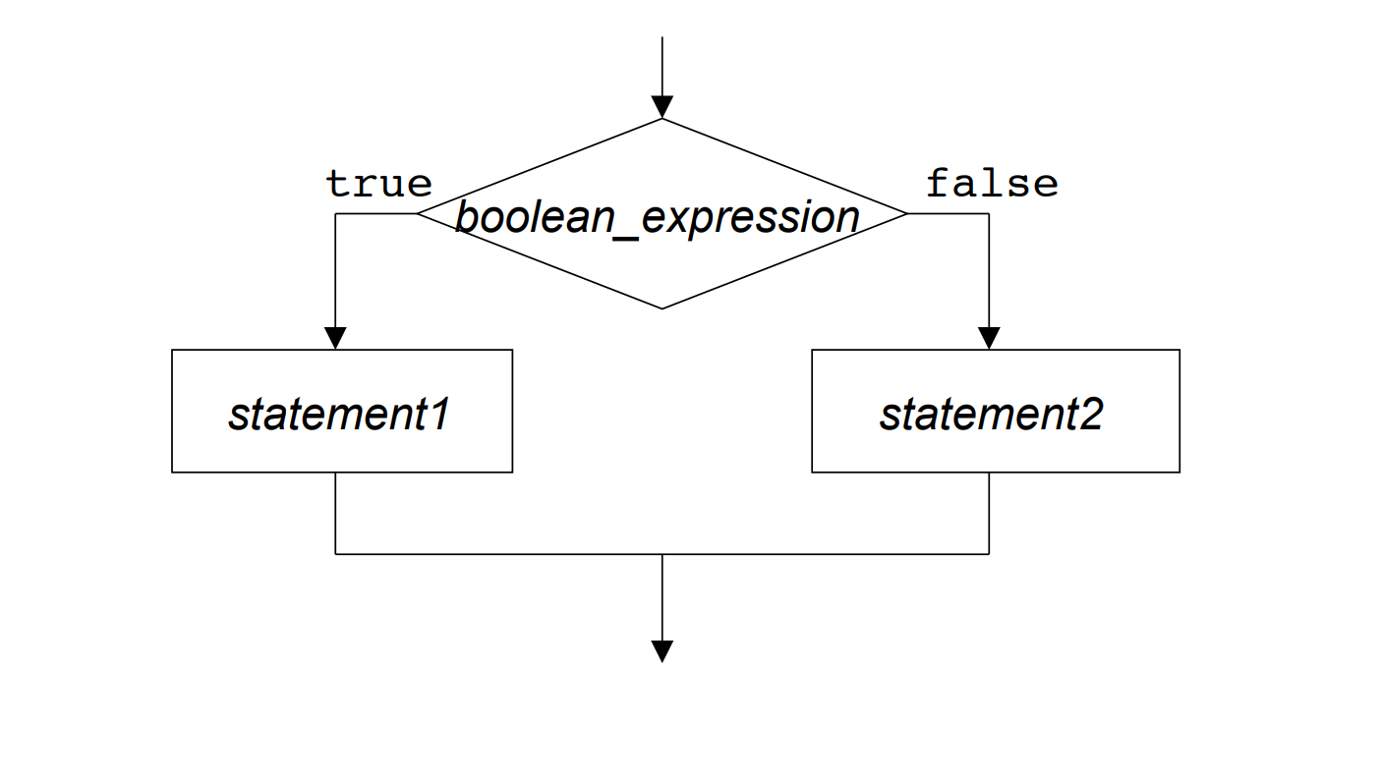
else clause flowchart
Notes:
This image helps visualize the else clause process.
The execution of the code will reach the if statement, and it will check the value of the boolean_expression. If it is true, it will execute statement1 from the body of the if statement. If it is false, it will execute statement2 from the body of the else clause. Then, either way, it will move on.

Slide 27
Mini-Quiz: What would the user see?
int money = 2;
if (money > 1000000) {
Console.WriteLine("You are rich");
} else {
Console.WriteLine("You are not rich");
}
You are not rich
Notes:
Ask this question to a student. If the code runs, it will check if 2 is greater than one million. That is false, so the code from the else body will execute.

Slide 28
else if Clause
if (grade < 6) {
Console.WriteLine("Elementary School");
} else if (grade < 9) {
Console.WriteLine("Middle School");
} else {
Console.WriteLine("High School");
}
Notes:
The else if structure allows a program to branch in more than two directions. This example will determine the level of school based on the grade.
It may be helpful to walk through a couple examples on the whiteboard to see which path they would take.
Ask the students to step through the code for these questions:
What would happen if grade was 6?
What would happen if grade was 2?
What would happen if grade was 9?
What would happen if grade was 8?
What would happen if grade was 12?

