Slide 1
Reading Input from the User
Hy-Tech Club: C# 101

Slide 2
Notes:
NOTE: This is a GIF – it takes a few seconds to begin.
Using the Console in C#, it is possible to ask the user for input and store it in a variable. This is how it looks.
The program can then use the input for any number of things! In this example, the program takes the user’s input and greets them by name.

Slide 3
HOW? Console.ReadLine
Console.WriteLine("What is your name?");
string name = Console.ReadLine();
Console.WriteLine("Hello " + name);
Console.ReadLine(); prompts the user for input
This takes the text the user enters and returns a string
The string is stored in a variable: name
Notes:
Show the code for the preceding example.
Note that the name from Console.ReadLine is the same name that is printed in the output.
The first line simply outputs the question text to the Console.
The second line allows the user to type some text, press the Enter key, and have the text stored in the name variable.
The third line outputs another message to the Console, using the value of the name variable to greet the user!

Slide 4
Mini-Quiz
What data type does Console.ReadLine return?
string
Notes:
Ask this question to a student.

Slide 5

Other Data Types
Sometimes a program needs a different type of input. What about a program that asks the user for their age, and then tells them how old they will be next year?
Console.WriteLine("How old are you?");
int age = Console.ReadLine();
int nextAge = age + 1;
Will this work?
Notes:
Ask the class if the code will work (thumbs up for yes, thumbs down for no). Click to reveal the answer…
It will not work! Ask the students why it might not work.
It does not work because Console.ReadLine returns a string, not an int.

Slide 6
CONVERTING THE INPUT: Convert.ToInt32
Console.WriteLine("How old are you?");
string ageString = Console.ReadLine();
int age = Convert.ToInt32(ageString);
int nextAge = age + 1;
Convert.ToInt32 takes a string and returns an int
The integer is stored in a new variable: age
Notes:
This is the working code for the previous example. There is a new variable, ageString, which stores the result of the Console.ReadLine. It is then converted

Slide 7

Mini-quiz: Will this work?
Console.WriteLine("Enter a number");
string numString = Console.ReadLine();
int num = Convert.ToInt32(numString);
int twice = num * 2;
It works!
Notes:
Ask the class if this code will work.
It will work! The Console.Read

Slide 8
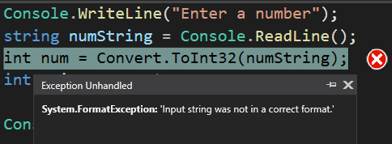
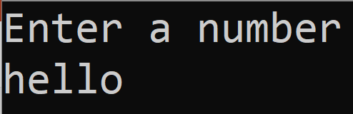
Side-note: Invalid input
If the program expects a number and the user enters non-numeric text, the program will crash
Notes:
Note that if the user of the program enters something that is not a number, Convert.ToInt32 will not be able to work.
There are ways to deal with invalid inputs, but exception handling is outside of the scope of this lesson.

