Slide 1
Collections
Hy-Tech Club: C# 101

Slide 2
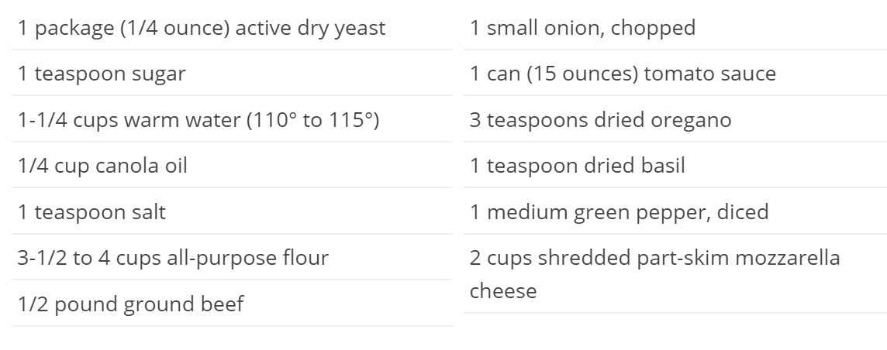
Notes:
Sometimes, it makes sense to group multiple things together in a list. For example, this list of ingredients for a recipe.
Collections of items like this are one of the primary data structures used in C#.
Ask the students if they can guess what these ingredients make. Pizza!

Slide 3

Lists in C#
Lists store multiple items of the same type
Developers can access each item by its index (starting at 0)
The size of a List is dynamic, so it can grow or shrink
using System.Collections.Generic;
Notes:
Explain the purpose of Lists in C#. Use the pizza ingredients list as an example.
For the last point, note that it is necessary to use the using statement to import the List.

Slide 4
List syntax: Declaration
List<double> scores;
Declaring a list of doubles
List<double> scores = new List<double>();
Declaring and creating an empty list
List<double> scores = new List<double>() {9.2, 8.7, 7.9};
List of 3 doubles, with values set
Notes:
Important parts of the syntax:
List (with a capital L)
Angle brackets (<>)
List type within the angle brackets (double)
Name of the list variable (scores)
Equals sign (just like assignment for other variables)
new keyword
Whole type again (List<double>)
Parentheses to create the list
The second point will be the most frequently used statement when creating lists.

Slide 5
List syntax: Declaration
double firstItem = scores[0];
Gets the first item in the list (9.2)
scores[2] = 9.4;
Sets the third item in the list to 9.4
int listCount = scores.Count;
Gets the total number of items in the list (3)
scores.Add(8.4);
Adds 8.4 to the end of the list
scores
0 – 9.2
1 – 8.7
2 – 7.9
9.4
3 – 8.4
Notes:
Start with an example list of scores. Explain that each index corresponds to an item. Explain how to interact with the list using code:
Get an item from the list using angle brackets ([])
Set an index of the list using angle brackets ([])
Note that this updates the list of scores
Get the total number of items with .Count
Add an item to the end of the list with .Add
Note that this updates the list of scores

Slide 6

Practice: Whiteboard Example
List<string> turtles = new List<string>();
turtles.Add("Leonardo");
turtles.Add("Donatello");
What are the values of the following?
string turtle1 = turtles[1];
int numTurtles = turtles.Count;
Notes:
Write out the numbered list on the whiteboard. Walk through each line of code, and update the whiteboard list. Possibly have a student volunteer to write on the whiteboard.
turtles[1] is “Donatello”
turtles.Count is 2

Slide 7
Whiteboard Example Continued
turtles.Add("Michelangelo");
turtles[1] = "Rafael";
turtles[2] = "Donatello";
turtles.Add("Michelangelo");
What are the values of the following?
string turtle3 = turtles[3];
int numTurtles = turtles.Count;
Notes:
Walk through each new line of code, and update the whiteboard list. Add an item to the end, update the 2nd item, update the 3rd item, and add another item to the end. The list should look like this at the end:
Leonardo
Rafael
Donatello
Michelangelo
turtles[3] is “Michelangelo”
turtles.Count is 4

Slide 8
foreach loops
foreach loops allow developers to easily iterate through collections
foreach (double score in scores)
{
Console.WriteLine("Score:" + score);
}
TIP: Read a foreach loop like English
Notes:
Explain the syntax of foreach loops:
foreach keyword
parentheses
Variable declaration (double score)
This means that score will be each item through the list
in keyword
Collection name (scores)
Curly brackets
Body – using score as a variable

Slide 9
Practice: Whiteboard Example
foreach (string turtle in turtles)
{
Console.WriteLine("Turtle: " + turtle);
}
Notes:
Walk through the loop on the whiteboard. Keep track of the turtle variable, the position in the turtles list, and the console output.
turtle: Leonardo, Rafael, Donatello, Michelangelo
Position: 0, 1, 2, 3
Console output
Turtle: Leonardo
Turtle: Rafael
Turtle: Donatello
Turtle: Michelangelo

Slide 10
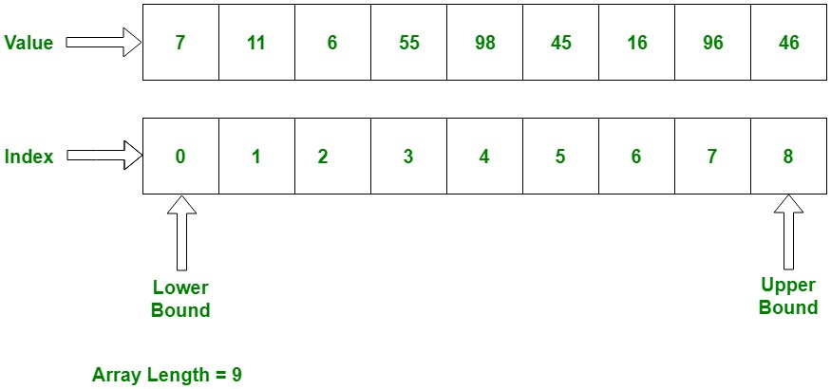
Arrays: the original collection
Arrays have a static length, set at initialization
Arrays allocate a given number of blocks in memory
It requires more work to insert an element in the middle of an array
Notes:
Briefly cover arrays. It is not necessary for the students to grasp the concepts, but they should at least be aware that arrays exist. The key differences are the static size, and the syntax.

