Slide 1
Abstract Classes
Hy-Tech Club: C# 102

Slide 2
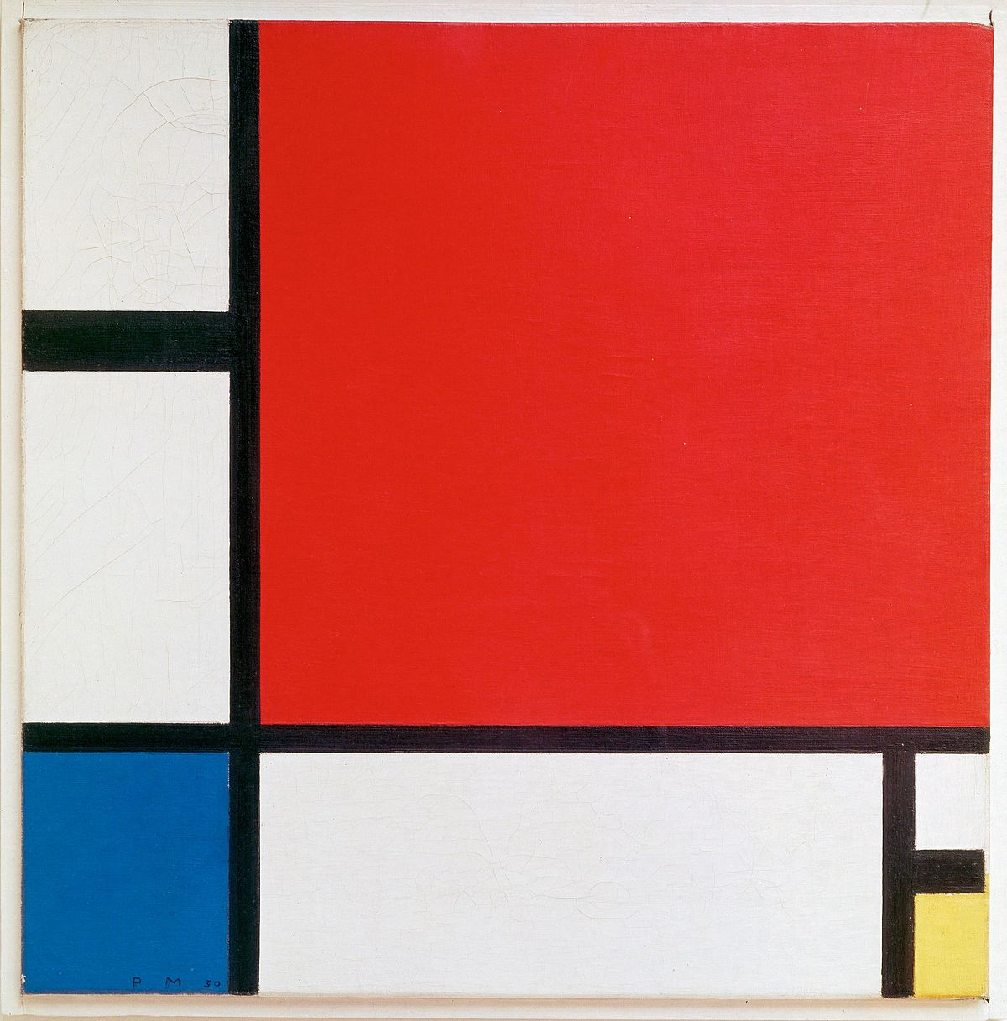
← not this
Notes:
We are not talking about abstract art here…

Slide 3
Abstract Class
An abstract class is a base class that is not completely implemented
Like other base classes, they provide a common definition that multiple derived classes can share
So what makes abstract classes different?
They cannot be instantiated (i.e. no objects)
They have methods that are designed to be overridden by the derived classes
Notes:
Explain the basics of abstract classes. It is helpful to think of them simply as base classes, but it is not possible to use them to make objects.
They also have special methods that the derived classes can override… next slide covers abstract methods.

Slide 4

Abstract methods
Abstract methods have signatures but no implementation
They have names, parameters, and return types, but no body
They are used within abstract classes
They are designed to be overridden by derived classes
The derived classes define what exactly these methods actually do!
Notes:
Go over the meaning of an abstract method. The important thing is that they don’t actually do anything… the derived classes define the behavior of abstract classes by overriding them in their implementation.

Slide 5
Example – Abstract Class definition
public abstract class Shape
{
public double XPos { get; set; }
public double YPos { get; set; }
public abstract double GetArea();
}
abstract method
Notes:
abstract keyword
Implementation of XPos and YPos properties
NO implementation of the GetArea method – it is an abstract method!
Ask the students why the GetArea method might be abstract. The reason is that different shapes calculate area in different ways, but all shapes have an area!

Slide 6
Example – Inheriting from an abstract class
public class Rectangle : Shape
{
public double Width { get; set; }
public double Height { get; set; }
public double GetRightEdgePosition()
{
return XPos + Width;
}
public override double GetArea()
{
return Width*Height;
}
}
Notes
Rectangle derives Shape
Width and Height are new properties
GetRightEdgePosition uses the XPos property from Shape
The GetArea method is overridden for Rectangle
Notes:
Note the important pieces of syntax for the derived class:
Derives from Shape
Has new Width and Height properties
The XPos from the Shape class is usable
The override keyword for GetArea
The body of GetArea is filled out

