Slide 1
Classes
Hy-Tech Club: C# 102

Slide 2
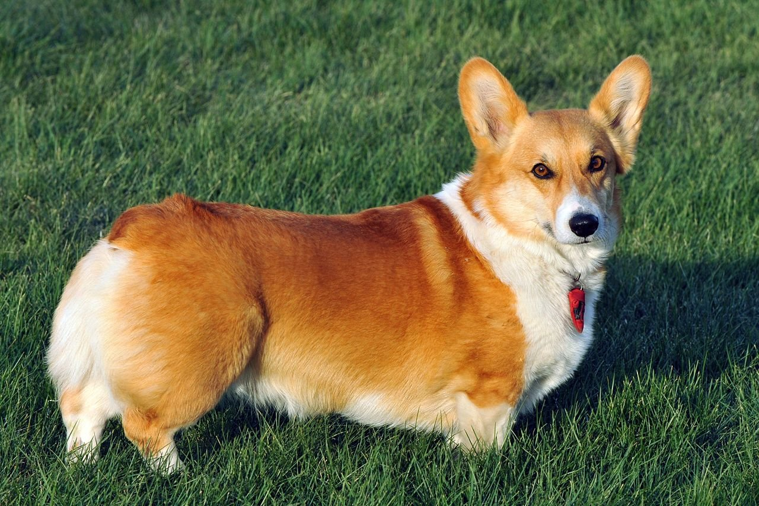
Notes:
Ask how students would describe this Dog… what properties does the Dog have?
Ask students what the Dog might be able to do… what functions can the Dog perform?
This leads to the main question for this lesson… how can we represent this Dog in C#?

Slide 3
The characteristics and abilities of dogs
Characteristic | Type
Breed | string
Height | integer
Name | string
Abilities
Bark
Notes:
These are some examples of properties all Dogs share. They also generally have the ability to bark.
All of these things need to group together to represent a Dog in C#. That’s where classes come in!

Slide 4
What is a class?
A class is a construct that enables you to create your own custom types by grouping together variables of other types, methods and events
Notes:
This is the definition of a class from https://docs.microsoft.com/en-us/dotnet/csharp/programming-guide/classes-and-structs/classes/

Slide 5

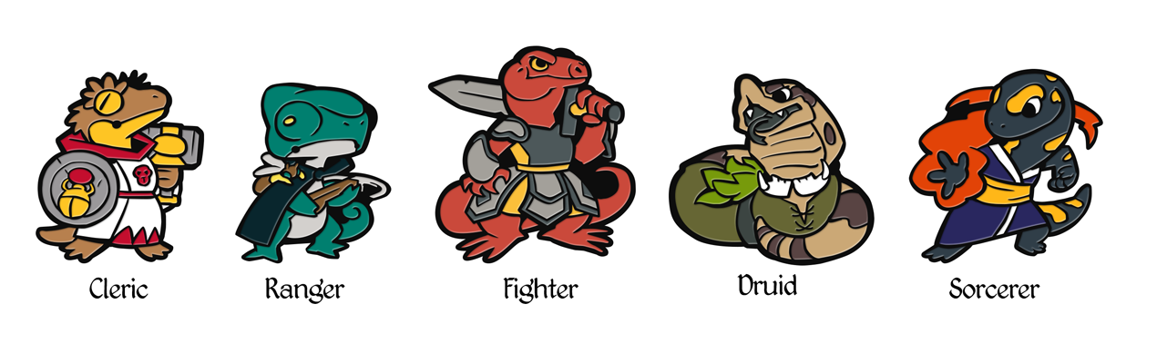
Why is it called a class?
It is called a class because it is used to classify objects!
In C#, the word “class” does not refer to a class at school…
Notes:
Go over the etymology of “class” in C#. Students may think it has something to do with a school class, but it’s all about the classification of data.
If any of the students have played Dungeons & Dragons, there is a system in that game where each character belongs to a certain class (like Cleric, Ranger, Fighter, etc). These classes all have different abilities and attributes. Classes in C# are kind of like that!

Slide 6
Two sides to a class
Class Definition
This is where the developer defines what a class should contain
The class definition says, “I want to keep track of these characteristics for each object of this type”
Class Instantiation
This is where the developer actually creates objects of a given class type
These are concrete variables that have values for each characteristic on the class
Notes:
NOTE: These concepts are very conceptual and hard to describe, so it might take some time for students to really grasp them.
Explain the two things we will do with classes: define them, and instantiate objects with them.

Slide 7
Example: A dog class
Dog Object 1
breed: Corgi
height: 18 inches
name: Cheddar
Dog Object 3
breed: Vizsla
height: 300 inches
name: Clifford
Class Definition
Each dog has a breed, a height, and a name
Dog Object 2
breed: Chihuahua
height: 5 inches
name: Oscar
Notes:
Show how the class definitions work. First, define the class. Then, instantiate objects of that class.

Slide 8

A class definition is like a blueprint for a house.
Notes:
Show a blueprint for a house. A blueprint for a house shows how to build a house, but it is not a house itself. It may have options for certain defining factors of a house, such as color, wall material, etc.

Slide 9
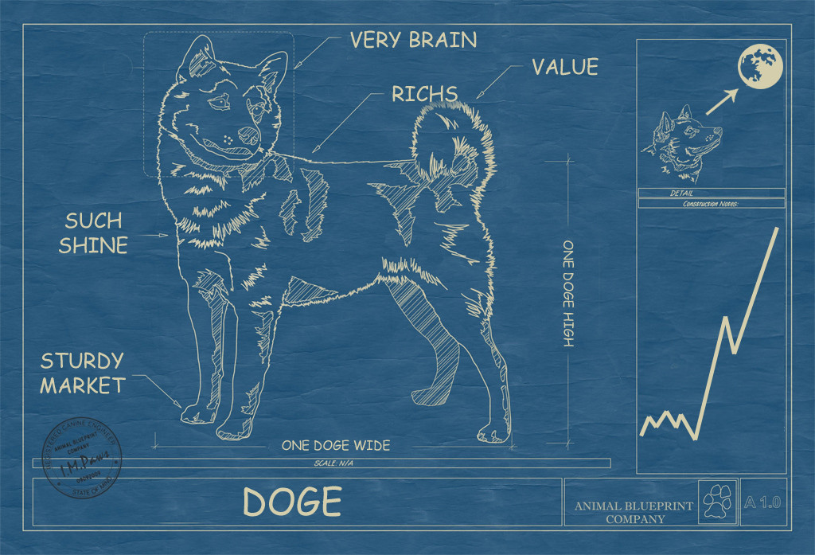
A Class definition in code
public class Dog
{
public string Breed;
public int Height;
public string Name;
public void Bark()
{
Console.WriteLine("Bark");
}
}
Notes:
Syntax for defining a class. Step through each part in order. Then, have the students copy this class into a new file called Dog.cs.
Explain how everything goes within the opening and closing curly braces. Those variables and functions make up the class definition.
Note that a function within a class is called a method.
Note that a variable within a class is called a field.

Slide 10
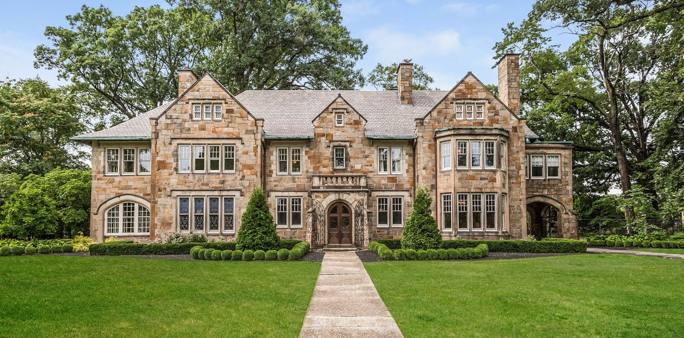
A object or instance of a class is like an actual house.
Notes:
Show an actual house. Each house is built based on the blueprint, but they are real and they have actual values. They are their own thing.
Each object can be stored in a variable, just like any other piece of data.
Make sure to emphasize that OBJECT and INSTANCE are synonymous.

Slide 11

A Class instantiation in code
Dog clifford = new Dog();
clifford.Name = "Clifford the Big Red Dog";
clifford.Height = 300;
clifford.Breed = "Vizsla";
clifford.Bark();
Bark
Notes:
Syntax for creating an instance of a Dog (Dog object). Things to note:
The type for the cliff variable is Dog
The way we create a new Dog object is using the new keyword
To access the Name variable for the Dog object, use dot notation (get/set)
To call a method on the Dog object, use dot notation
Have the students copy this code into the Main method to see it create the new Dog object and Bark.

Slide 12
Challenge
Add a method named SayName on the Dog class
It should show the user a message: “My name is __”
the blanks should be replaced by the Dog’s name
Hints
Use the Bark method as an example
You will have to use the Dog’s Name field
Call the method like so: dog.SayName();
Notes:
Give the students five minutes to attempt this challenge.

Slide 13
Solution
public void SayName()
{
Console.WriteLine("My name is " + Name);
}
Notes:
Show the solution to the challenge. Note that without WPF, this uses Console.WriteLine. Using WPF, it would be MessageBox.Show instead

Slide 14
Using field values within methods
Within the body of a method on a class, fields can be used like regular variables
The field values will be different for every object instantiated with the class
Notes:
This is a quick note about the challenge solution

