Slide 1
Interfaces
Hy-Tech Club: C# 102

Slide 2
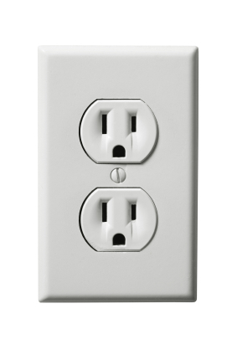
Example – a power outlet
As the user of this outlet, you don’t care how it provides power. It’s inner workings do not matter to you. All you care about is plugging something into it, and receiving the expected electrical output.
Say your energy provider upgraded to use solar power. YOU, as the user, should not have to change anything about YOUR power usage process.
An interface is like the outlet itself in this example. It lets a user utilize some functionality without knowing how it works; all they need to know is what it does!
Notes:
Use the outlet as a metaphor to explain interface. You plug something in, and get something out, but as a user, you don’t need to be aware of the actual implementation of the outlet.
Note that interfaces are also used for dependency injection and testing.

Slide 3
C# Example – IDataReader
The IDataReader interface in .NET has the methods GetValues, Read, NextResult, and many others
Other classes implement this interface by filling out those methods
Developers can use IDataReader objects without needing to know how the specific class has implemented the interface
This allows the implementation to change without usage changing!
Notes:
Explain an example – IDataReader. The power of interfaces is that the usage of the code can stay the same while things change up behind the scenes.
Hopefully this will solidify the idea of an interface before getting into the definition.

Slide 4
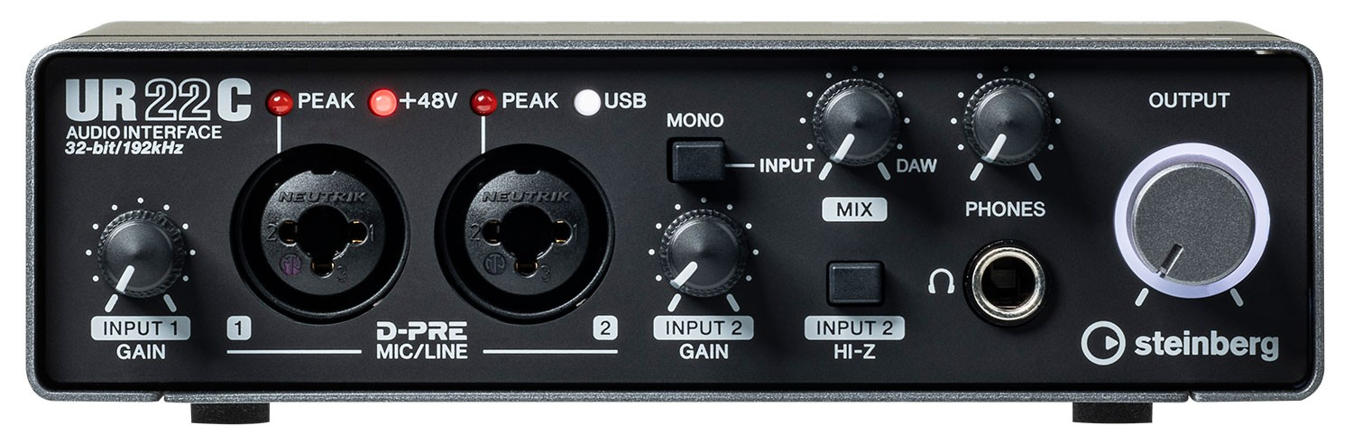
What exactly is an Interface in C#?
An interface contains definitions for a group of related functionalities that a class can implement. They’re like classes with no functionality!
They have NO implementation of any methods, fields, or properties
They can also inherit from other interfaces
They cannot be instantiated
Notes:
Explain the meaning of interfaces in c#. They are a lot like classes, but they have no implementation. They only say what they can do; not how to do it.
The image is an audio interface – something that can expand the sonic abilities of a computer. It basically lets the user’s hardware (microphones, inputs, headphones) talk to the computer. The headphones don’t have to know what the interface does – they just plug in and get audio!

Slide 5
Defining an interface in code
public interface IListable
{
string ListText { get; }
void OnClick();
}
Notes:
Show how to define an interface in C#
interface keyword
ListText property – must be gettable
OnClick method – no parameters, void return type
Ask the students what this interface does. It allows users to access a ListText and call an OnClick method.

Slide 6
Implementing an interface
A class that implements an interface must define and fill out all of the interface’s members
A class can implement multiple interfaces
A class can inherit from a base class and also implement one or more interfaces

Slide 7
Implementing an interface in code
public class Location : IListable
{
public string ListText { get; set; }
public string Coordinates { get; set; }
public void OnClick()
{
MessageBox.Show(Coordinates);
}
}
Notes:
Show how an interface is implemented – a class that defines all of the properties and methods from the interface.
Note:
The colon (:) is just like inheriting from a base class
MUST implement methods and properties from the interface – ListText and OnClick
Implements additional properties/methods as needed
With this implementation,

Slide 8
Another class
public class MeetingInvitation : IListable
{
public string ListText { get; set; }
public void OnClick()
{
OpenCalendar();
}
public void OpenCalendar() { /*...*/ }
}
Notes:
Another implementation of the IListable interface. This does things a little differently, but it still implements the interface.
It is a completely unrelated piece of data, but is still usable wherever IListable is used.
Specifies whatever type of action on OnClick is desired (like opening calendar)
The idea here is that some other piece of code could have implemented a list, where items have text and are clickable. That piece of code could now use MeetingInvitation objects OR Location objects!

Slide 9
Utilizing an interface
Objects of an interface type can be used anywhere that interface is required!
Polymorphism works in the same way with interfaces as it does with base classes
If an object is an interface type, the compiler will treat it as the interface, not the specific class
If an object is an interface type, it can access ONLY the properties and methods of the interface
Notes:
So, what does it look like to actually use these interfaces and the classes that implement them?

Slide 10
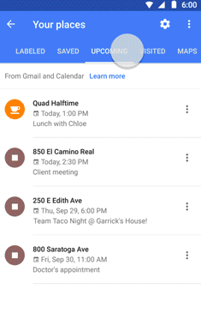
Utilizing an interface in code
List<IListable> list = new List<IListable>();
list.Add(new Location());
list.Add(new MeetingInvitation());
foreach (IListable item in list)
{
item.OnClick();
}
Notes:
Interfaces can be used just like any other type. For example, it is possible to:
Create a List of type IListable
Add Location and MeetingInvitation objects to the list
Loop through each item in the list
Call the OnClick method on each item in the list
Polymorphism works on interfaces!
Note, for an IListable, you would not be able to call the OpenCalendar method or access the Coordinates property. However, when calling the OnClick method, those objects have access to their own methods and properties, and can use them!
Image popup: This could be for something like a Google Maps list containing places and events! They can each be displayed with some text, and each do something when they are clicked. However, they display and do different things!

