Slide 1
⠀⠀⠀⠀⠀⠀⠀⠀⠀⠀⠀⠀⠀⠀⠀⠀⠀⠀⠀⠀⠀⠀⠀⠀⠀⠀⠀⠀⠀⠀⣠⣤⠶⢖⣚⣋⣭⣿⠍⠉⠙⠲⠶⣤⡀⠀⠀⠀⠀⠀⠀⠀⠀⠀⠀⠀⠀⠀⠀⠀⠀⠀⠀⠀⠀ ⠀⠀⠀⠀⠀⠀⠀⠀⠀⠀⠀⠀⠀⠀⠀⠀⠀⠀⠀⠀⠀⠀⠀⠀⠀⠀⢀⣰⠾⠋⠁⢀⡾⢋⡼⠛⠁⠀⣀⡤⠤⠤⢤⣀⠙⢷⡀⠀⠀⠀⠀⠀⠀⠀⠀⠀⠀⠀⠀⠀⠀⠀⠀⠀⠀ ⠀⠀⠀⠀⠀⠀⠀⠀⠀⠀⠀⠀⠀⠀⠀⠀⠀⠀⠀⠀⠀⠀⠀⠀⣠⢖⣿⣵⠀⠀⢀⣾⠞⠋⠀⢀⡴⠋⢁⣠⣤⠤⠤⣬⣷⡄⢿⡄⠀⠀⠀⠀⠀⠀⠀⠀⠀⠀⠀⠀⠀⠀⠀⠀⠀ ⠀⠀⠀⠀⠀⠀⠀⠀⠀⠀⠀⠀⠀⠀⠀⠀⠀⠀⠀⠀⠀⠀⣴⠞⣿⠋⢰⡇⠀⠀⠈⠉⠀⠀⢰⣿⠖⠋⠉⠁⠀⠀⠀⠀⠉⠳⠬⣷⠀⠀⠀⠀⠀⠀⠀⠀⠀⠀⠀⠀⠀⠀⠀⠀⠀ ⠀⠀⠀⠀⠀⠀⠀⠀⠀⠀⠀⠀⠀⠀⠀⠀⠀⠀⠀⠀⢠⢾⣡⡆⠘⢧⡸⡇⠀⠀⠀⠀⠀⠀⠉⠀⠀⠀⣀⣀⡤⢤⣀⠀⠀⠀⠀⢸⡆⠀⠀⠀⠀⠀⠀⠀⠀⠀⠀⠀⠀⠀⠀⠀⠀ ⠀⠀⠀⠀⠀⠀⠀⠀⠀⠀⠀⠀⠀⠀⠀⠀⠀⠀⠀⣴⣯⡾⣿⡇⠀⠀⠙⠿⠄⠀⠀⠀⠀⢲⡄⢀⡴⠚⠉⠀⠀⠀⠈⠓⢤⠀⠀⢸⡇⠀⠀⠀⠀⠀⠀⠀⠀⠀⠀⠀⠀⠀⠀⠀⠀ ⠀⠀⠀⠀⠀⠀⠀⠀⠀⠀⠀⠀⠀⠀⠀⠀⠀⢠⣾⣷⠋⠀⠹⣷⡄⠀⠀⠀⢀⣴⢖⣛⣿⣿⣷⠈⠉⠉⠉⠉⠉⠉⠙⠒⠻⠧⠀⢸⡇⠀⠀⠀⠀⠀⠀⠀⠀⠀⠀⠀⠀⠀⠀⠀⠀ ⠀⠀⠀⠀⠀⠀⠀⠀⠀⠀⠀⠀⠀⠀⠀⠀⢀⣾⡃⠙⠳⢦⣄⣹⣿⣄⠀⢐⣯⡟⠋⠀⢀⡿⠃⠀⢀⣀⣀⣀⠀⠀⠀⠀⠀⠀⠀⣸⠁⠀⠀⠀⠀⠀⠀⠀⠀⠀⠀⠀⠀⠀⠀⠀⠀ ⠀⠀⠀⠀⠀⠀⠀⠀⠀⠀⠀⠀⠀⠀⠀⠀⡿⣻⢿⡀⠀⠀⠈⠉⠉⠁⡴⠋⠀⠙⢒⣴⢛⡤⠖⠛⠉⠉⠉⠉⠛⠲⣤⠀⠀⠀⢠⡇⠀⠀⠀⠀⠀⠀⠀⠀⠀⠀⠀⠀⠀⠀⠀⠀⠀ ⠀⠀⠀⠀⠀⠀⠀⠀⠀⠀⠀⠀⠀⠀⠀⣼⢣⡏⠈⢷⣄⠀⠀⠀⢠⣾⡁⠀⢀⣴⠟⠷⠟⠓⠒⠲⢦⣤⠶⠶⠒⠒⠾⠇⠀⠀⣾⠁⠀⠀⠀⠀⠀⠀⠀⠀⠀⠀⠀⠀⠀⠀⠀⠀⠀ ⠀⠀⠀⠀⠀⠀⠀⠀⠀⠀⠀⠀⠀⠀⠀⣿⢸⣇⣀⣀⣘⣷⠄⢀⡞⠀⠉⣻⣿⡀⠀⠀⠀⠀⠀⠀⠀⠀⠀⠀⠀⣀⣀⠀⢀⣼⠁⠀⠀⠀⠀⠀⠀⠀⠀⠀⠀⠀⠀⠀⠀⠀⠀⠀⠀ ⠀⠀⠀⠀⠀⠀⠀⠀⠀⠀⠀⠀⠀⠀⢀⡇⣄⡀⠀⠀⠀⠀⠀⣸⠁⣰⡟⠋⠛⠛⢿⣟⠛⠛⠻⠟⠛⠛⢛⣷⠟⠛⠙⢻⣾⠃⠀⠀⠀⠀⠀⠀⠀⠀⠀⠀⠀⠀⠀⠀⠀⠀⠀⠀⠀ ⠀⠀⠀⠀⠀⠀⠀⠀⠀⠀⠀⠀⠀⠀⢸⡗⡏⠙⢷⣀⠀⠀⠀⡇⠀⣿⣄⣇⢀⡔⠀⢻⠒⠲⠆⠀⠐⠲⣾⠉⠲⣄⢀⣧⣿⡄⠀⠀⠀⠀⠀⠀⠀⠀⠀⠀⠀⠀⠀⠀⠀⠀⠀⠀⠀ ⠀⠀⠀⠀⠀⠀⠀⠀⠀⠀⠀⠀⠀⠀⢸⡇⣷⣀⣠⠬⠟⠁⢠⣧⡾⠛⠻⣿⠙⣦⡤⠜⠳⣄⠀⠀⢠⡴⠯⢤⣴⠟⢻⡟⠚⢿⣄⠀⠀⠀⠀⠀⠀⠀⠀⠀⠀⠀⠀⠀⠀⠀⠀⠀⠀ ⠀⠀⠀⠀⠀⠀⠀⠀⠀⠀⠀⠀⠀⠀⠀⣧⠈⠉⠁⠀⠀⠀⢨⣿⣟⢀⣼⣿⢶⣿⣧⣤⣤⡏⠀⠀⠸⣷⣤⣀⣿⣶⣿⢿⡀⢹⣿⡇⠀⠀⠀⠀⠀⠀⠀⠀⠀⠀⠀⠀⠀⠀⠀⠀⠀ ⠀⠀⠀⠀⠀⠀⠀⠀⠀⠀⠀⠀⠀⠀⠀⣿⢺⡟⠶⢤⣄⡀⢸⡿⢰⢘⠀⠞⠛⠿⣿⣿⠅⣭⠶⠴⣬⡩⣿⣿⡿⠛⠛⠆⠙⣾⢸⡟⠀⠀⠀⠀⠀⠀⠀⠀⠀⠀⠀⠀⠀⠀⠀⠀⠀ ⠀⠀⠀⠀⠀⠀⠀⠀⠀⠀⠀⠀⠀⠀⠀⢹⡟⢷⣤⠞⠋⠀⠘⢿⣼⣜⣇⠀⠀⠤⠿⠛⠋⠙⠃⠐⠛⠙⠛⠻⠧⠄⠀⢸⣏⣿⣾⠇⠀⠀⠀⠀⠀⠀⠀⠀⠀⠀⠀⠀⠀⠀⠀⠀⠀ ⠀⠀⠀⠀⠀⠀⠀⠀⠀⠀⠀⠀⠀⠀⠀⠈⣿⡌⠁⠀⠀⠀⠀⠀⠉⢿⣟⠦⣤⣀⣀⣀⠀⣂⣰⣶⣒⡀⢀⣀⣀⣠⣴⣻⡿⠋⠁⠀⠀⠀⠀⠀⠀⠀⠀⠀⠀⠀⠀⠀⠀⠀⠀⠀⠀ ⠀⠀⠀⠀⠀⠀⠀⠀⠀⠀⠀⠀⠀⠀⠀⠀⠙⣿⣶⡶⠶⠶⠿⣿⠏⠀⢻⣷⣶⡵⠿⣿⣭⣿⣿⣿⣮⣽⣿⠶⢾⣷⣾⡿⠁⠀⠀⠀⠀⠀⠀⠀⠀⠀⠀⠀⠀⠀⠀⠀⠀⠀⠀⠀⠀ ⠀⠀⠀⠀⠀⠀⠀⠀⠀⠀⠀⠀⠀⠀⠀⠀⠀⠸⣧⢷⡀⠀⡴⠋⠀⠀⠀⢿⣇⢿⡀⣿⣿⣿⡟⠻⣿⣿⣿⡇⣸⢳⣿⠁⠀⠀⠀⠀⠀⠀⠀⠀⠀⠀⠀⠀⠀⠀⠀⠀⠀⠀⠀⠀⠀ ⠀⠀⠀⠀⠀⠀⠀⠀⠀⠀⠀⠀⠀⠀⠀⠀⠀⠀⠙⣿⡻⠟⠁⠀⠀⠀⠀⠘⣿⡌⢷⣿⣿⣿⡟⣿⣿⣿⣿⣷⢇⣾⠃⠀⠀⠀⠀⠀⠀⠀⠀⠀⠀⠀⠀⠀⠀⠀⠀⠀⠀⠀⠀⠀⠀ ⠀⠀⠀⠀⠀⠀⠀⠀⠀⠀⠀⠀⠀⠀⠀⠀⠀⠀⠀⠘⢿⣶⣿⠞⠛⠛⣻⠏⠈⣿⣼⣿⣿⣿⡗⢿⣿⣿⣿⣃⣸⡟⠿⣄⡀⠀⠀⠀⠀⠀⠀⠀⠀⠀⠀⠀⠀⠀⠀⠀⠀⠀⠀⠀⠀ ⠀⠀⠀⠀⠀⠀⠀⠀⠀⠀⠀⠀⠀⠀⠀⠀⠀⠀⠀⠀⠈⠻⣮⠳⣤⡴⠃⠀⠀⢹⣟⠛⠛⠛⢳⡈⣿⣻⡟⣹⡟⠀⠀⠈⠙⢦⡀⠀⠀⠀⠀⠀⠀⠀⠀⠀⠀⠀⠀⠀⠀⠀⠀⠀⠀ ⠀⠀⠀⠀⠀⠀⠀⠀⠀⠀⠀⠀⠀⠀⠀⠀⠀⠀⠀⠀⠀⠀⠈⢳⣌⢳⣖⠒⢚⣿⠛⠓⠶⠒⠺⣗⣸⡿⠟⠋⠁⠀⠀⠀⠀⠀⠻⣦⡀⠀⠀⠀⠀⠀⠀⠀⠀⠀⠀⠀⠀⠀⠀⠀⠀ ⠀⠀⠀⠀⠀⠀⠀⠀⠀⠀⠀⠀⠀⠀⠀⠀⠀⠀⠀⠀⠀⠀⠀⠀⠙⢷⣌⢻⠟⠘⣷⣤⣀⠀⣰⢯⣟⣴⣿⠟⠁⠀⣠⡴⠚⠋⠀⠀⠹⣦⡀⠀⠀⠀⠀⠀⠀⠀⠀⠀⠀⠀⠀⠀⠀ ⠀⠀⠀⠀⠀⠀⠀⠀⠀⠀⠀⠀⠀⠀⠀⠀⠀⠀⠀⠀⠀⠀⠀⠀⠀⠀⠙⢳⣤⠀⠈⠛⠪⣟⢧⣼⢫⣿⡅⢀⡤⠞⠁⠀⠀⠀⠀⠀⠀⠈⠻⣦⡀⠀⠀⠀⠀⠀⠀⠀⠀⠀⠀⠀⠀ ⠀⠀⠀⣀⡀⠀⠀⠀⠀⠀⠀⠀⠀⠀⠀⠀⠀⠀⠀⠀⠀⠀⠀⠀⠀⠀⠀⠀⠉⠳⣤⡀⠀⠹⡆⠀⡿⠁⠻⡍⠀⠀⠀⠀⠀⠀⢀⡴⠖⠀⠀⠈⠻⣆⠀⠀⠀⠀⠀⠀⠀⠀⠀⠀⠀ ⠀⠀⡿⠟⠻⣤⣤⡀⠀⠀⠀⠀⠀⠀⠀⠀⠀⠀⠀⠀⠀⠀⠀⠀⠀⠀⠀⠀⠀⠀⠈⠛⢦⡀⠛⠛⠁⠀⠀⠙⣦⡀⠀⢀⡤⠚⠉⠀⠀⠀⠀⠀⠀⠈⢷⡄⠀⠀⠀⠀⠀⠀⠀⠀⠀ ⠀⣴⡇⠓⢦⡍⠉⢻⣶⣄⠀⠀⠀⠀⠀⠀⠀⠀⠀⠀⠀⠀⠀⠀⠀⠀⠀⠀⠀⠀⠀⠀⠀⠙⠳⣤⠀⣶⣦⣤⣬⡿⣶⠋⠁⠀⠀⠀⠀⠀⠀⠀⠀⠀⠀⠙⣦⡀⠀⠀⠀⠀⠀⠀⠀ ⠀⠻⣿⣶⡗⠉⣠⣾⡁⠘⢿⢷⣄⠀⠀⠀⠀⠀⠀⠀⠀⠀⠀⠀⠀⠀⠀⠀⠀⠀⠀⠀⠀⠀⠀⠈⠻⢮⣳⣤⣼⠀⠘⢷⡀⠀⠀⠀⠀⢀⡠⠖⠋⠀⠀⠀⠈⠻⣆⠀⠀⠀⠀⠀⠀ ⠀⠀⠀⠻⣿⣶⡇⠈⡳⣾⡃⠀⢹⣷⣤⠀⠀⠀⠀⠀⠀⠀⠀⠀⠀⠀⠀⠀⠀⠀⠀⠀⠀⠀⠀⠀⠀⠀⠙⢶⣄⠀⠀⠀⠹⣦⠀⣠⠴⠋⠀⠀⠀⠀⠀⠀⠀⠀⠹⣧⠀⠀⠀⠀⠀ ⠀⠀⠀⠀⠈⢿⣧⣠⠏⠈⠙⣦⡈⢀⡸⠟⢶⣄⠀⠀⠀⠀⠀⠀⠀⠀⠀⠀⠀⠀⠀⠀⠀⠀⠀⠀⠀⠀⠀⠀⠙⢷⡲⣖⣶⠊⢻⣅⠀⠀⠀⠀⠀⠀⠀⠀⢀⡄⠀⠈⢷⡄⠀⠀⠀ ⠀⠀⠀⠀⠀⠀⠉⢻⣷⣤⡞⠈⠻⢮⡀⠀⠤⠿⢷⣄⠀⠀⠀⠀⠀⠀⠀⠀⠀⠀⠀⠀⠀⠀⠀⠀⠀⠀⠀⠀⠀⠀⠻⣄⣀⣀⣀⣙⢧⡀⠀⠀⠀⣀⡴⠞⠉⠀⠀⠀⠈⢷⡄⠀⠀ ⠀⠀⠀⠀⠀⠀⠀⠀⠛⢿⣷⣤⡞⠀⢘⠶⣤⣠⡤⠿⣤⡀⠀⠀⠀⠀⠀⠀⠀⠀⠀⠀⠀⠀⠀⠀⠀⠀⠀⠀⠀⠀⠀⠙⢷⣽⠾⠋⠈⠻⣦⠶⠛⠉⠀⠀⠀⠀⠀⠀⠀⠈⢿⡀⠀ ⠀⠀⠀⠀⠀⠀⠀⠀⠀⠀⠙⠻⣷⣤⣿⠀⡿⠁⠀⠀⠀⠙⢷⡄⠀⠀⠀⠀⠀⠀⠀⠀⠀⠀⠀⠀⠀⠀⠀⠀⠀⠀⠀⠀⠀⠙⣷⣠⣤⣤⣘⣧⡀⠀⠀⠀⠀⠀⠀⠀⠀⠀⠈⣷⠀ ⠀⠀⠀⠀⠀⠀⠀⠀⠀⠀⠀⠀⠉⠻⣿⣿⣇⠀⠀⣠⣄⠀⠀⠹⣆⠀⠀⠀⠀⠀⠀⠀⠀⠀⠀⠀⠀⠀⠀⠀⠀⠀⠀⠀⠀⠀⠈⢻⣹⠴⠃⠈⢿⣄⠀⠀⣀⣀⠠⠀⠀⠀⠀⢹⡇ ⠀⠀⠀⠀⠀⠀⠀⠀⠀⠀⠀⠀⠀⠀⠀⠉⠙⢷⡀⠙⢻⣆⠀⠀⢹⣆⠀⠀⠀⠀⠀⠀⠀⠀⠀⠀⠀⠀⠀⠀⠀⠀⠀⠀⠀⠀⠀⠈⢻⣆⣀⠀⠀⠹⡖⠚⠋⠀⠀⠀⠀⠀⠀⠀⣇ ⠀⠀⠀⠀⠀⠀⠀⠀⠀⠀⠀⠀⠀⠀⠀⠀⠀⠘⣷⠀⣠⡾⡆⠀⠈⣿⠀⠀⠀⠀⠀⠀⠀⠀⠀⠀⠀⠀⠀⠀⠀⠀⠀⠀⠀⠀⠀⠀⠘⢿⣿⡷⣶⠶⠹⣦⠀⠀⠀⠀⠀⠀⠀⠀⢹ ⠀⠀⠀⠀⠀⠀⠀⠀⠀⠀⠀⠀⠀⠀⠀⣀⣀⣤⣿⠘⠛⠛⠟⠀⠀⢻⡷⢶⡶⠤⠤⣤⣄⣀⣀⣀⣀⡀⠀⠀⠀⠀⠀⠀⠀⠀⠀⠀⠀⠸⣟⠋⠉⠀⠀⠹⣆⠀⠀⠀⠀⡀⠀⠀⢸ ⠀⠀⠀⠀⠀⠀⠀⠀⠀⢀⣠⣤⡶⢾⣿⣛⡉⢉⣿⠀⢀⣤⠾⡇⠀⠘⡇⠘⢿⠓⢶⡤⠀⠉⢩⣭⣽⣿⣛⠓⠶⢦⣤⣤⣤⣀⠀⠀⠀⠀⣿⠀⠀⠀⠀⠀⠹⡦⠐⠒⠉⠀⠀⠀⢸ ⠀⠀⠀⠀⠀⢀⣠⡴⠾⢛⣍⣀⣀⠈⠻⣏⡿⢸⡇⠠⠿⠶⢦⡇⠀⠀⣿⡀⠈⠷⠟⠀⠀⠀⠀⠹⣄⢀⡽⠿⠃⠀⢰⡶⠬⢭⣹⡻⠶⣼⡏⣾⡄⠀⠀⠀⠀⢿⡄⠀⠀⠀⠀⠀⢸ ⠀⠀⠀⣀⣴⠟⢫⣴⣾⠯⢭⣍⣻⡄⠀⠘⠃⢸⡇⠀⠀⠀⢀⣤⣤⡀⠘⣧⡀⠀⠀⠀⠀⠀⠀⠀⢿⠏⠀⠀⠀⠀⠀⣧⣤⣤⠾⠁⢠⣿⣾⠁⠻⣤⡀⠀⠀⠸⡇⠀⠀⢀⡀⠀⢸ ⠀⢀⣾⠟⠁⠀⠈⠀⠀⠀⠀⠈⠹⠇⠀⠀⠀⠈⣿⠀⠀⢰⣿⠷⣬⣷⠀⠘⢷⣀⠀⠀⠀⠀⠀⠀⠀⠀⠀⠀⠀⠀⠀⠉⠁⠀⢀⣴⠟⠈⠙⠲⠶⣮⣿⡦⠀⠀⣇⠀⠉⠁⠀⠀⣾ ⢠⡿⠁⠀⠀⠀⠀⠀⣠⡤⣤⣘⣧⠀⠀⠀⢀⣀⣸⣆⠀⠀⠀⠀⠀⢼⣇⠀⠀⠙⢿⣛⠛⠻⠶⠶⠤⣤⣀⣀⠀⠀⠀⢀⣠⠾⢋⣡⢴⡄⠀⠀⠀⠀⠀⠀⠀⠀⢹⠀⠀⠀⠀⢠⡇ ⣾⠃⠀⠀⠀⠀⢀⣼⠃⣠⡤⠿⠛⢷⣴⣿⣋⣉⣤⡽⣧⣀⠀⢠⣴⣿⣿⣿⡦⠀⠀⠉⠛⢦⣤⣄⣀⣀⣠⣭⡿⠗⠚⠋⠡⣾⠋⠁⢸⣇⠀⠀⠀⠀⠀⠀⠀⠀⣼⠀⠀⠀⠀⣿⠃ ⣿⠀⠀⠀⠀⠀⢸⣷⠞⠉⠀⠀⣤⠾⠛⠻⣿⠉⠉⠉⢉⣿⣛⣒⣒⠒⠒⠒⢲⡒⠒⢒⡒⡒⠛⠉⢉⣉⣡⣤⠶⢷⡄⠀⠀⠹⣆⠀⠀⠹⣆⠀⠀⠀⠀⠀⠀⢰⣧⣤⡤⢄⣼⠃⠀ ⢸⣆⠀⠀⠀⠀⠙⠀⠀⠀⠀⠀⡇⠀⢀⡾⠃⠀⠀⢀⡾⠉⠉⣹⠟⠀⠀⠀⣼⠋⠉⠉⣹⡇⠀⠀⢸⡏⠀⠀⠀⢸⡇⠀⠀⠀⠉⠳⢤⣀⣙⣦⡀⠀⠀⠀⢀⡿⠁⠀⢀⣼⠋⠀⠀ ⠀⠙⣆⠀⠀⠀⠀⠀⠀⠀⠀⠀⡇⢠⡟⠀⠀⠀⠀⢸⡇⠀⣴⡏⠀⠀⠀⠀⢿⠀⠀⢰⠟⠀⠀⠀⠀⢷⠀⠀⠀⣸⠃⠀⠀⠀⠀⠀⠀⠀⠉⠛⠋⠀⠀⢀⡾⠁⠀⣠⣿⠃⠀⠀⠀ ⠀⠀⠈⢷⡀⠀⠀⠀⠀⠀⠀⠀⣷⡟⠀⠀⠀⠀⠀⢸⡇⣰⡏⠀⠀⠀⠀⠀⢸⡀⠀⣿⠀⠀⠀⠀⠀⠈⢷⡀⠀⡏⠀⠀⠀⠀⠀⠀⠀⠀⠀⠀⠀⠀⣰⠞⠒⣶⣾⠟⠁⠀⠀⠀⠀ ⠀⠀⠀⠀⠙⠦⣄⠀⠀⠀⠀⠀⠛⠁⠀⠀⠀⠀⠀⠀⠻⠿⠀⠀⠀⠀⠀⠀⠀⢷⣼⡏⠀⠀⠀⠀⠀⠀⠀⠻⣦⡇⠀⠀⠀⠀⠀⠀⠀⠀⠀⠀⣠⠾⣃⣠⡾⠟⠁⠀⠀⠀⠀⠀⠀ ⠀⠀⠀⠀⠀⠀⠈⠛⠦⣤⡀⠀⠀⠀⠀⠀⠀⠀⠀⠀⠀⠀⠀⠀⠀⠀⠀⠀⠀⠈⠿⠃⠀⠀⠀⠀⠀⠀⠀⠀⠈⠁⠀⠀⠀⠀⠀⠀⠀⣀⣴⣺⣥⠿⠟⠋⠀⠀⠀⠀⠀⠀⠀⠀⠀ ⠀⠀⠀⠀⠀⠀⠀⠀⠀⠀⠉⠛⠶⢦⣤⣀⣀⠀⠀⠀⠀⠀⠀⠀⠀⠀⠀⠀⠀⠀⠀⠀⠀⠀⠀⠀⠀⠀⠀⠀⠀⠀⠀⠀⠀⢀⣠⣴⣾⠿⠛⠉⠀⠀⠀⠀⠀⠀⠀⠀⠀⠀⠀⠀⠀ ⠀⠀⠀⠀⠀⠀⠀⠀⠀⠀⠀⠀⠀⠀⠀⠀⠉⠙⠛⠛⠷⠶⠶⠶⠤⠤⢤⣤⣤⣤⣤⣤⣤⣤⡤⠤⠴⠶⠶⠶⠶⠿⠟⡛⢛⠉⠉⢀⡀⠀⠀⠀⠀⠀⠀⠀⠀⠀⠀⠀⠀⠀⠀⠀⠀
Hello
, Python
Hy-Tech Club
Notes:
Let’s say hello to Python! But first…

Slide 2
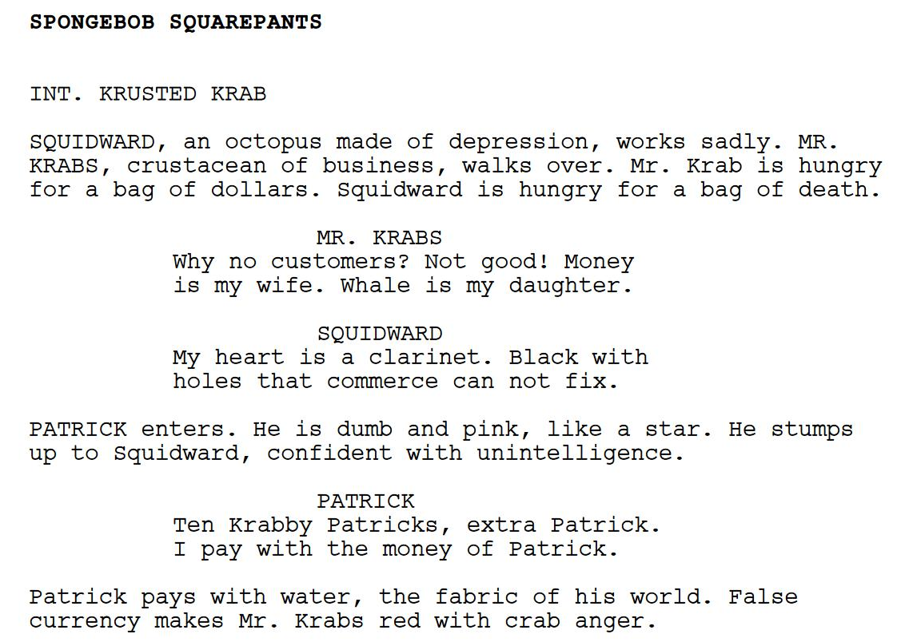
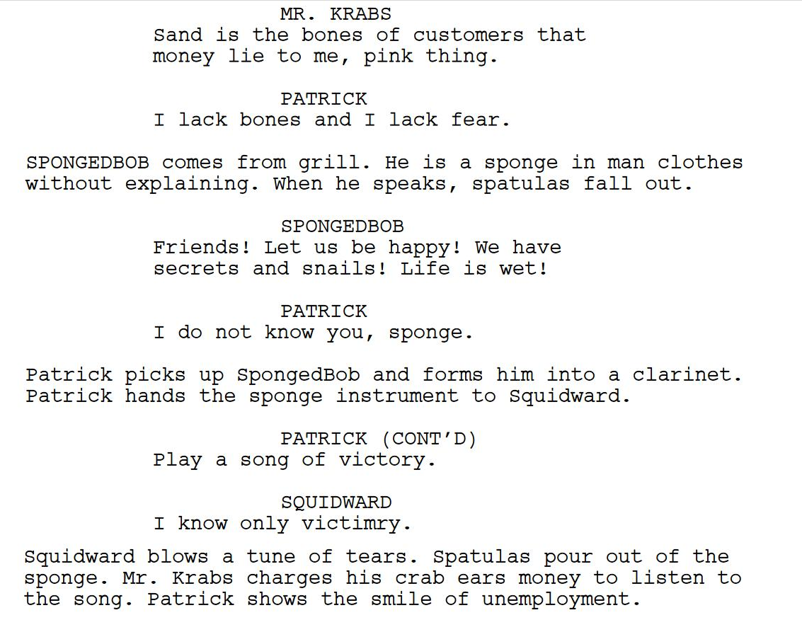
, Programming
Hello
Programming is telling a computer what to do
At its core, programming means writing instructions for a computer to follow
It is also called scripting – like writing a script for a play – and, like a play script, syntax matters
Notes:
Let’s say hello to programming. Does anyone know any programming languages?
Programming is different than writing HTML and CSS code. Those languages describe how to display a website, but they aren’t actually executing programs.
Programming means writing instructions for a computer to follow. These instructions have a very specific format, or what’s called syntax
This is a lot like writing a script for a play – and it’s super important that the script is the proper format. This script is not from a play, it’s from an AI-generated episode of spongebob. Still good. But we’re not ready to dispense with the theatrics just yet…

Slide 3
Agenda
What Python Does
Turtle Graphics
Mini Quiz
Loops
Python in the World

Slide 4
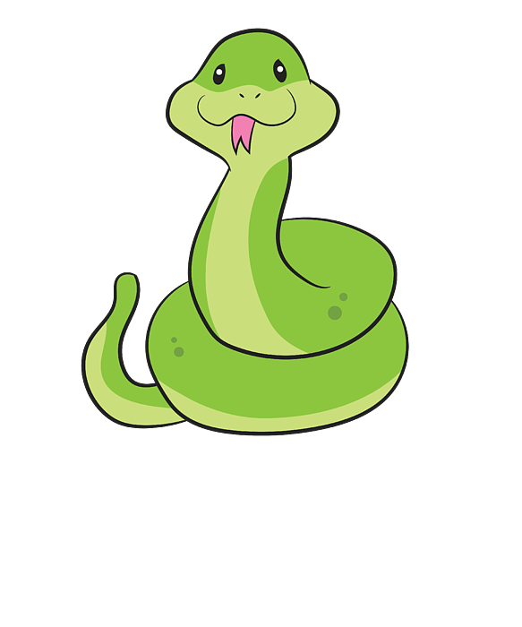
Python Executes Instructions
Hi!
Magical Scroll
Say “Hi”
Sleep for 5 seconds
Calculate 4+4
Do a flip
🐍
Notes:
Remember, Python (this snake guy) executes instructions. Python reads the instructions, and follows them – executing the commands.
Imagine there were a magical scroll that could control this snake. It has a set of instructions that MUST be followed.
The snake will read through these instructions ONE BY ONE. The first one happens first. Order matters.
The snake will execute the first instruction. Like this. It will say Hi!

Slide 5
Python Executes Instructions
z
z
Magical Scroll
Say “Hi”
Sleep for 5 seconds
Calculate 4+4
Do a flip
z
〰
〰
🐍
Notes:
After that, the snake will move on down to the next statement. It will read it, understand it, and then do it!
It looks like this.

Slide 6
Python Executes Instructions
8
Magical Scroll
Say “Hi”
Sleep for 5 seconds
Calculate 4+4
Do a flip
🐍
Notes:
The snake, being a super powerful computer, can also perform calculations. What’s four plus four?
It will spit out the answer.

Slide 7
Python Executes Instructions
Magical Scroll
Say “Hi”
Sleep for 5 seconds
Calculate 4+4
Do a flip
🐍
Notes:
Using some specific libraries (code other people wrote), it’s even possible to have graphical representations of the computer. If we tell Python to do a flip…
It will flip.

Slide 8
Python Executes Instructions
magical_scroll.py
print('Hi')
time.sleep(5)
print(4 + 4)
turtle.right(360)
Magical Scroll
Say “Hi”
Sleep for 5 seconds
Calculate 4+4
Do a flip
Each line of code is a statement or command
Each statement does something specific
Everything must be spelled correctly
Parentheses, quotation marks, periods - all important
Notes:
So, how does this actually translate into real Python code?
Really, it’s not too different from the text – but there are some specific format needs (or SYNTAX) that must be followed.
Each line here is a command or statement. Those are the same thing for our purposes.
Each statement does something very specific – the snake does exactly what you tell it, as long as it knows how!
It’s really important to spell everything correctly
Things like parentheses, quotation marks, and periods all need to be in the right place. They are super important! When in doubt, try to make sure everything you’re typing matches exactly.

Slide 9
🐢
___-------___
_-~~ ~~-_
_-~ /~-_
/^\__/^\ /~ \ / \
/| O|| O| / \_______________/ \
| |___||__| / / \ \
| \ / / \ \
| (_______) /______/ TURTLE \_________ \
| / / \ GRAPHICS / \
\ \^\\ \ / \ /
\ || \______________/ _-_ //\__//
\ ||------_-~~-_ ------------- \ --/~ ~\ || __/
~-----||====/~ |==================| |/~~~~~
(_(__/ ./ / \_\ \.
(_(___/ \_____)_)

Slide 10
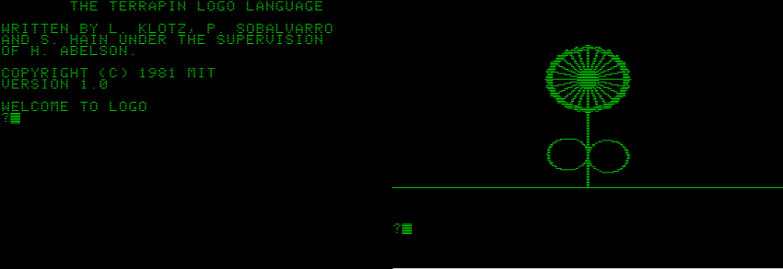
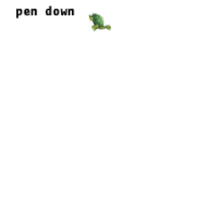
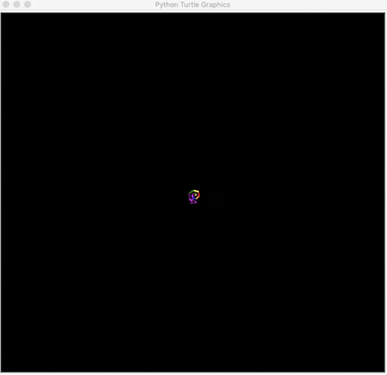
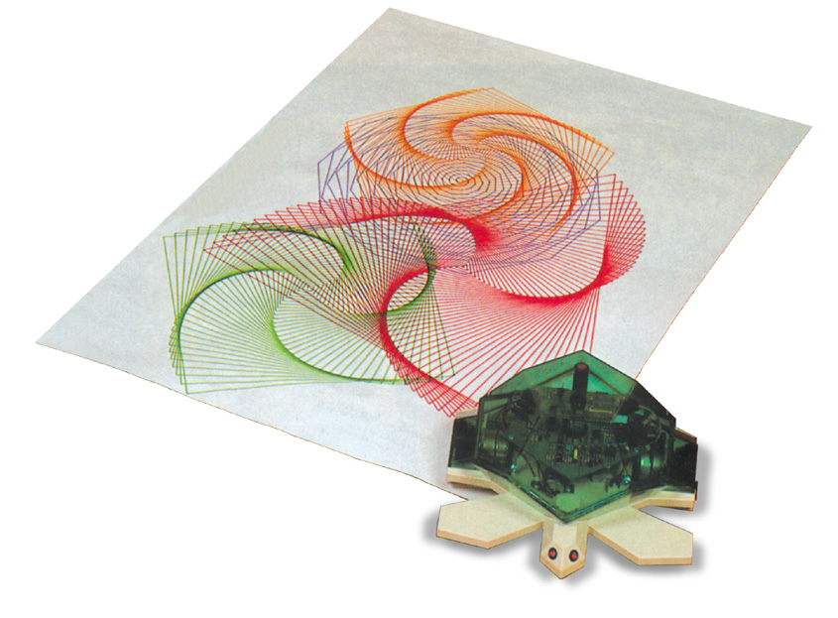
What are Turtle Graphics?
🐢
Logo (1969)
Julia/Luxor
Python
Valiant

Slide 11
Turtles in Python
🐢
📚
from turtle import *
pulls in all the code from the turtle library
nothing else will work without this at the top

Slide 12
Creating a New Turtle
🐢
myrtle = Turtle()
Capital T in Turtle
Only letters (no spaces) in the turtle name
Parentheses ()
Equals sign =

Slide 13
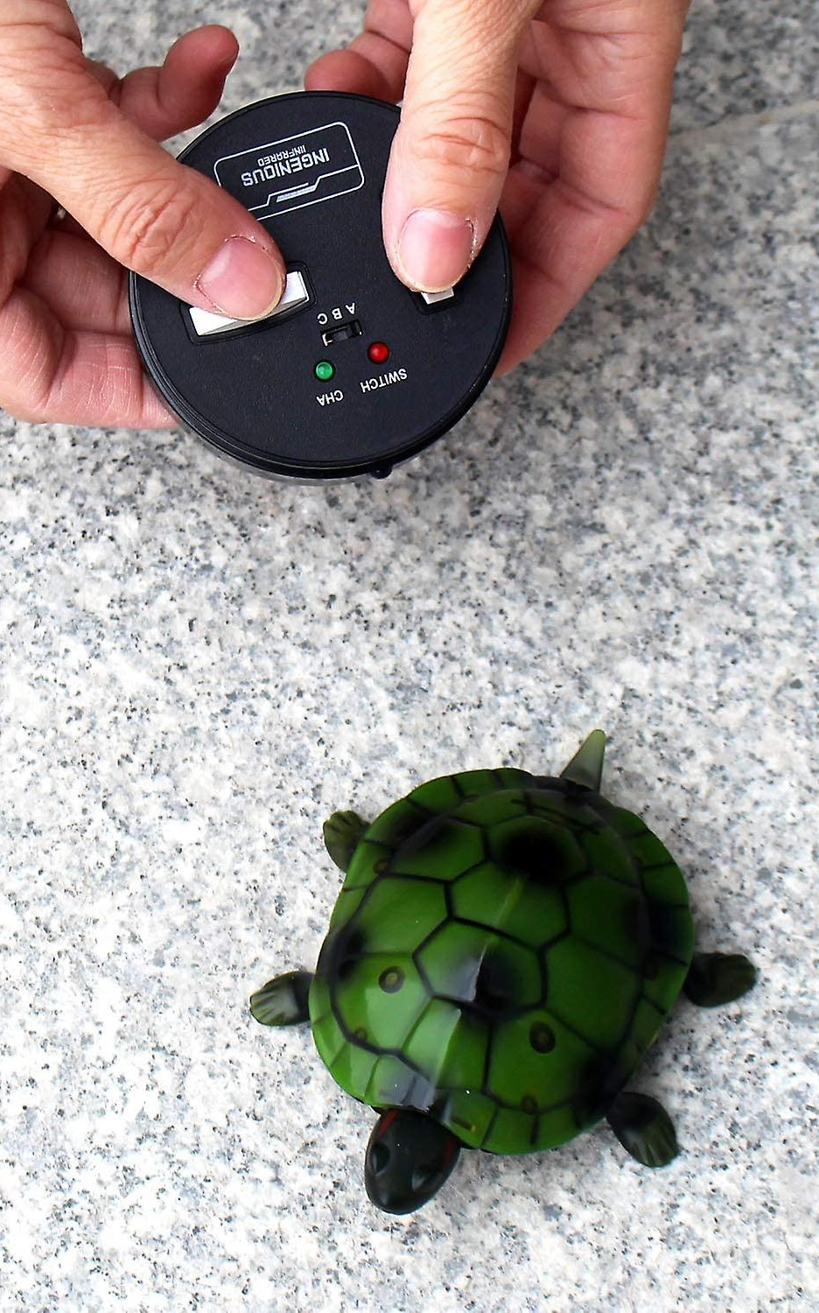
Controlling the Turtle
🐢
Call turtle functions with DOT .
example (not real):
myrtle.dance()

Slide 14

Turtle Features
🐢
myrtle.shape("arrow")
myrtle.color("green")
myrtle.turtlesize(1)
myrtle.speed(1)
myrtle.pensize(1)

Slide 15
Turtle Abilities
🐢
myrtle.forward(100)
myrtle.right(180)
myrtle.write("hi")

Slide 16
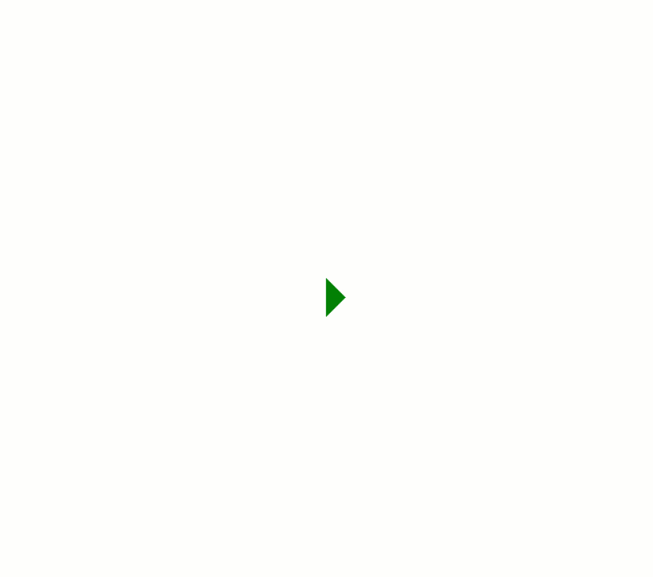
Turtle Abilities
Questions?
myrtle.forward(100)
myrtle.right(180)
myrtle.write("hi")

Slide 17
Mini Quiz #1
crush.write("ahoy")

Slide 18
Q: What is this turtle’s name?
crush.write("ahoy")
crush

Slide 19
Q: What are these symbols?
crush.write("ahoy")
Quotation marks

Slide 20
Q: What does this turtle do?
crush.write("ahoy")
write

Slide 21
Q: What is this symbol?
crush.write("ahoy")
A period/dot

Slide 22
Q: What are these symbols?
crush.write("ahoy")
Parentheses

Slide 23
Q: What does this turtle say?
crush.write("ahoy")
ahoy

Slide 24
Q: What is this line?
crush.write("ahoy")
A statement/command

Slide 25

Loops

Slide 26
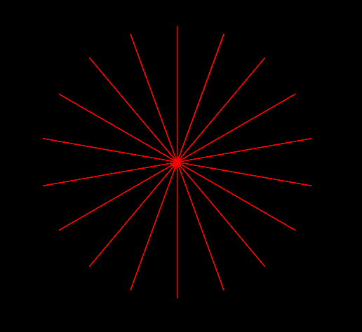
Code Without Loops
from turtle import *
sambi = Turtle()
paper = sambi.getscreen()
paper.bgcolor("black")
sambi.left(90)
sambi.color("red")
sambi.speed(10)
sambi.forward(100)
sambi.backward(100)
sambi.right(20)
sambi.forward(100)
sambi.backward(100)
sambi.right(20)
sambi.forward(100)
sambi.backward(100)
sambi.right(20)
sambi.forward(100)
sambi.backward(100)
sambi.right(20)
sambi.forward(100)
sambi.backward(100)
sambi.right(20)
sambi.forward(100)
sambi.backward(100)
sambi.right(20)
# and so on...

Slide 27
Code With Loops
from turtle import *
sambi = Turtle()
paper = sambi.getscreen()
paper.bgcolor("black")
sambi.left(90)
sambi.color("red")
sambi.speed(10)
sambi.forward(100)
sambi.backward(100)
sambi.right(20)
sambi.forward(100)
sambi.backward(100)
sambi.right(20)
sambi.forward(100)
sambi.backward(100)
sambi.right(20)
sambi.forward(100)
sambi.backward(100)
sambi.right(20)
sambi.forward(100)
sambi.backward(100)
sambi.right(20)
sambi.forward(100)
sambi.backward(100)
sambi.right(20)
# and so on...
Notes:
Ask the students which pieces of code are repeated

Slide 28
Code With Loops
from turtle import *
sambi = Turtle()
paper = sambi.getscreen()
paper.bgcolor("black")
sambi.left(90)
sambi.color("red")
sambi.speed(10)
sambi.forward(100)
sambi.backward(100)
sambi.right(20)
sambi.forward(100)
sambi.backward(100)
sambi.right(20)
sambi.forward(100)
sambi.backward(100)
sambi.right(20)
sambi.forward(100)
sambi.backward(100)
sambi.right(20)
sambi.forward(100)
sambi.backward(100)
sambi.right(20)
sambi.forward(100)
sambi.backward(100)
sambi.right(20)
# and so on...
sambi.forward(100)
sambi.backward(100)
sambi.right(20)
Notes:
These three lines are repeated! Over and over again!

Slide 29
Code With Loops
from turtle import *
sambi = Turtle()
paper = sambi.getscreen()
paper.bgcolor("black")
sambi.left(90)
sambi.color("red")
sambi.speed(10)
sambi.forward(100)
sambi.backward(100)
sambi.right(20)
sambi.forward(100)
sambi.backward(100)
sambi.right(20)
Notes:
We don’t need all the other ones!

Slide 30
Code With Loops
from turtle import *
sambi = Turtle()
paper = sambi.getscreen()
paper.bgcolor("black")
sambi.left(90)
sambi.color("red")
sambi.speed(10)
sambi.forward(100)
sambi.backward(100)
sambi.right(20)
sambi.forward(100)
sambi.backward(100)
sambi.right(20)
Notes:
Let’s take a look here

Slide 31
Code With Loops
Number of times to repeat
from turtle import *
sambi = Turtle()
paper = sambi.getscreen()
paper.bgcolor("black")
sambi.left(90)
sambi.color("red")
sambi.speed(10)
sambi.forward(100)
sambi.backward(100)
sambi.right(20)
sambi.forward(100)
sambi.backward(100)
sambi.right(20)
for x in range(18):
Notes:
And we want to throw these in a loop! 18 times!

Slide 32
Code With Loops
from turtle import *
sambi = Turtle()
paper = sambi.getscreen()
paper.bgcolor("black")
sambi.left(90)
sambi.color("red")
sambi.speed(10)
sambi.forward(100)
sambi.backward(100)
sambi.right(20)
sambi.forward(100)
sambi.backward(100)
sambi.right(20)
for x in range(18):
->
->
->
Indentation: shows Python which commands to repeat
Notes:
Indentation is how you show which lines to repeat!

Slide 33
Review
for x in range(5):
sambi.right(10)
for
x
in
range
parentheses ()
number 5
colon :
indentation ->
->
Question
How far will sambi turn in total?
Answer
50 degrees
(5 x 10)

Slide 34
Mini Quiz #2
for x in range(5):
sambi.right(10)
What eight (8) things are needed for a loop?

Slide 35
Python in the World

Slide 36
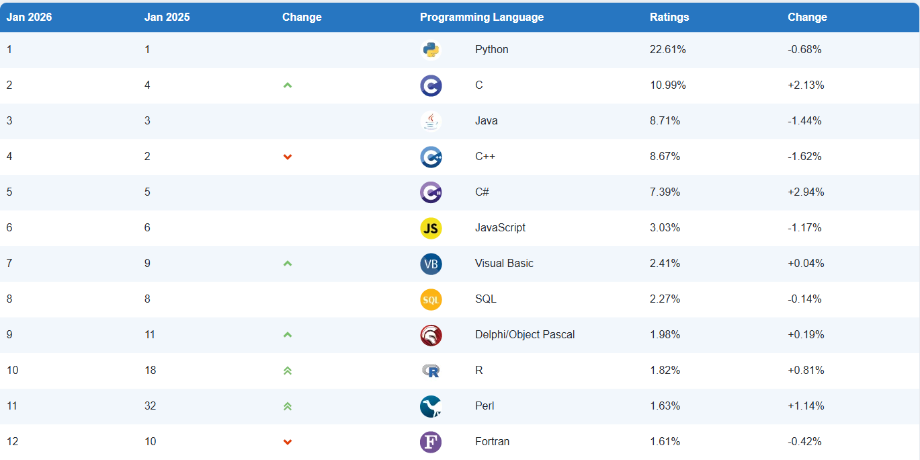

Slide 37
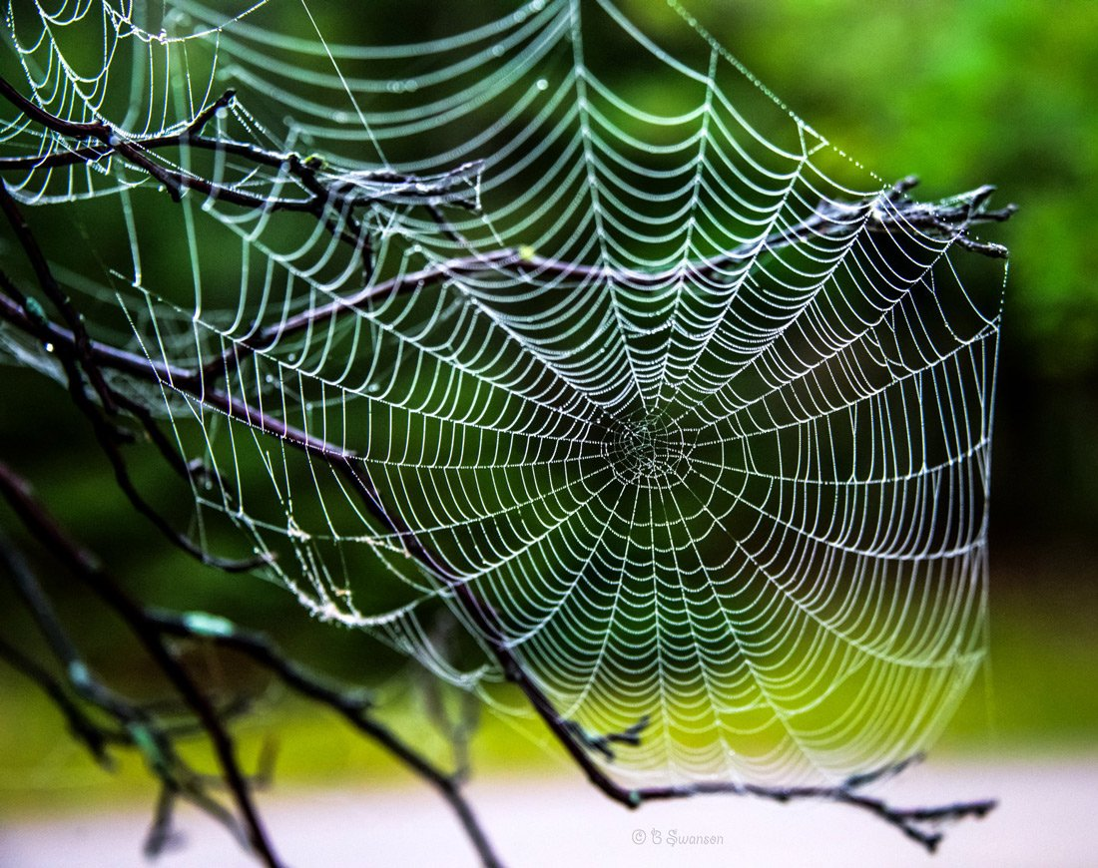
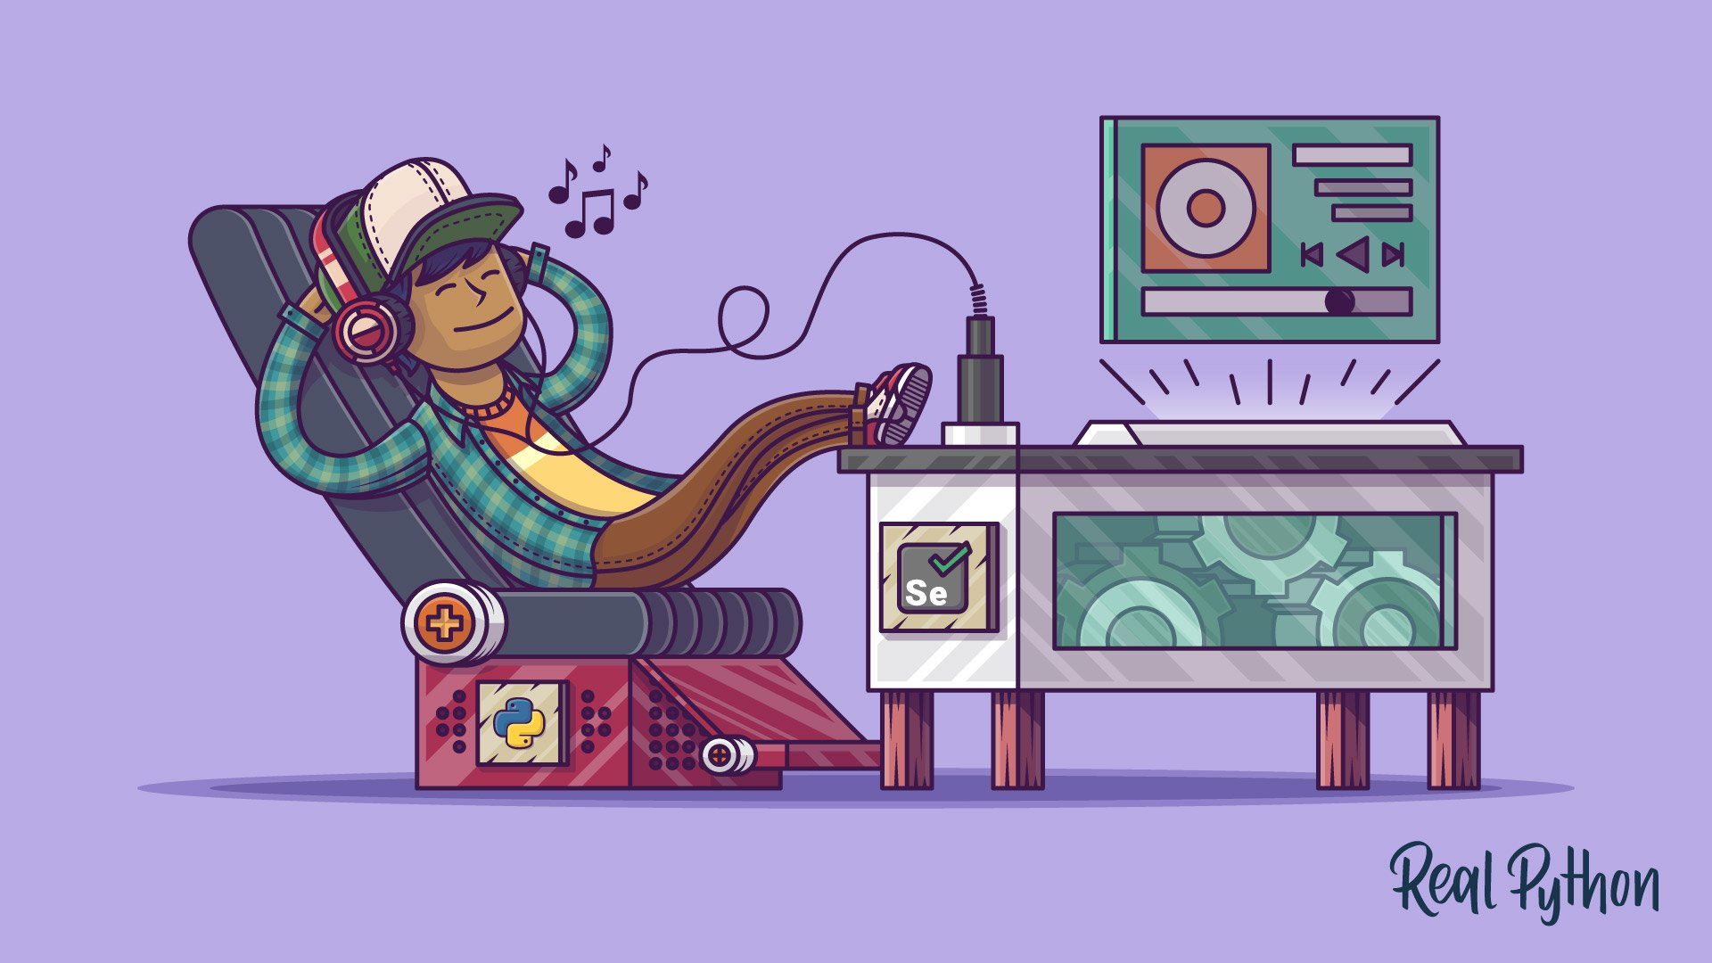
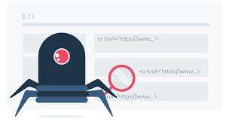
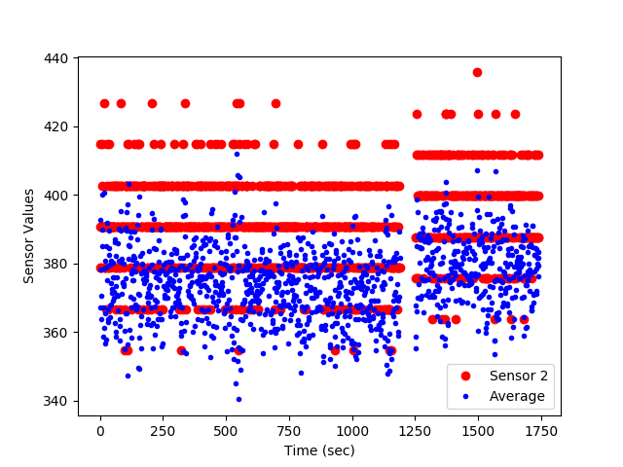
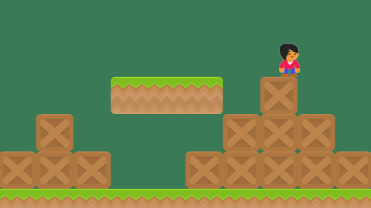

Things You Can Do
Make Websites
Automate Everything
Get Stuff from Websites
Analyze Data
Develop Games
Create A.I. Apps + Agents
Notes:
Python has a ton of uses. A few of them:
Game Development
Automation
Web Development
Data Analysis
Web Scraping
Machine Learning

Slide 38
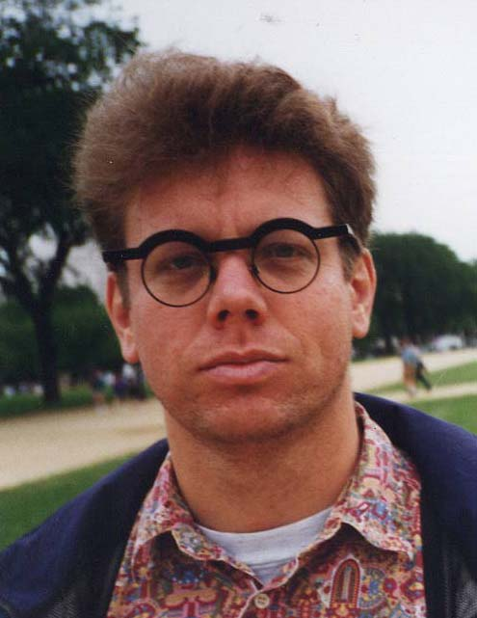
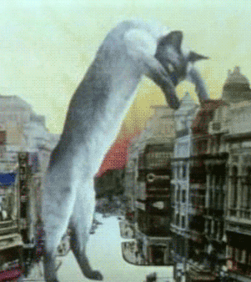
BONUS: Python Trivia
Some guiding principles include:
Beautiful is better than ugly.
Explicit is better than implicit.
Simple is better than complex.
Complex is better than complicated.
Readability counts.
Named after
Monty Python's Flying Circus
Released in 1991 by Dutch programmer Guido van Rossum
Notes:
None of this information is strictly necessary, but it’s fun to know!
Look at this cat – does anyone know Monty Python? That’s actually Python’s namesake.
The philosophy of Python has some key points. In comparison to other programming languages – these are some of the guiding principles.
Also, it was released in 1991 by this guy named Guido van Rossum. His glasses are cool as heck.

Slide 39
Why Python?
You can use it for so many purposes
It is popular so there’s a community of support
It’s a simpler place to start than Java, C, C#, etc
It’s fun!
Notes:
Python has a ton of uses. A few of them:
Game Development
Automation
Web Development
Data Analysis
Web Scraping
Machine Learning

Slide 40
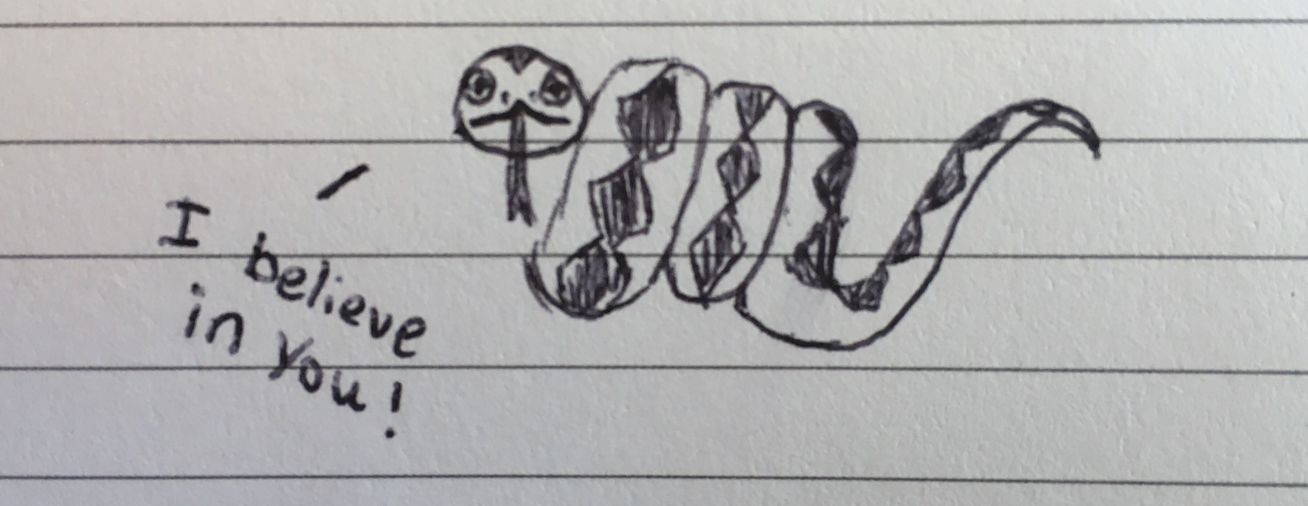
Final Thoughts
Notes:
This may feel like a lot of new information, a lot of new words, lots of different things – but that’s okay!
This snake believes in you, and I do too.

