Slide 1
Emerging Technology

Slide 2
Emerging technologies are technologies whose development, practical applications, or both are still largely unrealized
Wikipedia

Slide 3
CREATE
PREDICT
IMAGINE
the future

Slide 4
What’s an example of an emerging technology?

Slide 5
AI, AI, AI, AI, AI, AI, AI, AI, AI, AI, AI, AI, AI, AI
Everyone, all the time

Slide 6
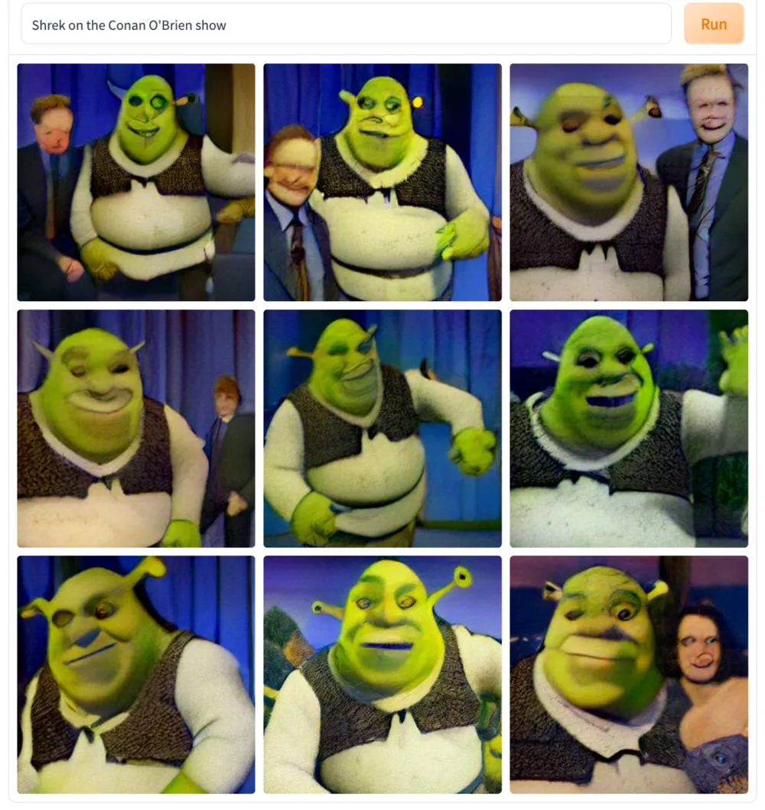
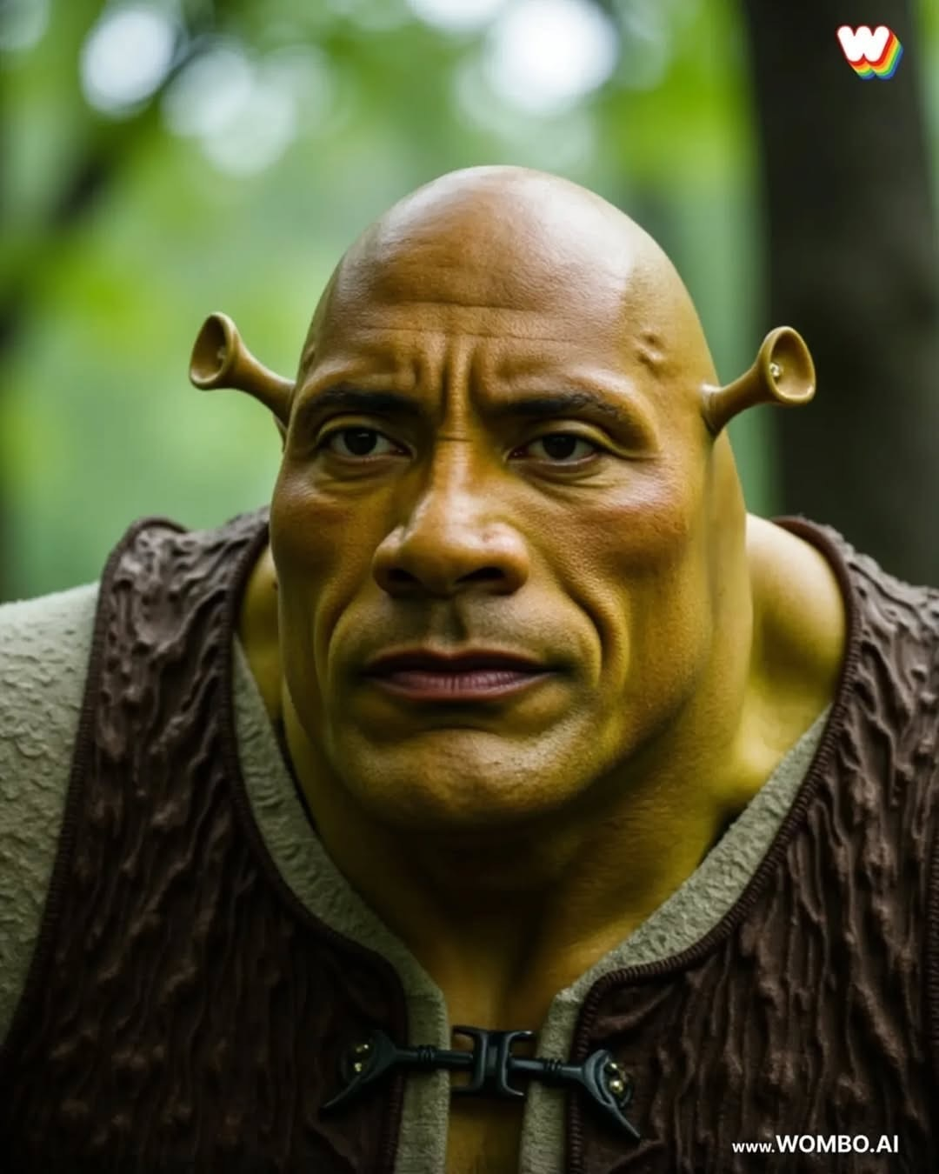
A.I. 2023
A.I. Now

Slide 7
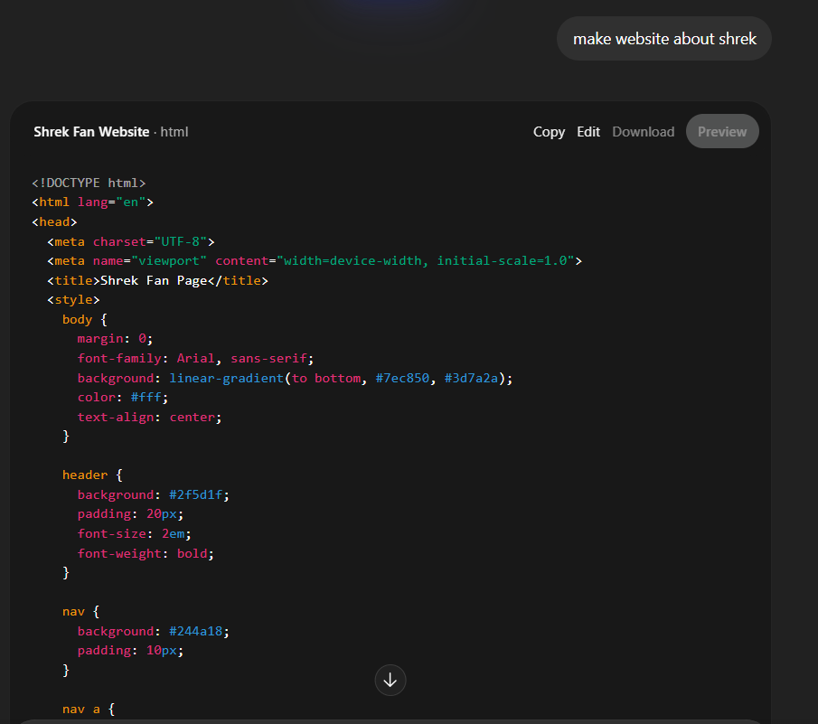

A.I. Now

Slide 8
?
A.I. Now
A.I. 2029
Agents that operate without human input
Video generation
Vibe Coding taken to the next level
Human-Quality writing
Learning Assistance
Recursively Self-Improving A.I.
Artificial General Intelligence
Robots
Superintelligence ?
Learning Assistance
What’s something A.I. can’t do now?
What’s something A.I. will never be able to do?

Slide 9
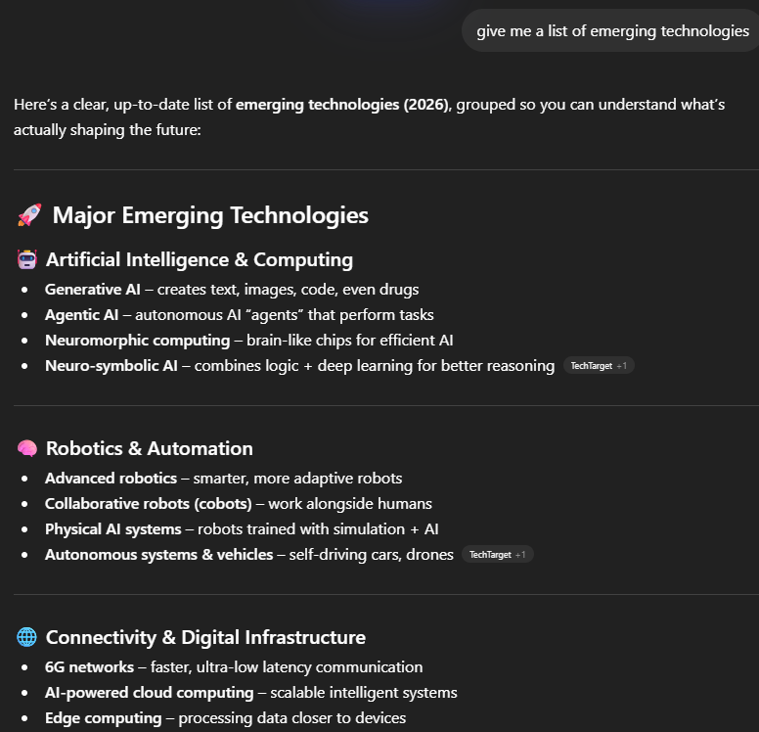
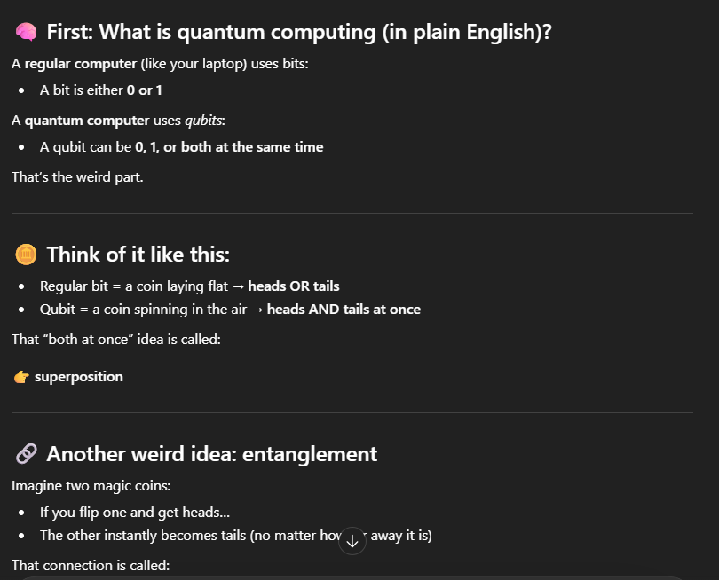
Learning Assistance
Teach me about quantum computing…

Slide 10
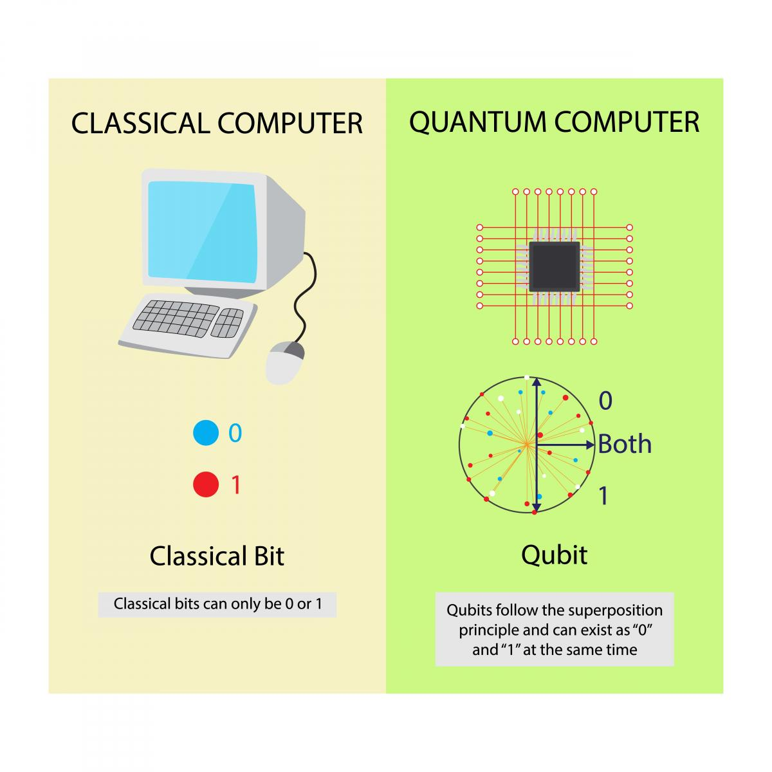
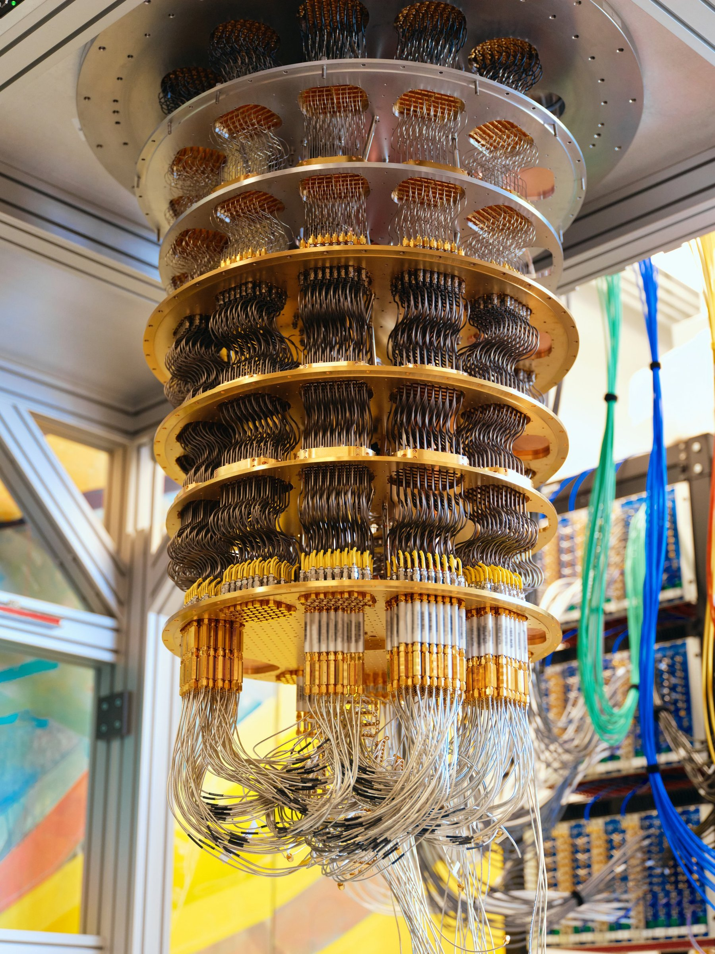
Quantum Computing
a quantum computer with several qubits in superposition can crunch through a vast number of potential outcomes simultaneously
https://www.technologyreview.com/2019/01/29/66141/what-is-quantum-computing/

Slide 11

One Example: Pharmaceuticals
Classical computers can't precisely simulate drug molecules, so robust experimentation is still needed to screen promising drug candidates. Quantum computers are ideal for getting precise simulations of how potential drugs interact with complex biological molecules. This may help researchers better identify drug candidates – and ultimately improve healthcare worldwide.
https://quantumai.google/applications

Slide 12
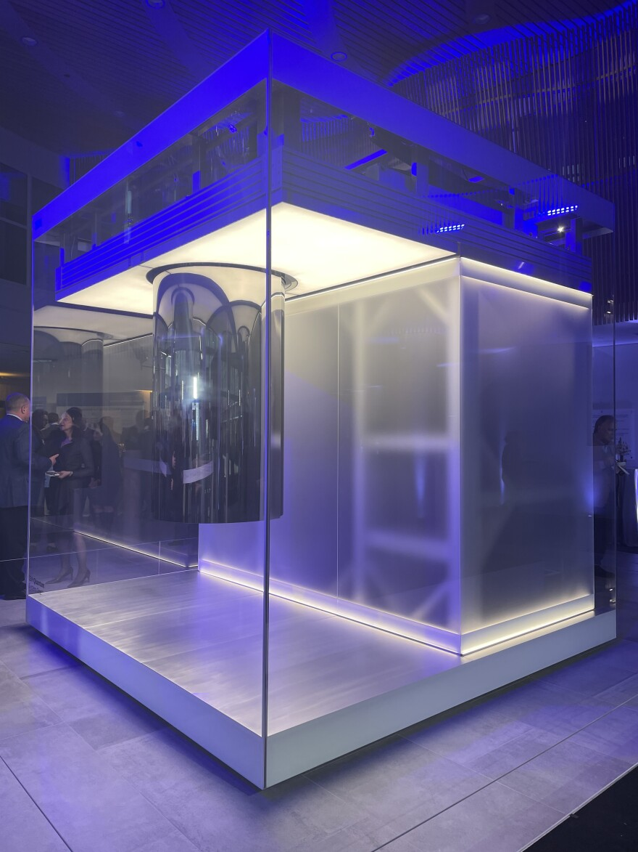
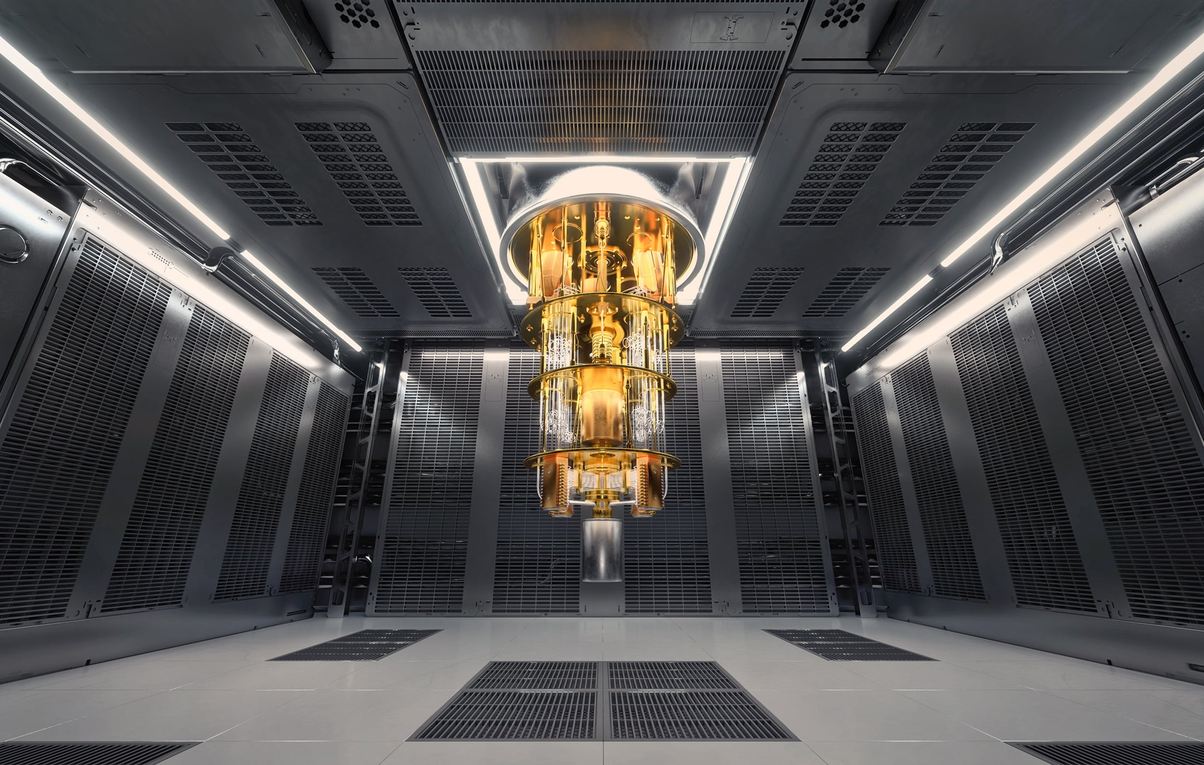
Also they just look really cool
This one is at Cleveland Clinic!

Slide 13
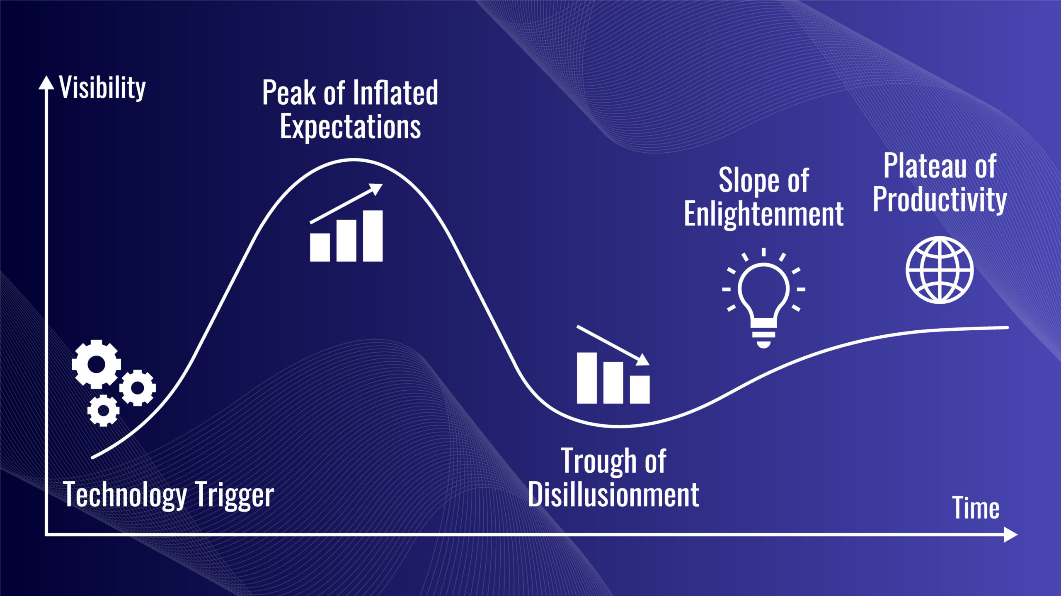
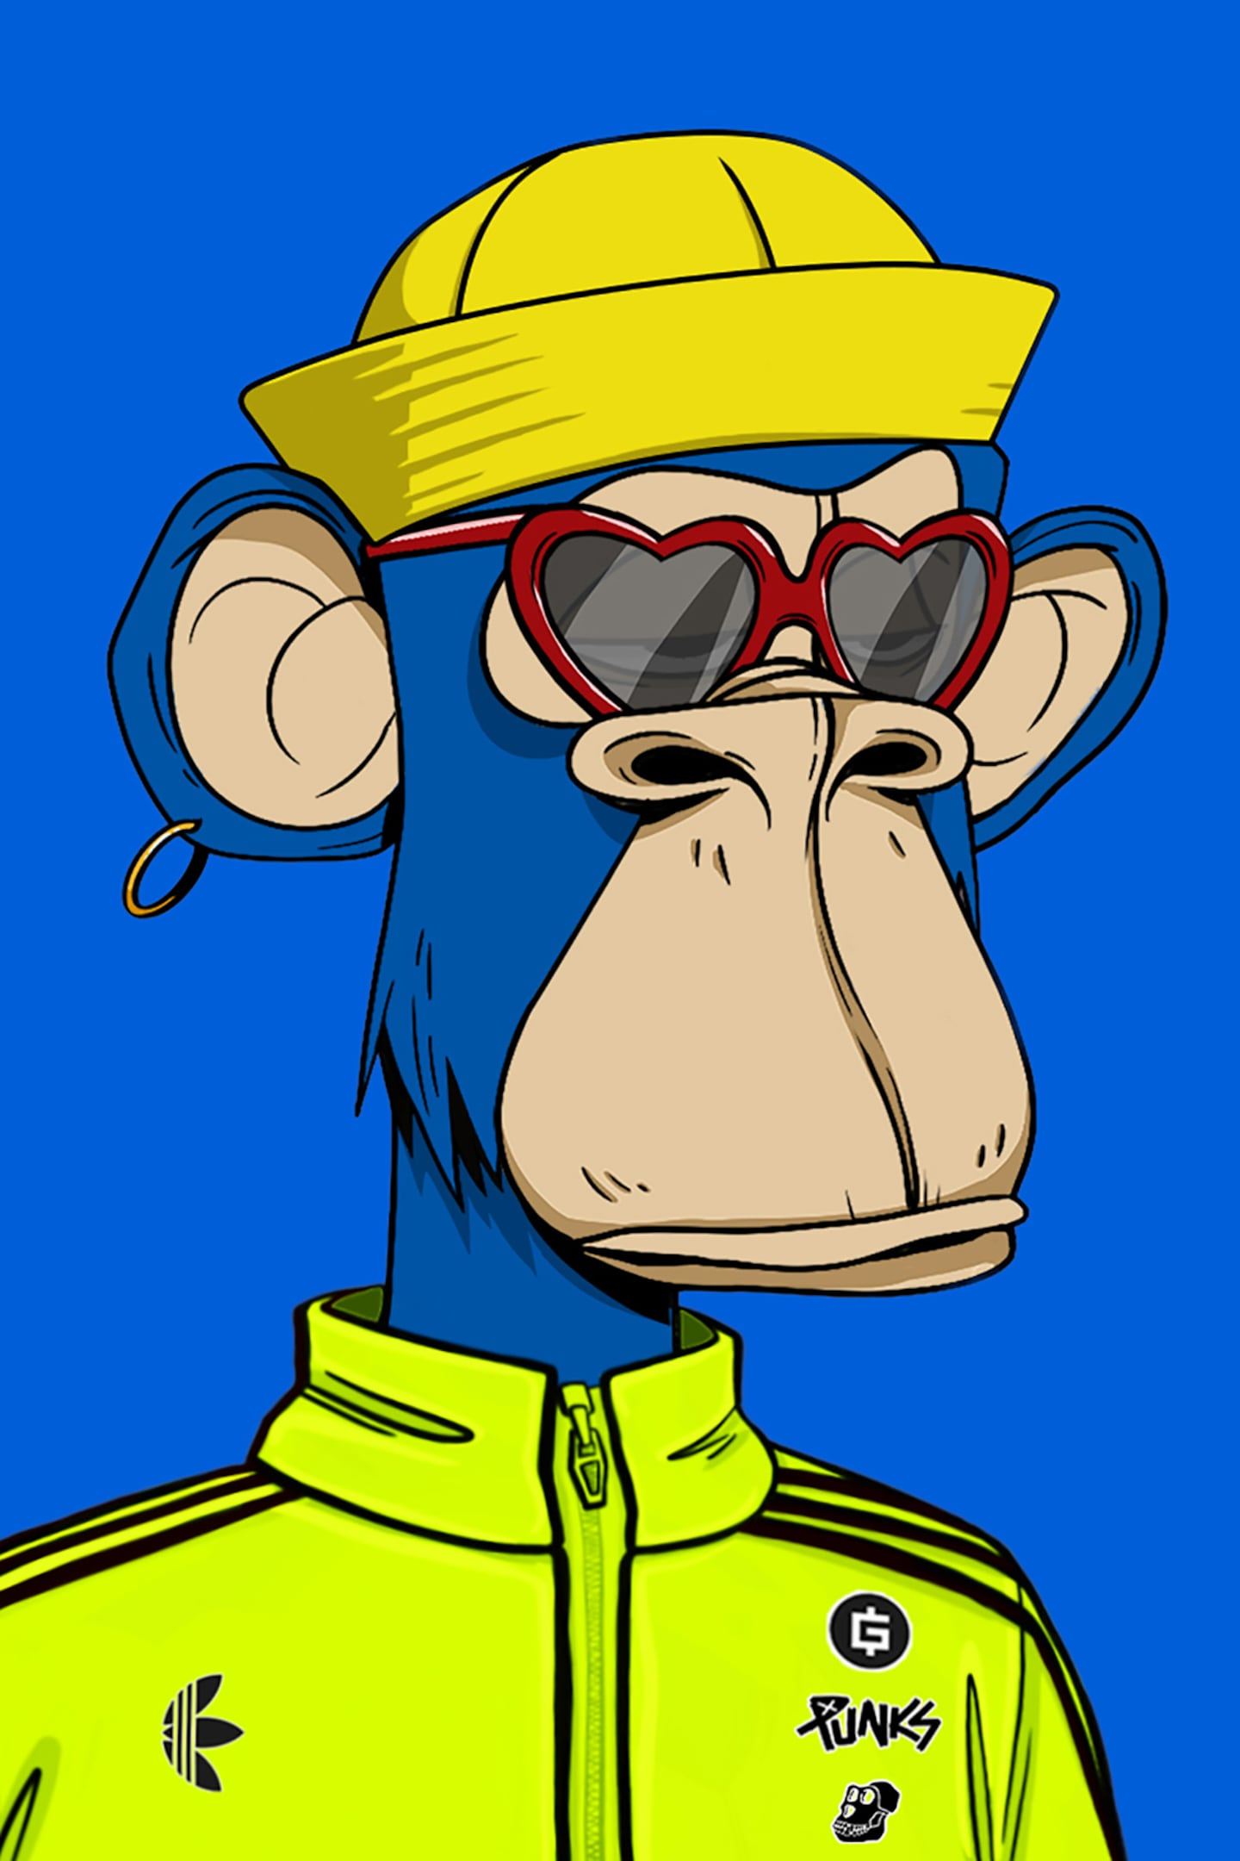
HYPE CYCLE
A.I. ?
Quantum Computing
A.I. ?
Blockchain /
NFTs

Slide 14
MORE TECHNOLOGIES!
Emerging
Must exist in some way
Must not be “mainstream”
Phases: research, prototype, development, diffusion
Hypothetical
Must not exist at all
Often the subject of science fiction books/movies
Might exist in the future
Examples
self-driving car … VR/AR … androids …
brain-computer interface
Examples
time machine … teleporter …
water-fueled car … immortality
Notes:
Let’s start by talking about two distinct types of futuristic technologies
The first is “emerging” – ask the students if they can guess what “emerging” technologies are
There are a few key criteria…
They must actually exist in some way
They must not be “mainstream” – not used by everyone already, like a smart phone or something like that
There are some basic phases:
Research (preliminary stage)
Prototype (actually having some version of the technology)
Development (active work on the technology)
Diffusion (technology works, and is in the process of becoming mainstream)
Ask the students if they can think of examples of “emerging” technologies
(hint: we have covered some of them in this presentation!)
Reveal some examples – some of these are farther along than others, but they are all considered “emerging”
Next, talk about another type of future technology – “hypothetical” – ask the students if they can guess what hypothetical technologies would be
The main criteria here is that the technology must NOT EXIST at all
These technologies are often used in Sci-Fi… but as we know, sci-fi can sometimes turn into sci-non-fi
The fun part is that these technologies might exist in the future
Ask the students if they can think of any examples of hypothetical technologies
Reveal a few examples – time machines and teleporters will probably never exist, but water-fueled cars and immortality via life extension may be possible
Or, who knows, anything might happen or not happen

Slide 15
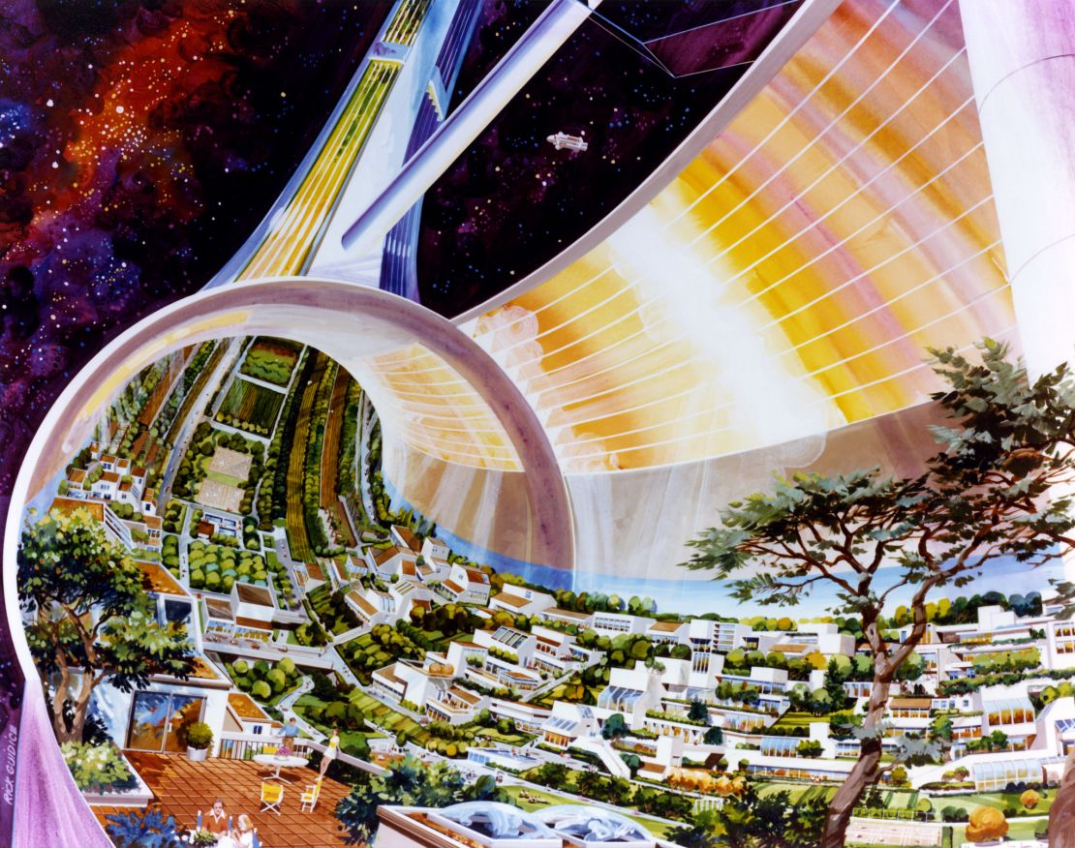
MEGASTRUCTURES

Slide 16
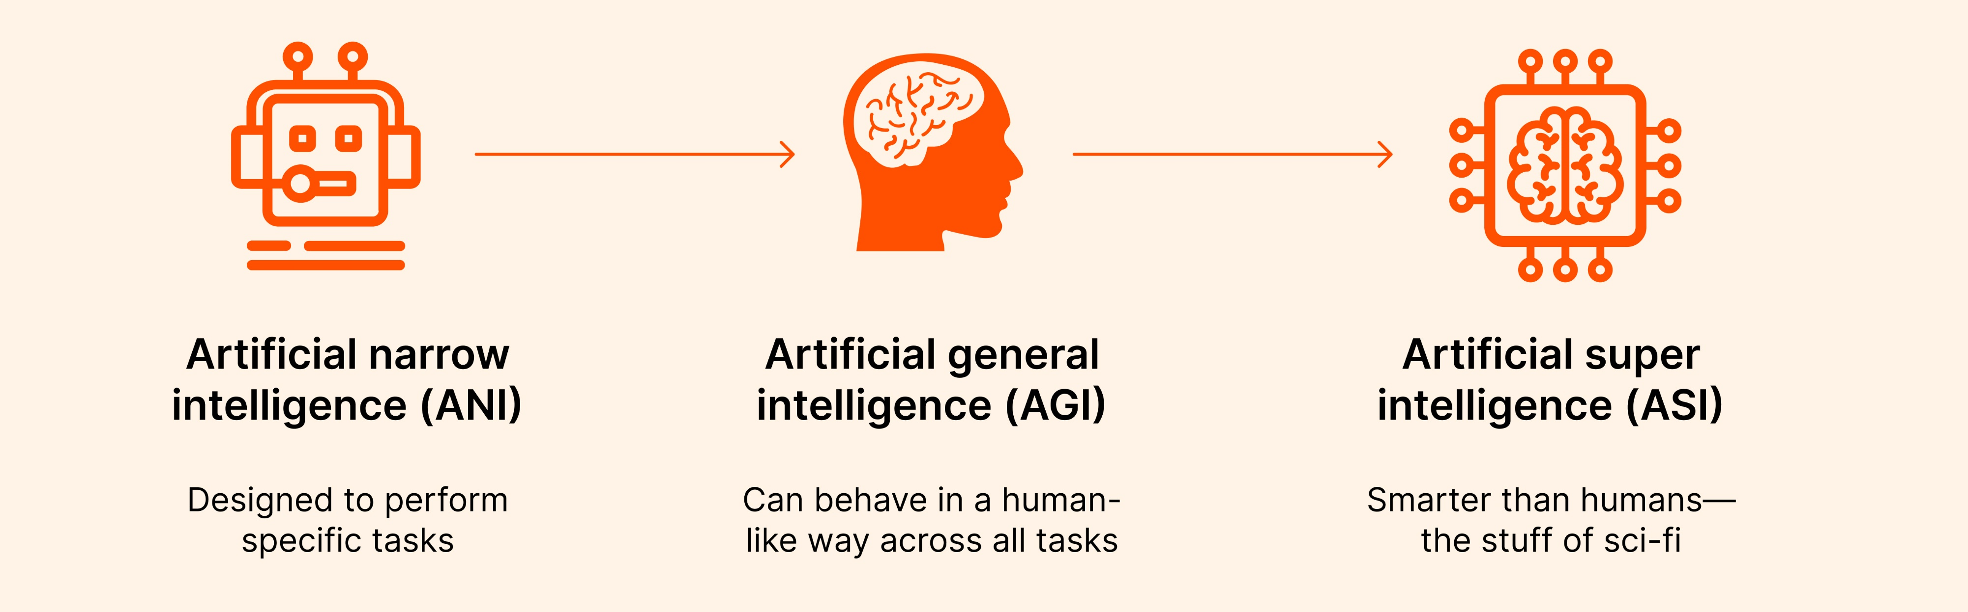
ARTIFICIAL GENERAL INTELLIGENCE

Slide 17
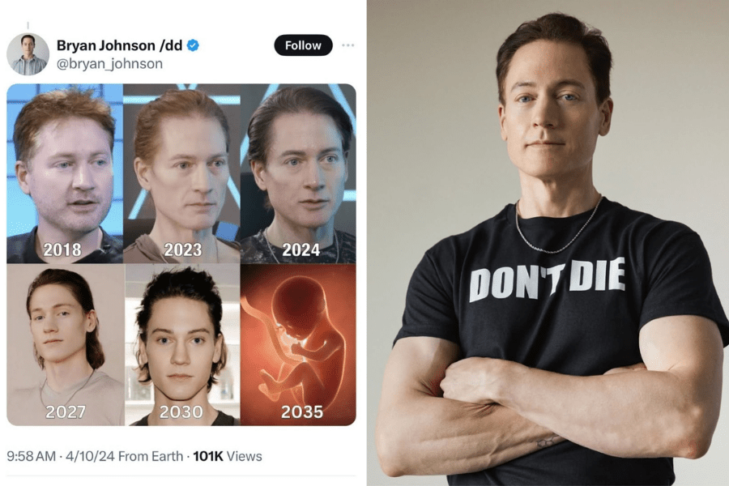
this is not real at all
AGELESSNESS
Notes:
Don’t be like him

Slide 18
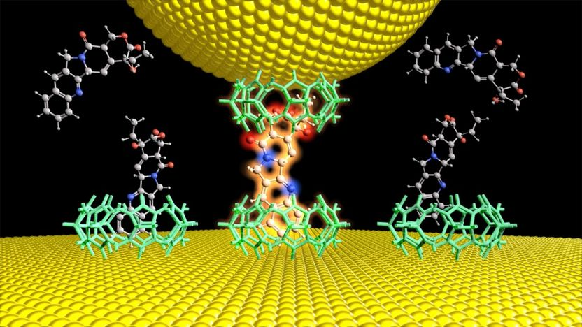
MOLECULAR ELECTRONICS

Slide 19
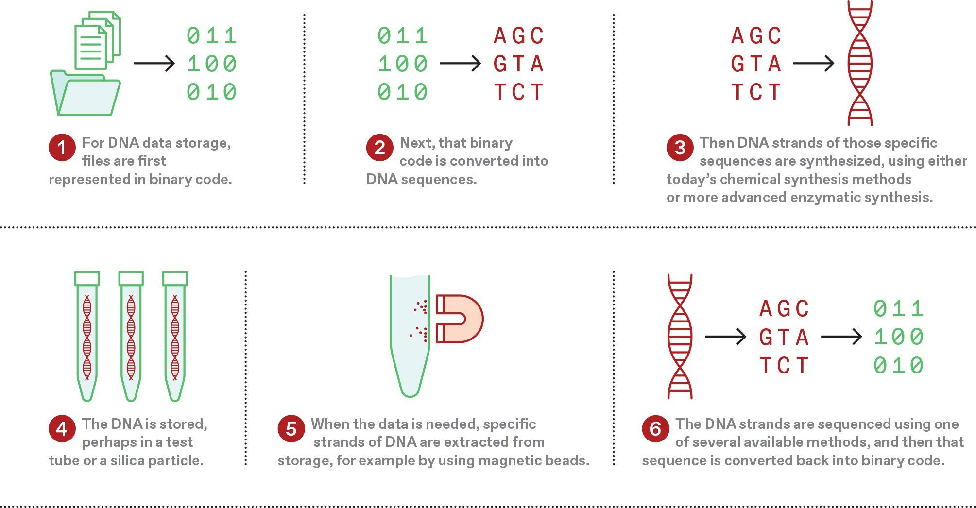
DNA DIGITAL STORAGE

Slide 20
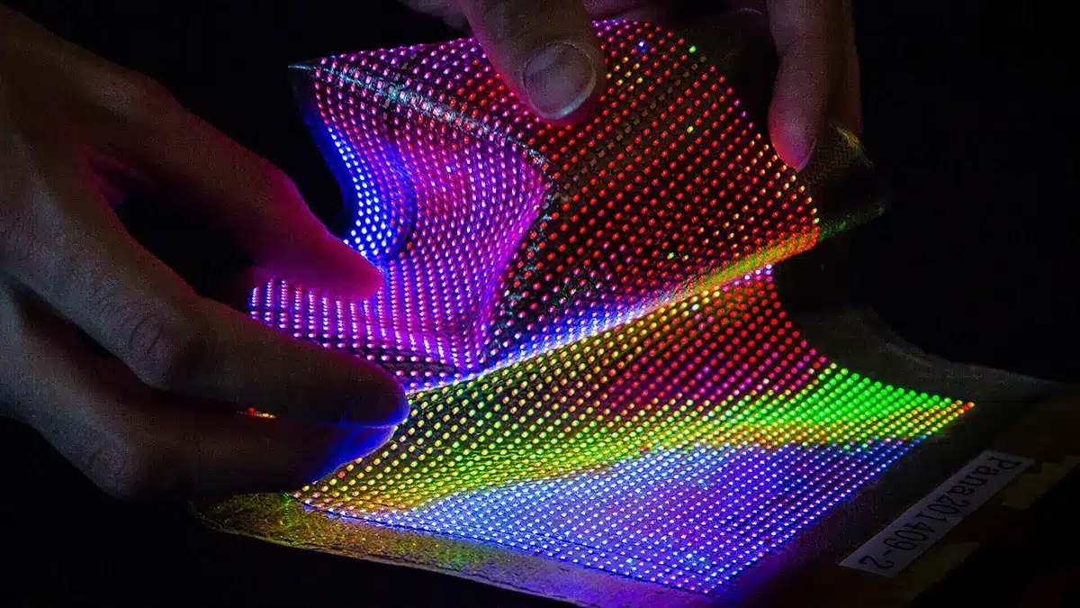
E-TEXTILES

Slide 21
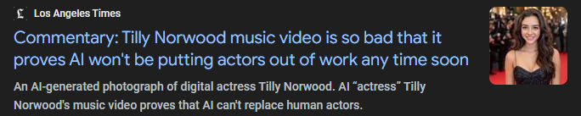
no one seems to like this
SYNTHETIC MEDIA

Slide 22

A.I. SLOP

Slide 23
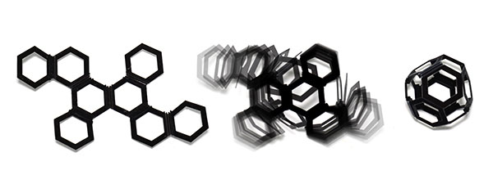
4D PRINTING

Slide 24
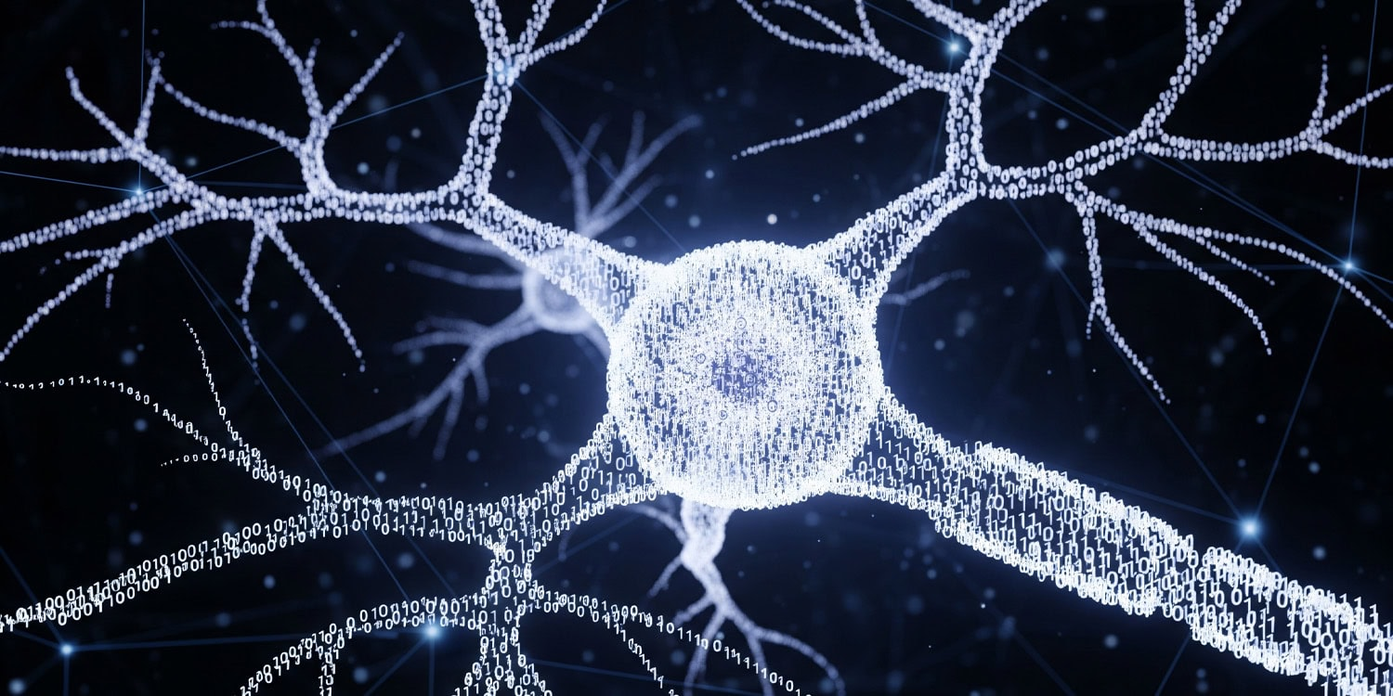
ARTIFICIAL BRAIN

Slide 25
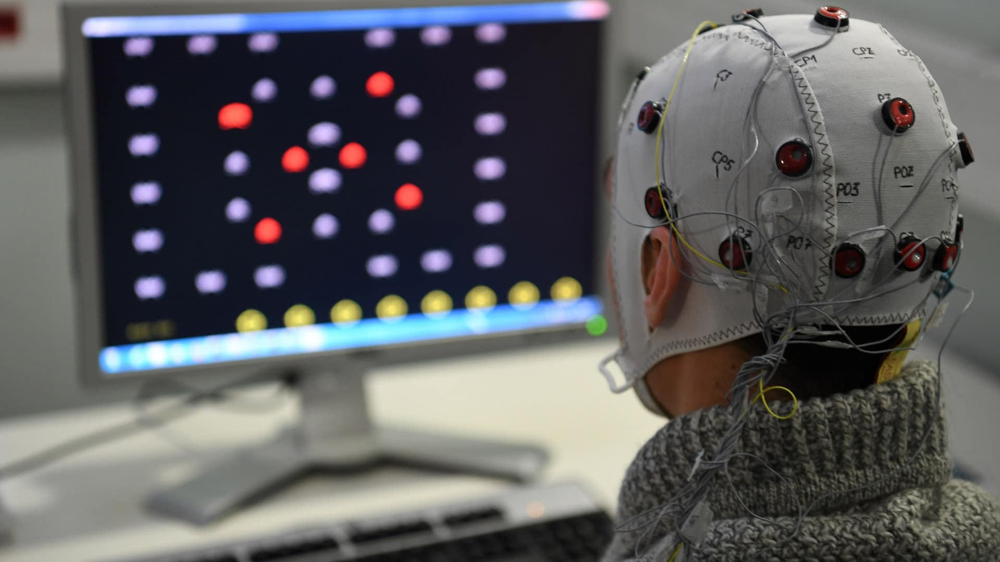
BRAIN-COMPUTER INTERFACE

Slide 26
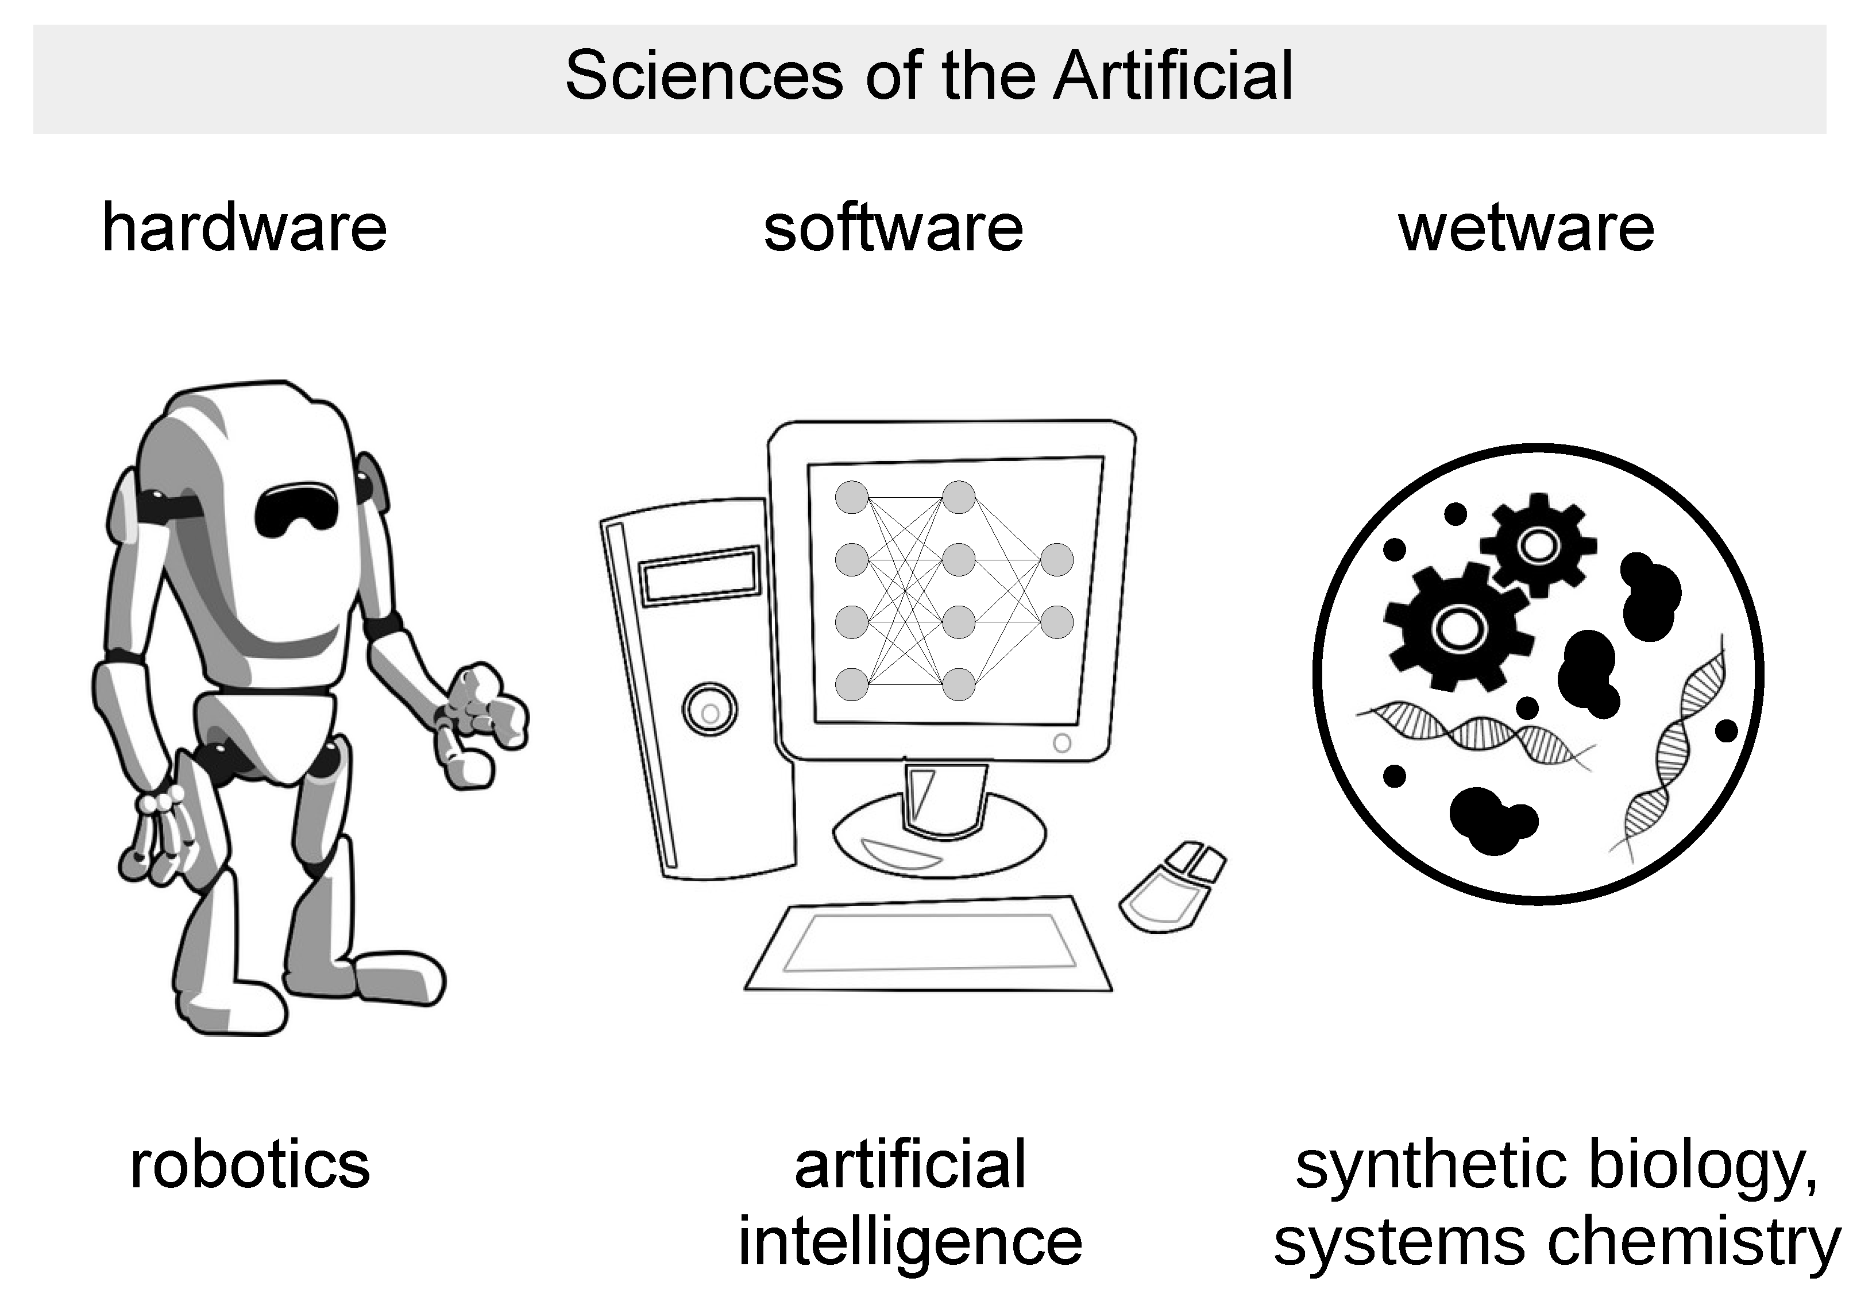
WETWARE COMPUTER

Slide 27
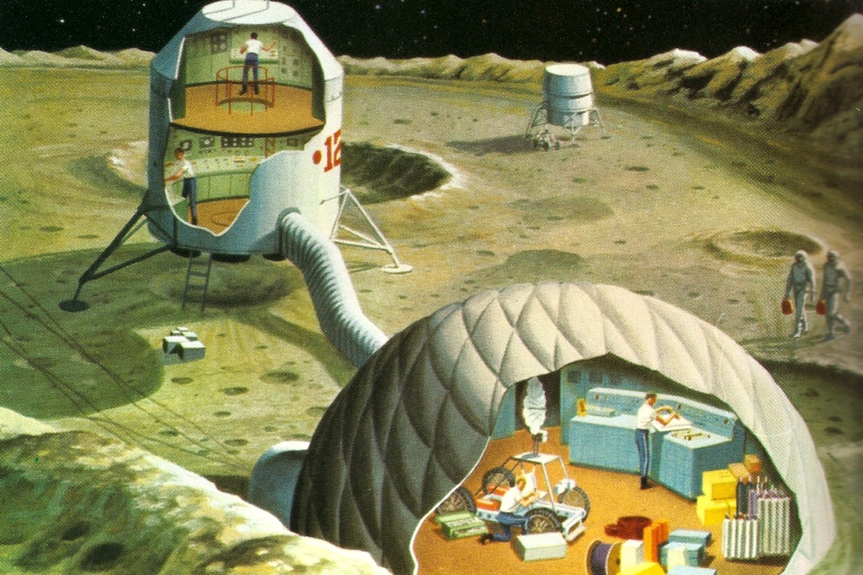
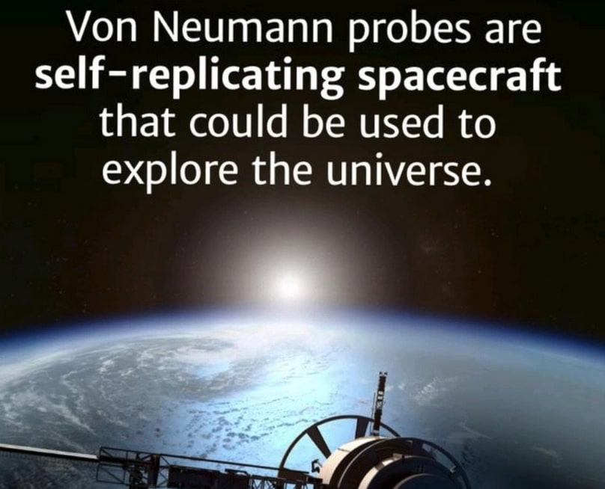
SPACE TRAVEL / COLONIZATION

Slide 28
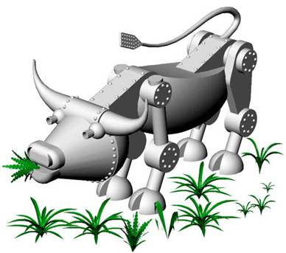
GASTROBOT

Slide 29
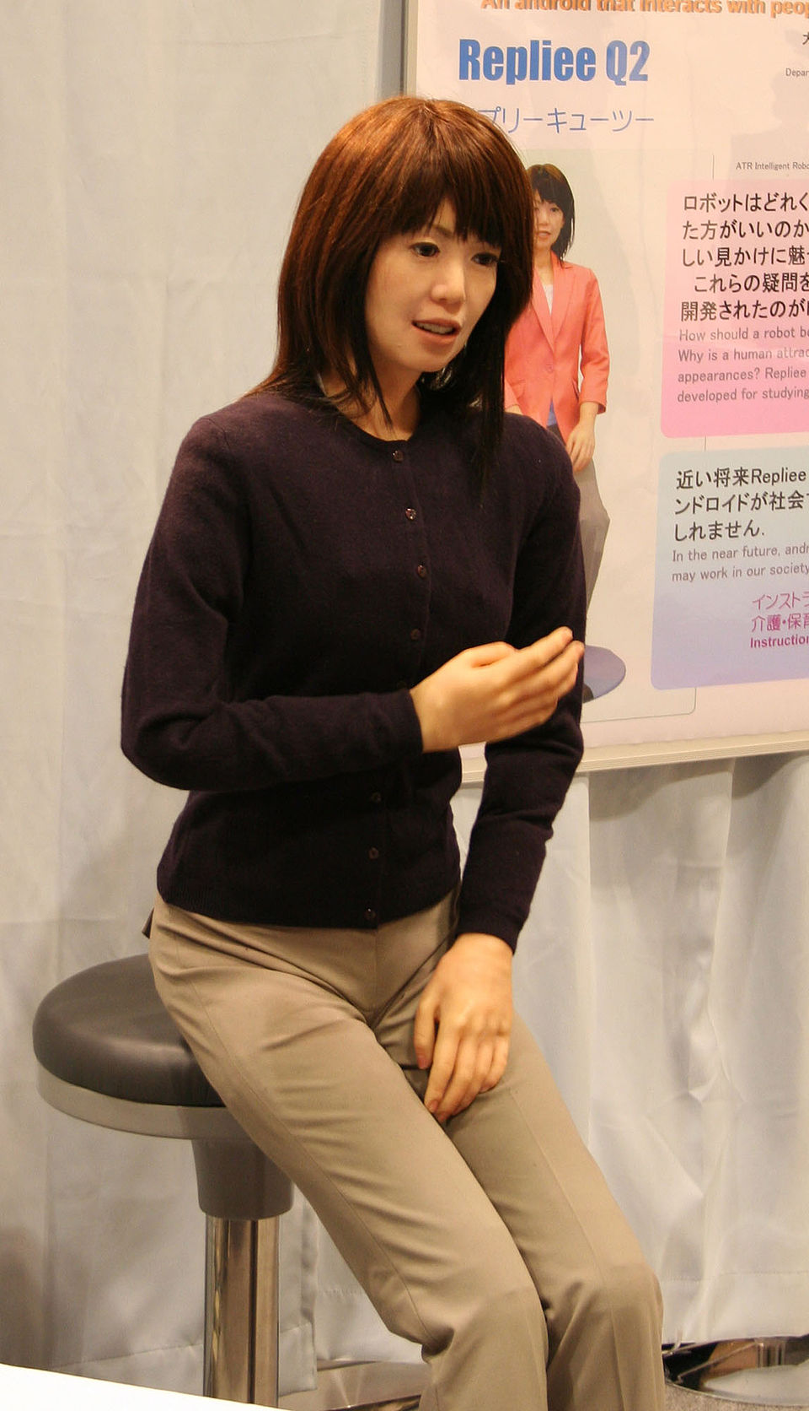
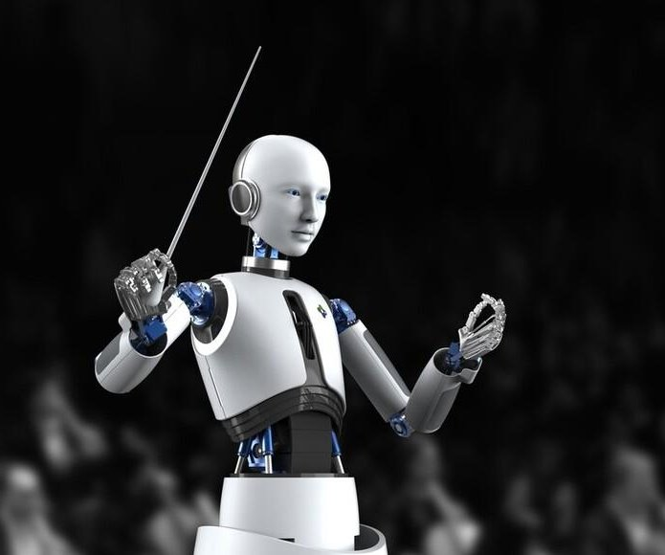
ANDROID

Slide 30
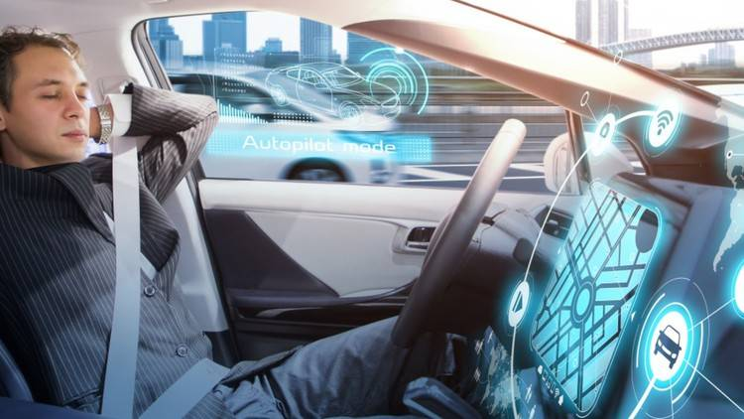
SELF-DRIVING CARS

Slide 31
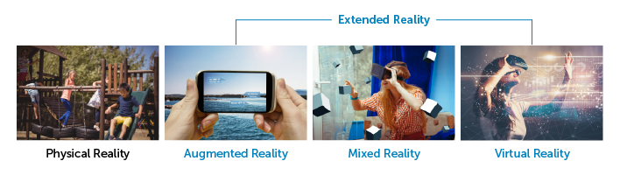
VIRTUAL / AUGMENTED REALITY

Slide 32
How can I learn about any of this?
You, right now, maybe

Slide 33


TWO LEARNING PATHWAYS: Try Both!
Wikipedia
Microsoft Copilot

Slide 34
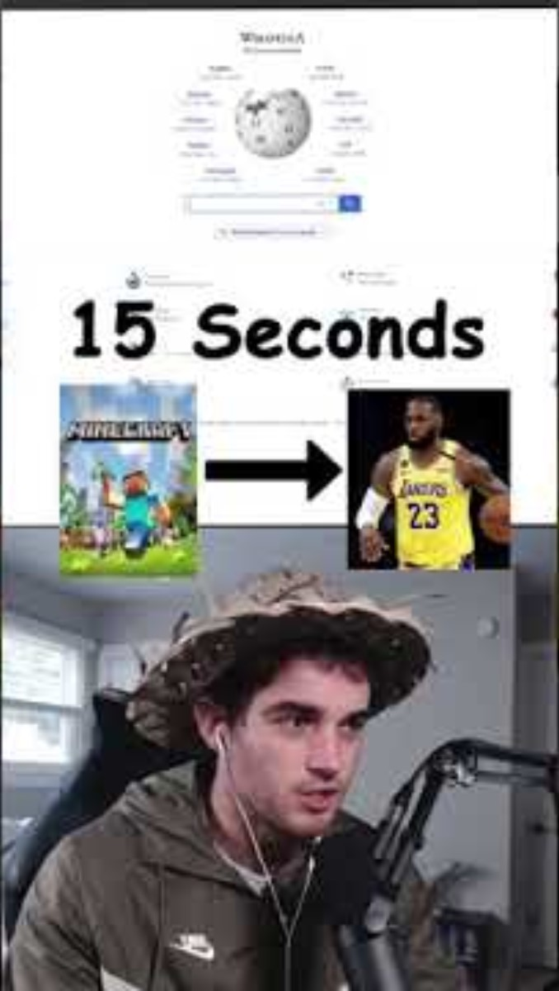
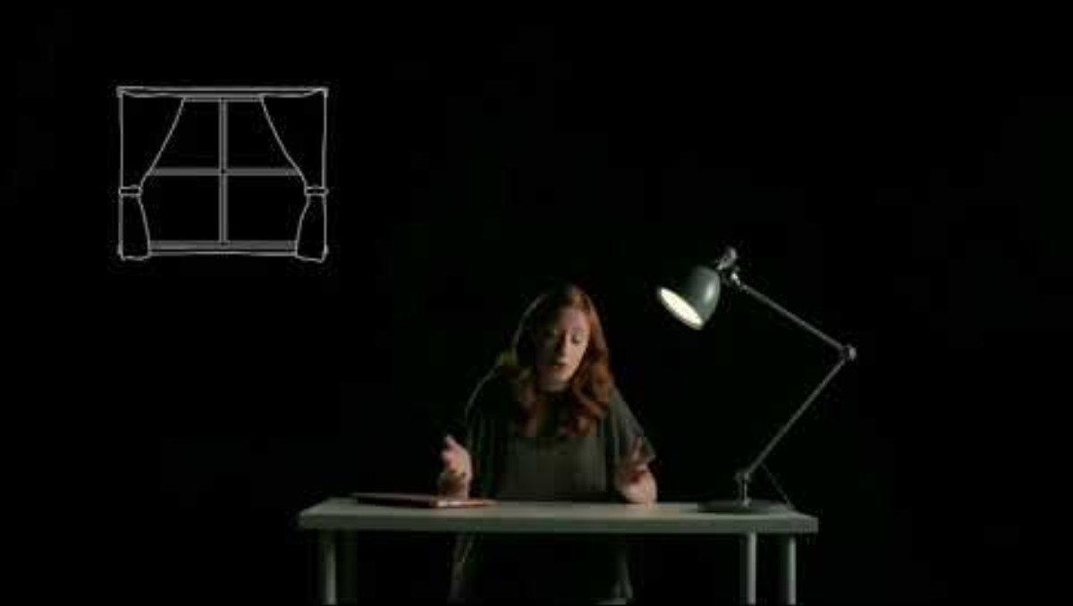
Wikipedia: Philosophy & Wikiracing

Slide 35
TIME FOR A WIKIRACE

Slide 36
Copilot: Learning & Quizzing
Go to copilot.microsoft.com
Choose a topic
Tell Copilot to explain your topic like you’re five years old
Quiz yourself!

