Slide 1
Introduction to Chat Bots
Hy-tech club: Python 201

Slide 2
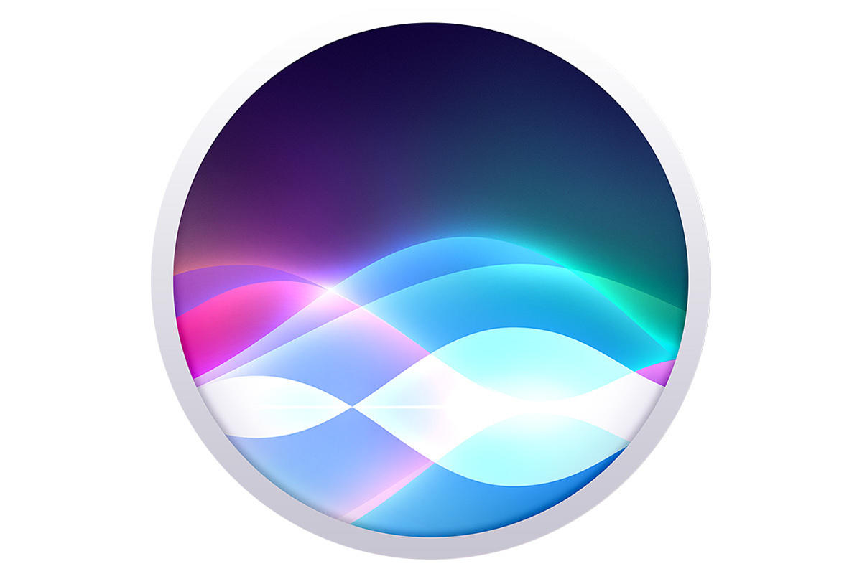


What is a chat bot?
A chat bot is a program that interacts with users via text or voice
The chat bot “reads” the messages that users send and generates a response or some other action
Discord allows the development of custom chat bots that can be added to any server!

Slide 3
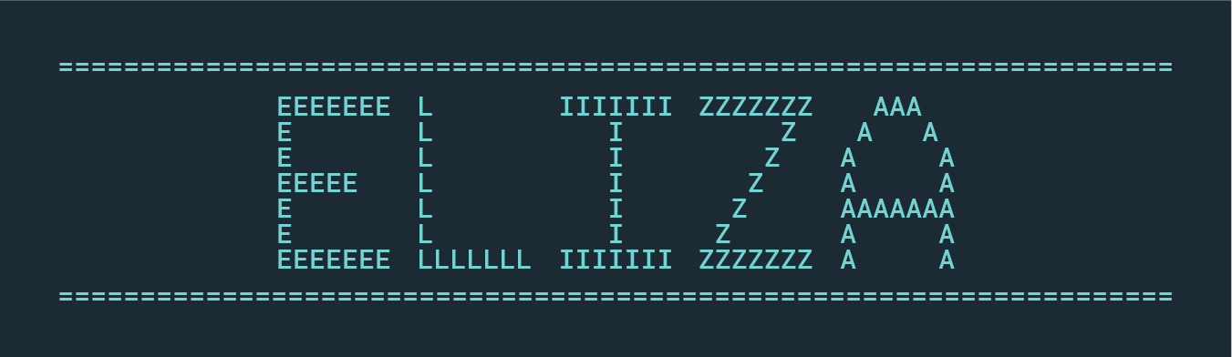
History of Chat bots
Developed by MIT professor Joseph Weizenbaum in the 1960s
Powered by scripts to determine responses, called MAD-Slip
Most well-known ELIZA script was DOCTOR
Simulation of the psychotherapist Carl Rogers

Slide 4
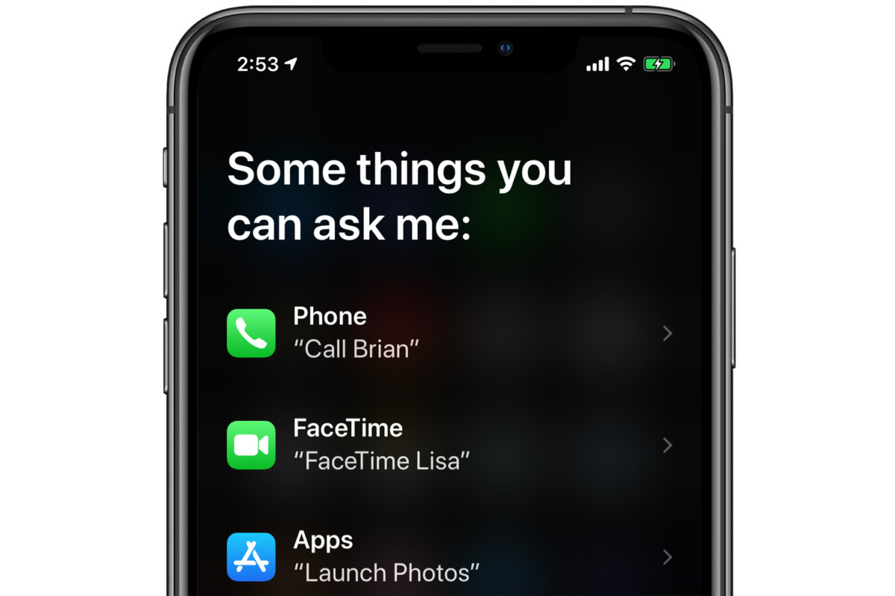
Modern chat bot applications
E-Commerce website assistants
Online technical support and troubleshooting
Siri, Alexa, Google Assistant, Cortana
Use text-to-speech software
Discord has all kinds of chat bots
Dice rollers for tabletop games
Game assistants (LFG, stats, teams)
Server management

Slide 5
Which Chat Bots have you used in the past?

Slide 6

Hy-Tech Club Chat Bot Sandbox Discord Server
Join the Hy-Tech Club Chat Bot Sandbox!
This Discord server will allow you to test your chat bots!
https://discord.gg/7VUAKkHEvm

Slide 7
Questions?

