Slide 1
The Repl.it DB
Hy-Tech Club: Python 201

Slide 2
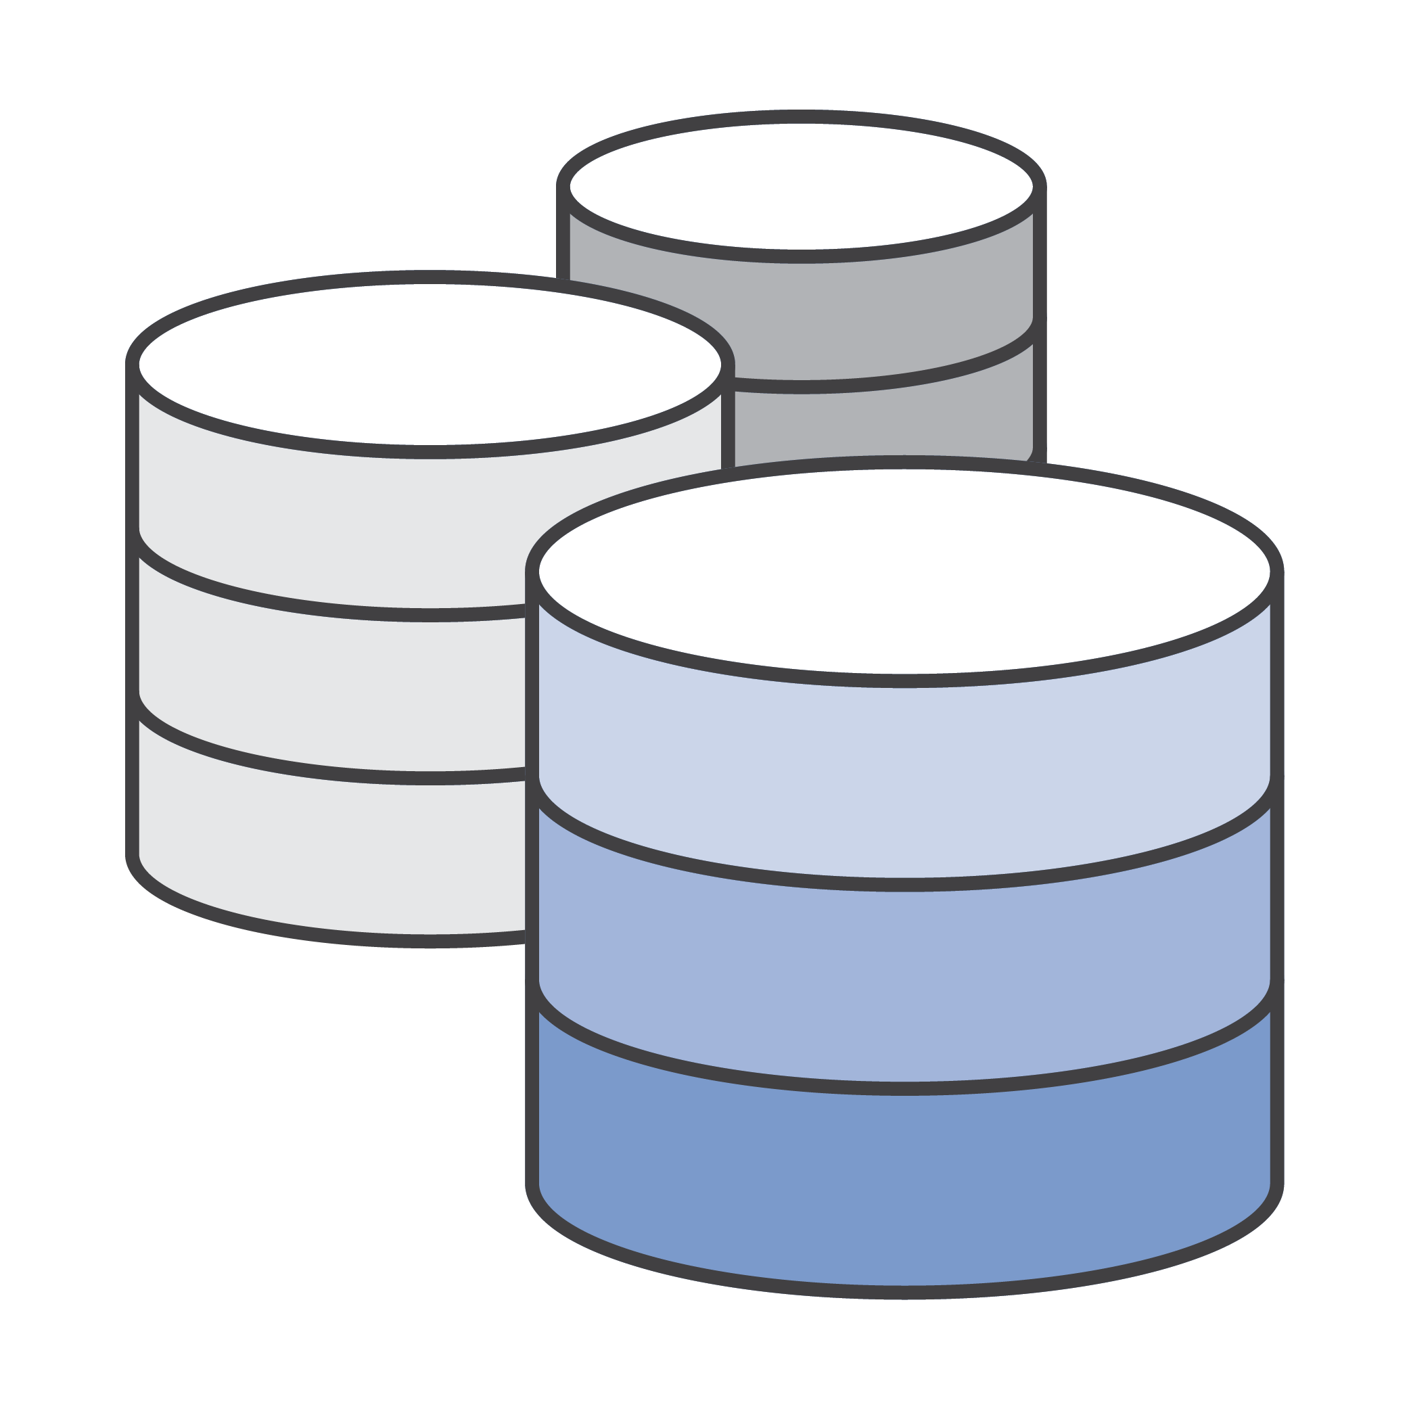
What is a database?
A database is an organized collection of structured information, or data, typically stored electronically in a computer system

Slide 3
Relational Database tables – SQL
Movies
Title | Year | Genre | Director
Billy Madison | 1995 | Comedy | Tamra Davis
The Wedding Singer | 1998 | Comedy | Frank Coraci
Reign Over Me | 2007 | Drama | Mike Binder
Grown Ups 2 | 2013 | Comedy | Dennis Dugan
Uncut Gems | 2019 | Thriller | Josh Safdie & Benny Safdie
Each row is an object, each column is a property
Notes:
In a relational database, like MySQL, the data is held in tables. Each row in the table represents one object (or record), and each column represents one property (or field) for the object.
However, we will not be working with relational databases for the Repl.it DB.

Slide 4
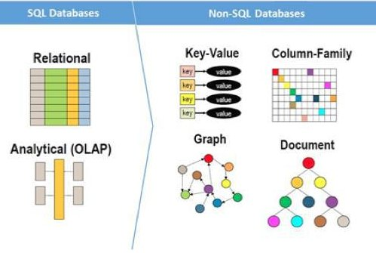
NOSQL – NOT relational
They can be:
graph based
document based
key-value pairs
wide column
They can work with “unstructured data”
(big data, messy data)
SQL databases can scale vertically
NoSQL databases can scale horizontally
NoSQL databases do NOT use tabular relations
Examples:
MongoDB, CouchDB, Redis, DynamoDB
Notes:
Explain some of the differences between relational databases (SQL) and NoSQL databases.
NoSQL = Not relational
Graph based – like a social network
Document based – semi-structured information (e.g. XML)
Key-value – a key points to a value
Wide column – still uses rows and columns, but the tables are not strictly structured
Unstructured data – data is messy, big data, does not always have certain properties for each object
Vertical scaling – easy to add data of the same form
Horizontal scaling – easy to change the form of the data
Several examples
NoSQL Databases have gained popularity over the last decade.
https://www.mongodb.com/nosql-explained/nosql-vs-sql

Slide 5


Repl.it DB – A Persistent key-value store
[A] fast, free, and easy key-value store that’s built into every repl.
Like a Dictionary object
db = {
"key1": "value1",
"key2": "value2",
"any key": any_value
}
Every key has a value
“key1” → “value1”
“key2” → “value2”
“any key” → any_value
Developers can set a key to a value, get a key’s value, delete a key, and search for keys
Notes:
Key-value databases are conceptually simple: they’re a flat map of keys to their values. There are no schemas, tables, or columns. There are only a few operations that you need to perform: set a key to a value, get a key’s value, delete a key, and search for keys.
The important thing about Repl.it DB – the values stick around! Anyone can visit your website, and see/update the same data.
Important: Keys must be strings, but values can be any object
If the students do not know, tell them that Key and Peele was a sketch comedy show from the 2010s.

Slide 6

R
Notes:
Ask if anyone has seen the movie C.H.U.D. (they probably haven’t). We aren’t actually going to talk about C.H.U.D. though; we will talk about CRUD instead.

Slide 7
CRUD – The building blocks of an app
Create – db["key"] = "value"
Read – value = db["key"]
Update – db["key"] = "newvalue"
Delete – del db["key"]
R
Notes:
CRUD encompasses the basic database interactions necessary for a simple app. These examples are pseudocode for how it would work in Repl.it’s database – but they are almost complete.

Slide 8
Interacting with The Repl.it DB in Python
Setup
from replit import db
Set a key to a value
db["key"] = "value"
Get a key’s value
value = db["key"]
Delete a key
del db["key"]
List all keys
keys = db.keys()
List all keys with a prefix
matches = db.prefix("prefix")
Notes:
Go over some of the syntax for connecting to Repl.it’s database in Python.
Setup – import the module containing the db object.
Set – just letting setting a dictionary value
Get – just like getting a dictionary value
Delete – just like deleting a dictionary value
Keys – just like listing all keys in a dictionary: get every key in the DB
Prefix – a way to limit the results. Only returns keys with the given prefix. More about this on the next slide.

Slide 9
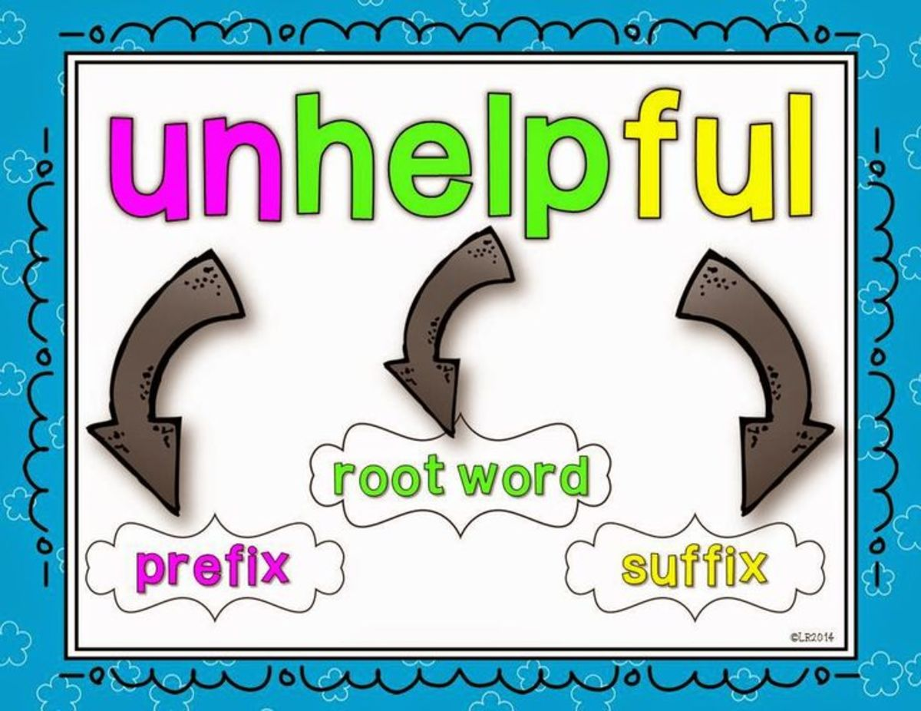
Prefixes
Prefixes can help separate different types of data in a key, value DB
They make it easier to find all data in a certain group
db.keys()
player_1
player_2
player_3
player_4
team_1
team_2
rankings
player_keys
player_1
player_2
player_3
player_4
Find all player data
player_keys = db.prefix("player_")
Notes:
Ask the students if they know what a prefix is (in English). Explain how they can be used in a key, value DB. As an example, say db.keys() contains a group of several different keys. If the program needs to find all player data, this is possible using db.prefix. This narrows down the list of keys, and player_keys contains all keys that are related to player data.

Slide 10

Auto-increment Id
Often, data objects must be identifiable with a unique key value
With user-generated data, this key can be created automatically
Auto-incremented IDs
Each ID key is numeric
The first ID is a certain value (e.g., 0 or 1000)
Every time a new object is created, the value for the ID increments automatically
Example Data
Player added
ID: 1000
New player added
ID: 1001
New player added
ID: 1002
Etc…
Note: in some DBs (like MySQL), this is built-in functionality. In the Repl.it DB, it must be added manually by tracking the current ID value and incrementing it
Notes:
Why might we want an automatically-created ID? It helps avoid user error.
This can happen automatically in a language like SQL, but in the case of the Repl.it DB – it must be done manually.

Slide 11
ASIDE: Multiple python files – modules
It is possible to use multiple Python files in the same project
Import other files from the same directory as modules
/extra.py
def print_hi():
print("hi")
/main.py
import extra extra.print_hi()
Running the main.py file will call the print_hi function from the extra.py file
Notes:
Walk through an example with two files – main.py and extra.py. Note that these two files must be in the same directory. It is possible to import files from other directories as well.
The import extra statement pulls all of the extra.py file into the main.py file, in an object named extra. The objects from extra.py can be accessed via extra dot <whatever>.

Slide 12
Questions?

