Slide 1
Pygame
Hy-Tech Club: Python 201

Slide 2

What is Pygame?
Pygame is a cross-platform set of Python modules designed for writing video games. It includes computer graphics and sound libraries designed to be used with the Python programming language.
Notes:
Ask the students if they know what Pygame is… it’s pretty obvious – it’s a game development framework for Python. It’s a bunch of cool modules with graphics and sound.

Slide 3
New Programming Concepts
Constants
Tuples

Slide 4
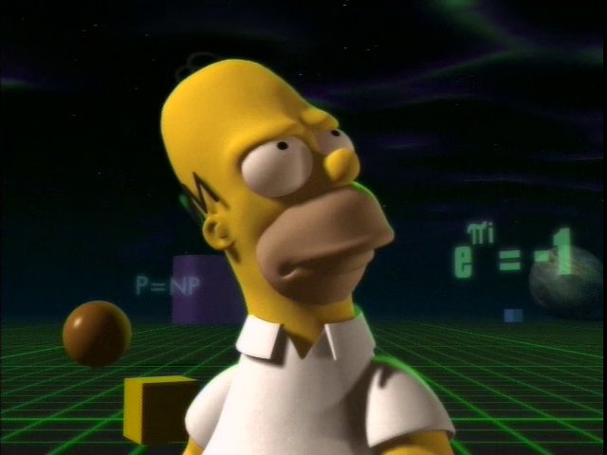
Constants
What is a constant in math?
In Programming
A constant is a piece of data that does not change
Stylistically, they are often written in ALL_CAPS
Python does not actually have constants – but variables work too
Notes:
Ask the students if they know what a constant is in math (e.g., e, pi, or physics constants). Note that e^{iπ} = −1.
Explain a bit about constants. Note that in Python, there aren’t real constants. These are basically just variables, with names in ALL_CAPS, that should not be altered throughout the program.

Slide 5
Tuples
What is a couple?
What is a triple?
What is a quadruple?
What does multiple mean?
-ple
Notes:
Ask the students each of these questions – the ultimate answer is that each of these things is a set of multiple things. What do they have in common as words?
They end with –ple.
Explain that these things all lead to the definition of tuple.

Slide 6
Tuples
In Python, a tuple is another type of collection
Tuples are ordered and unchangeable
They work a lot like lists (except for the unchangeability)
They are generally used to group small amounts of related data
E.g. x, y coordinates or RGB color values
They are created with parentheses
MY_TUPLE = (210, 79, 160)
Notes:
Tuples – pronounced either TOOpull or TUPPpull
Go over the basics of tuples. They are really similar to lists but with parentheses instead of square brackets, and they can’t be changed.

Slide 7
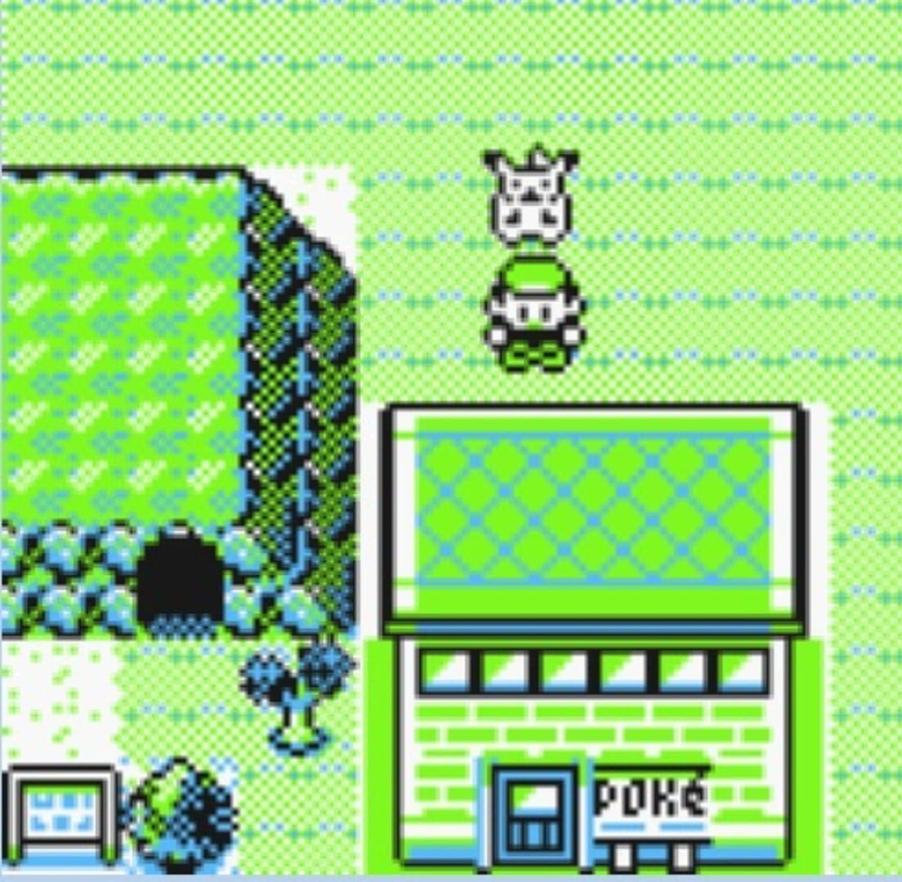
Pygame concepts
Display Surface
Game Loop
Tile system
Events

Slide 8
Display Surface
The most basic element in Pygame is the Surface
This is where everything is displayed
The surface must be initialized
The surface is stored in a new variable
display_surface =
pygame.display.set_mode((WIN_WIDTH, WIN_HEIGHT))
Notes:
Explain the purpose of a display surface in Pygame. It’s the thing that everything gets drawn to. It’s initialized with pygame.display.set_mode, passing in a Tuple with a width and height. It is stored in a variable

Slide 9
Game Loop
The game must be updated continuously
Everything must be updated and drawn
This is possible with a while loop
while True:
display_surface.fill(WHITE) pygame.display.update()
Notes:
Explain a bit about the game loop. In general, the loop will run continuously and take care of updating the game.
The display_surface.fill function fills the screen with a color.
The pygame.display.update() function tells the screen to update.

Slide 10
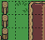
Tile System
Pygame uses pixel coordinates for drawing (x, y)
Tile coordinates represent the position of tiles instead (also x, y)
TILE_SIZE = 32
WIN_WIDTH = TILE_SIZE * 3
WIN_HEIGHT = TILE_SIZE * 3
0, 0
1, 0
2, 0
0, 1
1, 1
2, 1
0, 2
1, 2
2, 2
Notes:
Introduce the idea of a tile system in a game. Basically, instead of using the pixel coordinates, tile coordinates break up the screen by tiles. A TILE_SIZE constant is set, and then everything is calculated based on that.

Slide 11
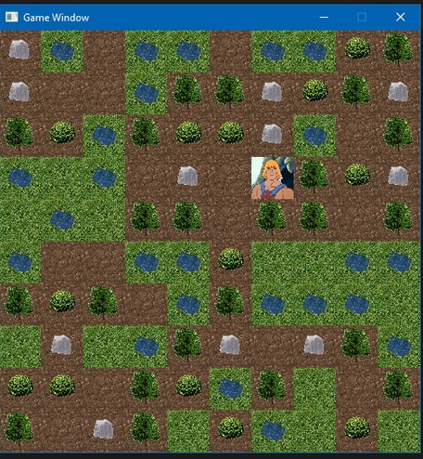
Calculating Pixel Coordinates
Pixel coordinates can be calculated based on tile coordinates.
Tile Coordinates | Pixel Coordinates
(0, 0) | (0, 0)
(1, 0) | (32, 0)
(1, 2)
(2, 3)
(32, 64)
(64, 96)
Notes:
Explain that pixel coordinates can be calculated based on tile coordinates. Run through a couple of examples – ask the students to provide the answers for the last two.

Slide 12
Events
A list of all current events can be retrieved
Events have types – like KEYDOWN
Loop through all events with a for loop
for event in pygame.event.get():
if event.type == KEYDOWN:
do_something()

Slide 13
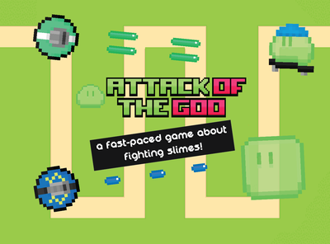
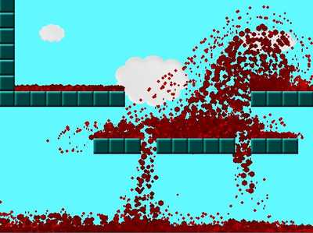
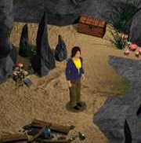
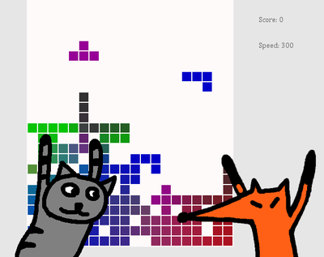
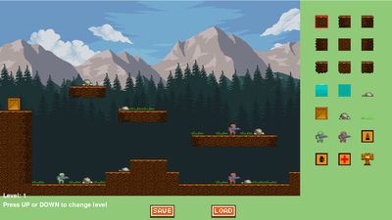
What’s possible with Pygame?
Top-down games, platformers, puzzle games, and more!
Notes:
The possibilities

Slide 14
Questions?

