Slide 1
Introduction to Chat Bots
Hy-tech club: Python 201

Slide 2
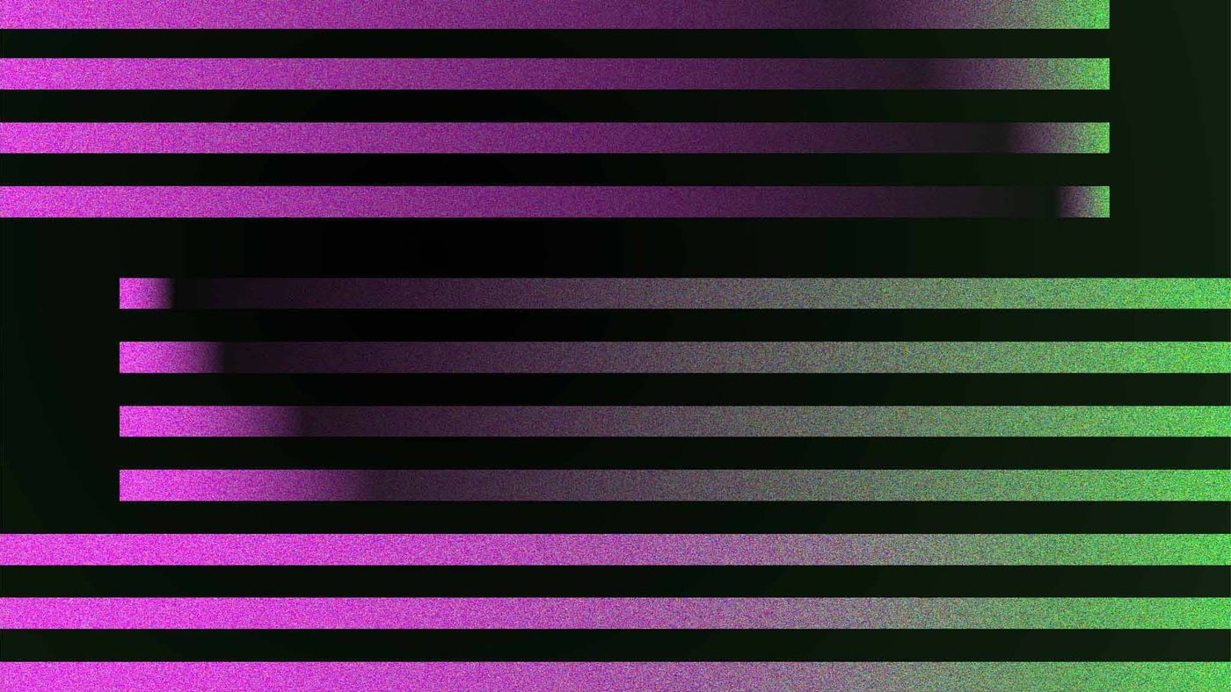

What is a chat bot?
https://chat.openai.com/
Notes:
Has anyone heard of a chat bot before? Any examples?
Maybe you’ve heard of ChatGPT, from OpenAI… but a chatbot isn’t always quite that sophisticated.
Do a quick demo of ChatGPT if it’s up and running

Slide 3
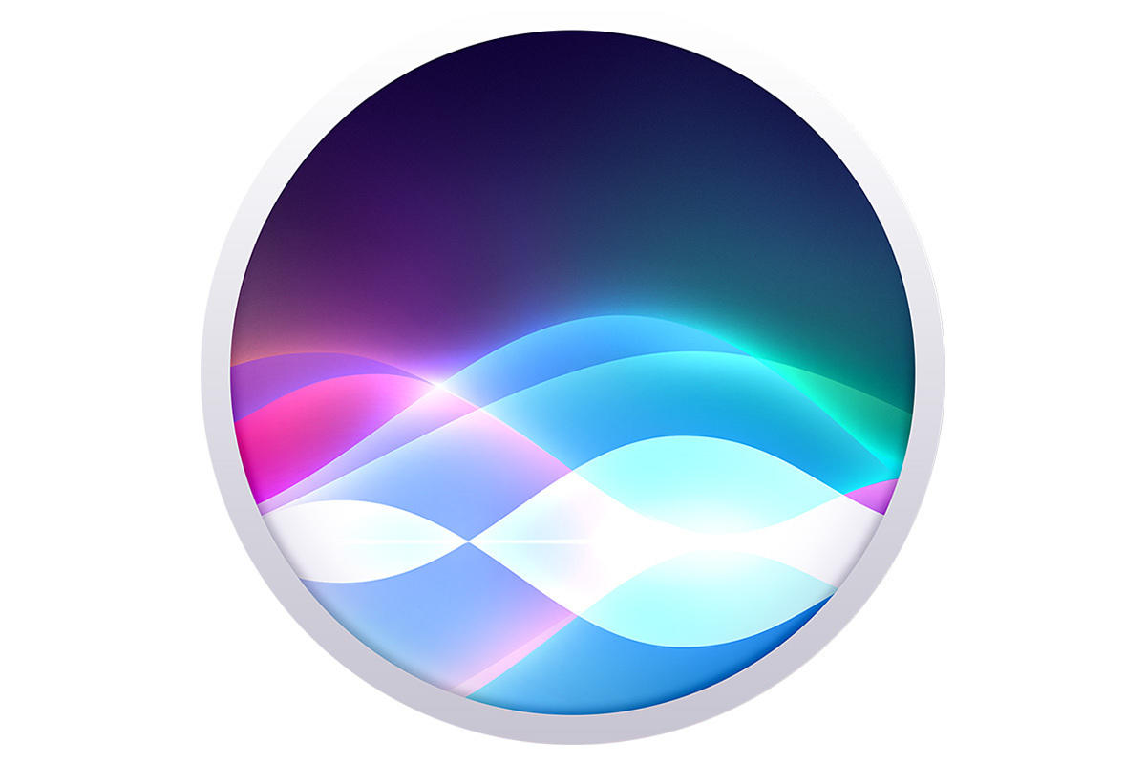


What is a chat bot?
A chat bot is a program that interacts with users via text or voice
The chat bot “reads” the messages that users send and generates a response or some other action
Discord allows the development of custom chat bots that can be added to any server!
Notes:
Let’s get into what a chatbot is.

Slide 4
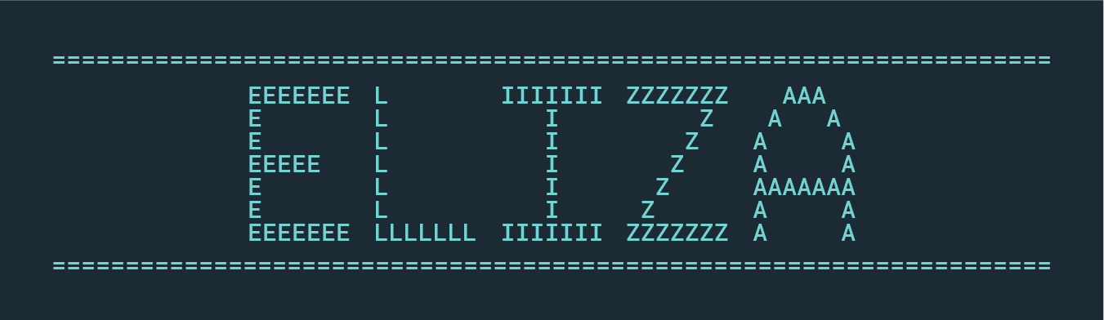
History of Chat bots
Developed by MIT professor Joseph Weizenbaum in the 1960s
Most well-known ELIZA script was DOCTOR
Simulation of the psychotherapist Carl Rogers
Notes:
Taking a step back
one of the first chatbots ever was ELIZA
It was all the way back in the 60s
And one of these scripts was designed to act like a Rogerian therapist – it could help people with their problems

Slide 5
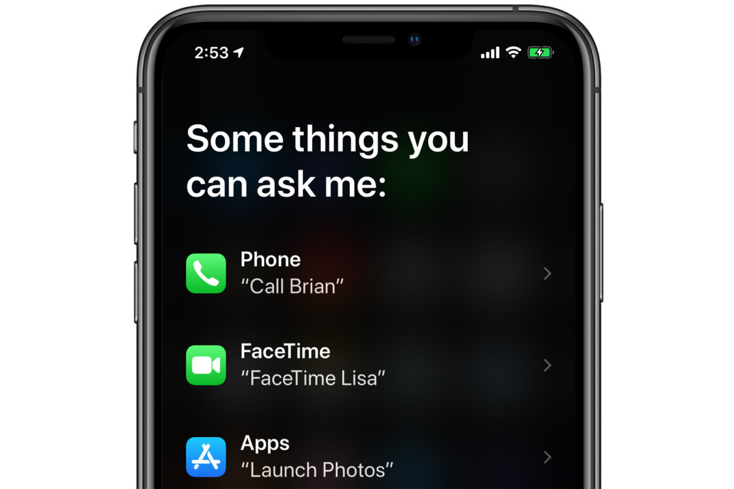
Modern chat bot applications
E-Commerce website assistants
Online technical support and troubleshooting
Siri, Alexa, Google Assistant, Cortana
Use text-to-speech software
Discord has all kinds of chat bots
Dice rollers for tabletop games
Game assistants (LFG, stats, teams)
Server management
Notes:
There are a ton of modern uses for chatbots
You might have some of them on your phone
Things like online assistants
Online tech support
Siri, Alexa, etc
And Discord has a ton of bots! That’s what we’ll be using for this lesson

Slide 6
Questions?

