Slide 1
More HTML Elements
Hy-Tech Club: Web 101

Slide 2
Agenda
HTML Attributes
HTML Lists & Inputs

Slide 3
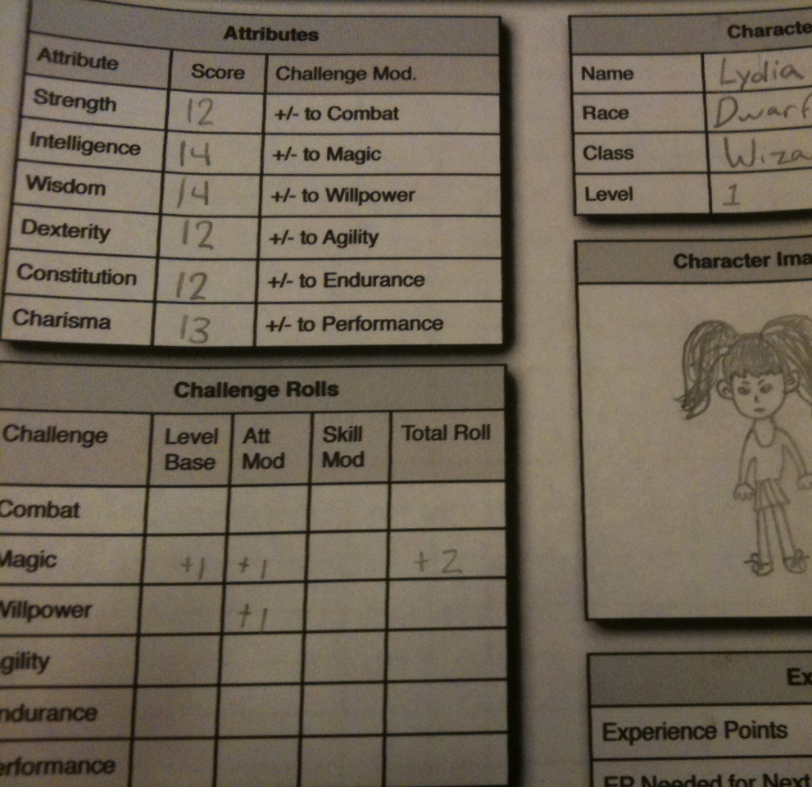
HTML Attributes

Slide 4
Attribute example: The anchor element
<a href="http://wikipedia.org/">Wikipedia</a>
Q: What does the href do?
A: The href attribute specifies the destination URL for the link
Notes:
Ask the students what href does – it tells the link where to go when clicked!

Slide 5
What are attributes?
Attributes add extra information to HTML elements
They allow developers to customize the behavior of elements
Attributes go inside of the opening tag of an HTML element
<a href="file.html" >
Attribute name, equals sign, quotation marks, attribute value
Notes:
Point out each part of the attribute syntax

Slide 6
Mini-quiz
<img src="dog.png" />
What is the attribute name?
src
What is the attribute value?
dog.png
Notes:
Ask the students these questions

Slide 7
Attributes Examples
https://replit.com/@HylandOutreach/AttributesExample
Notes:
Visit the Repl to show attributes in action. Uncomment the commented lines of code to display them. You should be able to use Ctrl+/ to comment and uncomment code in Repl

Slide 8
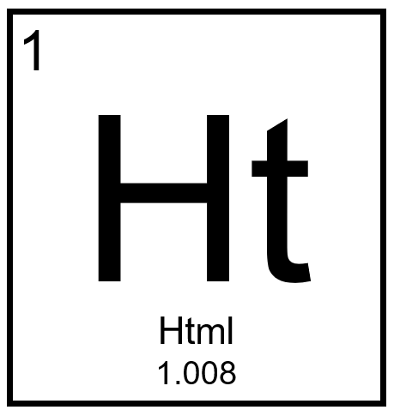
More HTML Elements

Slide 9
The list elements: ul and ol
Lists are used to display groups of items
They can be unordered (bullet points) or ordered (numbered)
Each item is its own HTML element: li
The list items are children and the list elements are the parents
<ul>
<li>Eggs</li>
<li>Milk</li>
</ul>
<ol>
<li>Iron Man</li>
<li>The Hulk</li>
</ol>
Notes:
The bullet points on this slide are an unordered list!
An ordered list has numbers – for example, the MCU movies in release order

Slide 10

Nesting activity
Notes:
Explain nesting as a concept using geography.
Start by writing the following on the whiteboard (leave a lot of space around the tags):
<county name=“Cuyahoga”>
</county>
Ask what goes within a county – a city! Add that to the code:
<county name=“Cuyahoga”>
<city name=“Westlake”></city>
</county>
Ask what goes around a county – a state! Add that to the code:
<state name=“Ohio”>
<county name=“Cuyahoga”>
<city name=“Westlake”></city>
</county>
</state>
Use this concept to explain nesting. Explain parent/child relationships. The next slide has an example using lists.

Slide 11
List Example
https://replit.com/@HylandOutreach/ListExample
Notes:
Visit the Repl to show lists in action.
Here we really want to emphasize the hierarchical structure of HTML
Also show the difference between ol and ul

Slide 12
The input element
inputs are interactive controls that accept data from the user
The type attribute determines how the input appears
It is a self-closing tag
<input type="text" />
<input type="button" />
<input type="radio" />
<input type="checkbox" />
<input type="range" />
<input type="submit" />
Notes:
Ask the students to guess how each of these input types might appear

Slide 13
Special inputs
textarea is used to create a multi-line text box
select and option are used to create a dropdown list
<select>
<option value="1">One</option>
<option value="2">Two</option>
</select>

Slide 14
input Examples
https://replit.com/@HylandOutreach/InputExamples
Notes:
Visit the Repl to show inputs in action

