Slide 1
Tables & IFrames
Hy-Tech Club: Web 101

Slide 2
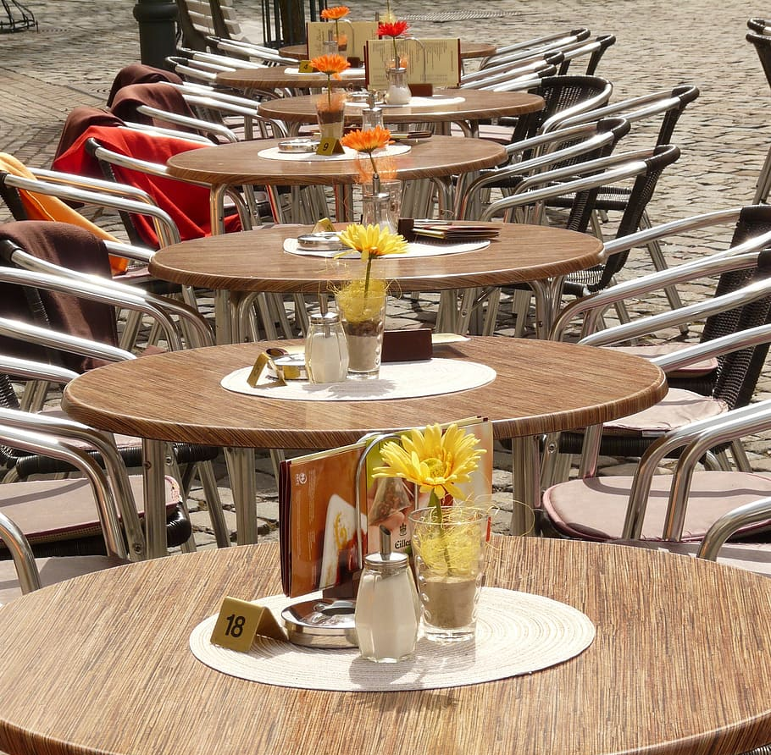
Tables

Slide 3
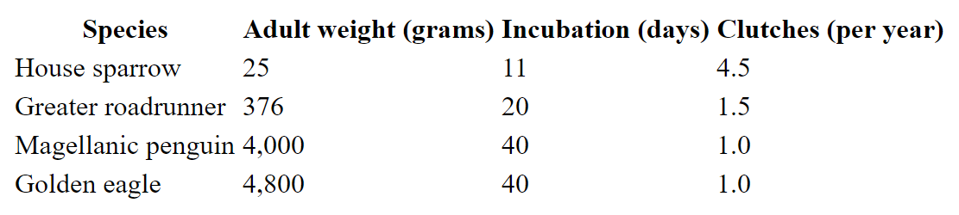
HTML Tables
What type of data could be displayed in a table?
Information about birds
Notes:
Ask the students for examples of tabular data. Lots of times there are things like stats (for sports, etc) or other information about people.
Show an example of this table, and ask the students what they think it is about.
It’s about birds.

Slide 4
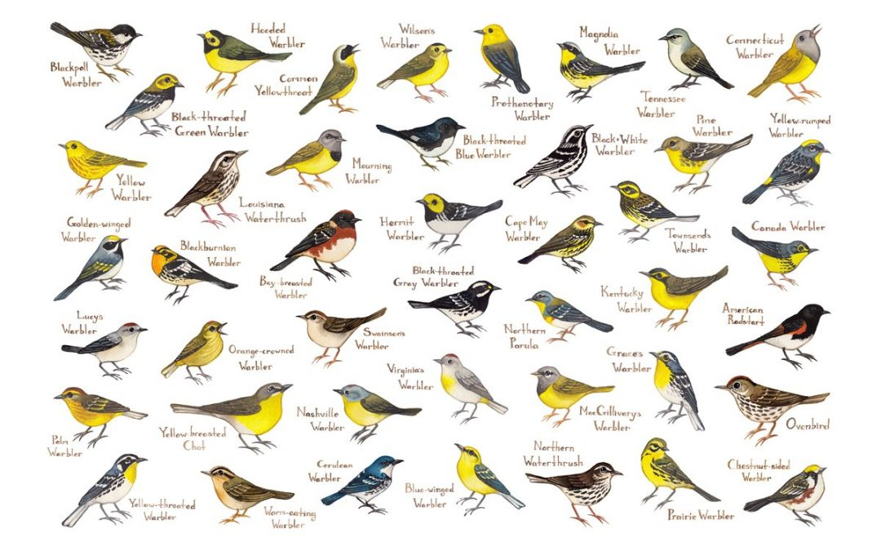
Table Elements
HTML Tables consist of several nested elements:
table: the primary element in a table, contains all other elements
tr: a row in the table
th: a header cell in the table
td: a normal cell in the table
Notes:
Explain each element that goes into a table. These will make more sense once we see the tables in action.
The Repl contains an actual full table in HTML.

Slide 5
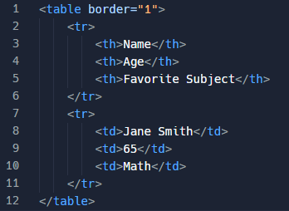
Table Elements

Slide 6
Table Example
https://replit.com/@HylandOutreach/TableExample
Notes:
Start by forking the Repl project. Emphasize the relationships between each table element. Ask students which elements are parents/children/sibilings/etc.
Additionally, show the border attribute – it starts as 0, so change it to 1 to see the border.

Slide 7
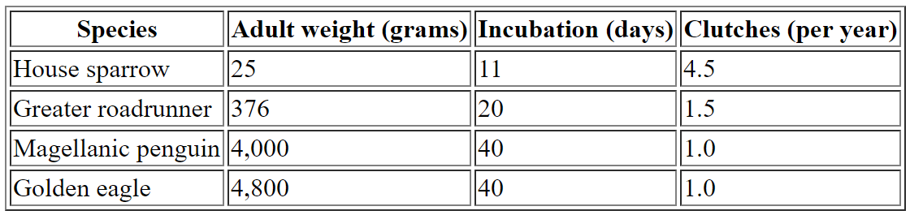
The border Attribute
<table border="1">
Set the border attribute to 1 to add a border

Slide 8

IFrames

Slide 9
The <iframe> Element
The Inline Frame element represents a nested browsing context, embedding another HTML page into the current one
Basically, you can display other webpages within your webpage
IFrames use the src element to determine which webpage to display
There are also height and width attributes
<iframe src="https://www.google.com"></iframe>
Notes:
Explain iframes

Slide 10
IFrame Example
https://replit.com/@HylandOutreach/IFrameExample
Notes:
For the Repl, emphasize the use of attributes. Add an attribute for width, change the height attribute. Also show embedding a YouTube video for fun

Slide 11
THANKS!
DO YOU HAVE ANY QUESTIONS?

