Slide 1
Basic HTML Elements
Hy-Tech Club: Web 101

Slide 2
The Fundamental Elements
<html>
<body>
<..stuff..>
</body>
<html>
“Root” element - contains entire document
HTML content element
Everything that is visible!
The code will work without these… but you should add them anyway!

Slide 3
Header Elements
Used for page headings or titles
There are six header elements – h1 through h6
<h1>This is the biggest</h1>
<h6>This is the smallest</h6>

Slide 4
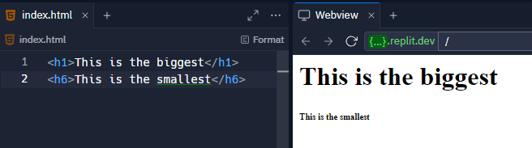
Header Elements

Slide 5
The Paragraph Element
Displays common text on the page
The content does not have to be multiple sentences
Each <p></p> creates a new line under it
<p>This will appear normal</p>

Slide 6
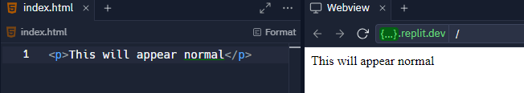
The Paragraph Element

Slide 7
The Hyperlink Element
Used to create a link to another page
Set the href to a URL
The text of the link goes in between the opening and closing tag
<a href="https://google.com">Google</a>

Slide 8
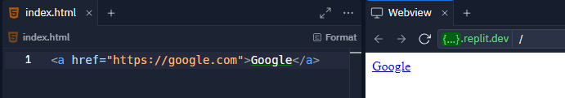
The Hyperlink Element

Slide 9
The Image Element
Used to display an image
Set the src to a URL
This element has no closing tag – it is self-closing
<img src="https://i.imgur.com/GfT5Z9R.png" />

Slide 10
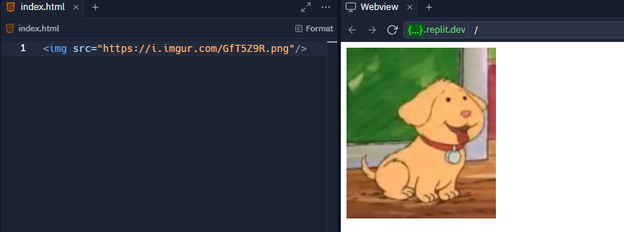
The Image Element

Slide 11
Example
https://replit.com/@HylandOutreach/BasicElementsExample
Notes:
https://replit.com/@HylandOutreach/BasicElementsExample

Slide 12
THANKS!
DO YOU HAVE ANY QUESTIONS?

