Slide 1
More HTML Elements
Hy-Tech Club: Web 101

Slide 2

Agenda
HTML Attributes
HTML Lists & Inputs

Slide 3
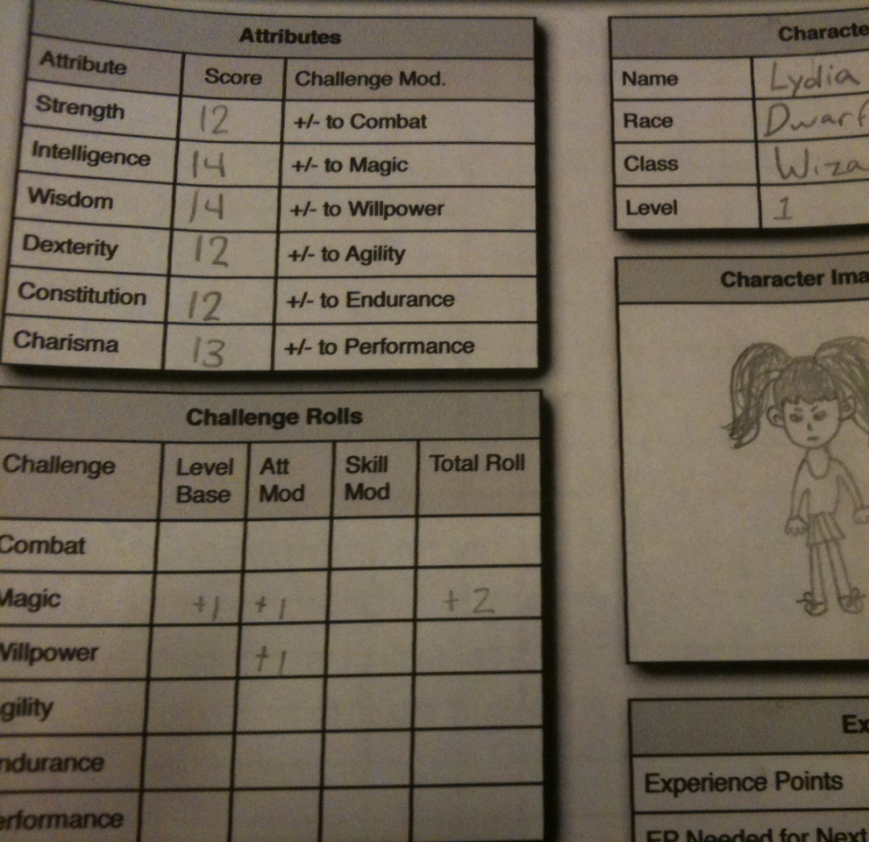
Attributes
Qualities or features regarded as a characteristic or inherent part of someone or something.

Slide 4
Attribute Example: <a>
<a href="http://wikipedia.org/">Wikipedia</a>
Q: What does the href do?
A: The href attribute specifies the destination URL for the link
Notes:
Ask the students what href does – it tells the link where to go when clicked!

Slide 5
What Are Attributes?
Attributes add extra information to HTML elements
They allow developers to customize the behavior of elements
Attributes go inside of the opening tag of an HTML element
<a href="file.html" >
Attribute name, equals sign, quotation marks, attribute value
Notes:
Point out each part of the attribute syntax

Slide 6
Mini-Quiz
<img src="dog.png" />
What is the attribute name?
src
What is the attribute value?
dog.png
Notes:
Ask the students these questions

Slide 7
Attributes Examples
https://replit.com/@HylandOutreach/AttributesExample
Notes:
Visit the Repl to show attributes in action. Uncomment the commented lines of code to display them. You should be able to use Ctrl+/ to comment and uncomment code in Repl

Slide 8
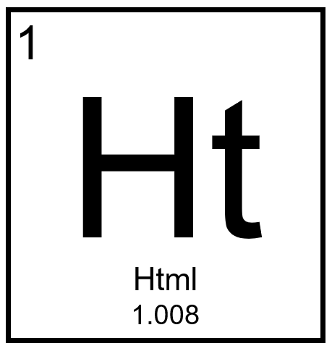
More HTML Elements

Slide 9
The List Elements
Lists are used to display groups of items
They can be unordered (bullet points) or ordered (numbered)
Each item is its own HTML element: <li>
The list items are children and the list elements are the parents
<ul>
<li>Eggs</li>
<li>Milk</li>
</ul>
<ol>
<li>Iron Man</li>
<li>The Hulk</li>
</ol>
Notes:
The bullet points on this slide are an unordered list!
An ordered list has numbers – for example, the MCU movies in release order

Slide 10
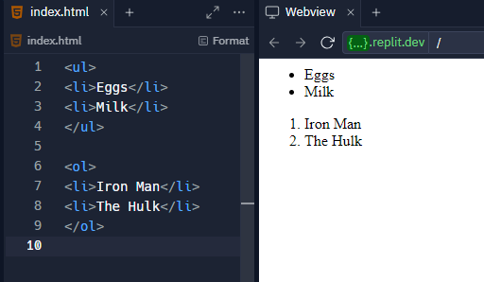
The List Elements
Notes:
The bullet points on this slide are an unordered list!
An ordered list has numbers – for example, the MCU movies in release order

Slide 11

Nesting Activity
Notes:
Explain nesting as a concept using geography.
Start by writing the following on the whiteboard (leave a lot of space around the tags):
<county name=“Cuyahoga”>
</county>
Ask what goes within a county – a city! Add that to the code:
<county name=“Cuyahoga”>
<city name=“Westlake”></city>
</county>
Ask what goes around a county – a state! Add that to the code:
<state name=“Ohio”>
<county name=“Cuyahoga”>
<city name=“Westlake”></city>
</county>
</state>
Use this concept to explain nesting. Explain parent/child relationships. The next slide has an example using lists.

Slide 12
List Example
https://replit.com/@HylandOutreach/ListExample
Notes:
Visit the Repl to show lists in action.
Here we really want to emphasize the hierarchical structure of HTML
Also show the difference between ol and ul

Slide 13
The <input> Element
inputs are interactive controls that accept data from the user
The type attribute determines how it appears
It is a self-closing tag
<input type="text" />
<input type="button" />
<input type="radio" />
<input type="checkbox" />
<input type="range" />
<input type="submit" />
Notes:
Ask the students to guess how each of these input types might appear

Slide 14
Special Inputs
<textarea></textarea> is used to create a multi-line text box
select and option are used to create a dropdown list
<select>
<option value="1">One</option>
<option value="2">Two</option>
</select>

Slide 15
Input Examples
https://replit.com/@HylandOutreach/InputExamples
Notes:
Visit the Repl to show inputs in action

Slide 16
THANKS!
DO YOU HAVE ANY QUESTIONS?

