Slide 1
HTML Elements
Hy-Tech Club: Web 101

Slide 2
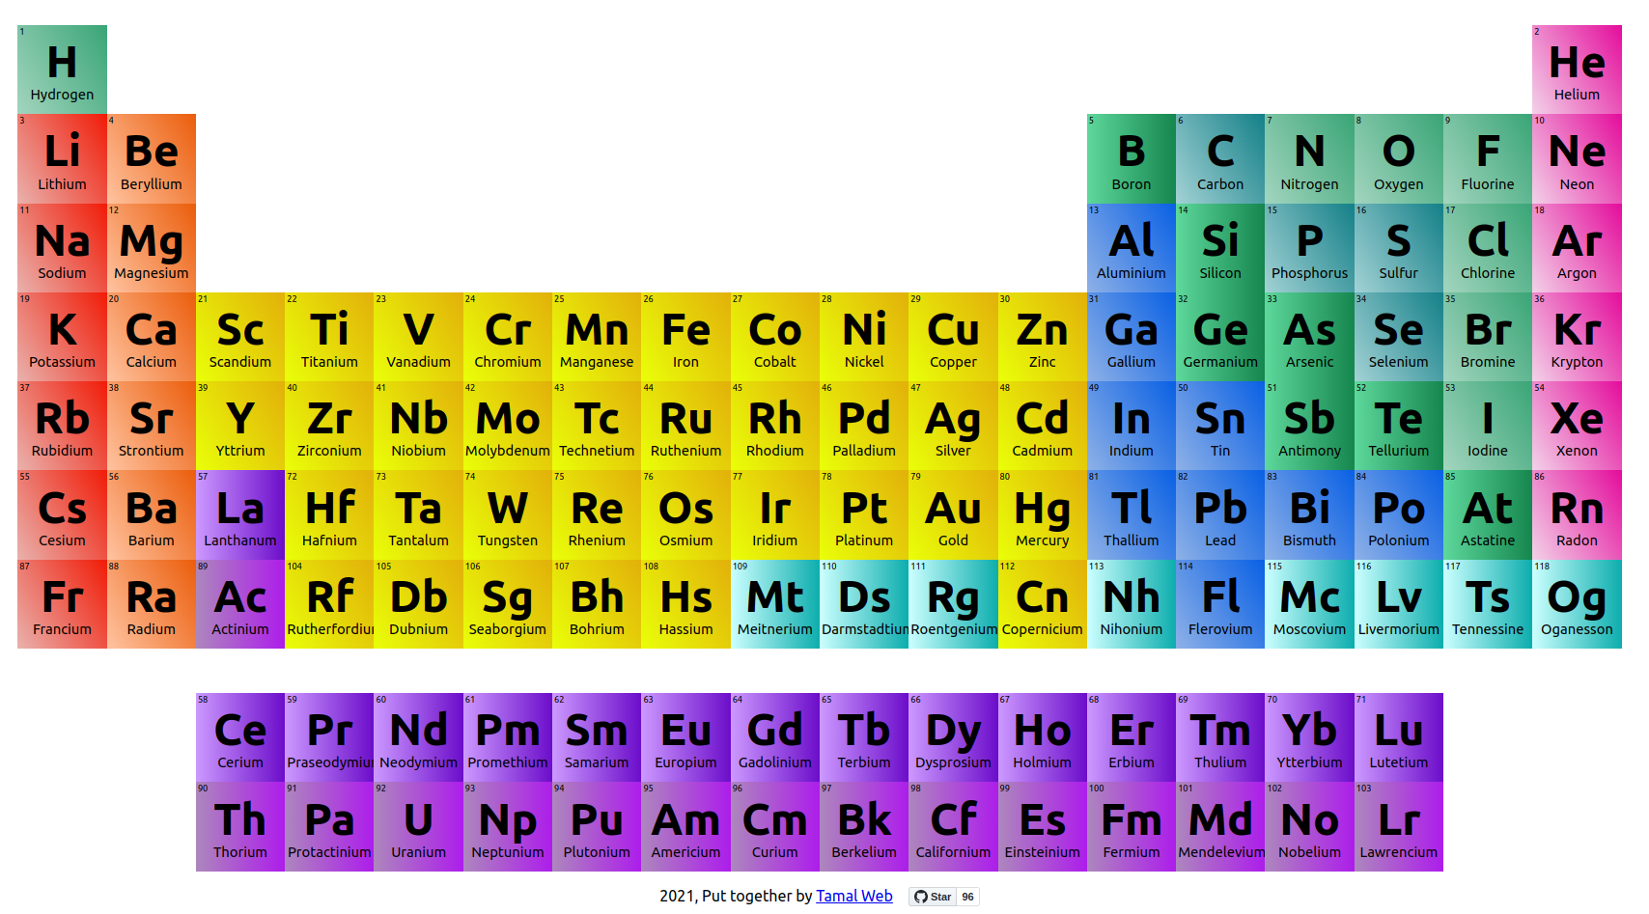
<p>Fire</p>
<p>Water</p>
<p>Earth</p>
<p>Air</p>
The chemical elements make up our entire universe
HTML elements make up a website

Slide 3
The Fundamental Elements
<html>
<body>
<..stuff..>
</body>
</html>
“Root” element - contains entire document
HTML content element
Everything that is visible!
The code will work without these… but you should add them anyway!

Slide 4
Header Elements
Used for page headings or titles
There are six header elements – h1 through h6
<h1>This is the biggest</h1>
<h6>This is the smallest</h6>

Slide 5
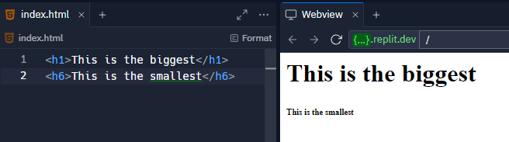
Header Elements

Slide 6
The Paragraph Element
Displays common text on the page
The content does not have to be multiple sentences
Each <p></p> creates a new line under it
<p>This will appear normal</p>

Slide 7
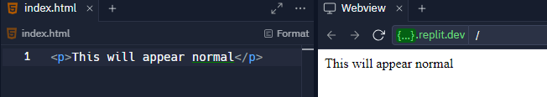
The Paragraph Element

Slide 8
The Hyperlink Element
Used to create a link to another page
Set the href to a URL
The text of the link goes in between the opening and closing tag
<a href="https://google.com">Google</a>

Slide 9
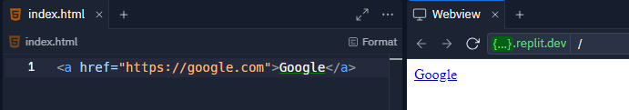
The Hyperlink Element

Slide 10
The Image Element
Used to display an image
Set the src to a URL
This element has no closing tag – it is self-closing
<img src="https://i.imgur.com/GfT5Z9R.png" />

Slide 11
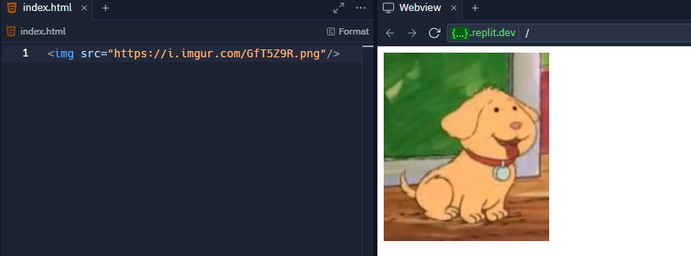
The Image Element

Slide 12
Example
https://jsfiddle.net/mxtdvL10/
Notes:
https://replit.com/@HylandOutreach/BasicElementsExample

Slide 13
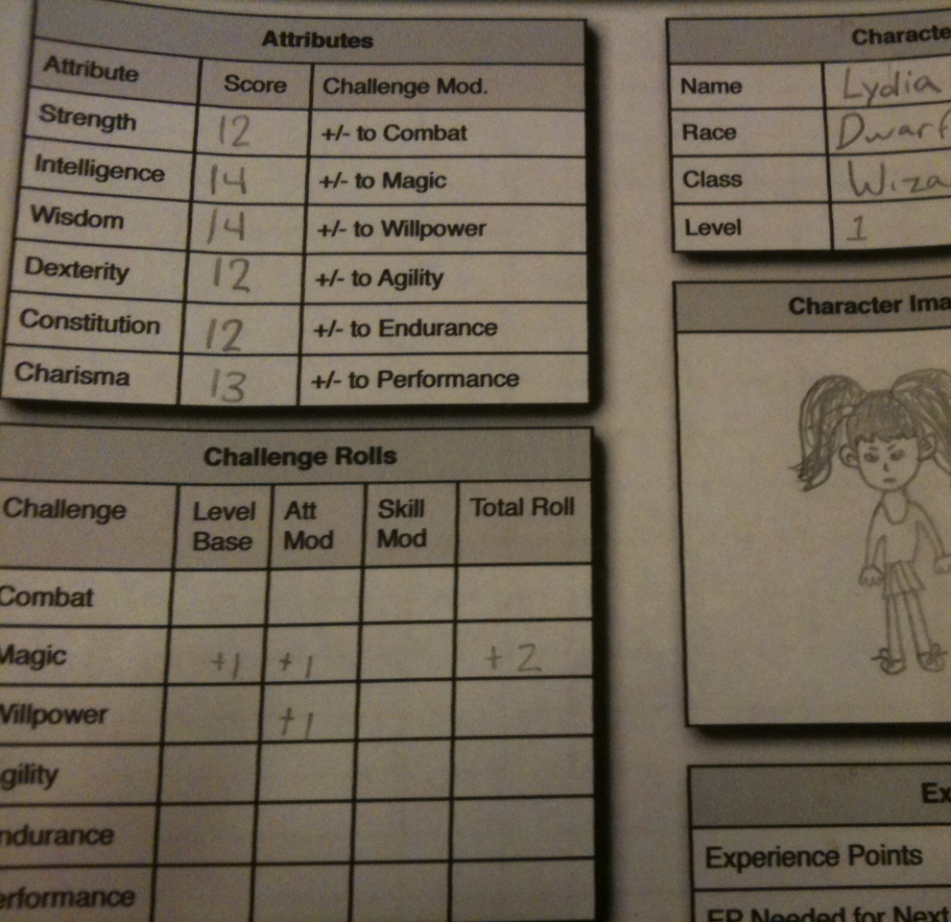
Attributes
Qualities or features regarded as a characteristic or inherent part of someone or something.

Slide 14
Attribute Example: <a>
<a href="http://wikipedia.org/">Wikipedia</a>
Q: What does the href do?
A: The href attribute specifies the destination URL for the link
Notes:
Ask the students what href does – it tells the link where to go when clicked!

Slide 15
What Are Attributes?
Attributes add extra information to HTML elements
They allow developers to customize the behavior of elements
Attributes go inside of the opening tag of an HTML element
<a href="file.html" >
Attribute name, equals sign, quotation marks, attribute value
Notes:
Point out each part of the attribute syntax

Slide 16
Mini-Quiz
<img src="dog.png" />
What is the attribute name?
src
What is the attribute value?
dog.png
Notes:
Ask the students these questions

Slide 17
Attributes Examples
https://jsfiddle.net/Lhodz460/
Notes:
Visit the Repl to show attributes in action. Uncomment the commented lines of code to display them. You should be able to use Ctrl+/ to comment and uncomment code in Repl

Slide 18
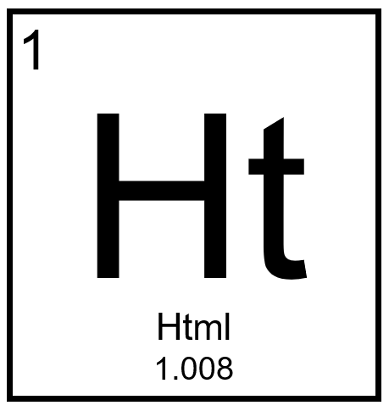
More HTML Elements

Slide 19
The List Elements
Lists are used to display groups of items
They can be unordered (bullet points) or ordered (numbered)
Each item is its own HTML element: <li>
The list items are children and the list elements are the parents
<ul>
<li>Eggs</li>
<li>Milk</li>
</ul>
<ol>
<li>Iron Man</li>
<li>The Hulk</li>
</ol>
Notes:
The bullet points on this slide are an unordered list!
An ordered list has numbers – for example, the MCU movies in release order

Slide 20
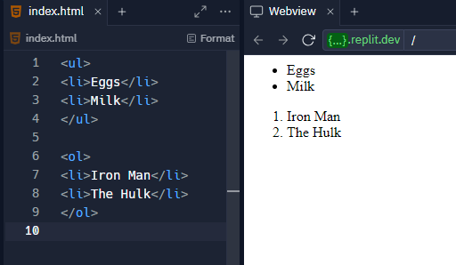
The List Elements
Notes:
The bullet points on this slide are an unordered list!
An ordered list has numbers – for example, the MCU movies in release order

Slide 21

Nesting Activity
Notes:
Explain nesting as a concept using geography.
Start by writing the following on the whiteboard (leave a lot of space around the tags):
<county name=“Cuyahoga”>
</county>
Ask what goes within a county – a city! Add that to the code:
<county name=“Cuyahoga”>
<city name=“Westlake”></city>
</county>
Ask what goes around a county – a state! Add that to the code:
<state name=“Ohio”>
<county name=“Cuyahoga”>
<city name=“Westlake”></city>
</county>
</state>
Use this concept to explain nesting. Explain parent/child relationships. The next slide has an example using lists.

Slide 22
List Example
https://jsfiddle.net/5fmw3dL8/
Notes:
Visit the Repl to show lists in action.
Here we really want to emphasize the hierarchical structure of HTML
Also show the difference between ol and ul

Slide 23
The <input> Element
inputs are interactive controls that accept data from the user
The type attribute determines how it appears
It is a self-closing tag
<input type="text" />
<input type="button" />
<input type="radio" />
<input type="checkbox" />
<input type="range" />
<input type="submit" />
Notes:
Ask the students to guess how each of these input types might appear

Slide 24
Special Inputs
<textarea></textarea> is used to create a multi-line text box
select and option are used to create a dropdown list
<select>
<option value="1">One</option>
<option value="2">Two</option>
</select>

Slide 25
Input Examples
https://jsfiddle.net/mz7gpx6c/
Notes:
Visit the Repl to show inputs in action

Slide 26
THANKS!
DO YOU HAVE ANY QUESTIONS?

