Slide 1
CSS Selectors & Properties
Hy-Tech Club: Web 101

Slide 2
CSS Selectors
CSS applies to different parts of the HTML based on selectors
Basic selectors apply certain styles to all elements of a certain type
a {
/* applies to all anchor elements */
}
li {
/* applies to all list item elements */
}
Notes:
Explain that CSS selectors decide which parts of the HTML to style. In the examples, the styles in the brackets will apply to those elements.

Slide 3
CSS Properties
A CSS property is an identifier that indicates which stylistic features to change on an HTML element
There are many, many properties that CSS controls
Examples of properties:
color: controls the color of text in an HTML element
background: controls the background color of an HTML element
font-size: controls the size of text in an HTML element
font-weight: controls the weight of text (e.g., boldness) in an HTML element
This is text
This is text
This is text
This is text
This is text
Notes:
Explain how CSS properties determine the actual styles that are controlled by CSS

Slide 4
CSS Declarations
A CSS declaration sets a property to a value
color: red;
Property
Value
Notes:
Define what declarations are

Slide 5
Putting it all together: A ruleset
Ruleset
h1 {
font-size: 60px;
background-color: purple;
}
Declaration
Selector
Property
Value
Notes:
Go over the vocabulary around different parts of CSS

Slide 6
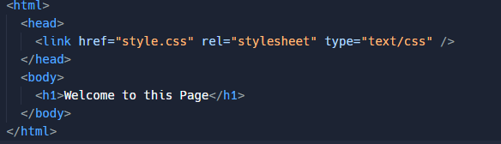
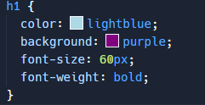

CSS Properties
Link to the CSS file

Slide 7
Ruleset Example
https://jsfiddle.net/6bhvk7aL/
Note: jsfiddle auto-links CSS
Notes:
For the Repl, show the whole ruleset in action. Make sure to switch to the CSS file to see the CSS. Change around the selector, properties, values etc to show how it affects the page.

Slide 8
THANKS!
DO YOU HAVE ANY QUESTIONS?

