Slide 1
Responsive Web Design
Hy-Tech Club: Web 101

Slide 2
What devices do you use to view web content?
Desktop computer, laptop, smartphone, tablet
Information should be accessible across devices
Responsive web design is an approach to web design that makes webpages render well on a variety of devices and window or screen sizes
Notes:
Ask the students which devices they use to visit websites.
Explain that more and more, web developers have to account for people using a variety of different devices to view information on the web.
Show the definition of responsive web design.

Slide 3
Responsiveness Examples
Bad:
https://en.wikipedia.org/wiki/Fortnite
Good:
https://www.nationalgeographic.com/
Notes:
Open the websites and show them in desktop and mobile modes.
In mobile mode, Wikipedia feels like a desktop website, and it is not easy to read everything on the screen. National Geographic feels like a mobile app!

Slide 4
Manual Responsive Design
Use percentage-based property values in CSS
img {
width: 50%;
}
Use media queries to style HTML based on the current viewport
@media screen and (max-width: 600px) {
.grid {
display: block;
}
}
Notes:
For the percentage-based property values, explain that the image’s width value will be 50% of the parent’s width.
For media queries, explain that wrapping a CSS ruleset in the query will mean it only applies if the condition is met. In this example, the .grid ruleset will only apply if the screen has less than a 600px width

Slide 5
Practice
Go to bit.ly/responsivedesignpractice
Make the h1 font bigger
Make the img bigger
Make the max-width for the mobile viewer smaller
CHALLENGE: Add an additional column
Notes:
View the Repl and show how it works. Change the size of the viewport to see the image change its size and the grid go from horizontal to vertical.
Allow students 5 minutes to work on this.
Note that these methods for responsive design are not as important, because Bootstrap takes care of a lot of this.

Slide 6

Bootstrap – A Better Way
Bootstrap is a free and open-source front-end web framework
It allows web developers to make their websites responsive out-of-the-box
It has a collection of existing CSS classes that developers can apply to their HTML

Slide 7
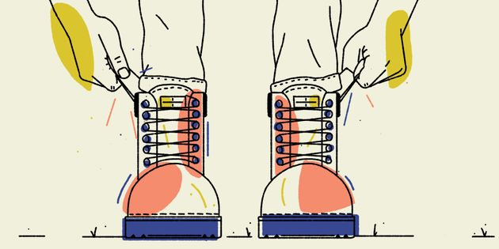
“Pull yourself up by your bootstraps”
Bootstrap allows developers to quickly prototype ideas without having to concern themselves with the user interface
It is a very good starting point for new projects
Notes:
Explain a little more background on the purpose of Bootstrap

Slide 8
Bootstrap Code
Meta tag – set viewport to scale appropriately
<meta name="viewport" content="width=device-width, initial-scale=1">
Link tag – import Bootstrap’s CSS
<link rel="stylesheet" href="https://maxcdn.bootstrapcdn.com/bootstrap/4.3.1/css/bootstrap.min.css">
Notes:
Students will not need to remember all this stuff – it should be copy/pasted when using bootstrap

Slide 9
Bootstrap Classes
jumbotron – to create big banner headers
text-center – to center text
container – to add space on sides
row – to create grid rows
col-md-* – to create grid columns (sized by *)
Each .row has 12 columns total, but they can merge depending on the class of the cell div
Notes:
A lot of classes are built into Bootstrap’s CSS. All a developer needs to do is add the class attribute with the given value to an HTML element.
More on rows/columns on the next slide.

Slide 10
Bootstrap Grid Columns
col-md-1 | col-md-1 | col-md-1 | col-md-1 | col-md-1 | col-md-1 | col-md-1 | col-md-1 | col-md-1 | col-md-1 | col-md-1 | col-md-1
col-md-4 |  |  |  | col-md-4 |  |  |  | col-md-4
col-md-3 |  |  | col-md-3 |  |  | col-md-3 |  |  | col-md-3
col-md-6 |  |  |  |  |  | col-md-6
col-md-8 |  |  |  |  |  |  |  | col-md-4
Notes:
Explain that adding any of these classes will set the size of a column within a row.
Every column in a given row has to add up to 12 total.
For example, the col-md-1 class will set a column to be 1/12 width of the row. The col-md-6 class will set a column to be ½ width of the row.

Slide 11
Bootstrap Example
https://v4-alpha.getbootstrap.com/examples/jumbotron/
Which part is the jumbotron?
Which part is the row?
What does the container class do?
What does the text-center class do?
Which class would be used for the columns?
Notes:
Visit the example site to show Bootstrap in action.
Ask the students the questions in the list to see if they can guess the answers.

Slide 12
THANKS!
DO YOU HAVE ANY QUESTIONS?

