Slide 1
Introduction to CSS
Hy-Tech Club: Web 101

Slide 2

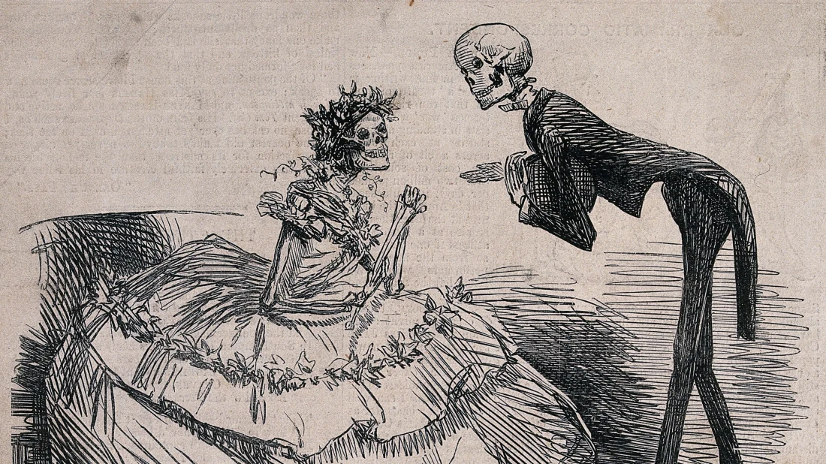
What is CSS?
CSS (Cascading Stylesheets) is a language that allows developers to change styles on a webpage
CSS can change fonts, colors, backgrounds, positioning, even animations!
If HTML is the skeleton of a page, CSS is the clothing that it wears
Notes:
Explain the purpose of CSS, and what it does.

Slide 3
A Webpage with CSS
<html>
<head>
<style>
p {
color: red;
}
</style>
</head>
<body>
<p>This paragraph is special...</p>
</body>
</html>
Notes:
Ask students about the relationships between all these tags.
E.g., HTML is parent, head/body are siblings. Style always goes in the head, structure goes in the body.

Slide 4
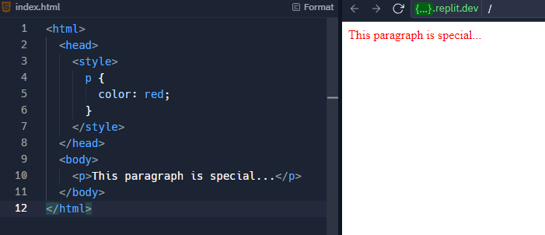
A Webpage with CSS
This is selecting the <p> element with text below as the specific thing that will turn red

Slide 5
CSS Example
https://jsfiddle.net/43rhtc20/
Notes:
For the Repl, ask the students how to change the text color to blue instead of red.

Slide 6
External Stylesheets – Why?
While it is possible to put CSS in HTML files, external stylesheets are easier to maintain
It is easier to swap out styles for HTML pages
https://www.w3schools.com/css/css_intro.asp
Notes:
Introduce the idea of separate CSS files. Click the link to show an example of multiple stylesheets applied to one HTML page

Slide 7
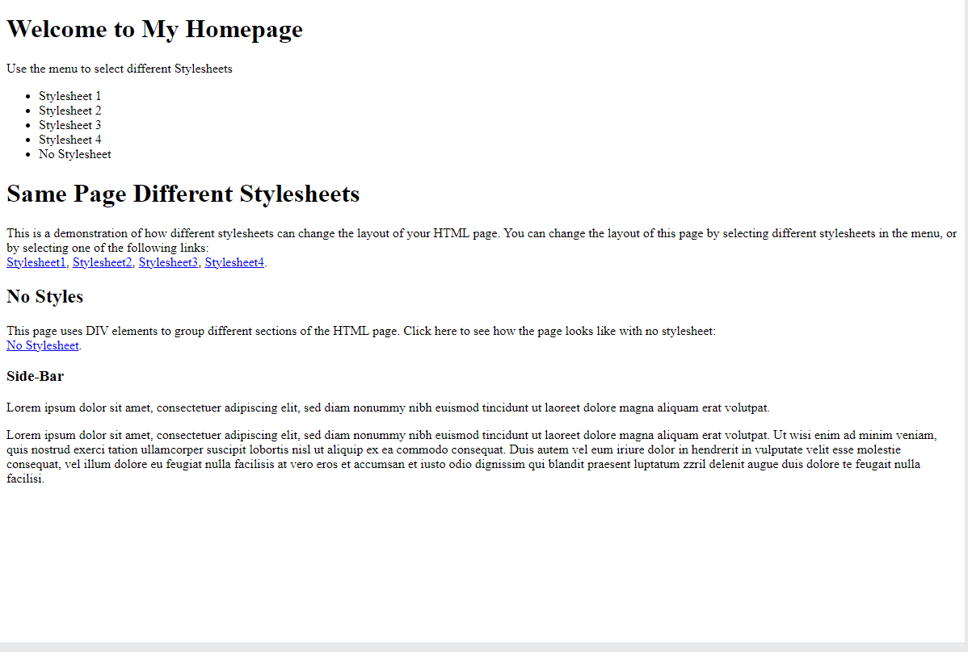
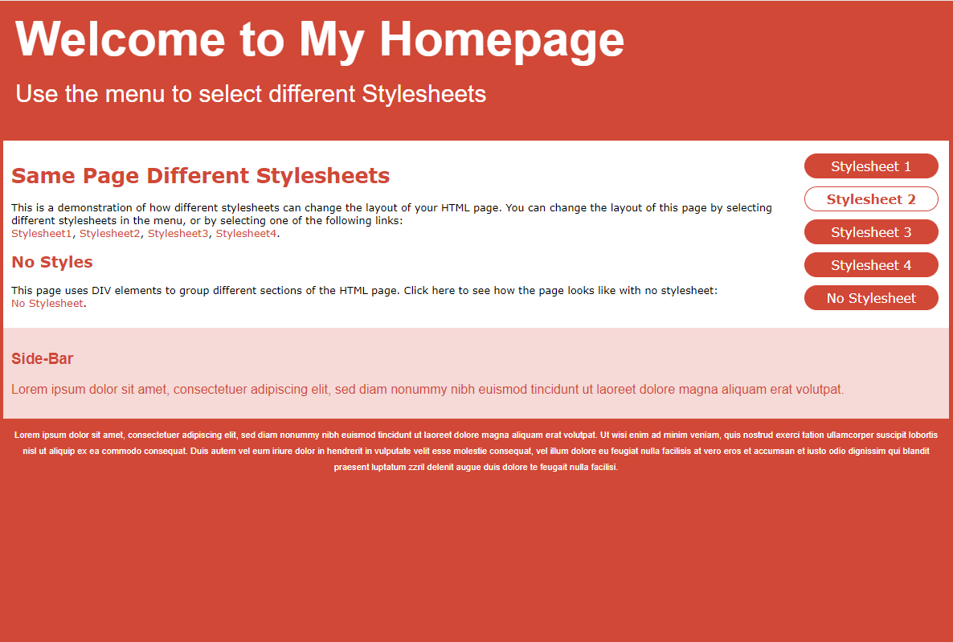
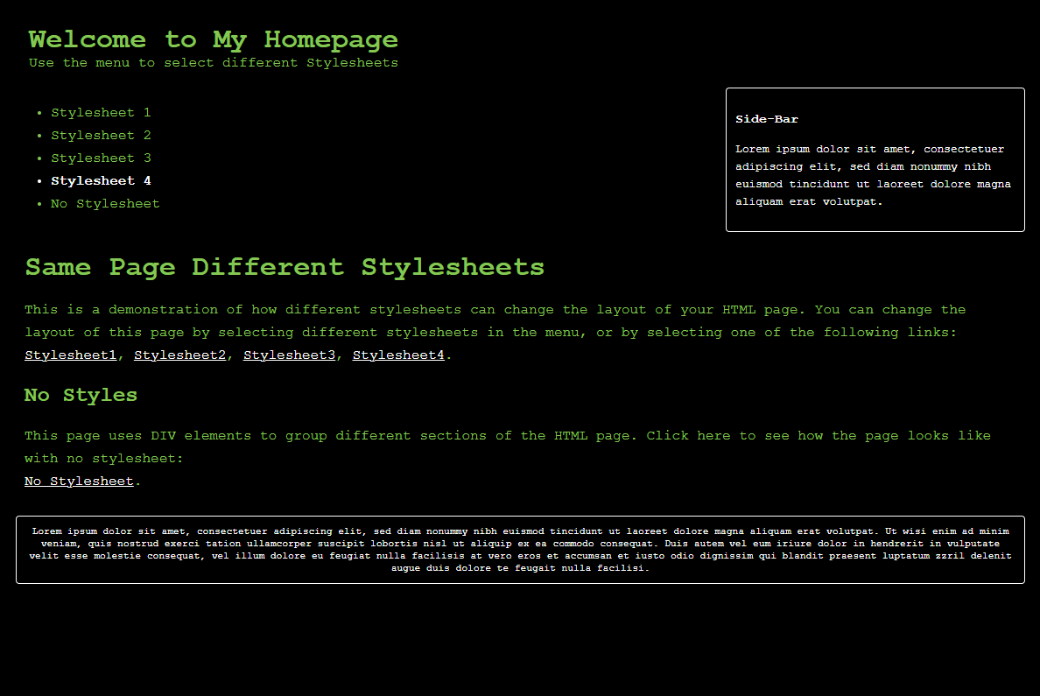
CSS Examples
Notes:
Introduce the idea of separate CSS files. Click the link to show an example of multiple stylesheets applied to one HTML page

Slide 8
External Stylesheets – How?
Create a separate .css file, with the CSS code
Make sure it’s in the same directory as the HTML file!
In the <head> of the HTML file, insert a <link> element:
<link rel="stylesheet" type="text/css" href="mystyle.css">
Notes:
Emphasize that the file has to end in .css and it has to be in the same folder as the HTML file
The link tag is an example

Slide 9

More about the link element
Links a variety of external files (CSS, fonts, icons)
It is a self-closing tag
It goes within the <head></head> element
Important attributes:
href: path to the file (either online or local)
rel: determines the relationship type (e.g., “stylesheet”)
type: specifies the content type of the file (e.g., “text/css”)
Notes:
Explain the link tag

Slide 10
Stylesheet Example
https://glitch.com/edit/#!/remix/oval-shared-wealth
https://stackblitz.com/edit/web-platform-bgy6gtls?file=index.html
Notes:
Show the link tag in action. Make sure to note the filename, attributes, and new CSS property.

Slide 11
THANKS!
DO YOU HAVE ANY QUESTIONS?

