Slide 1
Hello HTML!
Hy-Tech Club: Web 101

Slide 2
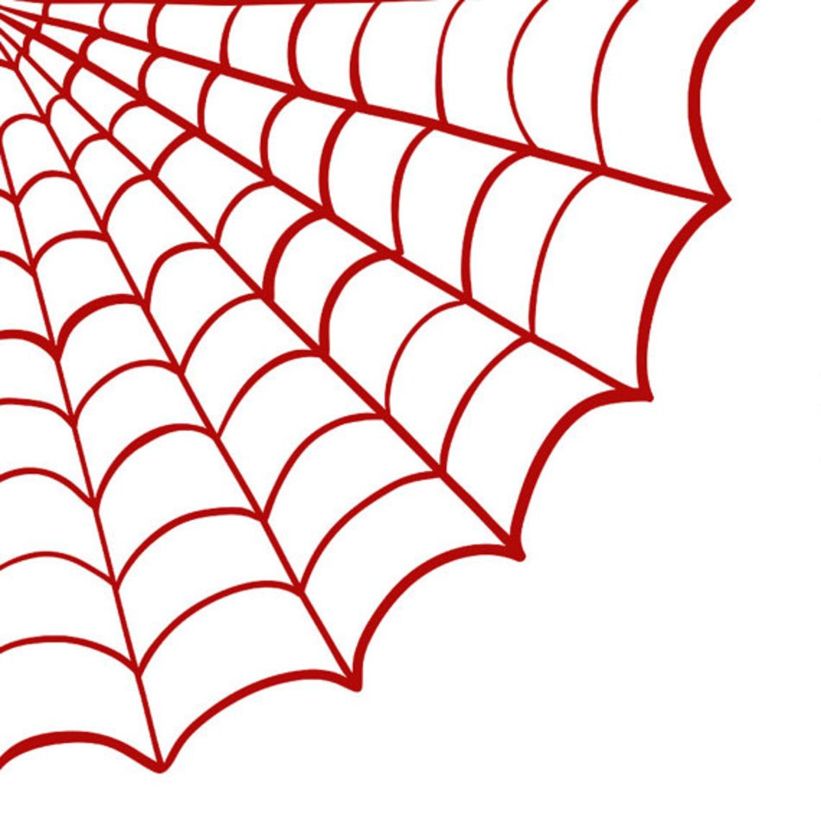
Web Overview

Slide 3

What is a web browser?
A web browser is an application that is used to view websites.
What are some examples of web browsers?
Notes:
Ask the students this question to see if they know the answer.

Slide 4
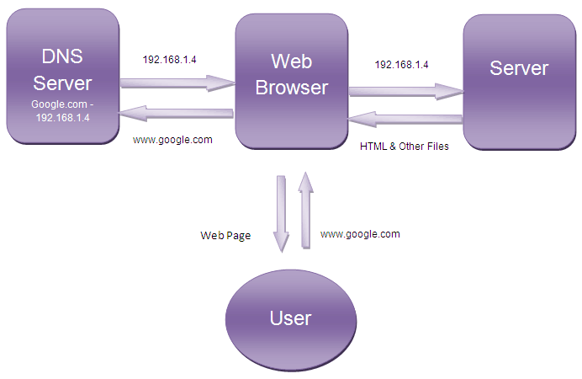
How does the web work?
User
Type a URL into a web browser
See the content of a website
Behind the Scenes
The browser finds the server
The server sends content
The browser renders content
Notes:
Students should be familiar with websites – they enter a URL, and see some content.
Behind the scenes, a lot of stuff happens to get that content to the user!
Most of this doesn’t really apply to this course, but it is helpful to have this background knowledge.

Slide 5
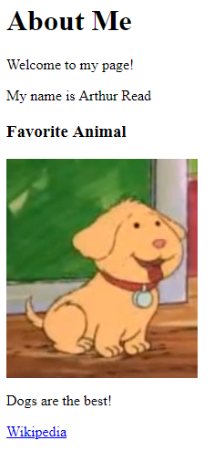
How does a browser use HTML?
The browser gets HTML from the server and turns it into a webpage
<html>
<body>
<h1>About Me</h1>
<p>Welcome to my page!</p>
<p>My name is Arthur Read</p> <h3>Favorite Animal</h3>
<img src="dog.png">
<p>Dogs are the best!</p>
<a href="dog.com">Wikipedia</a>
</body>
</html>
Server
Notes:
Browser reads the text, interprets it, and shows it to the user. HTML is behind every user interface on the web.
It can be helpful to view a popular Wikipedia page in the web, and then view the source to see how the web browser renders it into a viewable page.

Slide 6
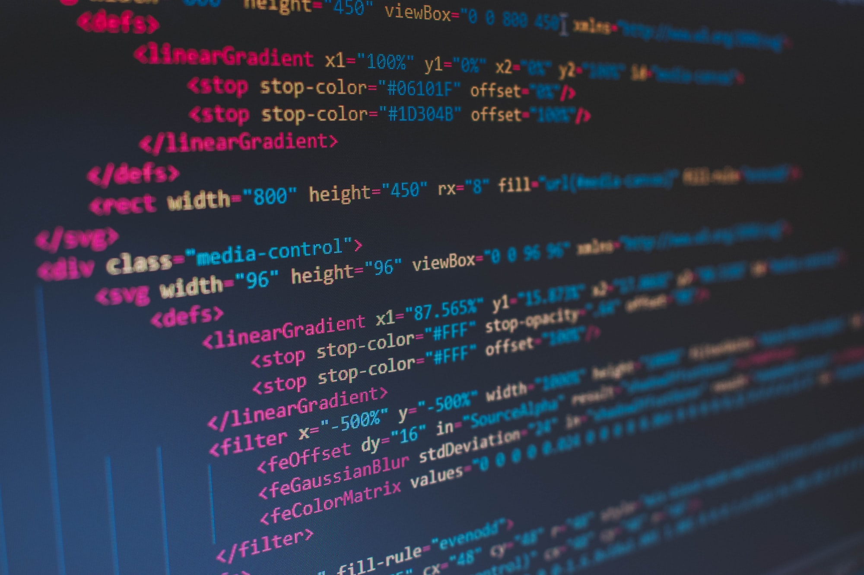
HTML Introduction

Slide 7
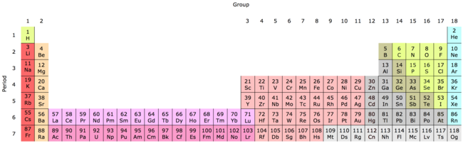
HTML Introduction
An HTML Document is a text file with a specific format
The file extension should be .html (e.g., index.html)
HTML has elements, each with a different purpose
E.g., images, text, tables, links, and so on!
Notes:
This may seem abstract, but it should make more sense after some examples

Slide 8
HTML Elements
html – container for everything
body – container visible elements
p – (paragraph) used for normal text
Notes:
These are the elements this lesson covers. There are so many elements out there, but this is a good place to start.

Slide 9
What are these?
< >
Angle Brackets
Less-than Sign
Greater-than Sign
Notes:
Ask the students if they recognize these symbols. They may have seen them in math – less than sign and greater than sign. In HTML, we also call these “angle brackets”. They will be necessary when writing the code for tags.

Slide 10
HTML TAGS
opening tag
<element-name>
closing tag
</element-name>
Notes:
Go over the syntax for making a tag. It starts with a less-than sign, then the element name, then a greater-than sign.
A closing tag starts with a less-than sign and a slash, then the element name, then a greater-than sign.

Slide 11
HTML Element Example - <p>
<p>Hello World</p>
Opening Tag
Closing Tag
Content
HTML Element
Notes:
Note the < and > (greater than/less than, or angle brackets).

Slide 12
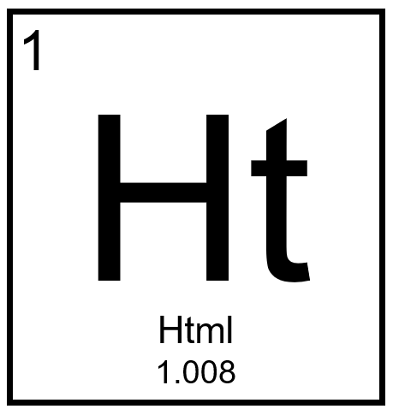
Basic HTML Elements

Slide 13
The <html> Element
The foundation for every HTML document
Starts and ends the entire file
All the other HTML is the content in between these tags
<html>
<!-- content -->
</html>

Slide 14
The <body> Element
Goes within the <html></html> element
Everything within these tags determines the structure of the page
All of the visible HTML elements go within the <body>
<html>
<body>
<!-- content -->
</body>
</html>

Slide 15
The <p> (Paragraph) Element
Displays common text on the page
The content does not have to be multiple sentences
Each <p></p> creates a new line under it
<p><!-- content --></p>

Slide 16
Full Document Example
<html>
<body>
<p>Hello World</p>
</body>
</html>
Notes:
This is an example of a full HTML document. There is a lot of code here, but it’s not too big of a deal. This is how the html and body elements are used. The p element goes within the body element, as its content.

Slide 17
THANKS!
DO YOU HAVE ANY QUESTIONS?

