Slide 1
Introduction to JavaScript
Hy-Tech Club: Web 102

Slide 2
JavaScript is the programming language of the web. It makes websites interactive.

Slide 3

A world without JavaScript
https://web.archive.org/web/19961017235908/http://www2.yahoo.com:80/
Notes:
Visit the site to show what the web was like before JavaScript. No interactivity – the internet used to be a lot of links going to websites – just a directory

Slide 4
What do developers use javascript for?
Game Logic
Animations
Retrieving data
Sending data
Validating data
Updating HTML and CSS dynamically
Notes:
Ask the students about their favorite websites, and how they were interactive. These are some examples of things JavaScript can do

Slide 5
A simple JavaScript program – in html
index.html
script.js
<html>
<head>
<script src="script.js">
</script>
</head>
<body>
</body>
</html>
alert("Hello, world!");
What happens when this page loads?
Hello, world! appears in a pop-up message
Notes:
Here there is an HTML file with a new HTML element… but a familiar attribute. The src points to another file…
script.js that has this one line of code. Like CSS, this is a new language, NOT HTML! It’s JavaScript!
So, what will happen when this page loads? Any guesses?
A pop-up appears that says Hello World!

Slide 6
Unpacking the example
<script></script> element
This adds some JavaScript to the HTML page
<head></head> element
This is where the <script> element goes
alert("Hello, world!");
This is an example of a statement in JavaScript. This one tells the computer to display a message of “Hello, world!”
Notes:
Unpack the important parts of the JavaScript in the example.

Slide 7
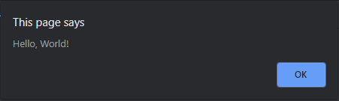
Unpacking the statement
alert("Hello, World!");
alert keyword (must be lowercase)
Open parenthesis
Opening double quote
Message for the user
Closing double quote
Closing parenthesis
Semi-colon – every statement ends in a semi-colon
Keywords, or reserved words, are pieces of text that have a special meaning in JavaScript
Notes:
List each part of the JavaScript statement. Explain that for the code to work, it has to be exactly right.
This statement, when executed, will show the message in a small box in the browser.

Slide 8

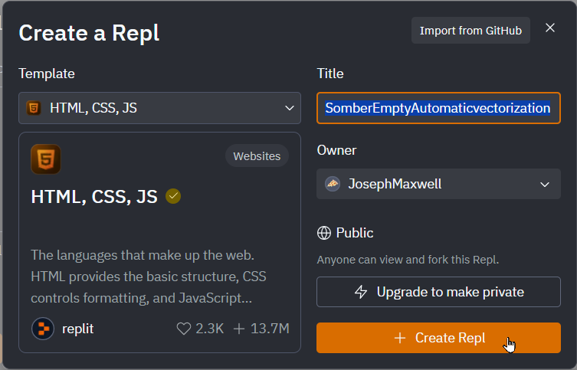
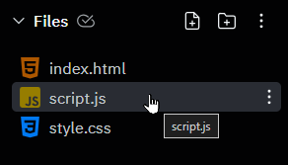
Mini-challenge: Setup
Go to replit.com
Make sure you’re logged in
Click + Create Repl
Select HTML, CSS, JS
Click + Create Repl
Open the script.js file

Slide 9
Mini-challenge
Write your own program that will say hello to you by name.
For example, if your name were Drake, it should say “Hello, Drake!”

Slide 10
Hello, Drake!
alert("Hello, Drake!");

Slide 11
Questions?

Slide 12
JavaScript Variables
Hy-Tech Club: Web 102

Slide 13
What are variables?
In computer science, variables are containers for storing data values
They are similar to variables in Algebra
What are some examples of data on a website?
User’s profile information (name, age, email, etc)
Any information the user enters
Messages/notifications
Notes:
Introduce the idea of variables – containers for data. Ask the students to think about data they might see on a website.

Slide 14
What do variables look like?
Creating a variable:
let movieTitle = "Despicable Me 2";
Setting a value:
movieTitle = "Despicable Me 3";
Using the value:
alert(movieTitle);
Variable Names
Must start with a letter
Cannot contain spaces
Cannot be a keyword (e.g., let)
Cannot have special chars
Notes:
In this Example, the variable name is “movieTitle”
Creating tells the computer to open up block of space to store the data. It allows you to reference the variable by name in subsequent statements.
-To declare a variable, you need to use the “let” keyword. A keyword is a word that JavaScript recognizes. It’s what tells the computer we’re going to be using a block of space, and referring to it by this name.
Setting the value of the variable stores some data in that block of space.
-To set the value of a variable, you need to use the “=“ operator. It basically means, put this value inside of this name.
Using a variable simply retrieves whatever value is currently stored by that name. You can use the variable name, and the computer will replace it with the value that was stored.
-Note: Values for now must have double quotes around them. That’s how the computer knows this data all goes together. Variable names have no spaces, and do not have double quotes.
Variable names must start with a letter, and contain only letters and numbers (no spaces or special characters).
Variable names cannot be keywords.

Slide 15
Review
5 Things to Create a Variable
let
Variable name
Equals sign =
Variable value
Semi-colon ;
let myVar = "myVal";
4 Things to Set a Variable
Variable name
Equals sign =
Variable value
Semi-colon ;
myVar = "myNewVal";
Notes:
Ask the students to try to name each thing needed to do both of these things. It will be important to emphasize the terminology here:
Keyword
Variable name
Variable value

Slide 16
Variables example
https://replit.com/@HylandOutreach/VariablesExample#script.js
Notes:
For the Repl, show how the variable is declared, set, and set again. The value changes based on the code.

Slide 17
Combining Text values and variable values
Developers can combine text values and variables that store other text values using the + sign.
let userName = "Jane";
alert("Hello, " + userName);
What message will appear?
Hello, Jane
Notes:
Ask the students what message the user will see. What is the value of the username variable?

Slide 18
Mini-challenge: update your script.js file
Write a program that will say hello to you by name WITHOUT using quotes in the alert
For example, if your name were Jane, it should say “Hello, Jane”
Notes:
Allow the students a few minutes to attempt the challenge

Slide 19
Solution
let myName = "Jane";
let greeting = "Hello, ";
alert(greeting + myName);
Notes:
Display the solution for the students. Note that the alert statement does not contain a quote, it combines two variables.

Slide 20
User Input in JavaScript
prompt("How are you today?");
Displays like an alert, but allows the user to enter text into a text box too
It is possible to store the user’s answer in a variable
This is called a return – a variable can be created and set to the value
Notes:
So far, we’ve seen the computer show a message to the user, but the user has had no way to send messages back to the computer. Ask the students to guess what the prompt might do.
Prompt looks just like alert, except:
-Different word (“prompt” instead of “alert”)
-It can be set as a variable value

Slide 21
Prompt and alert example
let answer = prompt("How are you today?");
alert("That is " + answer);
Fork this Repl project, and copy the code above to try it!
replit.com/@HylandOutreach/JavaScriptStarter
Notes:
Ask the students what they think this code will do. What will happen if the user says “good”? What if they say “bad”?
Let the students copy the code into their own file to play around and see what happens.

Slide 22
Variables example
https://replit.com/@HylandOutreach/PromptAlert#script.js
Notes:
Let’s take a look at this example in action!

Slide 23
Mini-challenge: Update your script.js file
Write a program that asks the user for their name, and says hello to them.
For example, if the user enters “Charlie”, it should say “Hello, Charlie!”
Notes:
Allow the students a few minutes to attempt the challenge

Slide 24
Solution
let name = prompt("What is your name?");
alert("Hello, " + name);
Notes:
Display the solution for the students. Note that the user’s answer is stored in the name variable, and then combined with “Hello, “ for the message.

Slide 25
Questions?

