Slide 1
Introduction to JavaScript
Hy-Tech Club: Web 102

Slide 2
JavaScript is the programming language of the web. It makes websites interactive.

Slide 3

A world without JavaScript
https://web.archive.org/web/19961017235908/http://www2.yahoo.com:80/
Notes:
Visit the site to show what the web was like before JavaScript. No interactivity – the internet used to be a lot of links going to websites – just a directory

Slide 4
What do developers use javascript for?
Game Logic
Animations
Retrieving data
Sending data
Validating data
Updating HTML and CSS dynamically
Notes:
Ask the students about their favorite websites, and how they were interactive. These are some examples of things JavaScript can do

Slide 5
A simple JavaScript program – in html
index.html
script.js
<html>
<head>
<script src="script.js">
</script>
</head>
<body>
</body>
</html>
alert("Hello, world!");
What happens when this page loads?
Hello, world! appears in a pop-up message
Notes:
Here there is an HTML file with a new HTML element… but a familiar attribute. The src points to another file…
script.js that has this one line of code. Like CSS, this is a new language, NOT HTML! It’s JavaScript!
So, what will happen when this page loads? Any guesses?
A pop-up appears that says Hello World!

Slide 6
Unpacking the example
<script></script> element
This adds some JavaScript to the HTML page
<head></head> element
This is where the <script> element goes
alert("Hello, world!");
This is an example of a statement in JavaScript. This one tells the computer to display a message of “Hello, world!”
Notes:
Unpack the important parts of the JavaScript in the example.

Slide 7
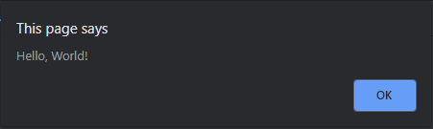
Unpacking the statement
alert("Hello, World!");
alert keyword (must be lowercase)
Open parenthesis
Opening double quote
Message for the user
Closing double quote
Closing parenthesis
Semi-colon – every statement ends in a semi-colon
Keywords, or reserved words, are pieces of text that have a special meaning in JavaScript
Notes:
List each part of the JavaScript statement. Explain that for the code to work, it has to be exactly right.
This statement, when executed, will show the message in a small box in the browser.

Slide 8

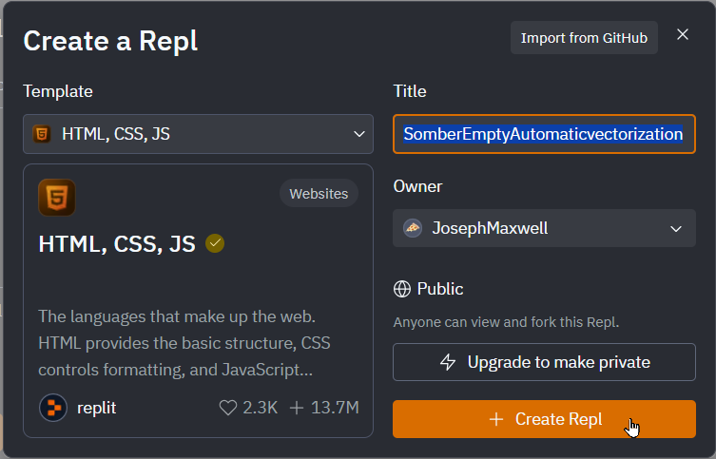
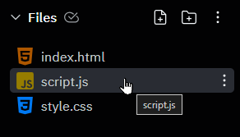
Mini-challenge: Setup
Go to replit.com
Make sure you’re logged in
Click + Create Repl
Select HTML, CSS, JS
Click + Create Repl
Open the script.js file

Slide 9
Mini-challenge
Write your own program that will say hello to you by name.
For example, if your name were Drake, it should say “Hello, Drake!”

Slide 10
Hello, Drake!
alert("Hello, Drake!");

Slide 11
Questions?

