Slide 1
Arrays
Hy-Tech Club: Web 102
Notes:
This lesson is going to cover arrays – what they are, why we need them, and how to use them!

Slide 2
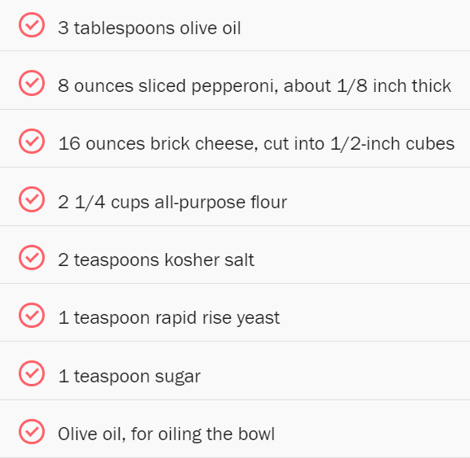
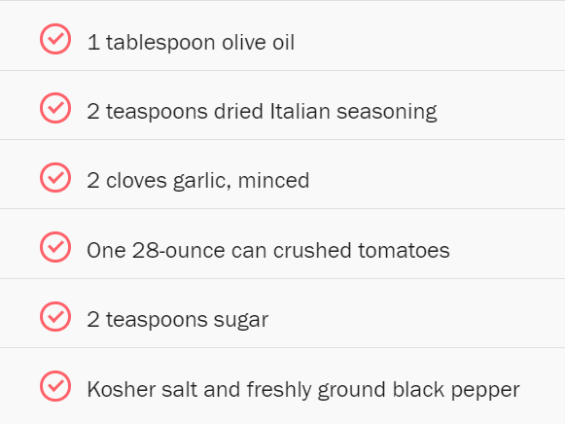
INGREDIENTS
Notes:
What does this look like?
It’s a list (or collection of ingredients! Can anyone guess what these ingredients make? Pizza!

Slide 3
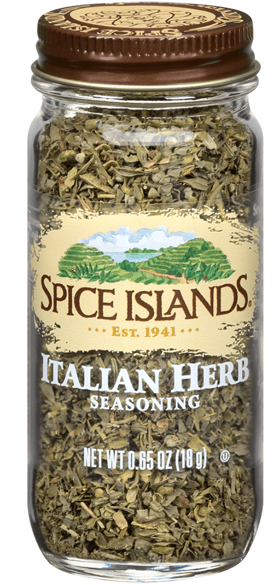
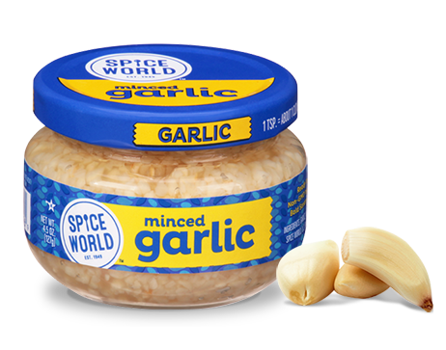
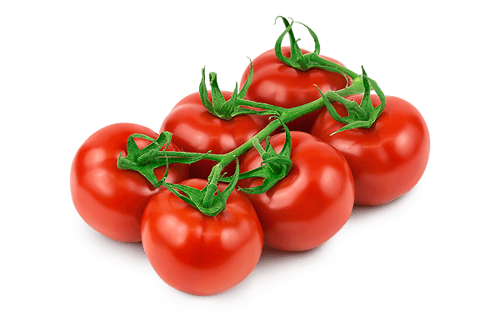
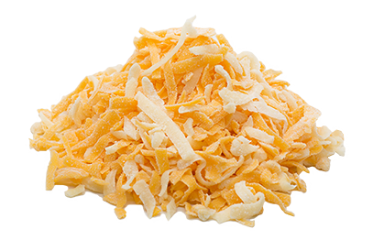
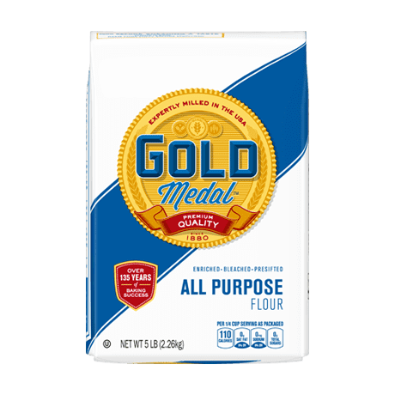

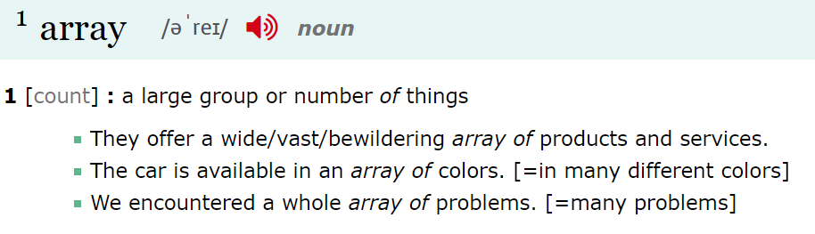
🍕🍕 An Array of Ingredients 🍕🍕
Notes:
So, does anyone know what an array is? Just in English, not in programming.
In English, an array is a group, or collection. Here are some example sentences. What about in programming?

Slide 4
Arrays in Programming
An array is a special kind of variable that points to a list of multiple values
Top 10 Movies
Shop Inventory
To-Do List
List of lists of lists
So what can you store in an array?
Tweets in a Timeline
Team Roster
Music Playlist
Recipe Ingredients
Notes:
In programming, an array is basically a list of values – it’s a special kind of variable that contains a list of other values.
So what do you think we could store in an array? What types of things would you store in a list?
There are a ton of different things these things can store! Top 10 Movies, music playlist, etc etc etc
Even a list of lists of lists – like this Wikipedia page!

Slide 5
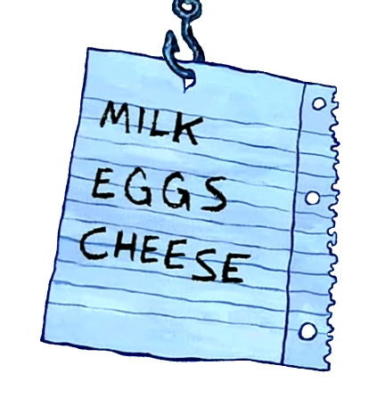

Creating an Array – New Syntax
Square Brackets
[ and ]
Comma
,
let shop = ["MILK", "EGGS", "CHEESE"];
Index | 0 | 1 | 2
Value | "MILK" | "EGGS" | "CHEESE"
Notes:
Now let’s take a look at some syntax (aka the text symbols we’ll need to use to make arrays).
Two important new symbols – we call these square brackets. They should be the same place as the curly brackets on your keyboard, but you don’t have to hold down shift!
Next is the comma. Hopefully you have seen these before! These three symbols are the only new ones. The rest of the array creation is exactly the same as creating any other variable!
We start with let, then a variable name and equals sign. Then, what do we have? Square brackets! Then we have a string value, followed by what? A comma! That goes on until the closing square bracket and semi-colon.
What we have in the shop variable now is an array containing 3 items. Each item has an index which we will talk about more soon.

Slide 6

Array Storage by Index
Loops allow developers to repeat code programmatically!
Statements can be repeated a certain number of times using a for loop
Notes:
Luckily we can prevent this with loops!
Loops allow developers to repeat code programmatically. This means they only have to write it once!
Let’s take a look at an example of a real life loop. See if you can catch when the clip starts to repeat. [play the video for about 2 mins]
Statements can be repeated a certain number of times using a for loop!

Slide 7
Accessing Values by Index
Loops allow developers to repeat code programmatically!
Statements can be repeated a certain number of times using a for loop
Notes:
Luckily we can prevent this with loops!
Loops allow developers to repeat code programmatically. This means they only have to write it once!
Let’s take a look at an example of a real life loop. See if you can catch when the clip starts to repeat. [play the video for about 2 mins]
Statements can be repeated a certain number of times using a for loop!

Slide 8
Setting Values by Index
Loops allow developers to repeat code programmatically!
Statements can be repeated a certain number of times using a for loop
Notes:
Luckily we can prevent this with loops!
Loops allow developers to repeat code programmatically. This means they only have to write it once!
Let’s take a look at an example of a real life loop. See if you can catch when the clip starts to repeat. [play the video for about 2 mins]
Statements can be repeated a certain number of times using a for loop!

Slide 9
Adding New Values
Loops allow developers to repeat code programmatically!
Statements can be repeated a certain number of times using a for loop
Notes:
Luckily we can prevent this with loops!
Loops allow developers to repeat code programmatically. This means they only have to write it once!
Let’s take a look at an example of a real life loop. See if you can catch when the clip starts to repeat. [play the video for about 2 mins]
Statements can be repeated a certain number of times using a for loop!

Slide 10
Array Example: Sorting
https://replit.com/@HylandOutreach/Arrays#script.js
Notes:
Now let’s actually take a look at the code in action!
Walk through this example in Replit. Ask the students how they might change the number of times the alert repeats. Ask them how to change the message, ask them for a new mantra or aphorism.

Slide 11
Looping Through Arrays
Loops allow developers to repeat code programmatically!
Statements can be repeated a certain number of times using a for loop
Notes:
Luckily we can prevent this with loops!
Loops allow developers to repeat code programmatically. This means they only have to write it once!
Let’s take a look at an example of a real life loop. See if you can catch when the clip starts to repeat. [play the video for about 2 mins]
Statements can be repeated a certain number of times using a for loop!

Slide 12
Looping Through Arrays
Loops allow developers to repeat code programmatically!
Statements can be repeated a certain number of times using a for loop
Notes:
Luckily we can prevent this with loops!
Loops allow developers to repeat code programmatically. This means they only have to write it once!
Let’s take a look at an example of a real life loop. See if you can catch when the clip starts to repeat. [play the video for about 2 mins]
Statements can be repeated a certain number of times using a for loop!

Slide 13
Array Example: Looping
https://replit.com/@HylandOutreach/ArraysLoop#script.js
Notes:
Now let’s revisit take that code and revisit the warm-up. In this version, we can make the count as high as we want just by changing one number!
Change the number of times the loop executes.

Slide 14
THANK YOU!
WHAT QUESTIONS DO YOU HAVE?
Notes:
Does anyone have any questions? Thanks!

