Slide 1
Databases Overview
Hy-Tech Club: Web 201

Slide 2
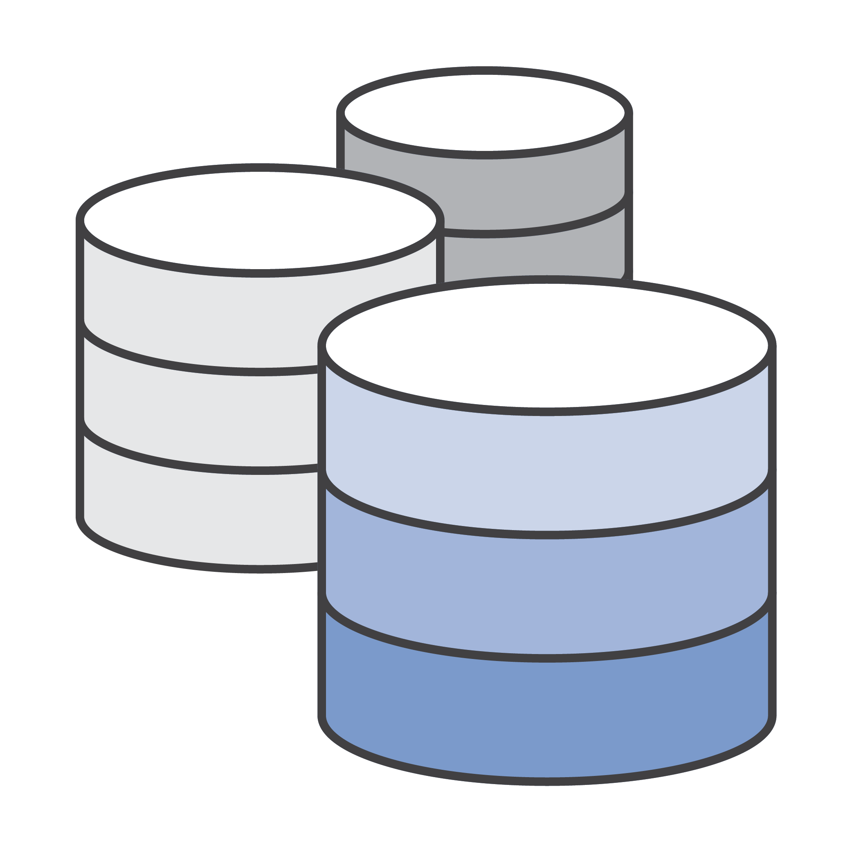
What is a database?
A database is an organized collection of structured information, or data, typically stored electronically in a computer system

Slide 3



Full-Stack Web Architecture
Front-end
(client side)
HTML, CSS, JavaScript, EJS
User Interface
Back-end
(server side)
HTTP
Queries
JSON Data
Node.js, Express
Server
Replit DB
Database
Notes:
The database holds all the data for the web application.

Slide 4
Relational Database tables – SQL
Movies
Title | Year | Genre | Director
Billy Madison | 1995 | Comedy | Tamra Davis
The Wedding Singer | 1998 | Comedy | Frank Coraci
Reign Over Me | 2007 | Drama | Mike Binder
Grown Ups 2 | 2013 | Comedy | Dennis Dugan
Uncut Gems | 2019 | Thriller | Josh Safdie & Benny Safdie
Each row is an object, each column is a property
Notes:
In a relational database, like MySQL, the data is held in tables. Each row in the table represents one object (or record), and each column represents one property (or field) for the object.
However, we will not be working with relational databases for the Repl.it DB.

Slide 5
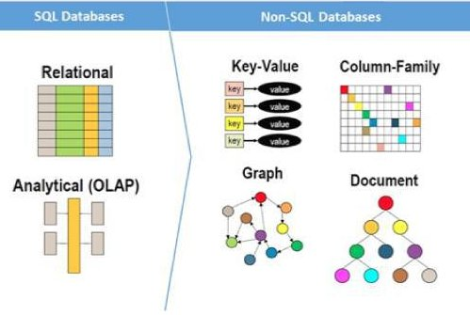
NOSQL – NOT relational
They can be:
graph based
document based
key-value pairs
wide column
They can work with “unstructured data”
(big data, messy data)
SQL databases can scale vertically
NoSQL databases can scale horizontally
NoSQL databases do NOT use tabular relations
Examples:
MongoDB, CouchDB, Redis, DynamoDB
Notes:
Explain some of the differences between relational databases (SQL) and NoSQL databases.
NoSQL = Not relational
Graph based – like a social network
Document based – semi-structured information (e.g. XML)
Key-value – a key points to a value
Wide column – still uses rows and columns, but the tables are not strictly structured
Unstructured data – data is messy, big data, does not always have certain properties for each object
Vertical scaling – easy to add data of the same form
Horizontal scaling – easy to change the form of the data
Several examples
NoSQL Databases have gained popularity over the last decade.
https://www.mongodb.com/nosql-explained/nosql-vs-sql

Slide 6


Replit DB – A Persistent key-value store
[A] fast, free, and easy key-value store that’s built into every repl.
Like a JSON object
let db = {
"key1": "value1",
"key2": "value2",
"any key": "any value"
}
Every key has a value
“key1” → “value1”
“key2” → “value2”
“any key” → “any value”
Developers can set a key to a value, get a key’s value, delete a key, and search for keys
Notes:
Key-value databases are conceptually simple: they’re a flat map of keys to their values. There are no schemas, tables, or columns. There are only a few operations that you need to perform: set a key to a value, get a key’s value, delete a key, and search for keys.
The important thing about Repl.it DB – the values stick around! Anyone can visit your website, and see/update the same data.
If the students do not know, tell them that Key and Peele was a sketch comedy show from the 2010s. https://www.youtube.com/watch?v=rT1nGjGM2p8

Slide 7

R
Notes:
Ask if anyone has seen the movie C.H.U.D. (they probably haven’t). We aren’t actually going to talk about C.H.U.D. though; we will talk about CRUD instead.

Slide 8
CRUD – The building blocks of an app
Create – db.set("key", "value")
Read – value = db.get("key")
Update – db.set("key", "newvalue")
Delete – db.delete("key")
R
Notes:
CRUD encompasses the basic database interactions necessary for a simple app. These examples are pseudocode for how it would work in Repl.it’s database – but they are almost complete.

Slide 9
Interacting with The Replit DB in Node.js
Setup
const Database = require("@replit/database");
const db = new Database();
Promises & Handlers
A Promise is a proxy for a value not necessarily known when the promise is created. It allows a developer to associate handlers with an asynchronous action's eventual success value or failure reason. This lets asynchronous methods return values like synchronous methods: instead of immediately returning the final value, the asynchronous method returns a promise to supply the value at some point in the future.
Set a key to a value
db.set("key", "value")
.then(() => {});
Get a key’s value
db.get("key")
.then(value => {});
Delete a key
db.delete("key")
.then(() => {});
List all keys
db.list()
.then(keys => {});
Notes:
Go over some of the syntax for connecting to Repl.it’s database in Node.js.
The students may notice the odd .then syntax – this is because connecting to Repl.it’s db in Node.js uses JavaScript Promises. Ask students if anyone knows what a Promise is in JavaScript. The Mozilla Developer Network definition for promises is provided on the slide. Don’t read the whole thing – it’s mostly there for reference purposes.
It is good for students to be aware of the existence of JS Promises, but they will not need to fully understand them in this course.

Slide 10
Async / Await – Simpler Promise Handling
Why do we need asynchronous programming?
Node.js is single-threaded, so a server would freeze without async!
async Functions
Encapsulate long processes
Are defined with the async keyword
Return a Promise
Can await Promises within the body
async function getAndSet() {
await db.set("myKey", "myVal");
let keyVal = await db.get("myKey");
return keyVal;
}
function handleVal(val) {
console.log("myKey is " + val);
}
getAndSet().then(handleVal);
await Keyword
await goes in front of Promises
Kicks off new Promise process
Blocks any subsequent execution
Only usable within async functions
Notes:
Ask the question to the students. There is no need to get too deep into the details of asynchronous programming – the goal is for the students to be able to use it within the context of Node.js to build their apps.
Async/await reference: https://developer.mozilla.org/en-US/docs/Learn/JavaScript/Asynchronous/Async_await
Async functions
Typically used when a process is going to take a long time (e.g. getting something from a database)
Defined by putting async in front of the function definition
Always return a promise, although not explicitly – return whatever, and the magic will happen
Can use the await keyword to wait for other processes to complete (processes must return Promise objects)
Can be awaited themselves because they return a Promise: any Promise can be awaited
Await Keyword
Goes in front of anything to be awaited – anything that returns a Promise
Kicks off the new process
Will block anything coming after it until it completes – so it won’t allow the code to continue
It can only be used within async functions – so it cannot be used in the main code execution!
The example shows async/await in action. Note:
The async keyword
The two uses of the await keyword
How the getAndSet function returns keyVal
This is a string, BUT it is wrapped in a promise
The handleVal function simply prints out a value given
The call to the getAndSet function – returns a promise, which then has the then which passes in the handleVal function
Students will not need to resolve any promises in this manner, because within a Node.js web application, all request handlers can be made async.

Slide 11
Questions?

