Slide 1
HTTP
Hy-Tech Club: Web 201

Slide 2
Agenda
Overview
Requests
Responses

Slide 3
Where have you seen http?
HTTP is at the beginning of URLs we use every day!
Notes:
Ask the students this question

Slide 4
What does HTTP stand for?
HyperText Transfer Protocol
Notes:
Ask the students this question

Slide 5



Full-Stack Web Architecture
Front-end
(client side)
HTML, CSS, JavaScript, EJS
User Interface
Back-end
(server side)
HTTP
Queries
JSON Data
Node.js, Express
Server
MySQL or Repl.it DB
Database
Notes:
HTTP is how the client and server communicate with each other. From the perspective of the full-stack architecture, it goes between the front-end and the back-end

Slide 6
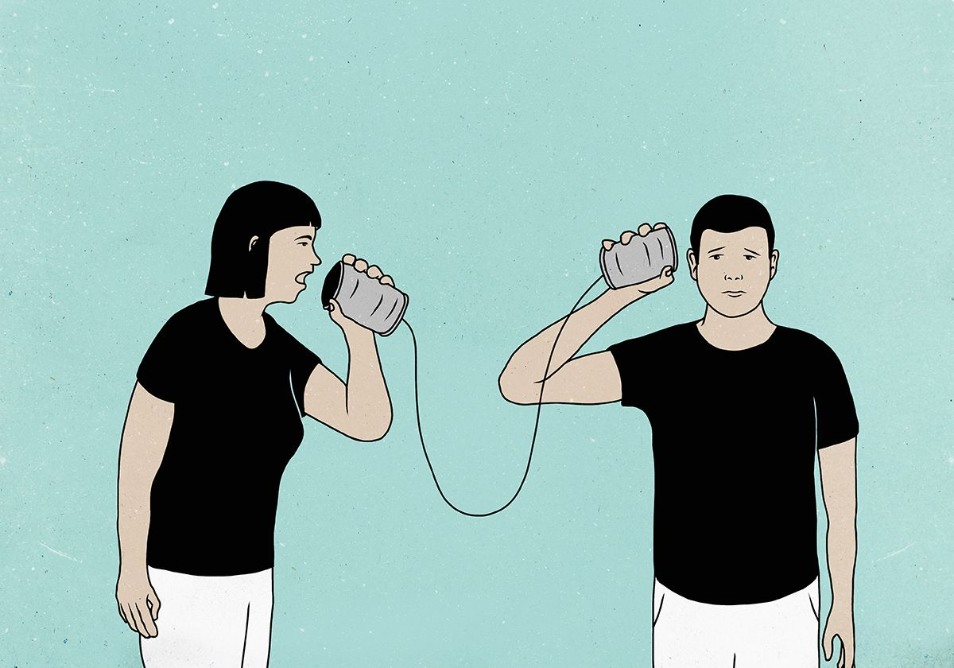
HTTP Request
Web Browser (client)
www.example.com (server)
GET /index.html HTTP/1.1
Host: www.example.com
Notes:
The web browser first sends an HTTP request. This happens whenever you type in a URL or click a link on the web!
This HTTP request contains some information, and is sent to the Host (in this case, www.example.com).
Ask the students what the complete URL would be for this request: www.example.com/index.html.

Slide 7

HTTP Response
Web Browser (client)
www.example.com (server)
HTTP/1.1 200 OK
Content-Type: text/html; charset=UTF-8
Content-Length: 208
<!DOCTYPE html... (more)
Notes:
After the host receives the request, it sends back an HTTP response.
The HTTP response contains information about the response along with the actual results. In this case, an HTML page was requested, so an HTML page is sent.
Ask the students what the status code is for the response: 200.
Note the two HTTP headers in the response: Content-Type and Content-Length.
Note that the actual HTML is also in the response.
Emphasize that the client sends requests, and the server sends responses.

Slide 8
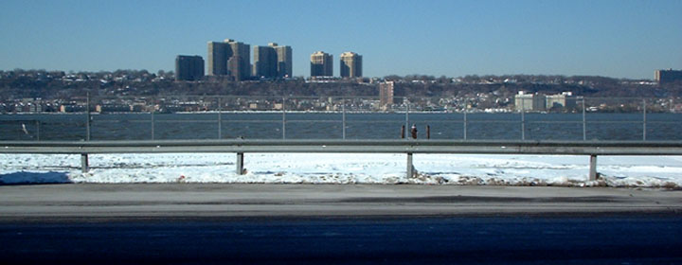
Example
http://www.columbia.edu/~fdc/sample.html
Notes:
Let’s see how this actually looks on the web.
Open the link in Google Chrome
Use F12 to open the developer tools
Go to the Network tab
Refresh the page
Click on the “sample.html” request
Click on “view source” for the Response Headers and Request Headers to see the raw HTTP

Slide 9

Requests
Notes:
Let’s talk a little bit more about requests.
Where are requests sent? From the client to the server.

Slide 10
Requests are sent
from the client
to the server
Notes:
Just to review this important piece of information, requests are sent from the client to the server.

Slide 11
HTTP Methods
GET is used to request data from a specified resource.
These are sent when the user loads a webpage for the first time, searches, or reads any data.
POST is used to send data to a server to create/update a resource.
These are sent when the user fills out a form, sends a new message, or creates/updates any data.
Notes:
Talk about GET requests and POST requests

Slide 12
Query Parameters
Example: https://www.imdb.com/search/title/
https://www.imdb.com/search/title/?title=star+wars&title_type=tv_series
Query parameters are optional key-value pairs appended to the end of a URL. The server uses this extra data to respond appropriately to the request.
?title=star+wars&title_type=tv_series
?
Parameter Name
=
Parameter Value
&
Notes:
Open the IMDB search link
Enter the text “Star Wars”
Check the “TV Series” checkbox
Click the “Search” button
Note the results and the updated URL that contains query parameters
Use a question mark at the end of the base URL, then the parameter name, then an equals sign, then the parameter value (no spaces)
Multiple parameters are separated by the ampersand
So now that the request has been sent, what happens next?

Slide 13

Responses
Notes:
Where are responses sent? From the server to the client.

Slide 14
Responses are sent
from the server
to the client
Notes:
To review this important concept, responses are sent from the server to the client.

Slide 15
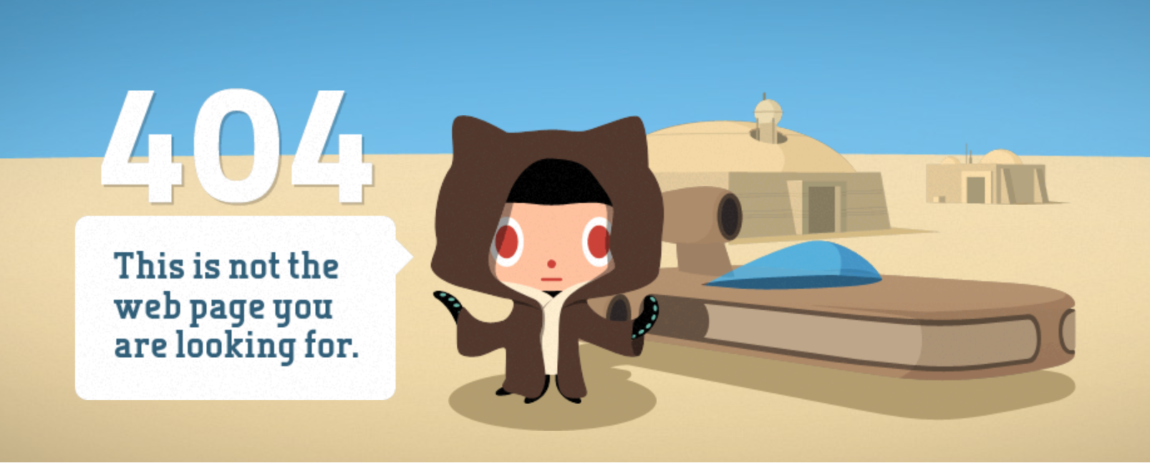
Notes:
This is an example of a response – has anyone seen something like this before?

Slide 16
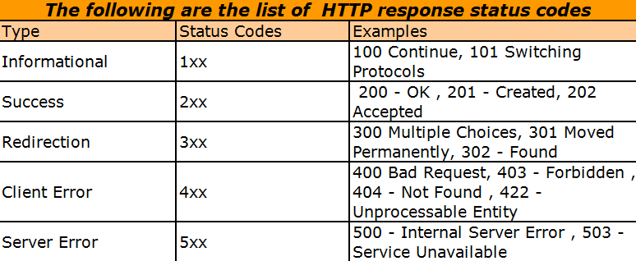
Status Codes
What does 404 mean?
Not Found
HTTP status codes tell the client the type of the response
Notes:
A status code is the primary piece of information in a response.

Slide 17
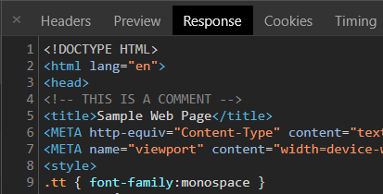
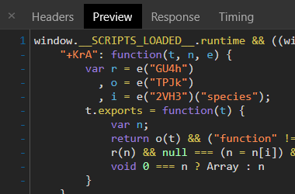
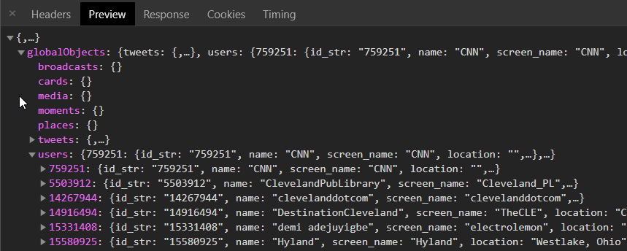
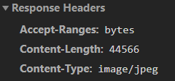
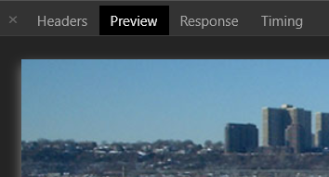
Types of Responses
HTML pages
Scripts
Images
Data (JSON, XML, etc)
Notes:
Here are some examples of responses. They can come in any number of types, often HTML pages but also other things!

Slide 18
Questions?

