Slide 1
JavaScript Arrays
Hy-Tech Club: Web 201

Slide 2
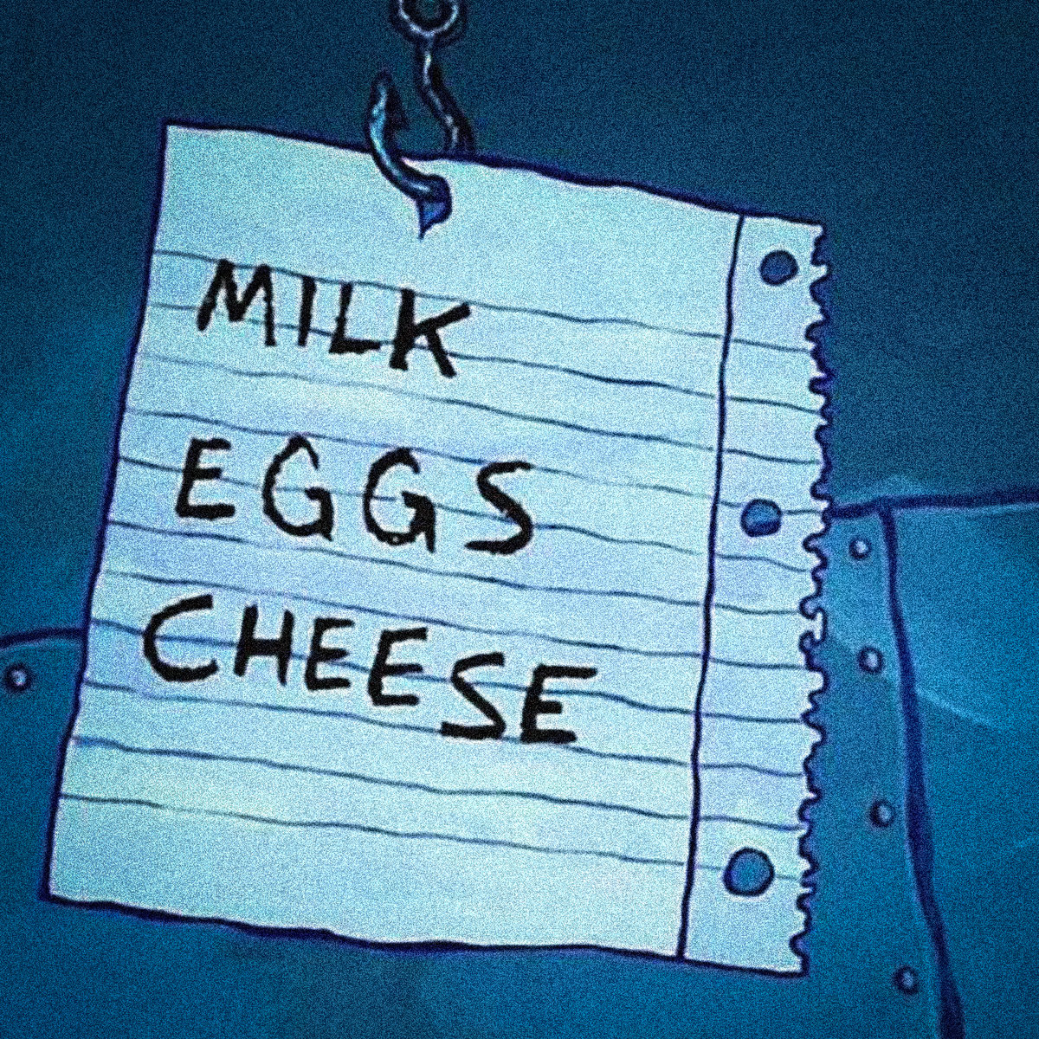
Creating an Array in Javascript
let shoppingList = [
'Milk',
'Eggs',
'Cheese'
];
What type of items does this array contain?
Notes:
Use square brackets to surround the entire list. Use a comma to separate the items in the list.
Each item is
What type of items does this array contain? String.

Slide 3
Accessing Array Items
let shoppingList = [
'Milk',
'Eggs',
'Cheese'
]
0
Arrays are zero-indexed
1
2
GET: let top = shoppingList[0];
SET: shoppingList[2] = 'Flour';
Notes:
Developers can access items in an array using square bracket notation. It is possible to get AND set array values like this.
JavaScript arrays are zero-indexed: the first element of an array is at index 0
What will be the value of `top`? “Milk”
What will be the list After the SET line? “Milk, Eggs, Flour”

Slide 4
Adding to Arrays
let shoppingList = [
'Milk',
'Eggs',
'Flour'
]
[
'Milk',
'Eggs',
'Flour',
'Butter'
]
shoppingList.push('Butter');
Notes:
Use the push function to add an element to the end of an array.
When pushing ‘Butter’, it is available at the end of the list

Slide 5
Looping through Arrays
Get the length of an array with .length
Use a for loop to iterate through the array the proper number of times
Use [i] to access each item of the array
for (let i = 0; i < shoppingList.length; i++) {
console.log(shoppingList[i]);
}

Slide 6
Questions?

