Slide 1
JavaScript Objects
Hy-Tech Club: Web 201

Slide 2
Agenda
Objects
Properties

Slide 3

Objects
Notes:
Ask the students to name some objects (any objects) and describe them.

Slide 4


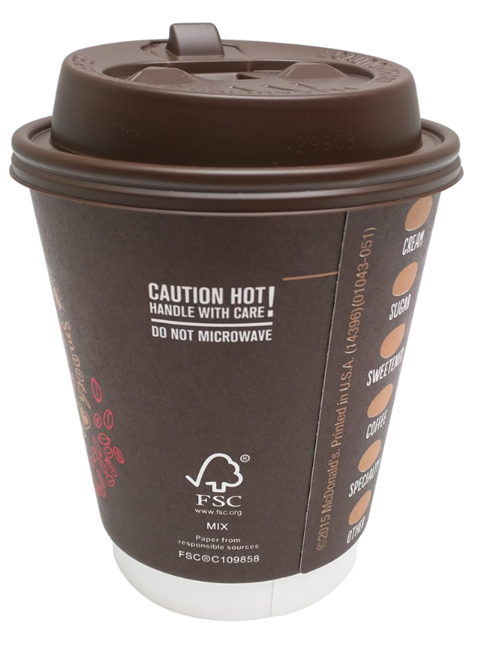
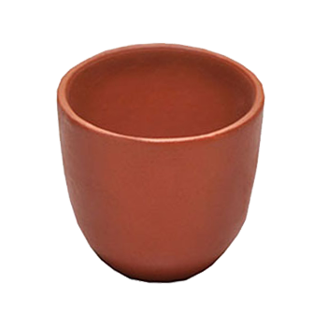

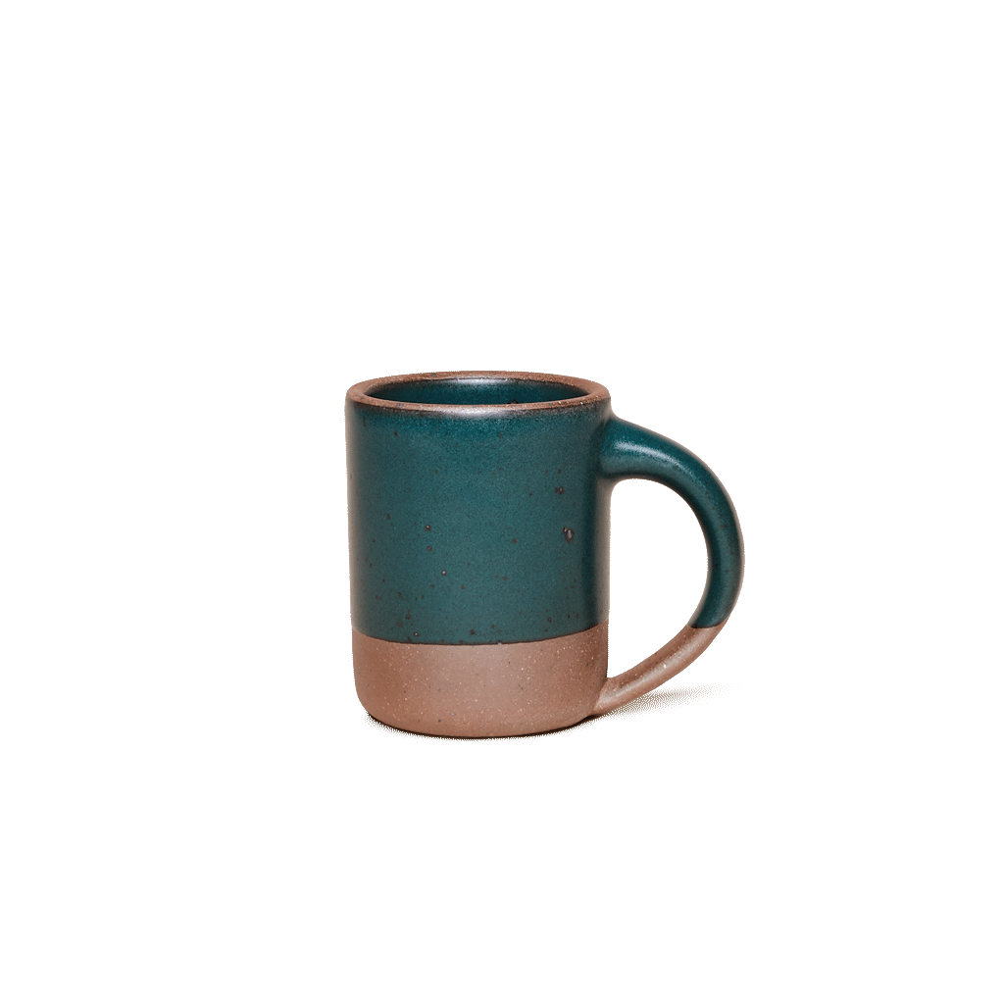
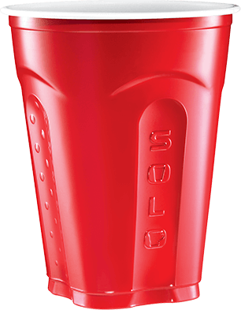

Objects Have Properties
What are some properties for a cup?
Color
Volume
Material
Hot
Notes:
In JavaScript, an object is a standalone entity, with properties and type. Compare it with a cup, for example. A cup is an object, with properties. A cup has a color, a volume, a material it is made of, etc. The same way, JavaScript objects can have properties, which define their characteristics.

Slide 5
Objects in JavaScript – JSON
let solo = {
color: 'red',
volume: 18,
material: 'plastic',
hot: false
}
Notes:
How could we represent the red solo cup in JavaScript?
An object is just a variable, so we use let to declare it. Use curly brackets to surround each property of the object. Use a colon to attach a value to a property. Use a comma to separate each property-value.
JSON stands for JavaScript Object Notation. It is a lightweight data-interchange format based on JavaScript objects.

Slide 6
What about this object?
let teacup = {
color: 'white',
volume: 8,
material: 'ceramic',
hot: true
}
Notes:
Have a student come up to the board and try to define the teacup object. Then, show the answer.

Slide 7

Properties
Notes:
Let’s talk a little more about properties.

Slide 8
What is a Property?
A property is a variable that is attached to an object
Each property on an object has a value
EXAMPLE
let solo = {
material: 'plastic'
}
Property: material
Value: 'plastic'
Notes:
A property of an object can be explained as a variable that is attached to the object. Object properties are basically the same as ordinary JavaScript variables, except for the attachment to objects. The properties of an object define the characteristics of the object. Just like variables, each property has a value that can change based on the object.
A value can be anything: a string, a number, even another object or a function!!

Slide 9
Getting a Property
Use dot notation to get a property value from an object
<object_name>.<property_name>
EXAMPLE
let teacup = {
material: 'ceramic'
}
let objectMaterial = teacup.material;
console.log('the teacup is ' + objectMaterial);
object_name: teacup
property_name: material
Notes:
If an object exists, you can access the properties attached to it using dot notation. This means <object_name>.<property_name>
For example, if you wanted to show the user the material for a cup, you could use teacup DOT material.
What message will the user see? “the teacup is ceramic”

Slide 10
Setting a Property
Use dot notation to set a property value from an object too!
<object_name>.<property_name> = <value>
EXAMPLE
teacup.color = 'blue';
console.log('the teacup is ' + teacup.color);
Notes:
Setting properties uses dot notation as well.
For example, if the user painted the cup to be another color, it is possible to set the color property using teacup DOT color.
What message will the user see? “the teacup is blue”

Slide 11
Questions?

