Slide 1
Trim Simulator
ECS251 Final Project
By: Hiu Hong Yu and Ming-Hung Lu

Slide 2
Fundamental Problem of SSD
Read by block
Write by page
Erase by block
Cannot directly overwrite
No knowledge of which block is deleted (Only OS know).

Slide 3
Delete/Modify
Modification
Read N Blocks from disk to memory
Delete contents from disk
Modify
Write back
Deletion
OS marked delete i-node

Slide 4
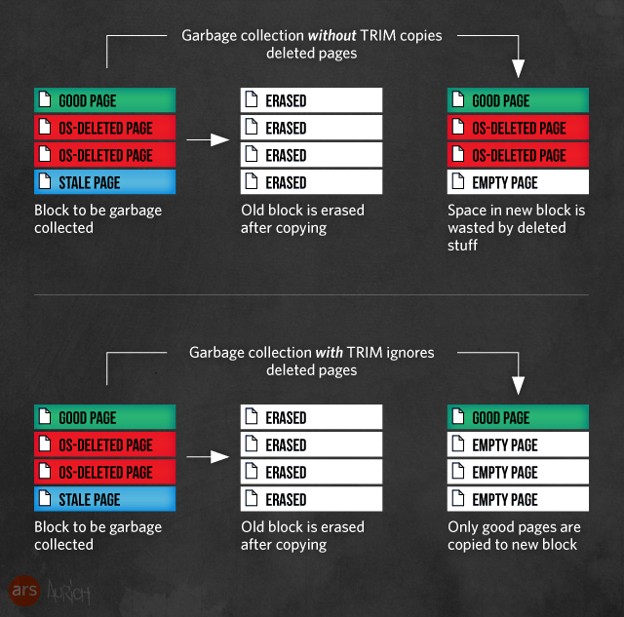
Deletion without Trim
Image source: http://arstechnica.com/

Slide 5
Deletion with Trim
Trim command - A special ATA command issued to SSD to indicate a particular page is not needed.
Image source: http://arstechnica.com/

Slide 6
Sequential Trim
Trim commands cannot be executed concurrently with IO
OS
IO
Trim
SSD

Slide 7
Queue Trim
Allow all commands to queue
Allow concurrent for all commands
OS
Commands
SSD

Slide 8
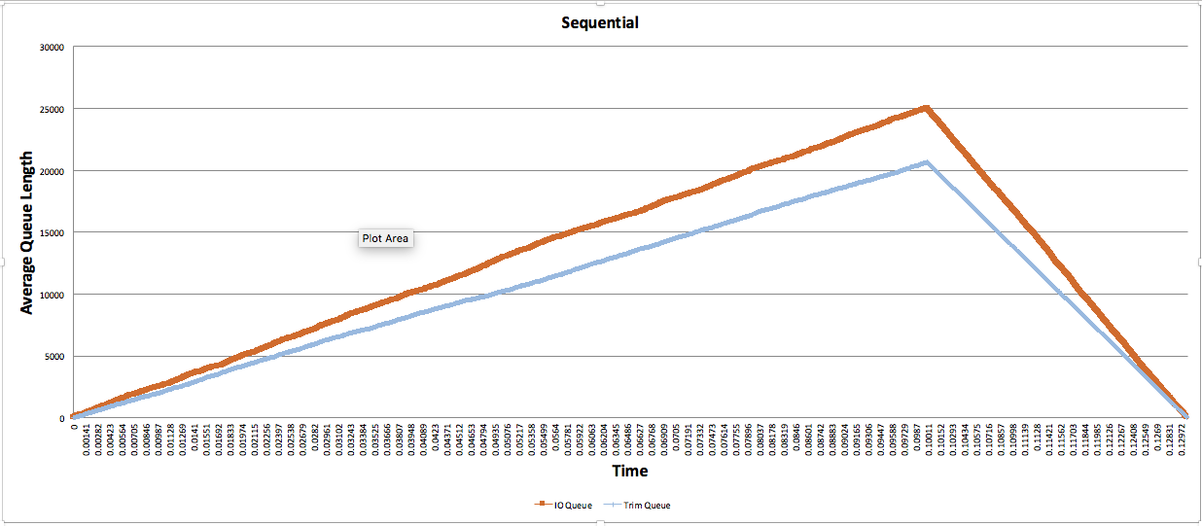
Sequential Trim

Slide 9
IO-Trim
Trim can execute along with IO, only if IO execute first

Slide 10
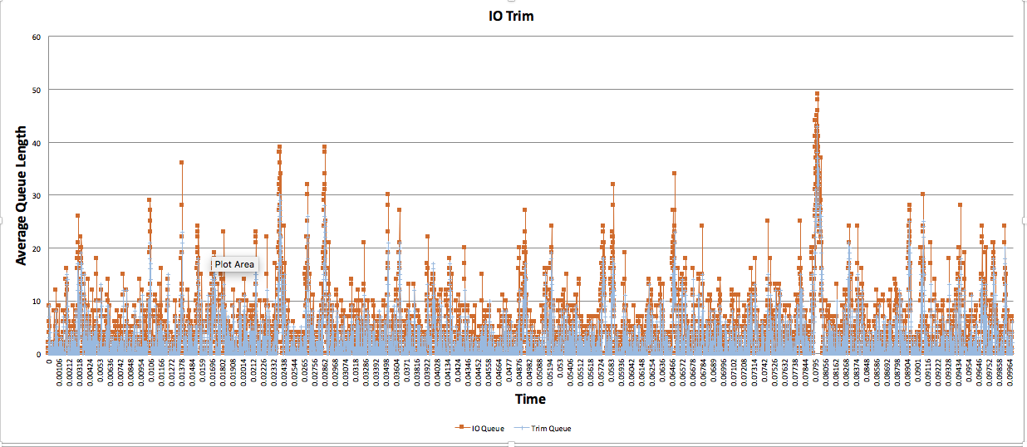
IO-Trim

Slide 11
Semi-Queue Trim
Queueable Commands vs Non-Queueable Commands
Queueable Commands:
Write && Read
Trim && Read

Slide 12
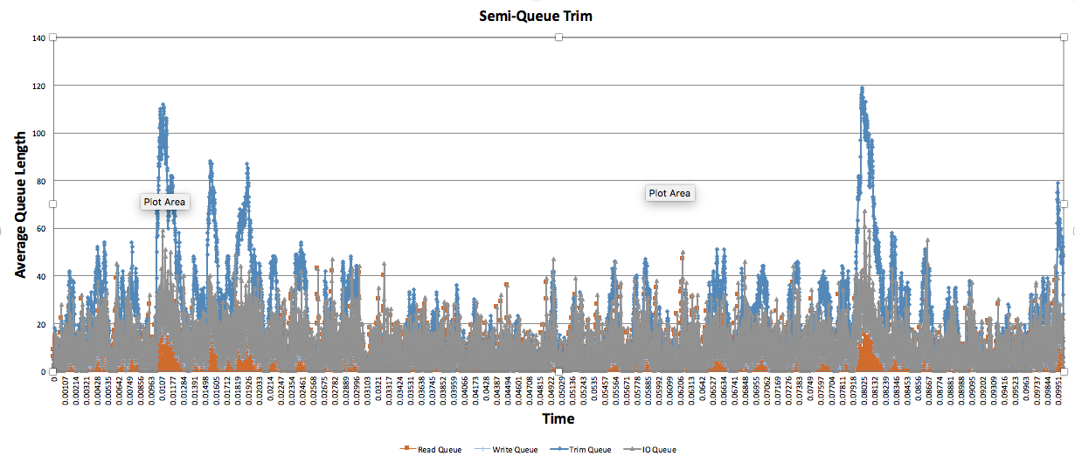
Semi-Queue Trim

Slide 13
Hold Trim
Delay Trim until next command is write

Slide 14
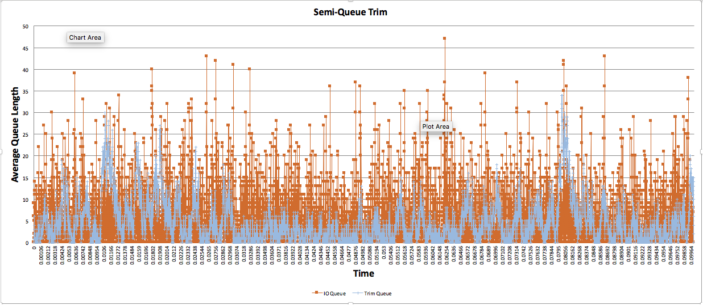
Hold Trim

Slide 15
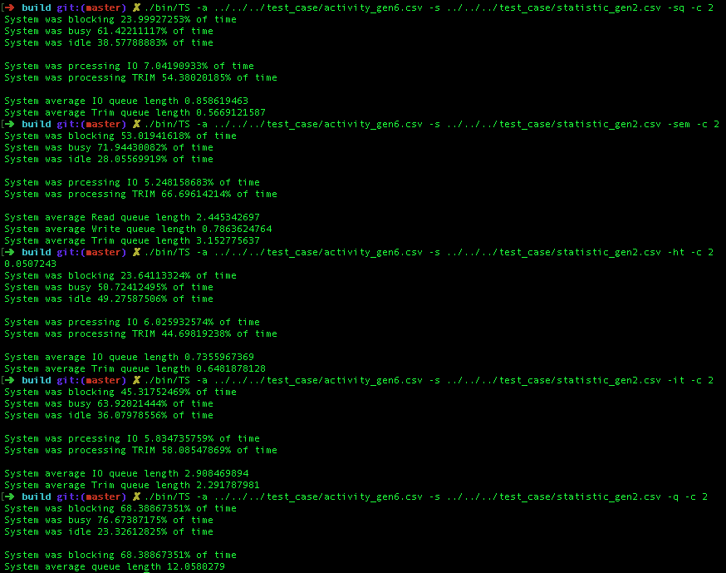

Slide 16
SSDEventGenerator
Real/Simulation

Slide 17
Real Data
blktrace
blkparse
sudo blktrace -a read -a write -a discard -w 10 -d /dev/sda -o - | blkparse -i -

Slide 18
Simulation
CLOCK_SPEED = 0.000000010
45% - Read
10% - Write
45% - Trim
10sec simulation - 19598739

Slide 19
