Slide 1

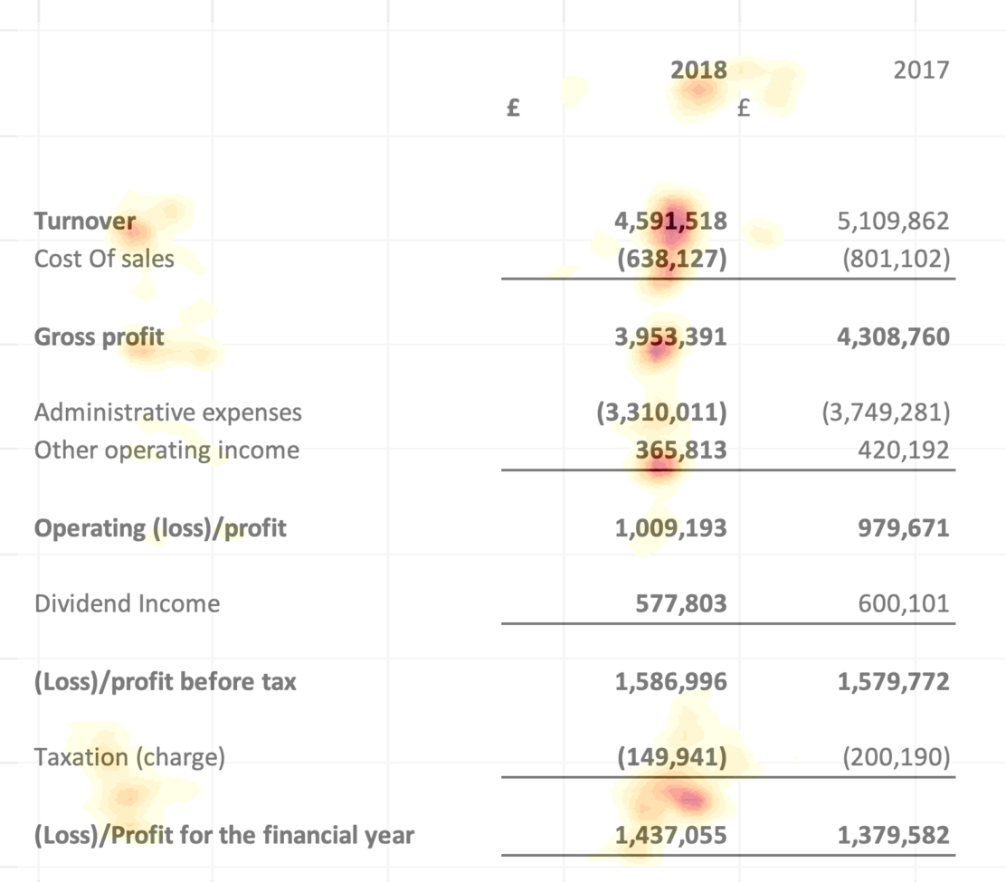
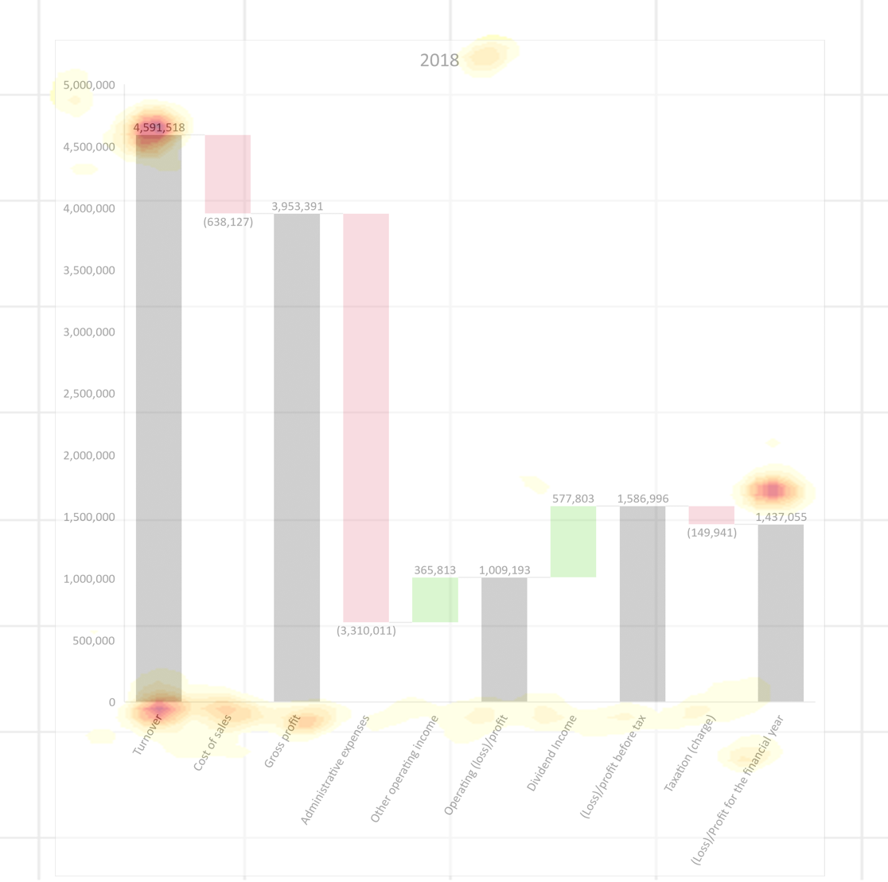
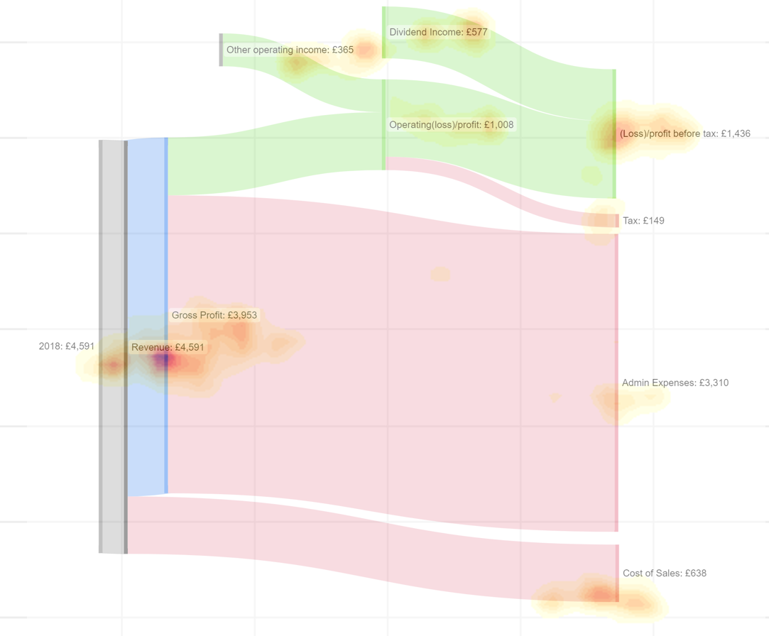

Harvey Yuan
CSC8639
Supervisor – Alma Cantu
Newcastle University
Compare The Ocular Behaviour of Novices and Visualisation Experts
Introduction
Data visualisations are becoming increasingly prevalent in more industries and has traditionally played a pivotal role in financial reporting. The utilisation of data visualisations in financial reporting facilitates a clear and concise understanding of intricate financial information
This study examines how data visualisations affect financial reporting by analysing participants' eye gaze data
Impact of financial data
Assessing Profitability: The income statement reveals if a company is making a profit or loss, providing critical insights into its financial health
Financial Decision Making: Understanding the income statement helps in informed financial decision-making, including identifying revenue drivers and cost components
Aim
The primary objective is to compare eye gaze patterns of novices and experts while viewing financial data through different data visualisations.
Develop practical guidelines for designing financial data visuals that enhance comprehension and engagement among consumers
Discussion
Initially, the three data visualizations were presented to a financial data expert. Predominantly, their primary concern was the bottom line. This refers to the net profit, income or earnings at the bottom of the company’s income statement.
Hotspots shows the regions of interest which represents the participants eye gaze.
Financial data expert are adept at efficiently location relevant information to them. They typically focus directly on the pertinent regions which allows them to accurately and quickly absorb the material
Motivation
Accuracy and Consistency: Guidelines ensure accurate representation of financial data and maintain consistency in design and formatting across visualizations
Clarity and Comprehension: Guidelines simplify complex financial information, making data visualisations easier to understand
Avoiding Misinterpretation: Guidelines help creators present data without unintended errors or bias, preventing misinterpretation of financial insights
Method
The study compared the eye gaze patterns of novices and experts while they viewed financial data visualisations
Three visuals are presented to participants: a standard income statement and two visual representations of the same data
Basic income statement
Sankey Diagram
Waterfall Chart
Tobii X2-30 eye tracker will capture precise eye gaze data during participants' observations of three visuals, this is placed below the monitor to allow for best tracking [1]
Previous Works
Kamil Franek
7 Best Charts for Income Statement Presentation & Analysis [2]
Lauren E. Matzen
Using Eye Tracking Metrics and Visual Saliency Maps to Assess Data Visualizations[3]
Using Eye Tracking Metrics and Visual Saliency Maps to Assess Image Utility[4]
[1] Tobii, “Positioning in front of an eye tracker,” 2016. [Online]. Available: https://help.tobii.com/hc/en-us/articles/210250305-Positioning-in-front-of-an-eye-tracker. [Accessed 08 2023].
[2] K. Franek, “7 Best Charts for Income Statement Presentation & Analysis,” 13 03 2020. [Online]. Available: https://www.kamilfranek.com/best-charts-for-income-statement-presentation-and-analysis/. [Accessed 08 2023].
[3] D. L. E. Matzen, “Using Eye Tracking Metrics and Visual Saliency Maps to Assess Data Visualizations,” OSTI.gov, 2016. [Online]. Available: https://www.osti.gov/biblio/1376793. [Accessed 2023].
[4] D. L. E. Matzen, “Using Eye Tracking Metrics and Visual Saliency Maps to Assess Image Utility,” 2016. [Online]. Available: https://www.osti.gov/biblio/1340620. [Accessed 2023].

