Slide 1

Stat 418 PROJECT PROPOSAL • MAY 2026
Predicting NBA Playoff
Underperformance
From Regular-Season Statistics to Postseason Risk
PRESENTED BY
Hanzhang Yuan
DATE
May 5, 2026
Sports Analytics × Machine Learning

Slide 2




2
OVERVIEW • MOTIVATION
Why Some Stars Fade in the Playoffs
WHY THIS MATTERS
RESEARCH QUESTION
The playoffs are a different game.
Can historical regular-season statistics predict which NBA players are likely to underperform in the playoffs relative to their regular-season level?
Tighter Defenses
Defensive intensity rises and rotations shorten — volume scorers face sharper pressure.
Targeted Adjustments
Playoff series allow teams to scout and counter individual offensive tendencies.
APPROACH
Decision Value
Frame the problem as supervised classification: each player-season is labeled as a playoff decline or not, learned only from regular-season inputs.
Drop-off risk matters to fans, analysts, and front offices when regular-season numbers may overstate reliability.
Predicting NBA Playoff Underperformance from Regular-Season Statistics
2 / 7

Slide 3
3
DATA COLLECTION
Building the Player-Season Dataset
DATA SOURCE
UNIT OF ANALYSIS
NBA Stats / nba_api
Player-Season
Player game logs for regular-season and playoff games, pulled directly via the official NBA Stats API.
BOX-SCORE VARIABLES
PTS · FGM · FGA · FTM · FTA · OREB · DREB
AST · STL · BLK · TOV · PF · MIN
Each row = one player in one season. Regular-season stats are inputs; playoff stats define the target only.
CURRENT PROGRESS
✓
Box-score variables identified
✓
Game Score formula validated
✓
nba_api endpoints scoped
Bulk scraping & caching
Player-season aggregation pipeline
Predicting NBA Playoff Underperformance from Regular-Season Statistics
3 / 7

Slide 4



4
METRIC • TARGET VARIABLE
Hollinger Game Score & the Decline Label
TARGET VARIABLE
PRIMARY METRIC
Hollinger Game Score
Underperformance Label
GS =
PTS + 0.4·FGM − 0.7·FGA − 0.4·(FTA−FTM) + 0.7·OREB + 0.3·DREB
+ STL + 0.7·AST + 0.7·BLK − 0.4·PF − TOV
y = 1
Playoff GS ≤ Reg-season GS − threshold
y = 0
Player held or improved performance
RECOMMENDED THRESHOLD
1.0
Computed from Box Scores
Transparent & Interpretable
PIE as Benchmark
Game Score points
Built from raw stats — not a pre-packaged advanced metric.
Every coefficient maps to an observable basketball action.
Compare Game-Score-based labels against the official NBA PIE.
Avoids labeling small, noisy differences as real decline — adjustable during analysis.
Predicting NBA Playoff Underperformance from Regular-Season Statistics
4 / 7

Slide 5
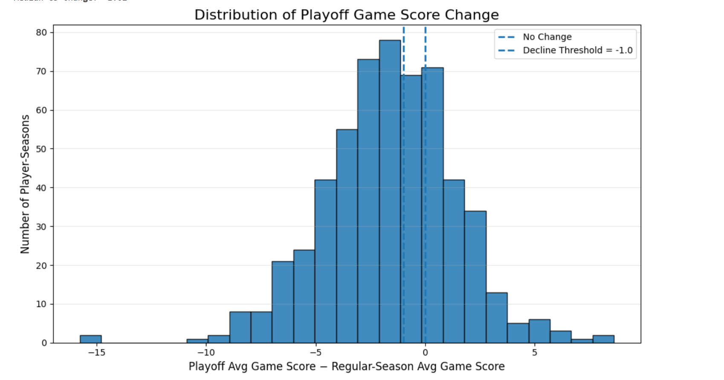
5
EDA • FEATURE ENGINEERING
Exploring Patterns & Designing Predictors
EDA — Game Score Change
FEATURE GROUPS
Playoff Game Score Change Plot
Seven families of predictors
Scoring Volume
Efficiency
PPG · FGA · 3PA · FTA
FG% · 3P% · FT% · eFG% · TS%
Role & Minutes
Usage Proxy
MPG · GS · GS-per-minute
FGA + 0.44·FTA + TOV
All-Around
Team Context
Main Finding
A decline threshold of -1.0 Game Score point identifies meaningful playoff underperformance.
Extreme left-tail cases suggest the need to control for injuries, role changes, and small playoff samples.
REB · AST · STL · BLK · TOV
Win % · Seed · ORtg / DRtg
Opponent Strength
Opp DRtg · Opp Pace · Top-10 defender minutes
Predicting NBA Playoff Underperformance from Regular-Season Statistics
5 / 7

Slide 6
6
MODELING • EVALUATION
Three Models, Recency Weights, Five Metrics
BASELINE
NONLINEAR
PRIMARY
Logistic Regression
Random Forest
Gradient Boosting
Interpretable coefficients; serves as the floor for performance comparisons.
Captures interactions among role, efficiency, and scoring volume.
Often the strongest performer on structured tabular box-score data.
EVALUATION METRICS
TRAINING STRATEGY
Historical seasons + recency weights
Accuracy
Overall correctness
Precision
Of predicted decliners, how many actually declined
TRAIN
VALIDATE
PREDICT
Older recent seasons
Most recent completed season
Current regular season
Recall
Of true decliners, how many we caught
F1
Balance of precision & recall
weight = α ^ years_ago (α ≈ 0.8)
ROC-AUC
Ranking quality across thresholds
Predicting NBA Playoff Underperformance from Regular-Season Statistics
6 / 7

Slide 7

7
TIMELINE • CHALLENGES • NEXT STEPS
From Data to Final Report
1
2
3
4
5
6
7
Collect
Compute
Aggregate
Label
EDA
Train
Evaluate
Game logs
Game Score
Player-season
Decline + PIE
Visualize
Models
Final report
◆ YOU ARE HERE
CHALLENGES & MITIGATIONS
Where the project gets hard
NEXT 2 WEEKS
Immediate Next Steps
Small playoff sample size
→
Use multiple historical seasons; filter on minimum playoff minutes/games.
1
Finish bulk scrape & local cache of player game logs
Player development & role change
→
Player-season observations + recency-weighted training.
Build player-season aggregation pipeline
2
Injuries & limited availability
→
Apply minutes/games filters; document exclusions transparently.
3
Generate first underperformance label distribution
Data leakage
→
Use only regular-season inputs; playoff stats build the target only.
4
Run baseline Logistic Regression for sanity check
Predicting NBA Playoff Underperformance from Regular-Season Statistics
7 / 7

