Slide 1
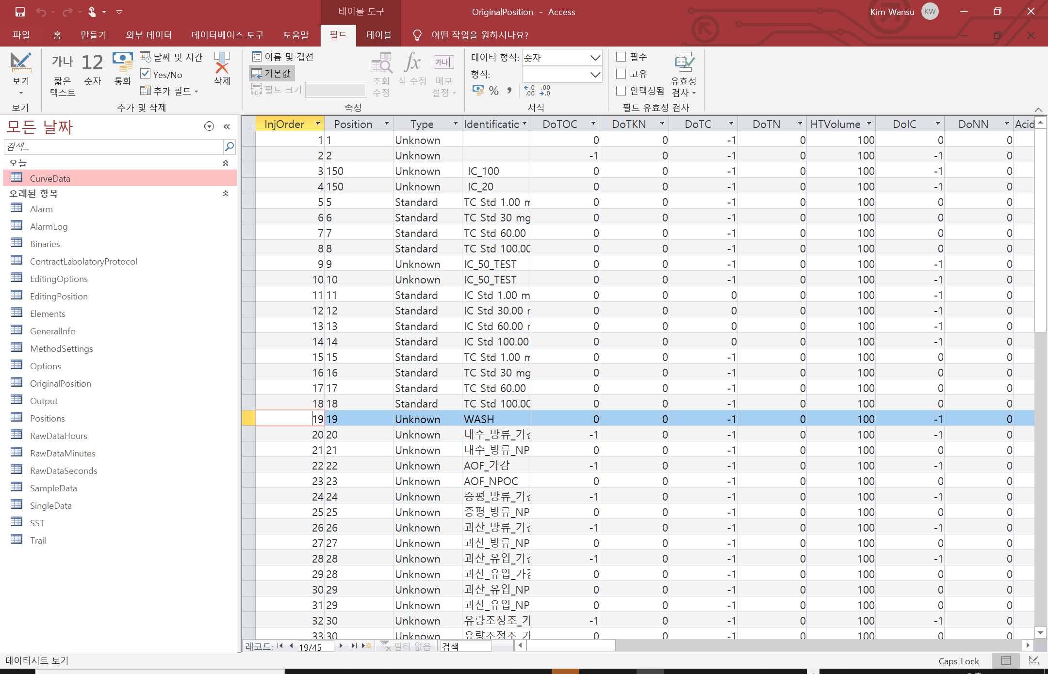
Evaluation Warning : The document was created with Spire.Presentation for .NET
검량선 데이터(기울기, 절편)
분석 기본정보
시료명
시료결과(계산된 값)
시료 결과(개별 측정값)

Slide 2
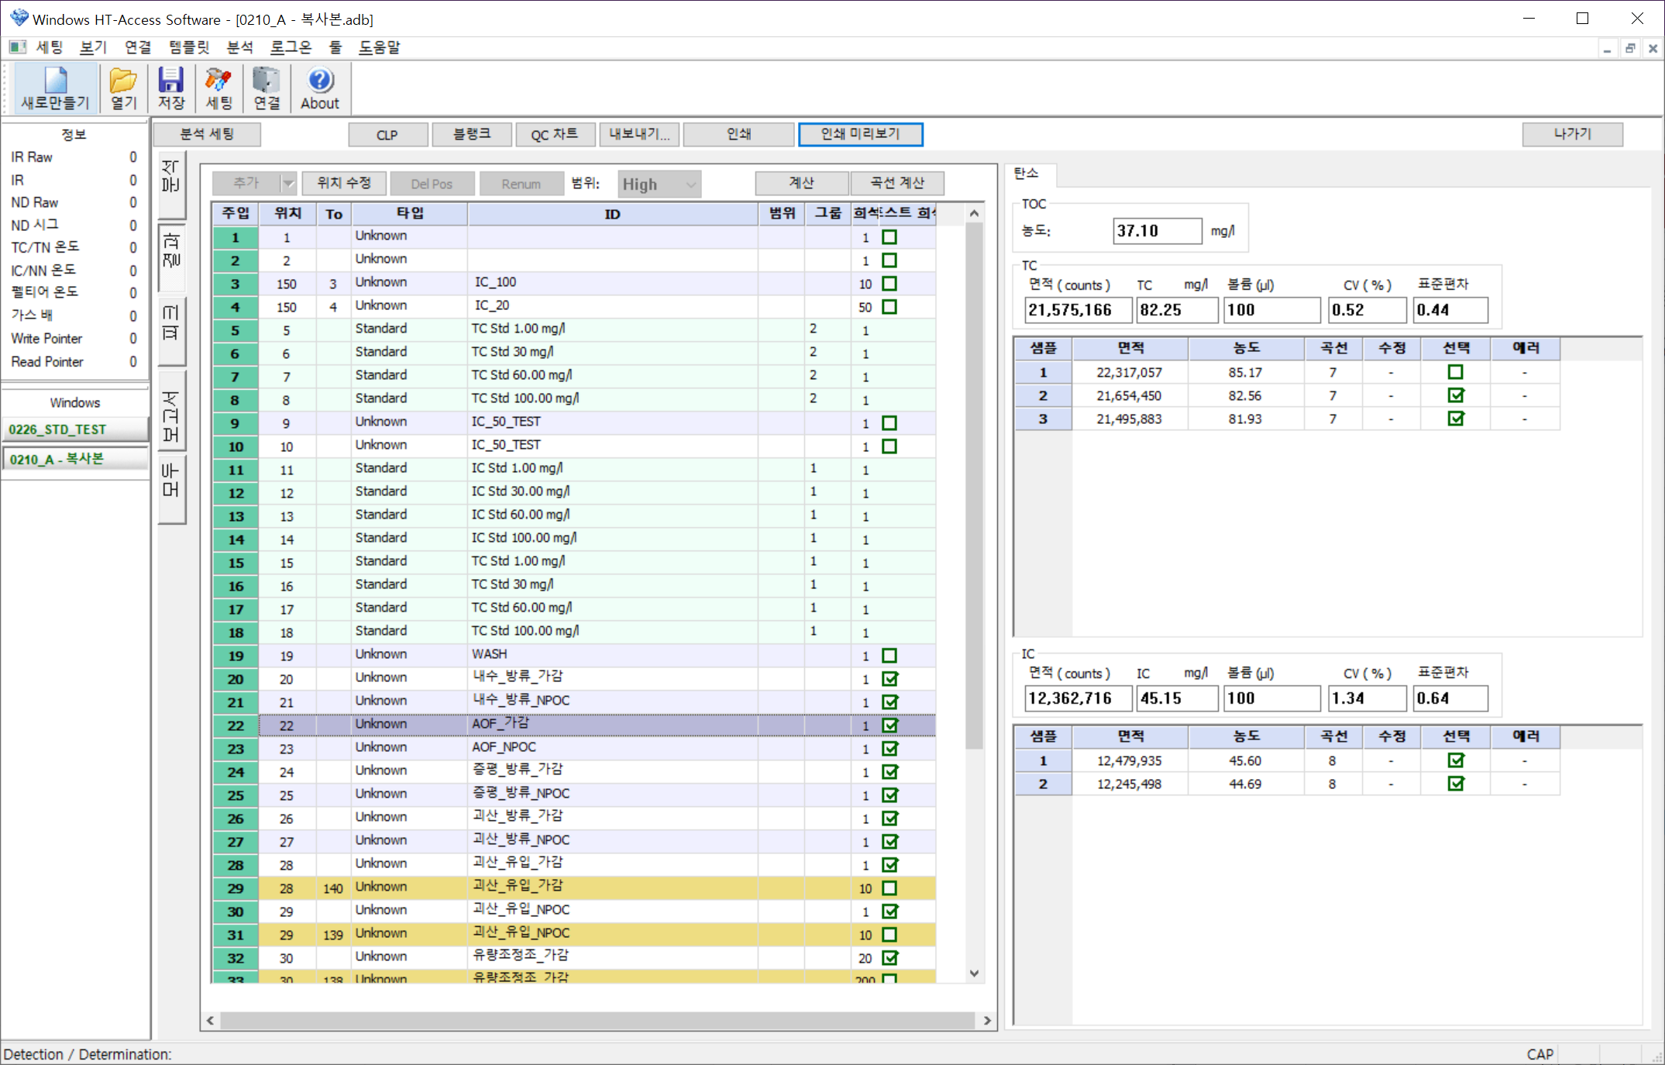
Evaluation Warning : The document was created with Spire.Presentation for .NET
시료 결과(계산된 값)
시료 결과(계산된 값)
시료명
시료 결과(개별 측정값)
시료 결과(계산된 값)
시료 결과(개별 측정값)

Slide 3
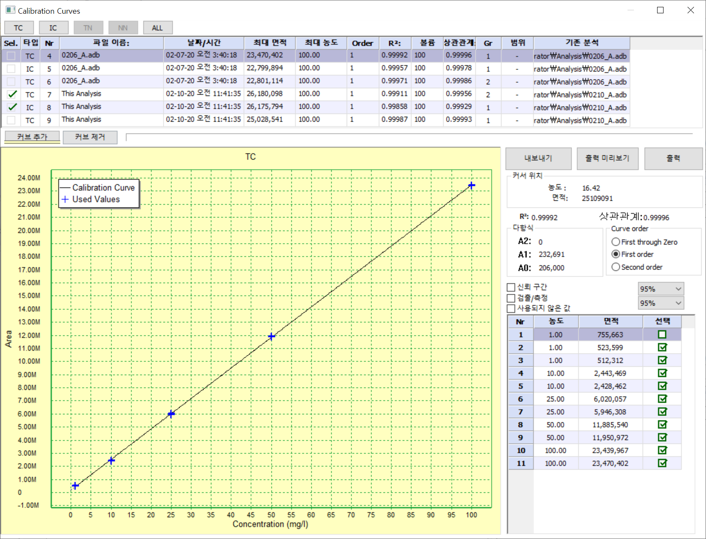
Evaluation Warning : The document was created with Spire.Presentation for .NET
검량선 데이터

Slide 4
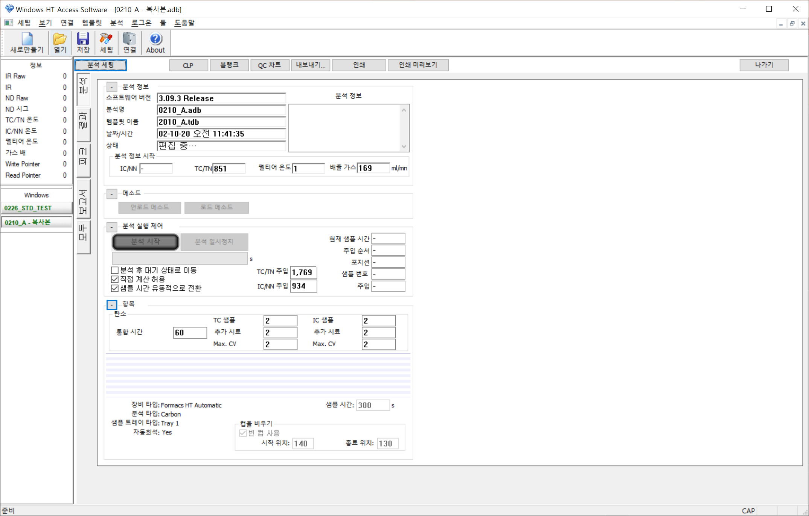
Evaluation Warning : The document was created with Spire.Presentation for .NET
분석 기본정보

